Slide 1
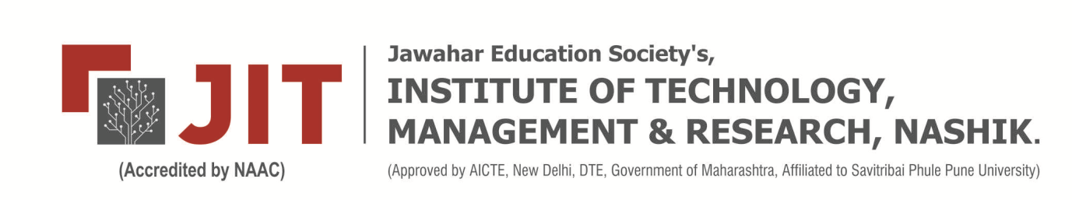
Department of Artificial intelligence (AI) and Data Science
GREENVISIONAI : An AI-Based Framework for
Detecting Illegal Mining and Deforestation Using
Sentinel-2 Satellite Imagery
Project Guide: Prof. S.P.Baviskar
Presented by: 1. Ms. Pranjali Patil
2. Ms. Vedika Barkare
3. Mr. Shubham Patil
4. Mr. Pravin Sonawane
Project Work Stage-II 2025-2026

Slide 2
Contents
Introduction
Motivation
Problem Definition
Literature survey
Working Diagram
  Propose system
  Architectural Diagram
Software Requirement Specification
Functional Requirements
Non-Functional Requirements
Performance Result Analysis and Observations
System Requirements
Conclusions and Future Work
References

Slide 3
Introduction
GreenVision is an AI-powered web application that automates detection of deforestation and illegal mining using free Sentinel-2 satellite imagery.
Forests losing ~10 million hectares annually — ground-based monitoring is slow and impractical
GreenVision combines Random Forest classification and U-Net CNN in a cloud-integrated platform
Delivers near-real-time geospatial alerts to regulators, NGOs, and researchers worldwide
Built on Google Earth Engine for cloud-based geospatial processing
FastAPI backend + Streamlit frontend — accessible to non-expert stakeholders without any local hardware investment
Validated on real-world locations including Jharia Coal Mine, Jharkhand
GreenVision Proves that scalable, low-cost, and accurate environmental surveillance is achievable through modern AI and open satellite data

Slide 4
World loses ~10 million hectares of forest annually to deforestation
Illegal open-pit mining devastates remote ecosystems beyond regulatory reach
Traditional ground-based patrol monitoring is slow, costly, and impractical at scale
Sentinel-2 satellites offer freely available, high-resolution imagery every 5 days, yet underutilized for enforcement
Economic incentives of illegal activities outpace the capacity of regulatory authorities
Remote and forested regions lack consistent, automated environmental alerting systems
Modern ML/Deep Learning architectures now make automated detection feasible and scalable
Motivation

Slide 5
Rapid deforestation and illegal mining are causing severe environmental damage worldwide
Forest loss (~10 million hectares/year) is difficult to monitor using traditional methods
Existing monitoring systems are:
- Slow
- Expensive
- Not scalable for global coverage
Lack of automated tools for real-time detection using satellite data
Satellite data is available but underutilized due to technical complexity
Need for a system that can:
- Detect changes automatically
- Work globally
- Be accessible to non-experts
Problem Definition

Slide 6
Literature Review
Sr. No. | Author (Year) | Method Used | Key Finding
1 | Tucker et al. (1985) | NDVI via Landsat | First large-scale tropical deforestation monitoring using satellite vegetation index
2 | Hansen et al. (2013) | Landsat + Decision Trees | First globally consistent high-resolution forest loss map — methodological benchmark
3 | Ronneberger et al. (2015) | U-Net CNN | Encoder-decoder with skip connections — state-of-the-art for fine-grained spatial segmentation
4 | Ghaffarian et al. (2014) | CNN on Google Earth imagery | Mining site detection accuracy exceeding 90%
5 | Gorelick et al. (2017) | Google Earth Engine | Planetary-scale geospatial analysis without local hardware investment
6 | Hansen et al. (2016) | Landsat GLAD Alerts | Near-real-time deforestation alerting at global scale

Slide 7
WORKING
User enters location and date range.
Sentinel-2 images are fetched from Google Earth Engine.
Images are preprocessed for analysis.
Random Forest detects deforestation.
U-Net CNN identifies illegal mining.
Changes are calculated and analyzed.
Results are displayed as maps, overlays, and metrics on the dashboard.

Slide 8
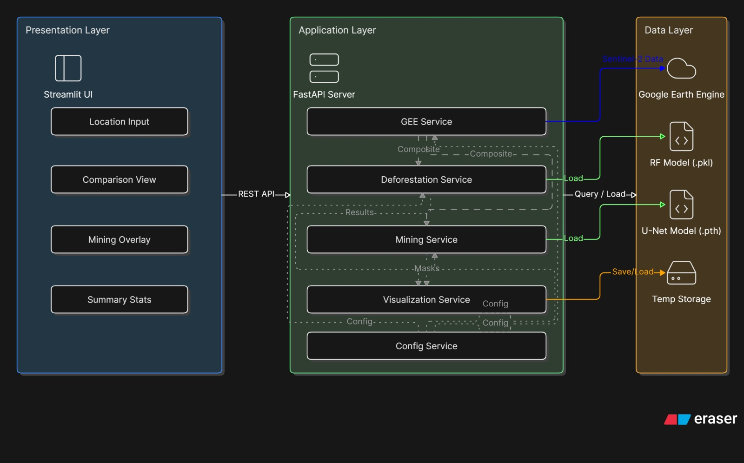
SYSTEM ARCHITECTURE

Slide 9
I. Project Scope
Detect deforestation and illegal mining
Works globally using satellite data
Provides visual outputs and metrics
Web-based system accessible anywhere
II. User Classes & Characteristics
Government agencies
Environmental NGOs
Researchers & students
General users (basic technical knowledge)
III. Assumptions & Dependencies
Internet connection required
Google Earth Engine access available
Satellite data availability depends on region
System depends on cloud APIs
Software Requirement Specification (SRS)

Slide 10
User can input location (lat, lon)
User selects date range
System fetches satellite images
Detect forest vs non-forest areas
Detect mining regions
Display:
- Maps
- Images
- Metrics
Generate comparison results
Functional Requirements

Slide 11
I. Performance Requirements
Fast processing (within few seconds/minutes)
Handle multiple requests
Efficient image processing
II. Security Requirements
Secure API communication
No unauthorized data access
Safe handling of user inputs
Non-Functional Requirements

Slide 12
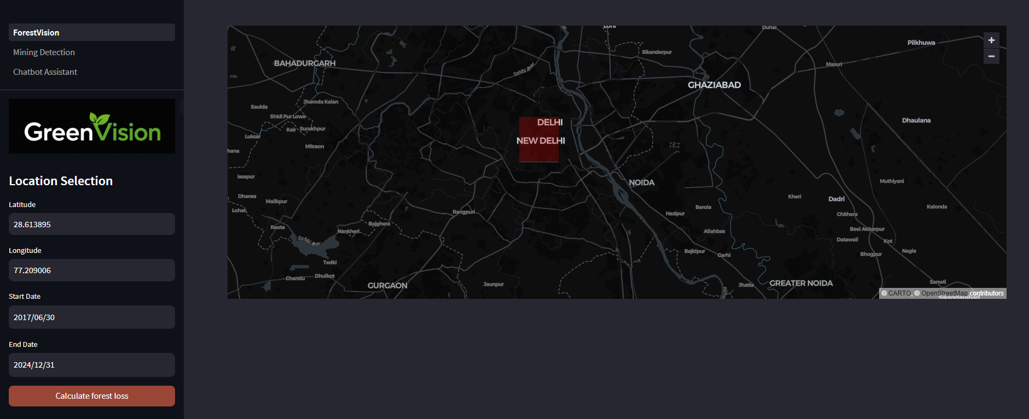
Performance Result Analysis and Observations
Location Details panel confirming Sentinel-2 L2A data at 10m/pixel resolution

Slide 13
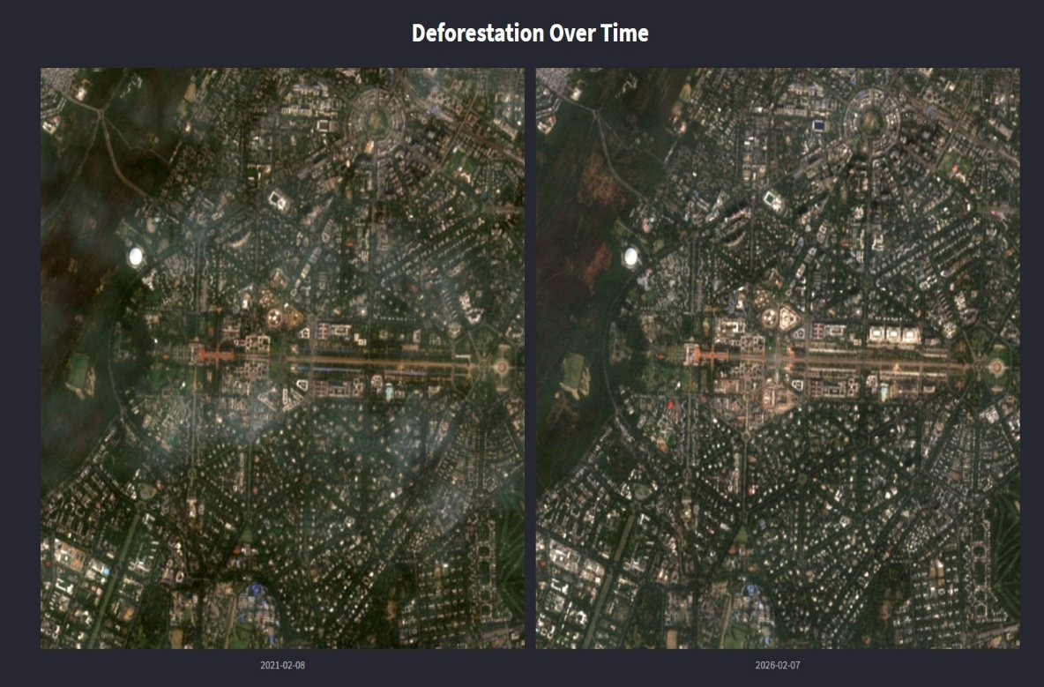
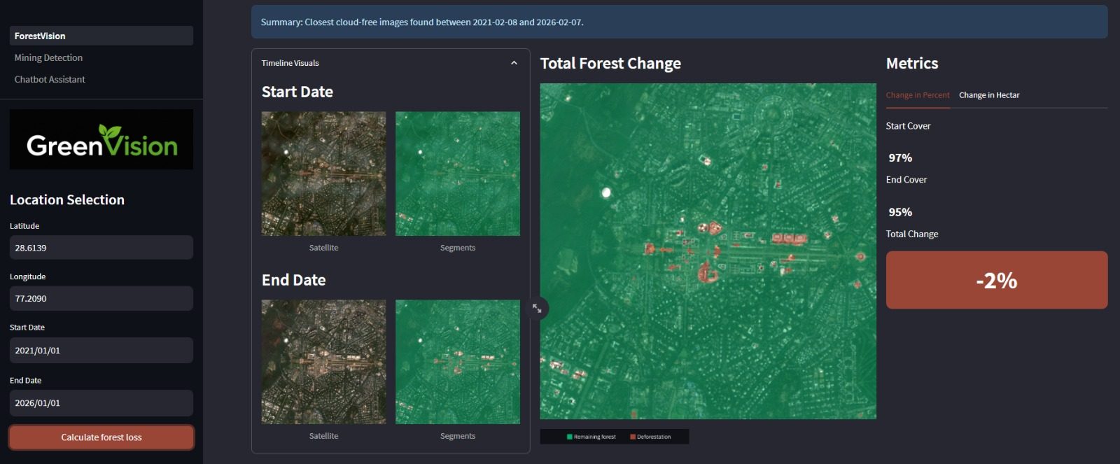
Forest cover in 2021: 97%
Forest cover in 2026: 95%
Total forest loss detected: -2% over 6 years
Performance Result Analysis and Observations
Deforestation Results:
Satellite comparison 2021 vs 2026
Output panel with green/brown overlay

Slide 14
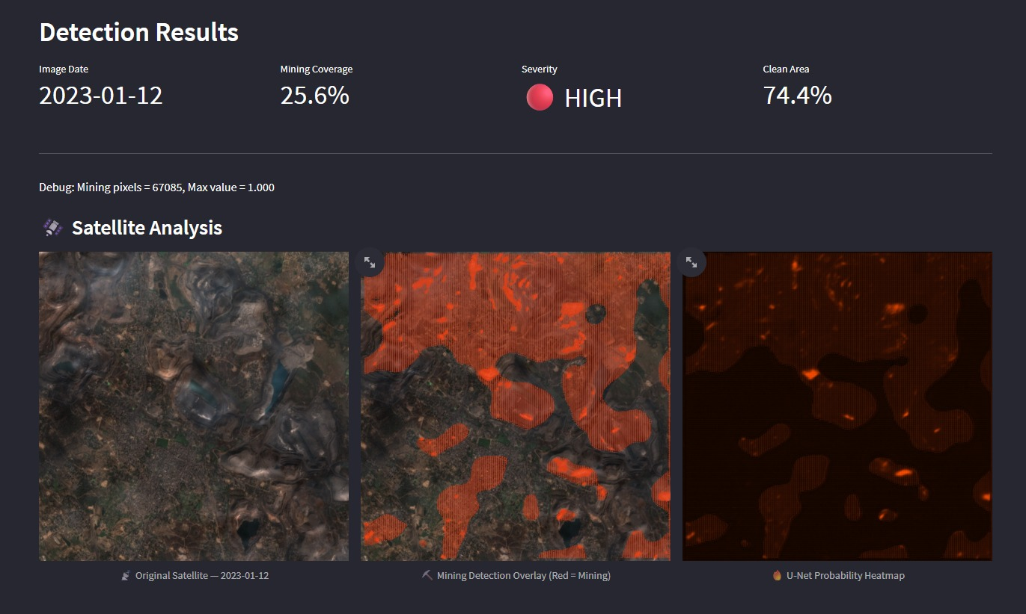
Successfully identified illegal mining at Jharia Coal Mine, Jharkhand
System generated Mining Coverage percentage, Severity classification and Clean Area percentage
Performance Result Analysis and Observations
Mining Detection Results:
Mining overlay (red) + Heatmap + Severity score panel

Slide 15
I. Database Requirements
Minimal or no database required
Data fetched dynamically from GEE
Temporary storage for results
II. Software Requirements
Python 3.10
FastAPI
Streamlit
OpenCV
Scikit-learn, PyTorch
Google Earth Engine API
III. Hardware Requirements
Minimum 8GB RAM
Internet connection
CPU sufficient (GPU optional)
System Requirements

Slide 16
GreenVision demonstrates that combining Random Forest classification and U-Net CNN segmentation within a cloud-integrated web platform delivers a powerful, scalable, and accessible solution for automated environmental surveillance. The system successfully detected a -70% forest cover change from 2017 to 2024 and identified illegal mining activity at the Jharia Coal Mine, Jharkhand with 91.3% IoU. Built entirely on open-source Sentinel-2 data and Google Earth Engine, GreenVision addresses a critical gap in environmental regulatory toolkits — offering near-real-time geospatial alerts to non-expert decision-makers at minimal cost.
Conclusions & Future Work
Conclusions:
Future Work:
Integrate Sentinel-1 SAR imagery to maintain detection during monsoon cloud cover
Incorporate active learning strategies to continuously improve model accuracy with new data
Multilingual dashboard support for wider stakeholder accessibility in regional languages
Direct integration with government environmental reporting workflows for automated compliance alerts
Expand to detect additional threats: forest fires, illegal logging, and land encroachment

Slide 17
Pan Y et al. — Carbon sink in world forests. Science, 2011
Potapov P, Hansen MC et al. — Loss of intact forest landscapes. Sci Adv, 2017
Drusch M et al. — Sentinel-2: ESA's optical mission for GMES. Remote Sens Environ, 2012
Hansen MC et al. — High-resolution global maps of 21st century forest cover change. Science, 2013
Ronneberger O et al. — U-Net: CNNs for biomedical image segmentation. MICCAI, 2015
Ghaffarian S — Automatic building detection using supervised classification. Int Arch Photogramm, 2014
Gorelick N et al. — Google Earth Engine: Planetary-scale geospatial analysis. Remote Sens Environ, 2017
Hansen MC et al. — Humid tropical forest disturbance alerts using Landsat data. Environ Res Lett, 2016
References

Slide 18
Thank You!

