Slide 1




Bankruptcy Prediction Team: Data4Breakfast
Abhinav Chanda
Pranay Khandelwal
Sachin Arakeri
Notes:
Good afternoon everyone,
We are team Data4Breakfast

Slide 2
Project analysis slide 10
Project Overview
Objective
Develop a Predictive model to assess whether a firm goes bankrupt or not
Dataset Provided
Training Dataset (n=10,000 obs, 64 attributes)
Test Dataset (n=5,000 obs, 64 attributes)
Platform
Solution to be submitted on Kaggle
Project KPI
AUC (Area under the curve) of ROC graph

Slide 3
Project analysis slide 10
Data Processing
Techniques Applied
Processing that did NOT yield satisfactory results
PCA
Correlation
Interaction
Terms
Log
Transformation
Processing that were successful
Drop Duplicates
Oversampling
Stratified
K-Sample
Hyper- parameter
Tuning

Slide 4
Project analysis slide 10
Data Modeling
Techniques Applied
Models that were overfitting the data
Gradient Boosting
Random
Forrest
Adaptive
Boosting
Neural
Networks
The models, when used in isolation overfit the data and led to sub par results
We decided to apply ensemble technique to overcome overfitting
Notes:
We observed that individual models were overfitting. We wanted to resolve this issue. We thought mixture of models would work best and reduce the overfitting

Slide 5
Project analysis slide 10
Performance of models on validation dataset
Final model selected
Models that were used in ensemble methods
Models that were rejected
95.5%
94.3%
93.5%
92.7%
AUC
92.1%
92.4%
91.2%
Random Forest
SVM
Adaptive Boost
Gradient Boost
XG Boost
Light GBM
Stacked CV
Notes:
We used these multiple models and rejected the RF and SVM. Later on the top 4 models were picked and we used the ensemble of the models. Ensemble of multiple models reduces the model overfitting and variability. We aimed to produce a robust model. Abhinav would be taking up the description on how exactly we got the solution.

Slide 6
Project analysis slide 10
Ensemble Method
XG Boost used at the Meta Classifier
XG-Boost
Gradient
Boosting
Stacking CV Classifier
Ensemble:
Used the four
Most Robust Model
96.25%
AUC (private)¹
Light-Gradient Boosting
95.47%
AUC (public)²
Adaptive
Boosting
We selected the model that had the least variability in results when applied on validation dataset and on the public test dataset
1. Based on the test dataset used for Kaggle’s private leaderboard
2. Based on the test dataset used for Kaggle’s public leaderboard

Slide 7
Thank You

Slide 8
Project analysis slide 4
Solution Process
Reiterate for improvement of the output
N=1,000 observations
X=64 predictors
Final Output
Training Dataset
Training Dataset
Performance Evaluation
(AUC score)
Data Preparation
Data Transformation
Modeling
Validation Dataset
N=500 observations
X=64 predictors
Test Dataset

Slide 9
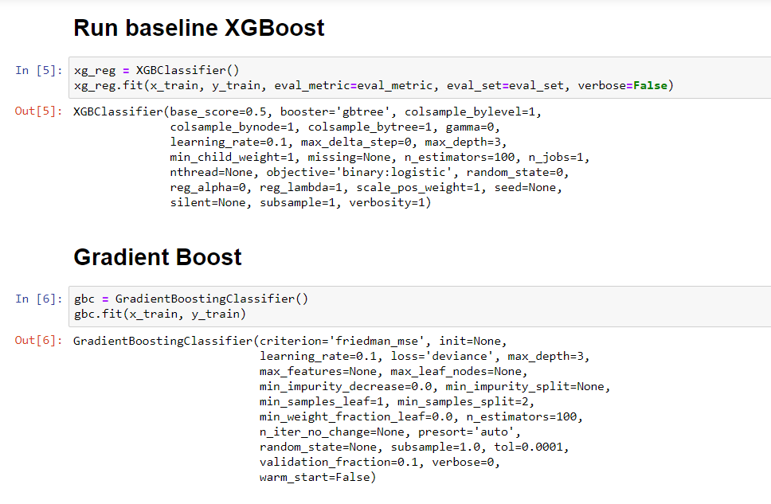
Baseline Models
Notes:
1.

Slide 10
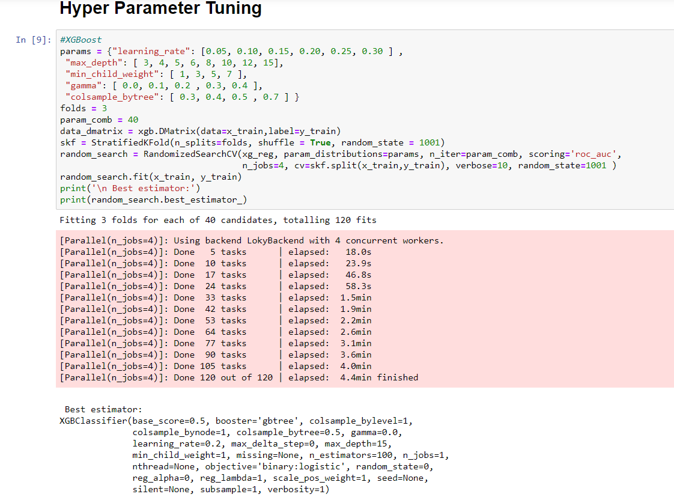
Project analysis slide 6
Hyperparameter Tuning
Notes:
Statistical summary of our significant parameters. For example- total 486 number of games played in season 17-18, and mean salary of players is 7.4m USD.

Slide 11
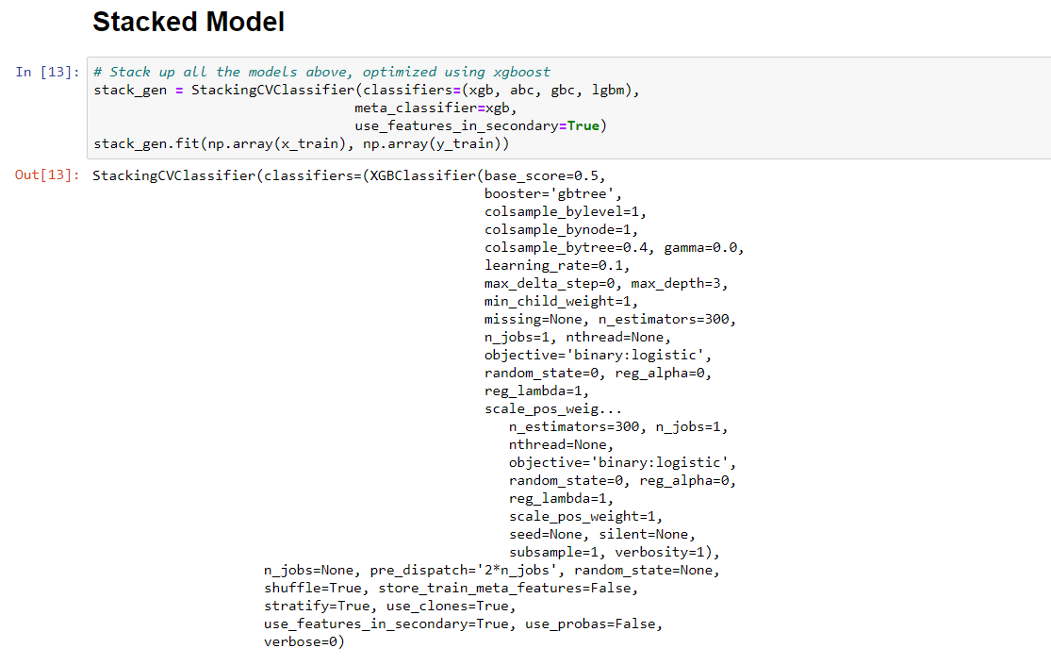
Project analysis slide 6
Stacked Model
Notes:
We have made a correlation heatmap, where the yellow color shows highest correlation and blue is the lowest.
We can see that Player Efficiency rating has strong correlation with True Shooting %;
You may also that “TOV%” does not have a significant correlation with PER by itself, but in combination with other parameters, it is statistically significant

Slide 12
Tools and Libraries covered
S.N | Libraries used | Functions used | Application in our project
1 | pandas | .read, .concat, .DataFrame, | data manipulation and cleaning
2 | numpy | .power, .array, .linspace | Array manipulation
3 | matplotlib | .plot, .show, .title | data visualization
4 | sklearn | RandomForestClassifier, DecisionTreeClassifier, GradientBoostingClassifier, AdaBoostClassifier | Prediction models
5 | scipy | stats | Random sample generation
6 | xgboost | Fit, XGBClassifier, DMatrix, | Prediction model
7 | mlxtend | StackingCVClassfier | Ensemble
Notes:
This project provided us an opportunity to explore multiple libraries and capabilities of python for data analysis and we now look forward to take these learnings to explore the world of Python programming much more

Slide 13
Project analysis slide 4
Solution Framework:
A. Data Preparation
A
B
C
D
N=1,000 observations
X=64 predictors
Training Dataset
Training Dataset
Data Filtering
Training Dataset
(n=944)
Data Partition
80-20
split
56 duplicate observations filtered out
Data Transformation
Modeling
Performance Evaluation
Validation Dataset
N=500 observations
X=64 predictors
Test Dataset
Final Output

Slide 14
Project analysis slide 4
Solution Framework:
B. Data Transformation
A
B
C
D
Training Dataset
(n=755)
Resampling
Training Dataset
N=1,000 observations
X=64 predictors
Training Dataset
Up-sample the dataset to reduce prediction bias (>97% of dataset class = 0)
Hyperparameter Tuning
Data
Preparation
Stratified K Sampling
Stratified K Sampling
Modeling
Performance Evaluation
Validation Dataset
(n=189)
N=500 observations
X=64 predictors
Test Dataset
Final Output

