Slide 1
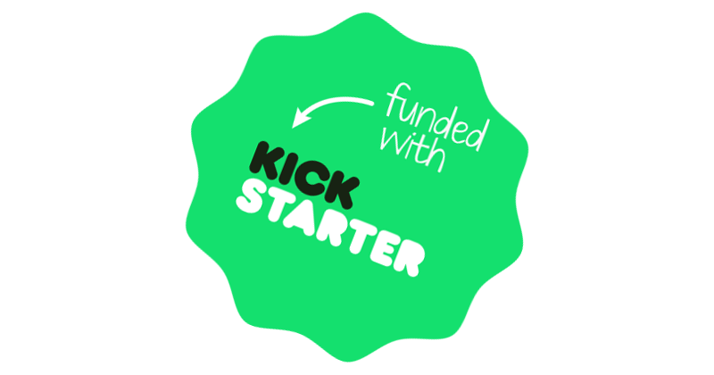
Kickstarter - Project Success Prediction
Team 6 - Sagar Kurada, Shreeansh Priyadarshi, Rahul Raj, Pranav Saboo, Rukmini Sunil Nair

Slide 2



Kickstarter sets itself apart from other crowdfunding websites because the backers, the individuals who pledge money receive a reward corresponding to the amount pledged only if the project is successful.
Overview
Kickstarter is a global crowdfunding platform built around creative projects/ideas. It serves as a launchpad for creators to realize their project ideas.
Project is successful
YES
Launch of project/idea with a defined goal amount
Receive funding from backers
Funding matches goal amount?
NO
Project has failed
Kickstarter Statistics
Over 165,000 projects
17 Million backers
$4.4 Billion pledged
Notes:
Reward can be a merchandise, product or a percentage stake

Slide 3
Project Flow
Defining problem statement
Data cleaning
Exploratory Data Analysis (EDA)
Data pre-processing
Model building and Analysis
Results and Observations
Notes:
Kickstarter founded in 2009

Slide 4
We aim to develop a model that could help backers select the right project/idea by predicting which projects are likely to be successful
Which projects are likely to be successful?
Successful projects are defined as the ones which have received pledges equal to or exceeding the goal amount
Problem Statement
The data is collected from the Kickstarter platform for 380,000 projects spanning over 9 years – from 2009 to 2018. The dataset includes project categories, funding deadlines, pledged amounts, countries, and number of backers.
Data Overview
Notes:
Kickstarter founded in 2009

Slide 5
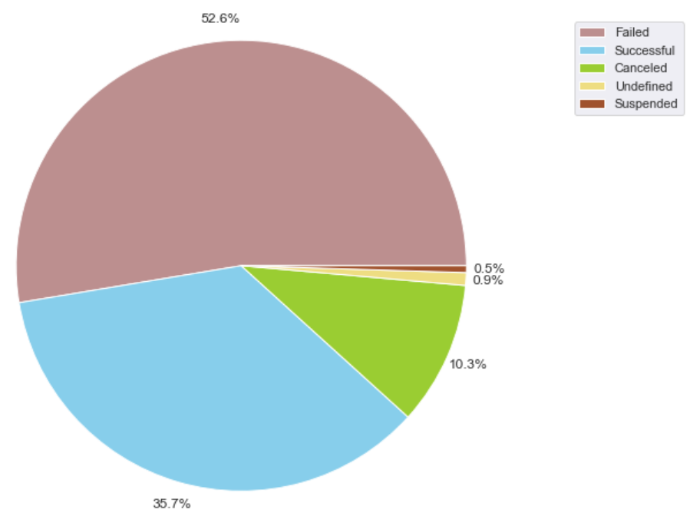
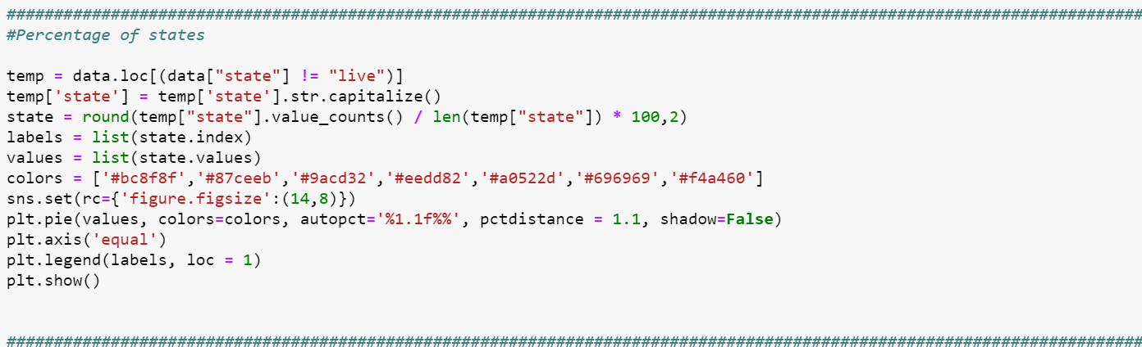
Over half of the overall projects were deemed to be a failure, with successful projects more than a third of the total
Apart from success and failure, the other project states can be classified as follows:
Cancelled – User cancels the project
Suspended – Project deemed to be in violation of Kickstarter’s rules
Undefined – No data available for the project state
Live – Current projects; ignored due to incomplete data
Henceforth, we are considering only successful and failed projects, which comprise 88% of the overall dataset

Slide 6
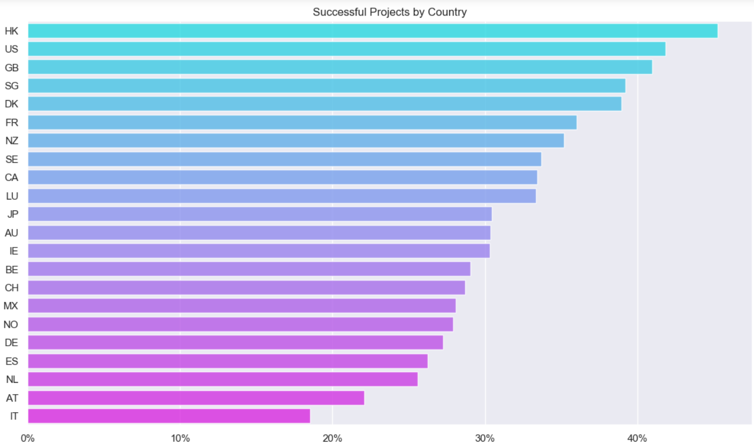
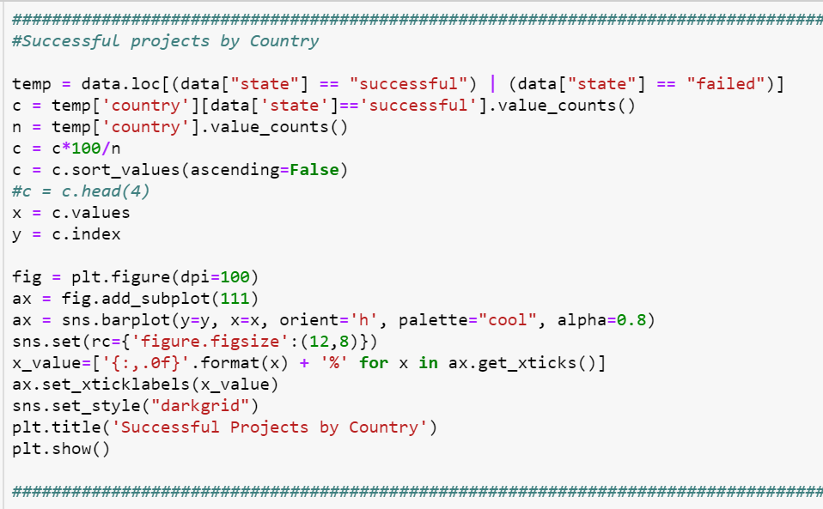
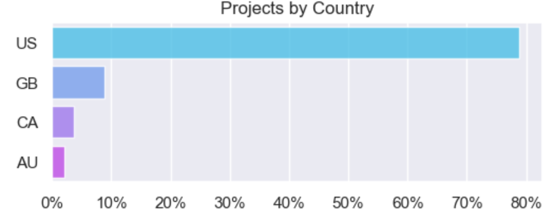
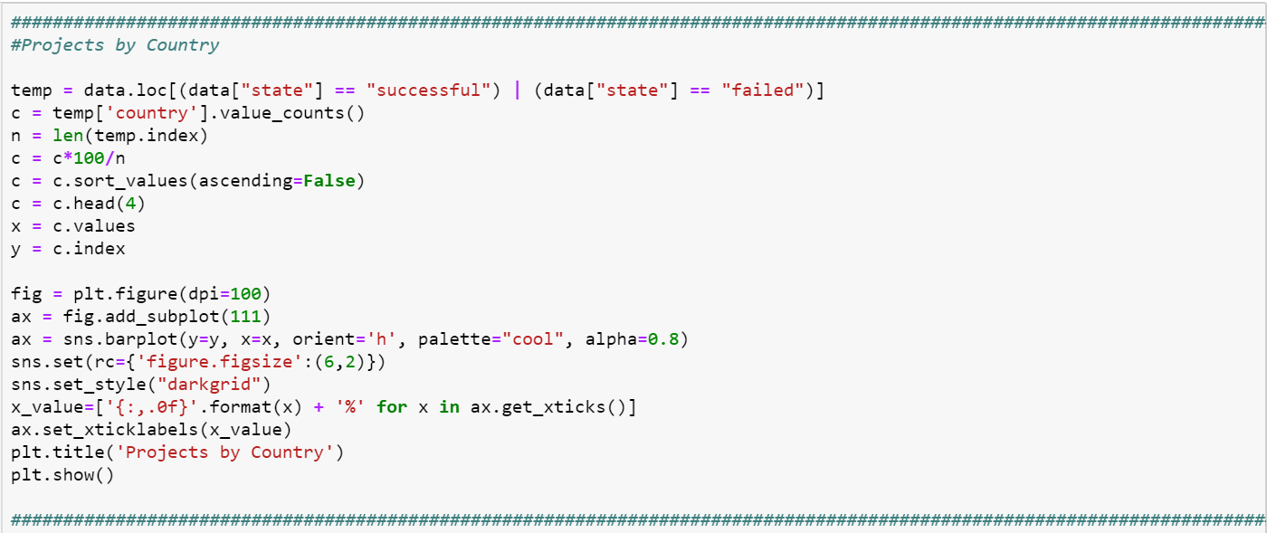
Projects in the U.S. leads the way with the highest number of successful projects, followed by Great Britain
Hong Kong, the U.S., Great Britain and Singapore represent countries with the highest rate of successful projects. Furthermore, looking at the sheer number of total projects by country, U.S. represents nearly 80% of the overall projects in Kickstarter. This means that higher number of successful projects come from U.S.

Slide 7
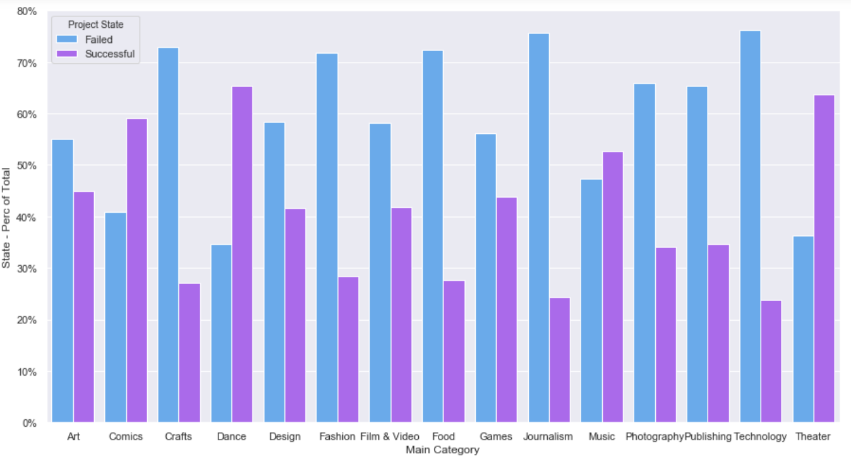
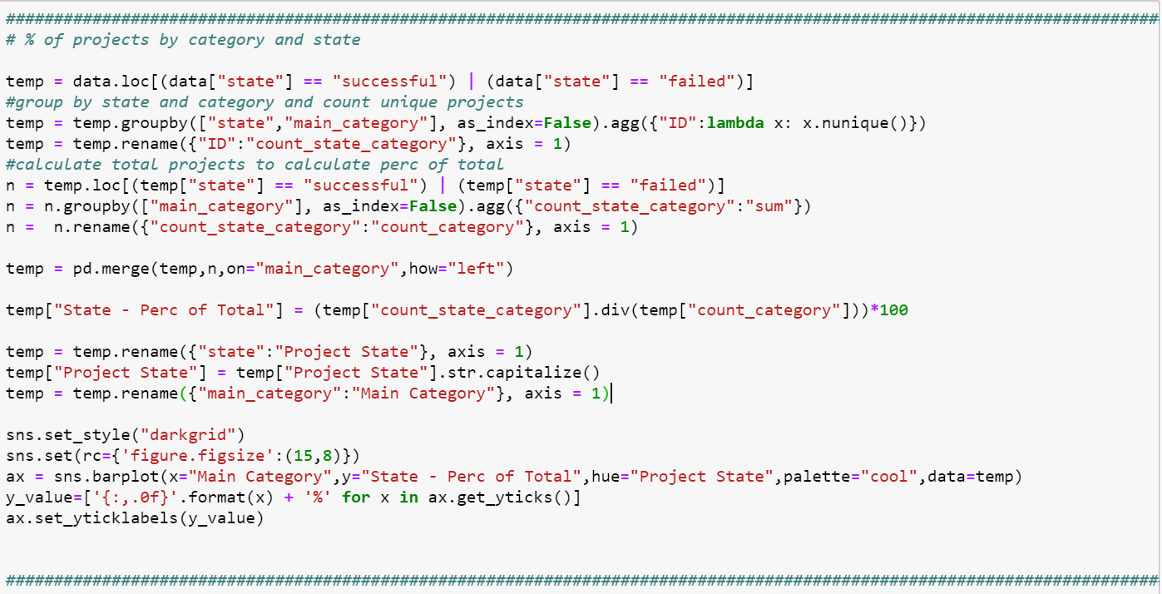
Nearly 3/4th of the categories have more failed projects than successful projects
Categories such as Comics, Dance, Music and Theatre have some of the highest rates of success. In contrast, categories such as Technology and Journalism have the highest risk, with the failure rates over 3 times that of the success rates

Slide 8
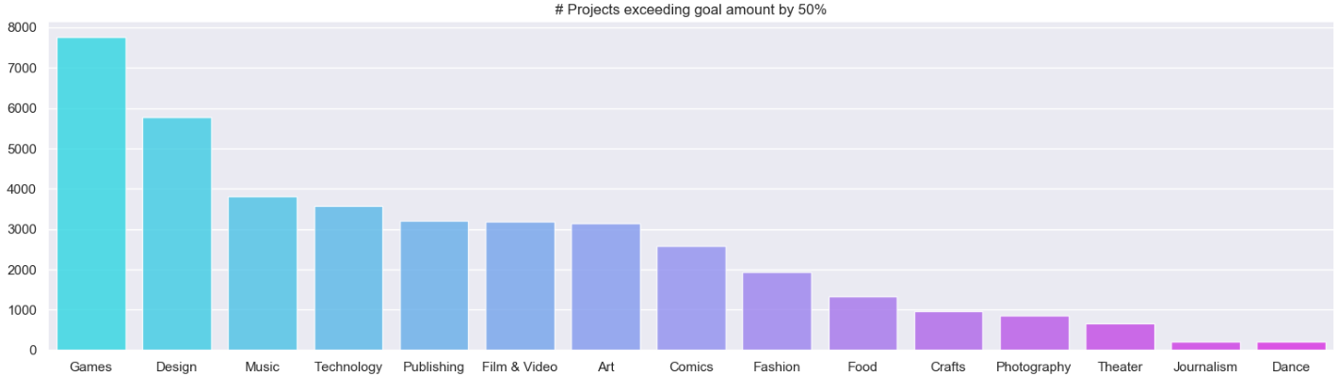
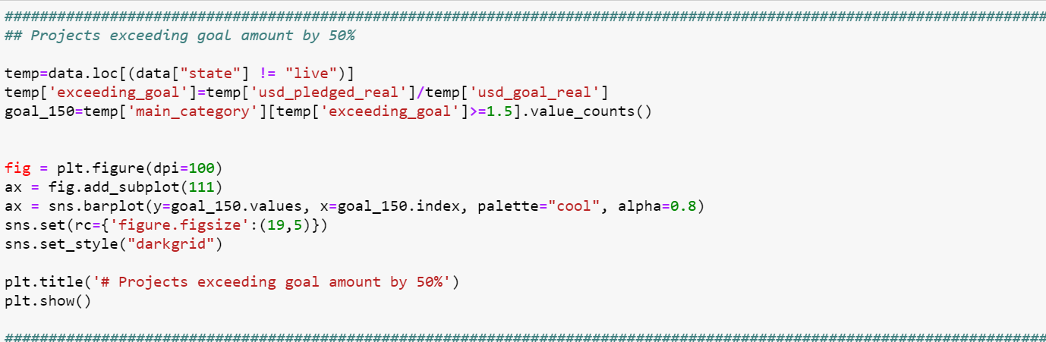
Music has high number of projects exceeding goal amount by 50% with a greater success rate
The above chart shows the project categories which have received pledges exceeding their goal amounts by 50%. Comparing these results with that of the previous slide, we infer that projects under categories such as Games and Design have a high chance of exceeding the goal amount by 50%, but are riskier as their actual success percentage is low. Music, on the other hand has a high chance of exceeding the goal amount by 50% and a high success rate as well.

Slide 9
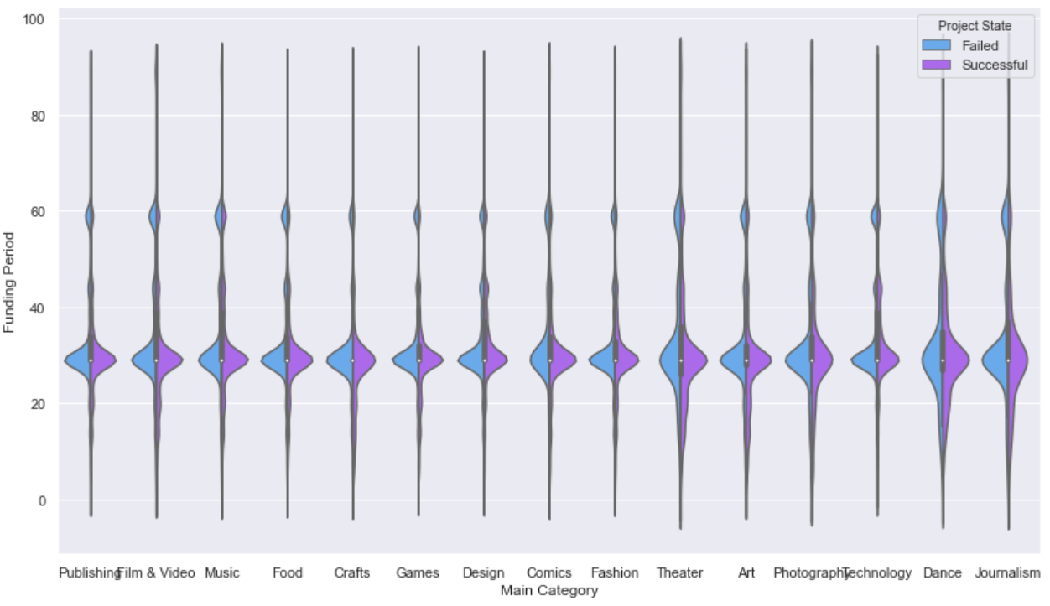
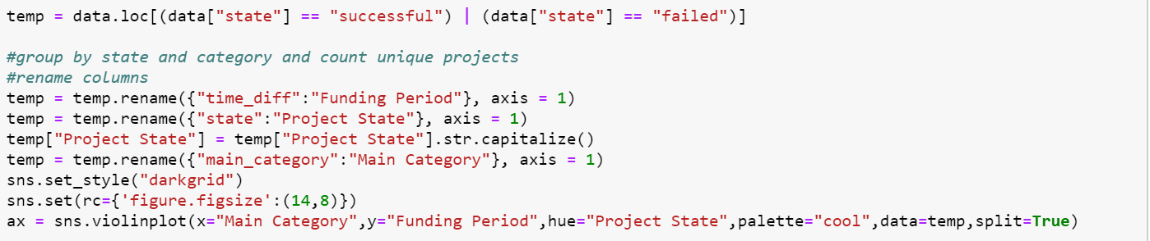
Average funding period across categories
All categories have similar funding period, between 30-35 days.

Slide 10
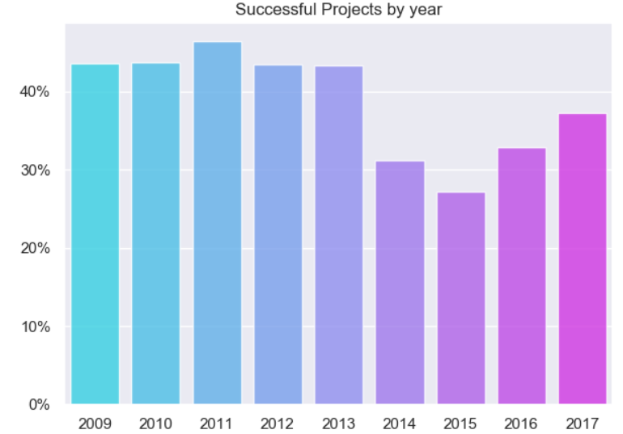
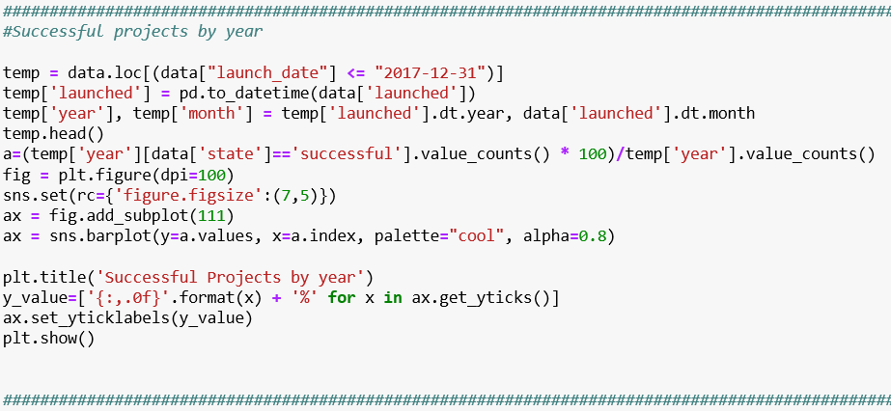
Kickstarter has seen a drop in the success rates in recent years
Since its inception in 2009, Kickstarter witnessed a steady success rate, which has dipped in recent years.

Slide 11
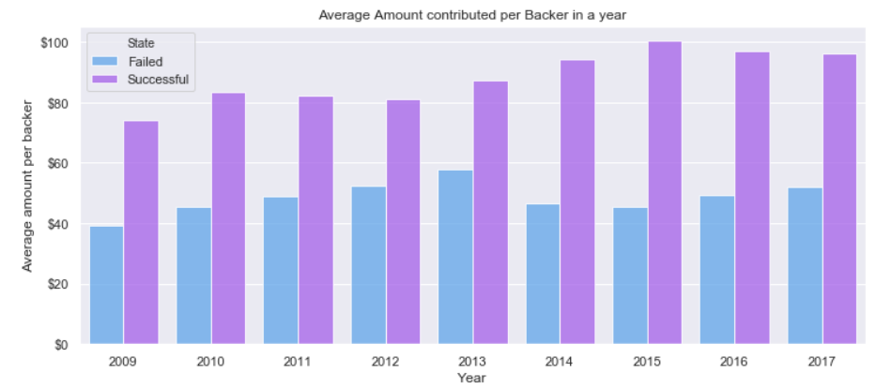
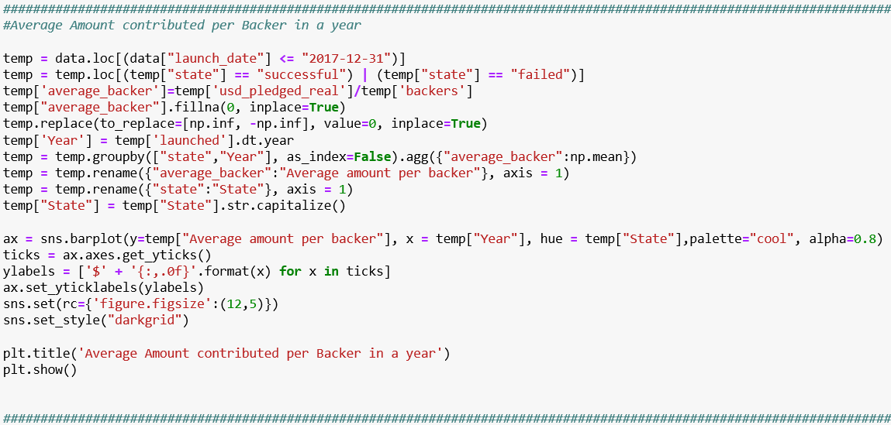
Confidence level of backers has remained steady recently, with the average funding period remaining constant over the past three years
The average amount contributed per Backer in a year has remained in the range of $80 - $100 in the past few years.

Slide 12
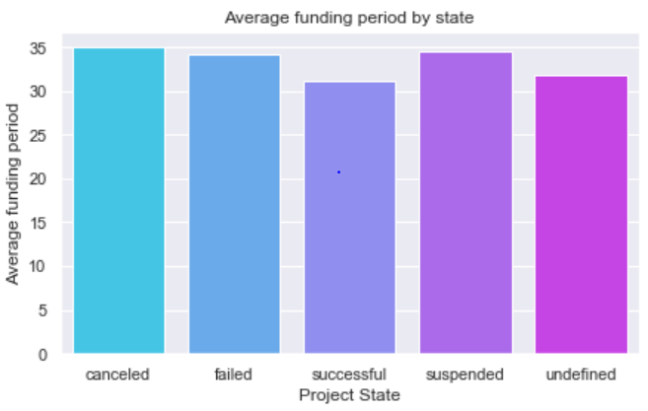
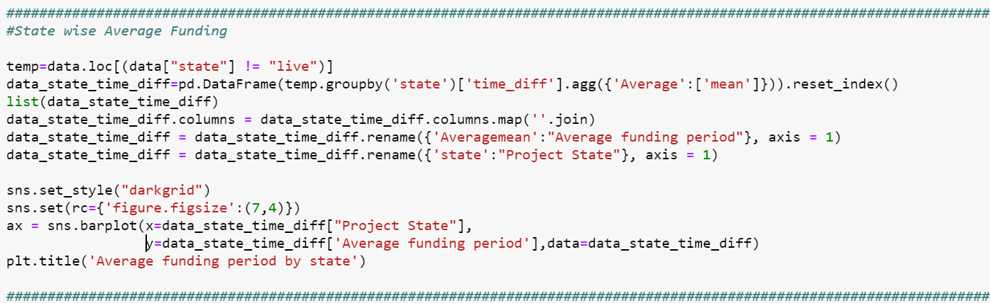
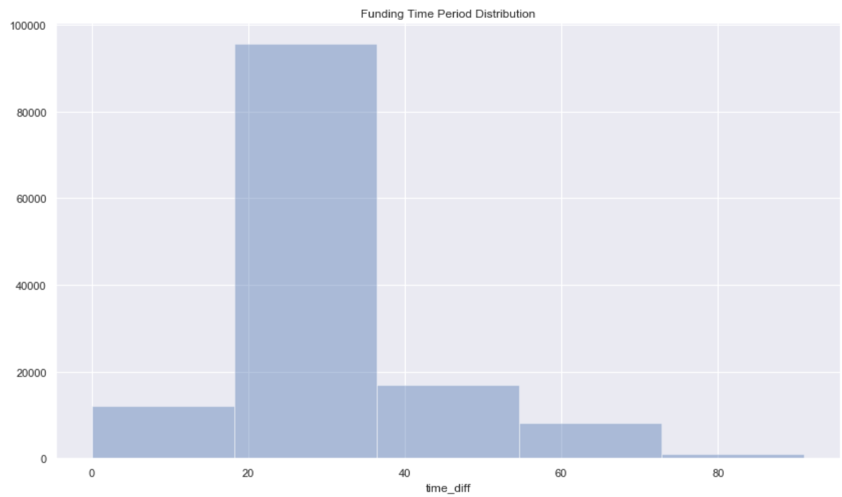
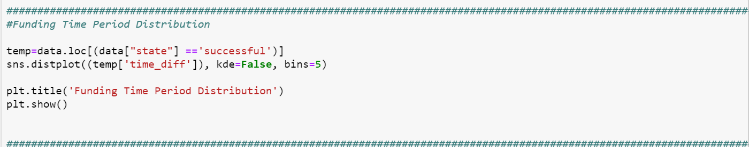
Successful projects usually have a low average funding period
We can see that average funding period is lower for successful projects, even though Kickstarter allows a funding period between one to sixty days. This could be explained by the fact that shorter periods set a tone of confidence and help potential backers to invest in the project.

Slide 13
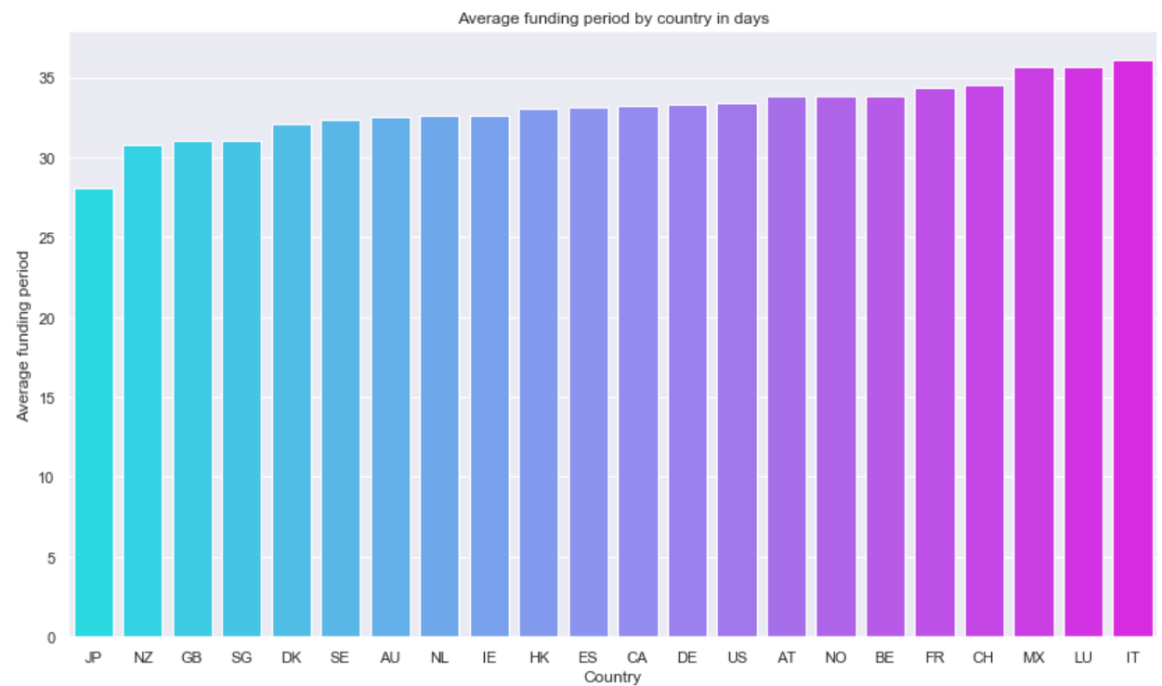
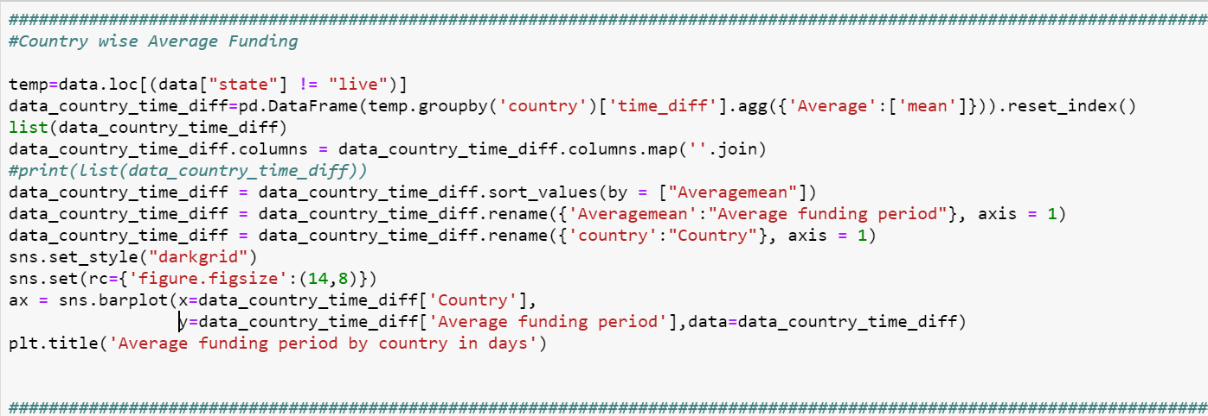
Countries with higher average funding period correspondingly have low rates of success
Concurrent to our inferences, projects from the country with the longest average funding period (Italy) also have the lowest rate of success. Countries with predominantly high rates of success such as Great Britain have low average funding period.
Notes:
Refer slide 6

Slide 14
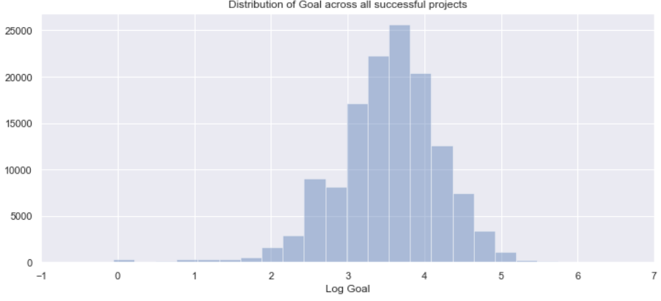
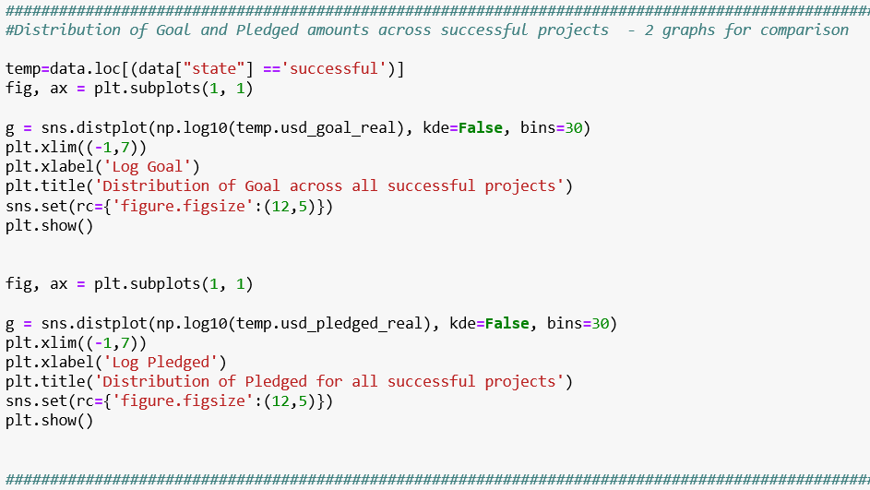
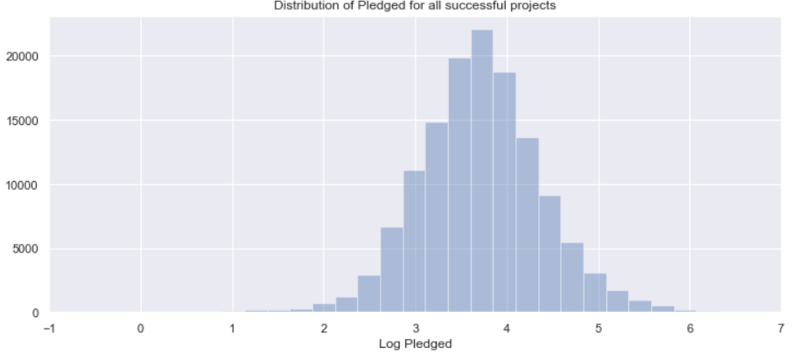
Mean of Goal amount for successful projects is higher than the mean for all the projects
There is no guarantee that a project with goal amount close to the mean of all successful projects will end up in a success.

Slide 15
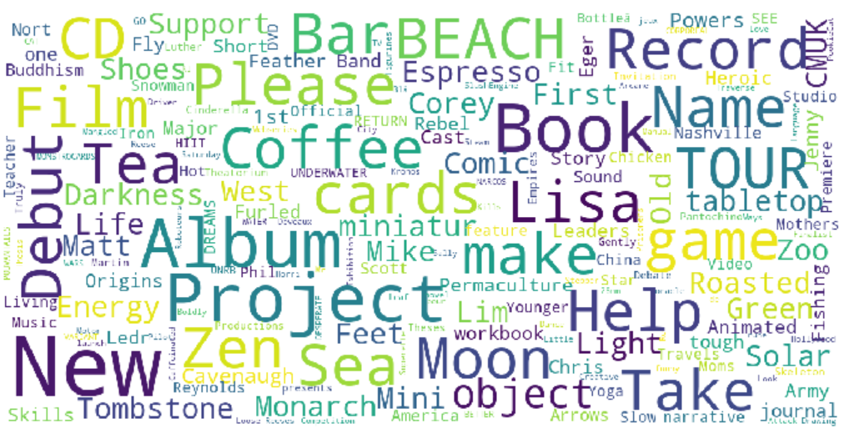


Based on Name
New
Record
Book
Film
Album
Based on Main Categories
Music
Film
Video
Games
WORDCLOUD
Based on Sub-Categories
Music
Film
Rock
Narrative

Slide 16
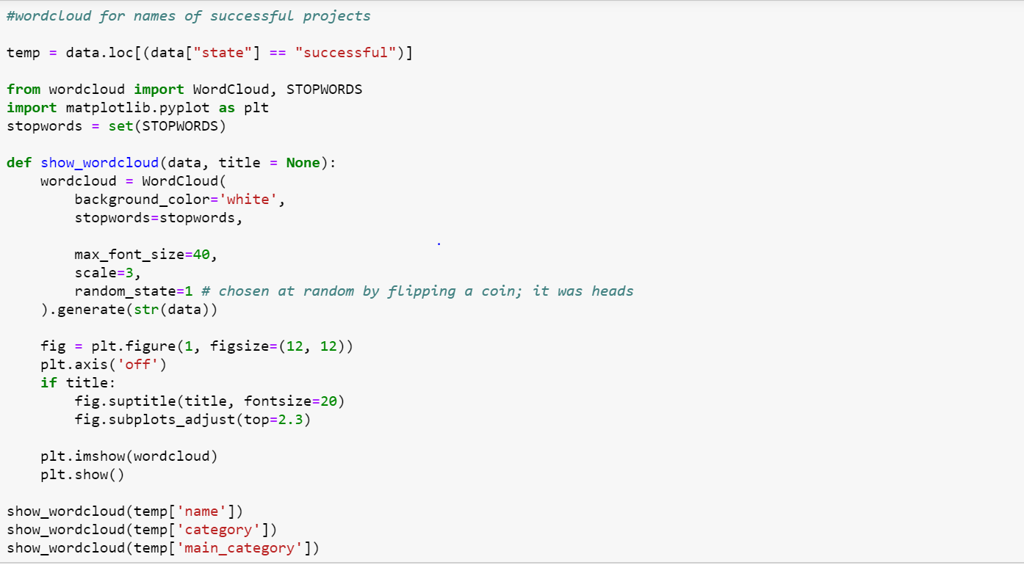
Generating word cloud

Slide 17
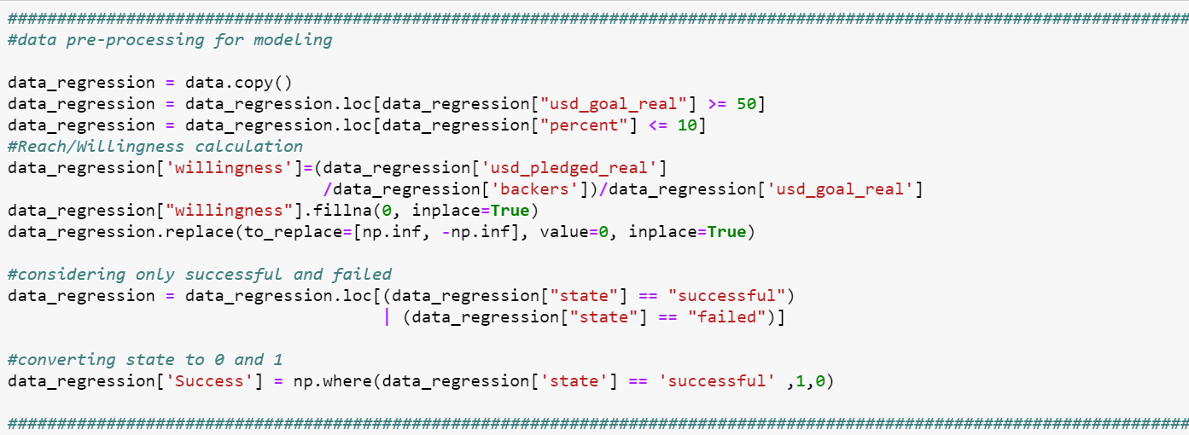
Data pre-processing for modelling
We have introduced a metric called Willingness which gives an idea about percentage of goal amount a backer is willing to fund based on past trends. This helps a potential investor as they can learn about the past interest for a project under a particular category and decide whether to invest in a similar project.

Slide 18
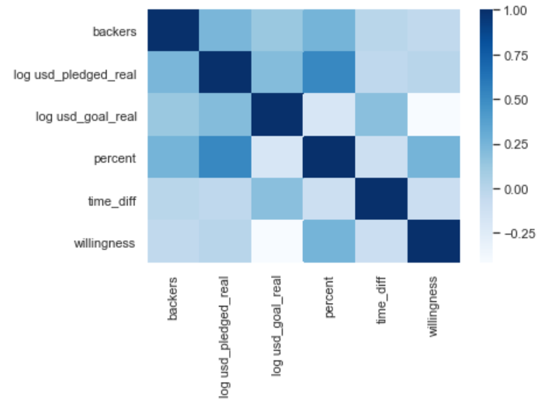
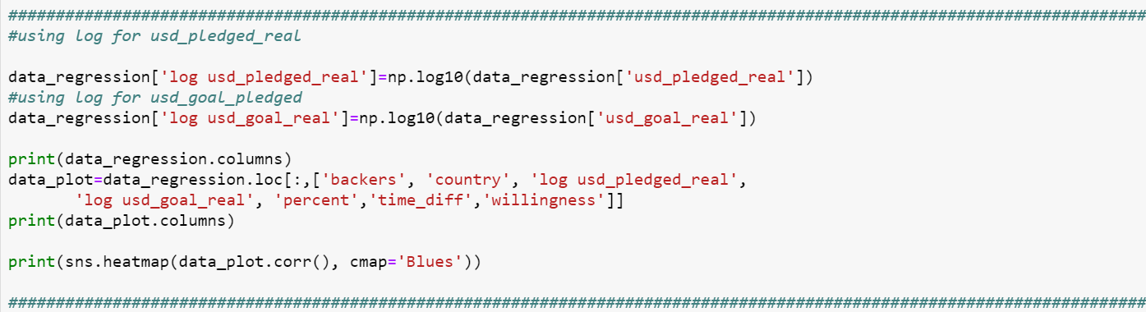
Correlation Plot
Backers and the USD pledged amount have a relatively high correlation. We are not considering the correlation with percent since it is a derived metric.
This plot can be used to finalise the variables for the modelling. We have considered willingness, time difference and categories for modelling.

Slide 19
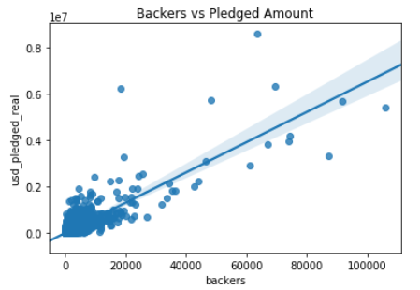
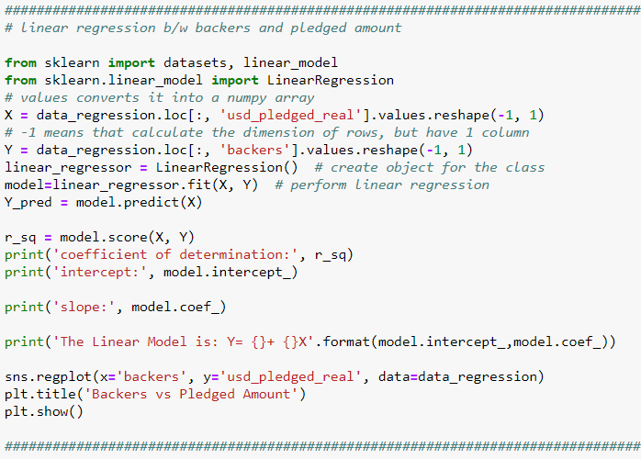
Linear relationship between pledged amount and number of backers
Coefficient of Determination: 0.690678348296891
Intercept: [13.53088962]
Slope: [[0.01057472]]
The Linear Model is: USD Pledged Amount = [13.53088962] + [[0.01057472]] * Number of backers

Slide 20
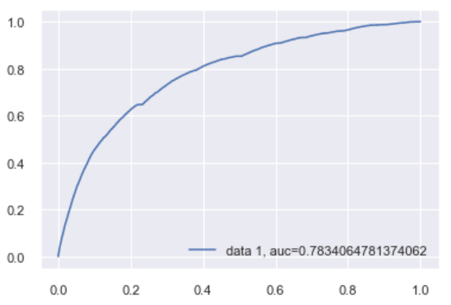
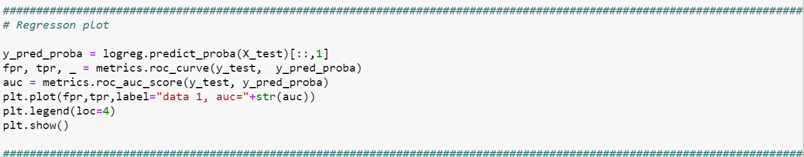
Logistic Regression
Logistic regression is used to classify the project as successful or failed.
Area under the curve gives the measure of accuracy of the model: 72%

Slide 21
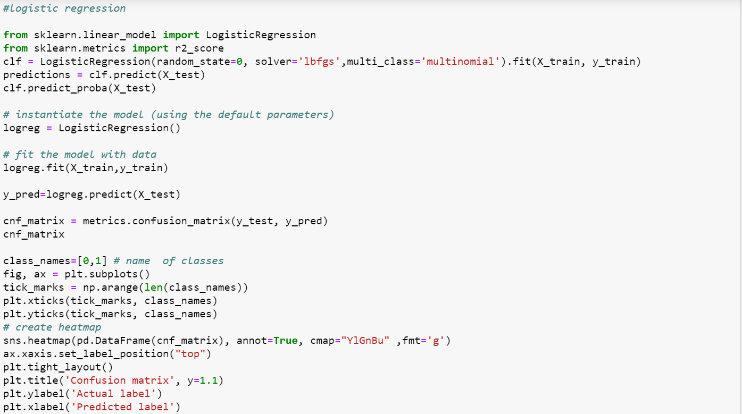
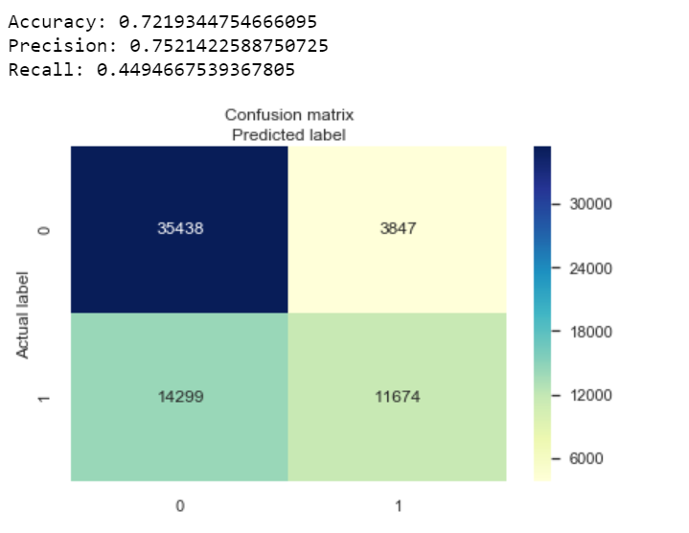
Confusion Matrix
Using willingness, time difference and categories as variables, our logistic regression model predicted project success with an accuracy of 72%.

Slide 22
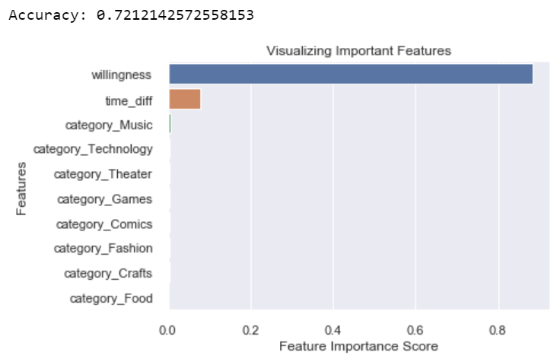
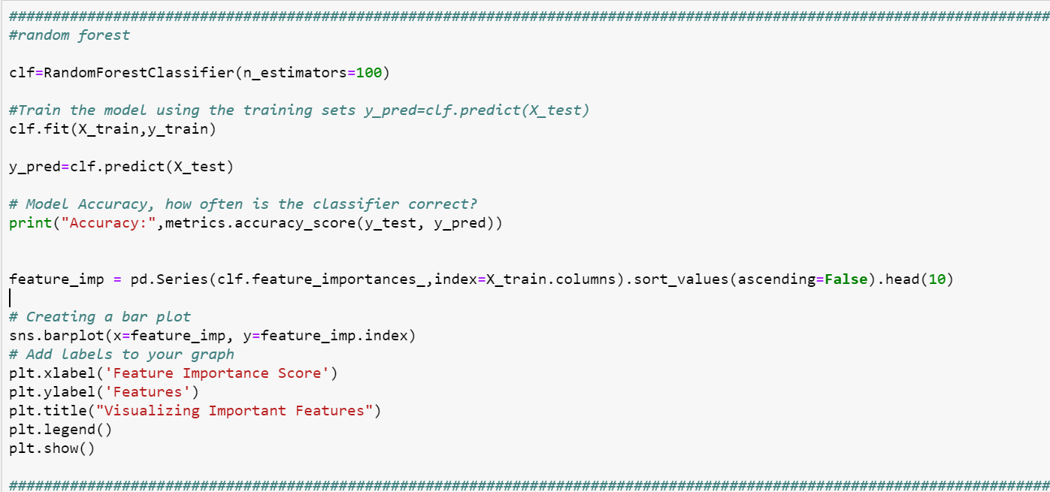
Random Forest
This model gives us the relative importance of the variables considered in the model. Willingness and time difference have high importance.

Slide 23
Results and Observations
Willingness Factor
The past trends of percentage of goal amount a backer is willing to fund is a deciding factor for a project to be a success in any category/country and so on
If a backer wishes to fund a project in a particular domain, he should look at the historical funding patterns for similar project
Successful projects usually have a low average funding period
Music has the most number of projects exceeding goal amounts by 50% and it also has a high success rate, thereby making it the safest bet

