Slide 1
Zomato- Bangalore
Anirudh Buchalli
Karthik Krishna
Medha Gupta
Pranay Khandelwal
Shikhar Jamuar
MGMT 58600- Introduction to Python

Slide 2

Introduction

Slide 3


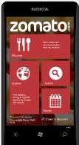
Objective and Introduction
How can we help restaurant?
How can we help Zomato ?
1
2
Zomato
Customized Marketing strategy based on Clustering output
Restaurant
Identify the Parameters using Classification
Benchmarking success using Regression Modeling
Use Sentiment analysis to analyze the parameters based on text reviews
3
Top 5 places to visit next based on the user input using Regression Modeling
How to help users?
User

Slide 4
Data Cleaning & EDA

Slide 5

Data Cleaning
2.Row Reduction
Duplicate Row Removal​
Removal of Non-Demographic data​
1.Initial dimensions
4.Data Transformation
3.Column Reduction
Creation of UID and Dummy variables
Manually clustered cuisines, locations and restaurant types.
Rows:60k​
Columns:17​
Removal of unnecessary columns like URL ,phone number etc.

Slide 6
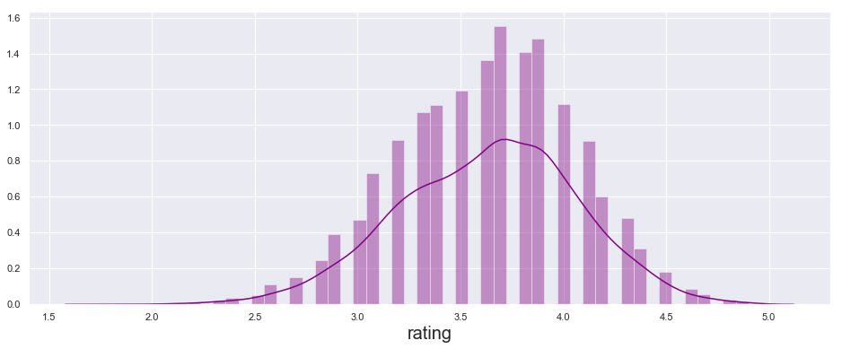
Univariate Analysis(Graphical Analysis)
Normal Distribution Chart
Mean = 3.7
# Load the seaborn package and the draw the chart
import seaborn as sns
plt.figure(figsize=(16, 6))
sns.distplot(df['rating'],color='darkblue')
plt.xlabel(d.value, size =20)
Checking for the normality of the response variable (rating) to ensure appropriate modeling

Slide 7
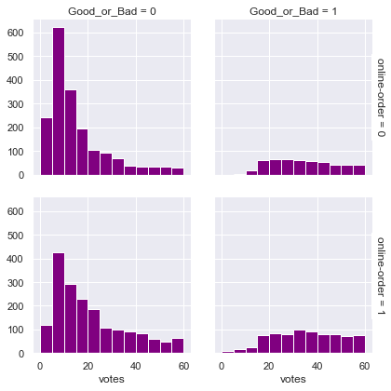
Multivariate Analysis(Graphical Analysis)
Rating Does not depend on the availability of online-order in a restaurant
# Load the seaborn package and the draw the chart
import seaborn as sns
sns.set(style="darkgrid")
tips = df
g = sns.FacetGrid(df, row="online-order", col="Good_or_Bad", margin_titles=True)
bins = np.linspace(0, 60, 13)
g.map(plt.hist, "votes
Successful restaurant have tendency to have higher votes

Slide 8
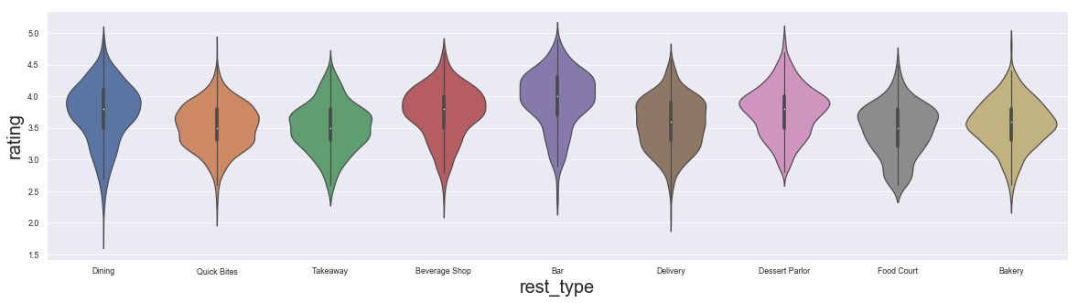
Violin Plot
# Load the seaborn package and the draw the chart
import seaborn as sns
sns.violinplot(x='rest_type', y= d.value, data=df)
Insights
For Bars median rating is the highest in comparison to others
Whereas, QuickBites and Takeaways have a lower median ratings

Slide 9
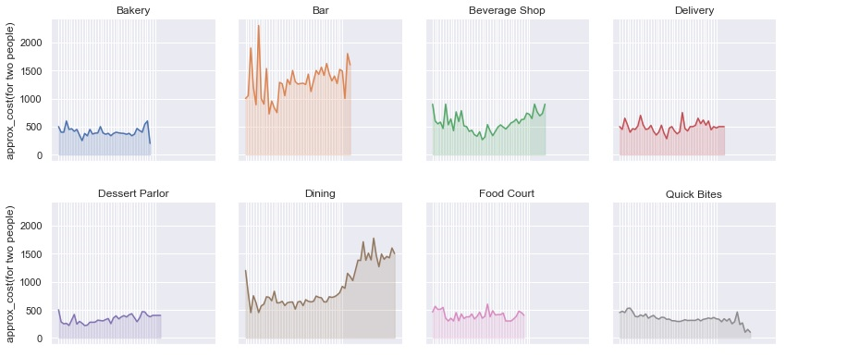
Bivariate Analysis(Graphical Analysis)
#Load the seaborn and plot the chart
import seaborn as sns
sns.violinplot(x='rest_type', y= d.value, data=df)
df1 = df.groupby(['rest_type','cuisines'], as_index=False).mean()
df2 = df1[[ 'rest_type','cuisines','approx_cost(for two people)']]
g = sns.FacetGrid(df2, col='rest_type', hue='rest_type', col_wrap=4, )
g = g.map(plt.plot, 'cuisines', 'approx_cost(for two people)')
g = g.map(plt.fill_between, 'cuisines', 'approx_cost(for two people)', alpha=0.2).set_titles("{col_name} rest_type")
g = g.set_titles("{col_name}")
plt.subplots_adjust(top=0.92)
Insights
Bars tend to be costlier
Dessert Parlor tend to be cheaper

Slide 10
Classification & Modeling

Slide 11


Business Objective- 360 degree solution ecosystem for the Owners and Users
Attracted by More Users
Restaurants
Users
Attracted by More Restaurants
Existing Owners
New Owners
Zomato users
Identify the parameters impacting the rating of the restaurant
Benchmarking targets for the new restaurant owners
Building Recommender for users to visit next rest.

Slide 12
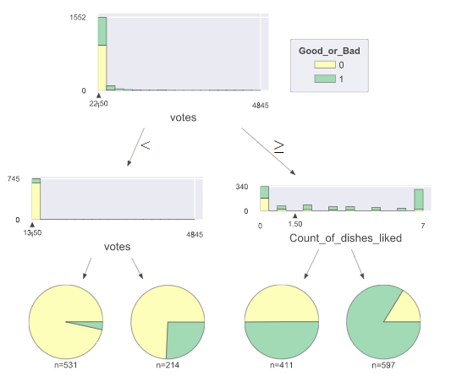
Decision Tree- to visualize the important factors
Insights from the Tree
# Load the data and split it in train and test to prepare the chart
# max depth is the level to which we want to dep dive
clas = tree.DecisionTreeClassifier(max_depth=4)
# Fit the model
clas.fit(X_train, y_train)
# Draw tree
viz = dtreeviz(clas,
X_train,
y_train,
target_name='Good_or_Bad',
feature_names=features,
class_names=["0", "1"],
histtype= 'barstacked') # barstackes is default
viz
Votes
22.5
22.5
# dishes liked
<13.5
>13.5
<1.5
>1.5
Cost

Slide 13



Modeling techniques used
Logistic Regression
Accuracy = 80%
Accuracy = 81%
Random Forest
Applying various modeling approach to identify the best and also cross verify the over-fitting. Ensemble and Random forest stand out above the others
Gradient Boosting
Accuracy = 80%
Accuracy = 81%
Ensemble

Slide 14
Ensemble Classification Modeling
Output
Overall Accuracy = 81%
# Run the KNN, Random Forest and Logistic Regression model
#create a dictionary of our models
estimators=[('knn', knn_best), ('rf', rf_best), ('log_reg', log_reg)]
#create our voting classifier, inputting our models
ensemble = VotingClassifier(estimators, voting='hard’)
#fit model to training data
ensemble.fit(X_train, y_train)
#test our model on the test data
ensemble.score(X_test, y_test)
Combiner
RF Accuracy= 81%
KNN Accuracy= 75%
Logistic
RF
KNN
Logistic Accuracy= 80%
Input

Slide 15
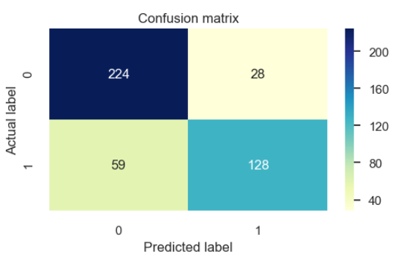
Confusion metrics
# Create the confusion metrics using the model
cnf_matrix = metrics.confusion_matrix(y_test, y_pred)
cnf_matrix
class_names=[0,1] # name of classes
fig, ax = plt.subplots()
tick_marks = np.arange(len(class_names))
plt.xticks(tick_marks, class_names)
plt.yticks(tick_marks, class_names)
# create heatmap
plt.figure(figsize=(5,3))
sns.heatmap(pd.DataFrame(cnf_matrix), annot=True, cmap="YlGnBu" ,fmt='g')
ax.xaxis.set_label_position("top")
plt.tight_layout()
plt.title('Confusion matrix', y=1.1)
plt.ylabel('Actual label')
plt.xlabel('Predicted label')
Accuracy = 80.63%

Slide 16
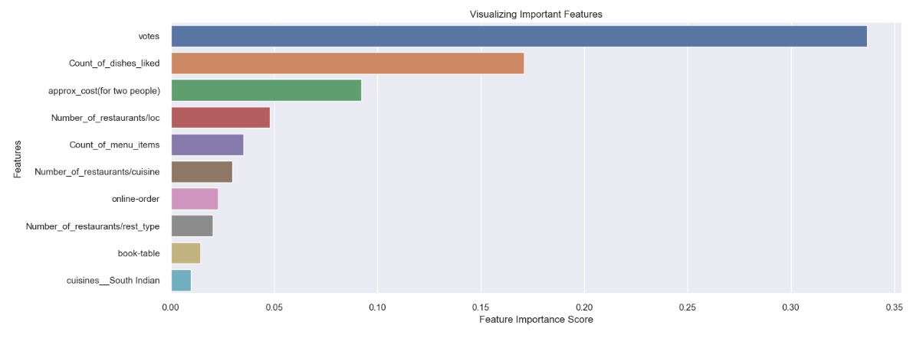
Classification Story-Factors Influencing Success
Success
Mantras
Should push and get more votes
Increase
variety of
dishes
Should start to have online order
Should have a table booking system
Menu items should be increased

Slide 17
Recommender & Simulator

Slide 18

Simulator and Target setting
Business Problem- Parameter benchmark to open a new successful restaurant
How do I become successful
Should I have an online booking
What should be my menu item
How many specialty dishes should I plan for
What should be my marketing strategy
What should be my approximate cost

Slide 19
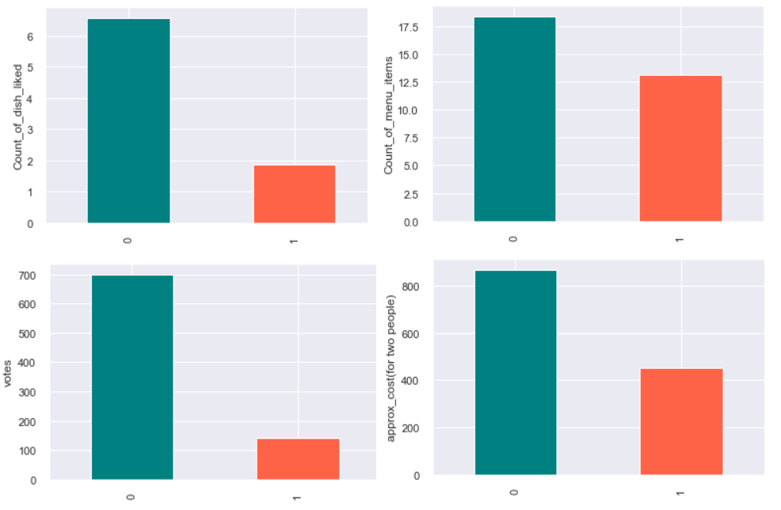
Recommendation
3. Approx cost~2: 870
1
2
Success Factors
2. # of Menu Items: 18
1. Dishes liked: 7
4. Votes: 700
4
3

Slide 20







Recommender
Business Problem – Suggest me the next best restaurant that I should visit. Methodology similar to the Amazon recommender system. The only difference is data does not allows us to peep into the past orders/places visited.
Its weekend. I want
to eat something
Enter the Wishes
Regressive Model
Suggest Top 5 restaurant
Location
Rates
Menu
Ratings

Slide 21

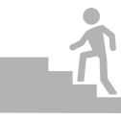

Recommender Output
# Random forest regression model
X_train = sc.fit_transform(X_train)
regressor = RandomForestRegressor(n_estimators=20, random_state=0)
regressor.fit(X_train, y_train)
# Apply the filters
df_rec_loc = df_rec.location == 'Banashankari'
# df_rec_rat = df_rec.rating >= 4
# Output- Top 5 restaurant
df_rec2.sort_values(by=['ypred','rating’])
df_rec3.UID.head(5)
Input
Model
Output
Enter types (e.g.) 1.Location
2.Cuisines (e.g.)
Build a Random Forest Regressor
Top 5 Recommendations
Model Output : Places to visit
Name | Location
New Gowda's Fried Chicken | 4th Cross Road, Banashankari
SLV Refreshment | 130, 3rd main, Banashankari
Floured-Baked With Love | 415, 1st C Cross, Banashankari
Thanco's Natural Ice Creams | 941, 21st Main Road, Banashankari
Kidambi's Kitchen | 2465, BDA Complex, Banashankari

Slide 22
Personalized Promotional Strategies - Clustering

Slide 23
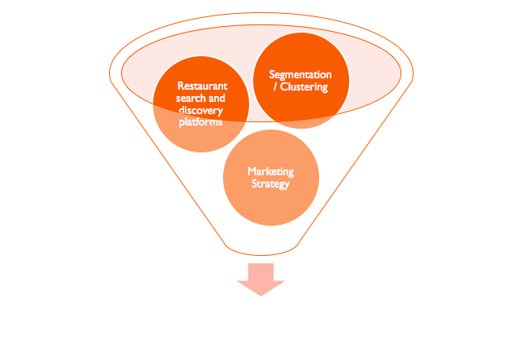



K-Means Clustering
Zomato's Personalized Promotional Strategies
?
Notes:
Restaurant search and discovery platforms have always struggled while formulating their promotional and advertisement strategies. The time is gone when a general plan of marketing advertisement will yield a firm a competitive edge. In today’s world it becomes crucial to switch to personalized promotional strategies for the customers. Clustering is one of the methods to segment customers and to go forward with segment wise personalized advertising.

Slide 24
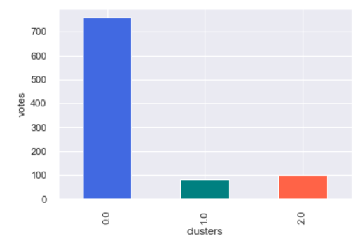
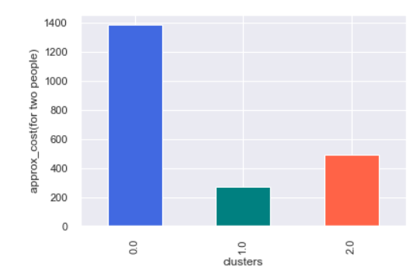
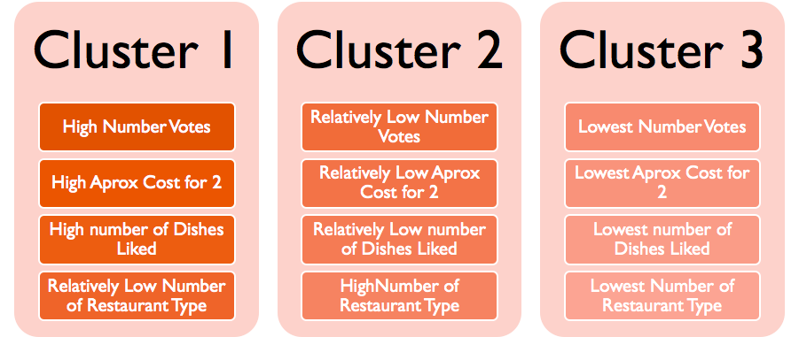
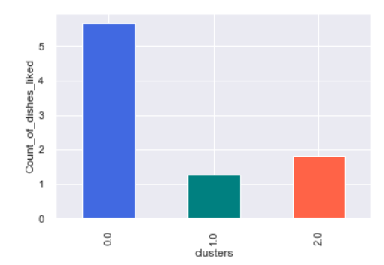
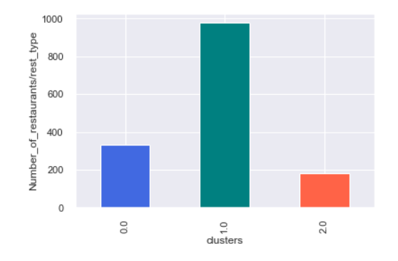
Cluster Attributes

Slide 25
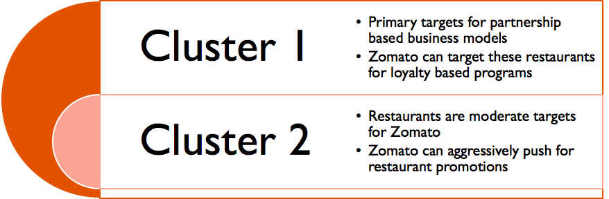
Cluster Recommendations
Cluster 1
Cluster 2/3

Slide 26
NLP- Understanding the Customer

Slide 27

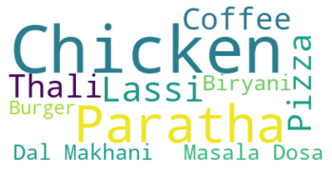
Understand the Trends
What do Bangalore People Like?
Import Packages and load processed data
from PIL import Image
from wordcloud import WordCloud, STOPWORDS, ImageColorGenerator
import matplotlib.pyplot as plt
text=pd.read_csv("Final_file.csv")
# Process to create word cloud
stopwords = set(STOPWORDS)
stopwords.update(["x83Ã","x82Ã","place","restuarant","nan"])
wordcloud = WordCloud(stopwords=stopwords,background_color="white",max_words=10).generate(' '.join(text2["dish_liked"]))
plt.imshow(wordcloud, interpolation='bilinear')
plt.axis("off")
plt.show()

Slide 28
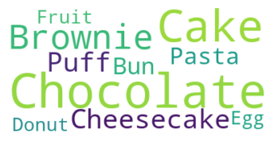
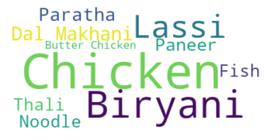
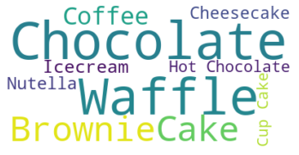



Deep Dive – Dishes Liked based on restaurant type
Bakery
Dining
Desert Parlor

Slide 29



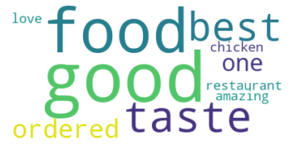

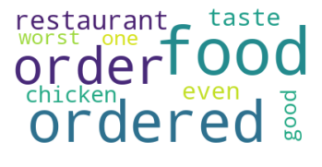
Can I understand the reviews?

Slide 30



Sentiment Analysis (Scoring)
Preprocessing
Segmentation
Tokenization
Sentiment Analysis
Lemmatization
Dependency Parsing
Modeling
Understanding the meaning`
Naïve Bayes (Contextual Analysis)
Import Packages and use NLP
from nltk.corpus import stopwords
text['stopwords'] = text['Review'].apply(lambda x: len([x for x in x.split() if x in stop]))
text['upper'] = text['Review'].apply(lambda x: len([x for x in x.split() if x.isupper()]))
from sklearn.feature_extraction.text import TfidfVectorizer
tfidf = TfidfVectorizer(max_features=1000, lowercase=True, analyzer='word',
stop_words= 'english',ngram_range=(1,1))
train_vect = tfidf.fit_transform(text['Review’])
from sklearn.feature_extraction.text import CountVectorizer
bow = CountVectorizer(max_features=1000, lowercase=True, ngram_range=(1,1),analyzer = "word")
train_bow = bow.fit_transform(text['Review'])
train_bow
text['sentiment'] = text['Review'].apply(lambda x: TextBlob(x).sentiment[0] )

Slide 31
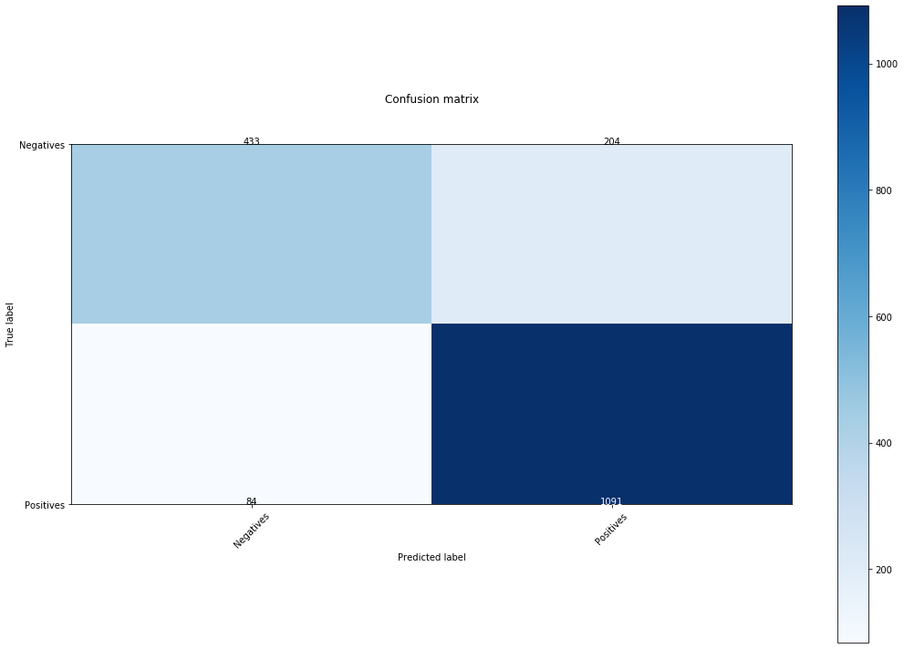
Sentiment Analysis (Modeling)
# Create confusion metrics
from sklearn.feature_extraction.text import CountVectorizer
from sklearn.naive_bayes import BernoulliNB
from sklearn.metrics import confusion_matrix
def training_step(data, vectorizer):
training_text = [data[0] for data in data]
training_result = [data[1] for data in data]
training_text = vectorizer.fit_transform(training_text)
returnBernoulliNB().fit(training_text,training_result)
Accuracy : 84.1%
Sensitivity : 68%
Specificity : 93%

Slide 32
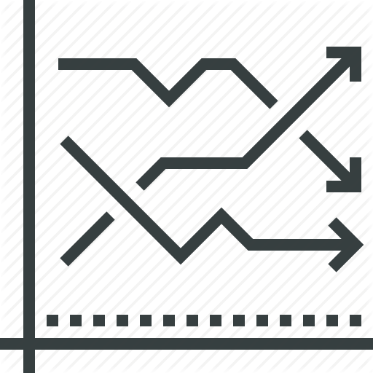



Business Use Cases
Identify the key KPIs for the restaurant to focus
Understand the trends and needs of the customer
Target the right customers via digital marketing channels
Modify the infrastructure/Themes

Slide 33
Restaurant Product Life Cycle Management
Introduction
Maturity
Decline
Growth
Understand the restaurant industry landscape
Identify trends in the food service industry and build leverage by deploying capital resources
Identify the loyal customers
Look to personalize the service
Cut down on marketing/promotion activities
Look to maximize the existing resources
Fine tune the processes
Segment and target customers to provide personalized benefits
Identify and benchmark your restaurant vs the competition
Look for new avenues of growth by leveraging marketing campaigns

Slide 34
















Restaurant Positioning
H
Market Strengths
Invest in Skills/Resources
Follow the market trends
Invest in marketing/promotional activity (Brand Building)
L
L
Own Strengths
H

Slide 35


