Slide 1
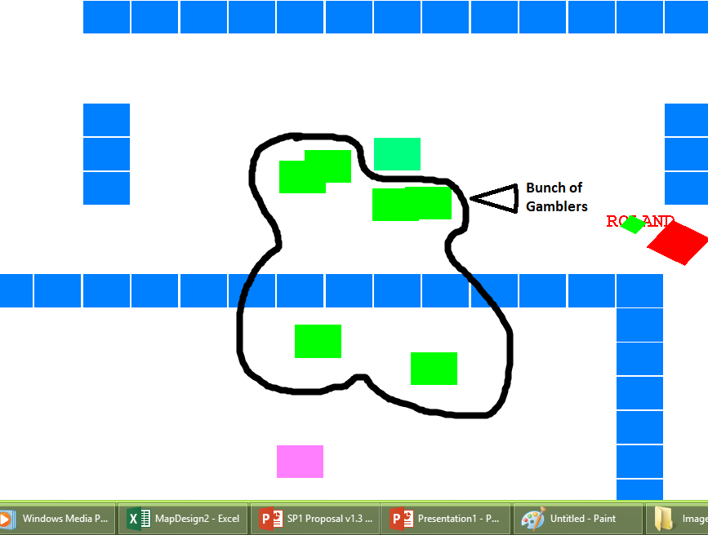


Gamblers
What they look like in game:
Texture of the gamblers:
Texture of the Special Gambler:

Slide 2
Description
-The Gamblers are in search of Money. So they seek after you, trying to take your money.
-The level will end once all the gamblers have been eliminated
-Special Gambler: + it is mirror image of the player.
+ it has the same stats of the player.

Slide 3
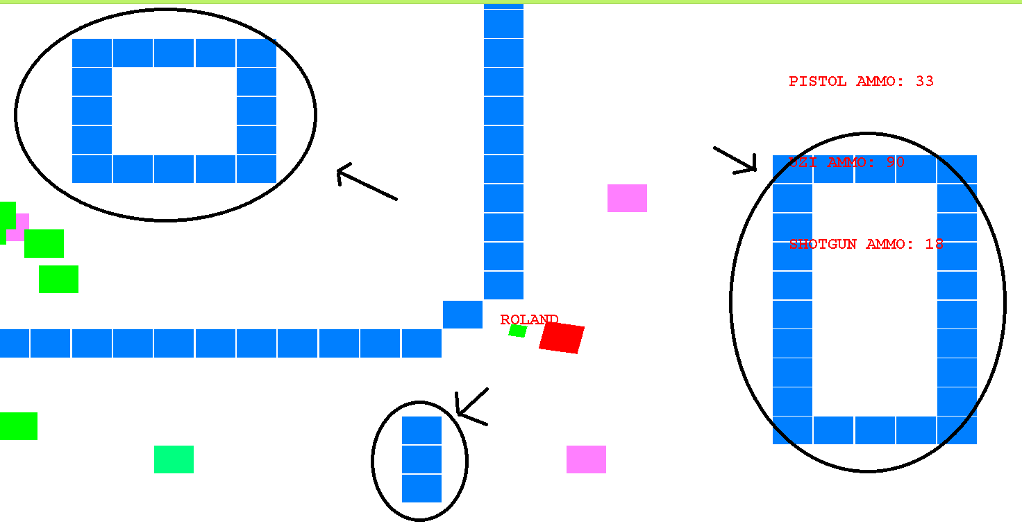
Obstacles

Slide 4
Description
Building – they are obstacle which simulated to be in a city area. So the building are designed to be a obstacle for the Gamblers and the Player a

Slide 5
Description
The naming convention gives the player each time he/she plays a new name.
So each play is a unique.
Also the Special Gambler since is a mirror image of the player it will have the same name as the previous player.

Slide 6
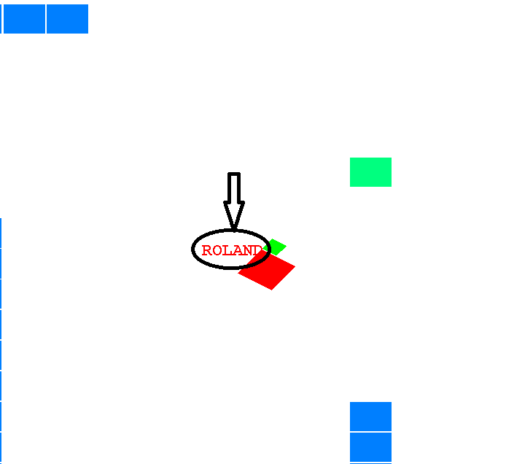
Naming

Slide 7
Problems Faced
Some of the features are ambitious and thus research are required and those researched took up a lot of time
Programming error such as linking error, faults. But overall it is solvable errors.

