Slide 1


UNITED INSTITUTE OF TECHNOLOGY
SUMMER TRAINING
COMPETATIVE CODING
FROM -15 July to 23 Sep 2021

Slide 2
TOPIC - 2048 GAME
PRESENTED BY-
HARIPRIYA YADAV
CSE 3rd YEAR
ROLL NO. - 2002840109003

Slide 3
About 2048
2048 is a single-player sliding block puzzle game designed by Italian web developer Gabriele Cirulli. The game’s objective is to slide numbered tiles on a grid to combine them to create a tile with the number 2048. However, one can continue to play the game after reaching the goal, creating tiles with larger numbers.
It is basically based on Backtracking.

Slide 4
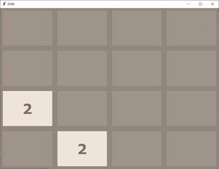
How to play:
1. There is a 4*4 grid which can be filled with any number. Initially two random cells are filled with 2 or 4 in it. Rest cells are empty.

Slide 5
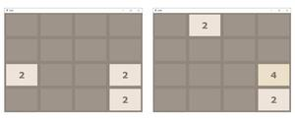
2. We use move up, down, left, or right key to slide a tile and tiles with same number get merge.

Slide 6
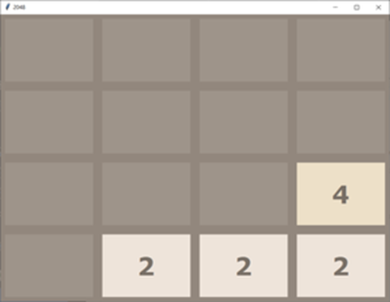
3. After this grid compression any random empty cell gets itself filled with 2

Slide 7
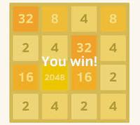
4. Our aim is to build tile with 2048 number. If we are able to do that we wins.

Slide 8
THANK YOU

