Slide 1
Locate an Optimal Food Service Delivery Area
Capstone Week 2 Assignment

Slide 2
Business Problem
Considering multiple factors such as time of day, traffic patterns, clustering of food providers, and population density help optimize the delivery area by providing maximally efficient routes and service coverage areas, to reduce driver costs and time and shorten customer delivery times. The audience for this data report is investors, existing or planned businesses, and logistics providers.

Slide 3
Data Acquisition and Cleansing
Data was acquired for the NY dataset over the internet, and the raw JSON file was parsed and loaded into a pandas frame. The frame structure was refined to correlate with Foursquare API venue data to simplify downstream analysis.
The features selected as key indicators were the number of venues, and within a fixed radius of a neighborhood. These features provide an overall relative view of neighborhoods with maximum delivery potential and minimum cost.

Slide 4
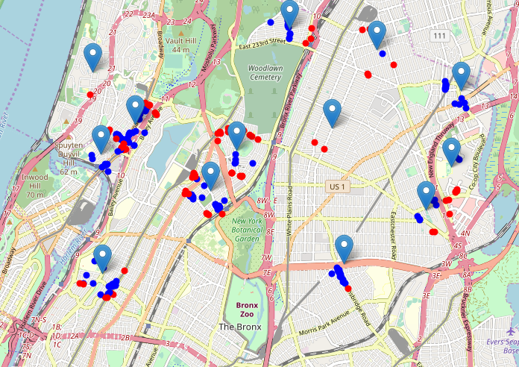
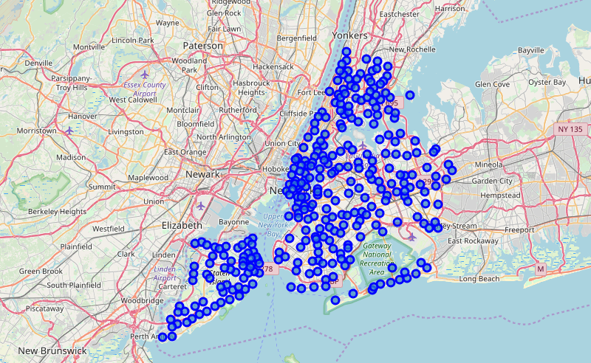
Exploratory Analysis
In order to calibrate the data and prepare for deeper analysis, an overall view of the geographic distribution of locations was created. This shows that a local analysis of the top ranking venues by location is likely the best approach to start, given the targeted focus of maximizing ROI.

Slide 5
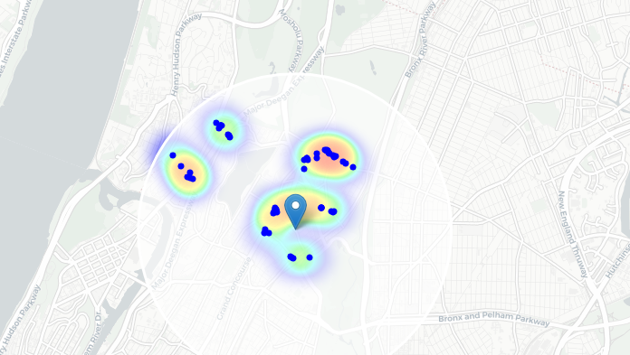
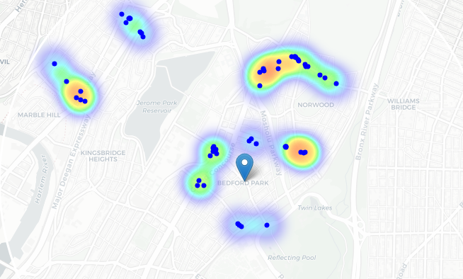
Clustering and Heat Maps
In the next phase of the analysis, the identified sample dataset was used to represent groupings of most of the candidate locations and cluster centers are placed nicely in the middle of the zones with top location candidates.
Heatmap
K-Cluster Heatmap

Slide 6
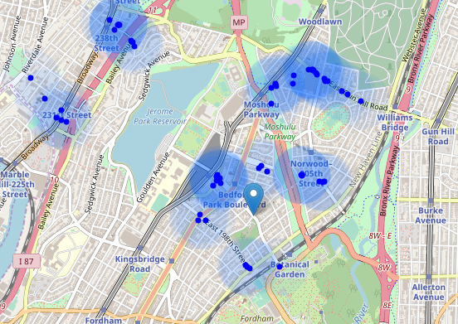
Conclusion
The shaded areas indicate the cluster strength. The upper right quadrant clearly shows the strongest relationship between the features selected toward the business goal of high efficiency and low cost delivery services. High density venue neighborhoods with close proximity are indicted by the clustering, and relative relationship between the neighborhoods sampled is shown by the heat map and blue circles.
From this analysis, a broader review can be done city-wide, and provide the groundwork for prioritizing delivery services with maximum ROI potential.

