Slide 1

ERIS SUBMISSION INFORMATION
[ERIS Submission Title]
[Company Name]
  Address:
  UEI:
  POC:
  Email:
  Phone number:

Slide 2
COMPANY INTRODUCTION
[One chart company overview to introduce you to DARPA and the DoD]

Slide 3
ERIS SUBMISSION CRITERIA QUAD CHART
Defining the Problem & Current State of the Art
Advancing the State of the Art
Detail why the proposed solution, if successful, will advance the current state of the art within the solution's relevant field(s). How is the problem being addressed today? What is "new" within your approach as it compares to current practices? What barriers do you foresee when attempting to advance the state of the art?
Clearly and comprehensively define (1) the scope of the problem(s) that the solution is/will be developed to address and (2) the current state of the art within the field of potential solutions for the problem defined.
Team Capability (Key Personnel Vision, Expertise, and Experience)
Defense and/or Commercial Market Use Case/Impact
Clearly demonstrate that your team has the capability to drive the proposed project to a successful outcome based on your proposed team's unique vision, expertise, and experience. There are a ton of great teams/people operating within your field; why is your team the best and why do they have the "it” factor when it comes to successfully completing the proposed project/solution?
Clearly demonstrate that your proposed project/solution has or will have an impact on the defense and/or commercial markets. Detail what application(s) or use cases you see your solution/project having in the defense and/or commercial space(s). This is your opportunity to identify the "so what" of the solution/project you are proposing.

Slide 4

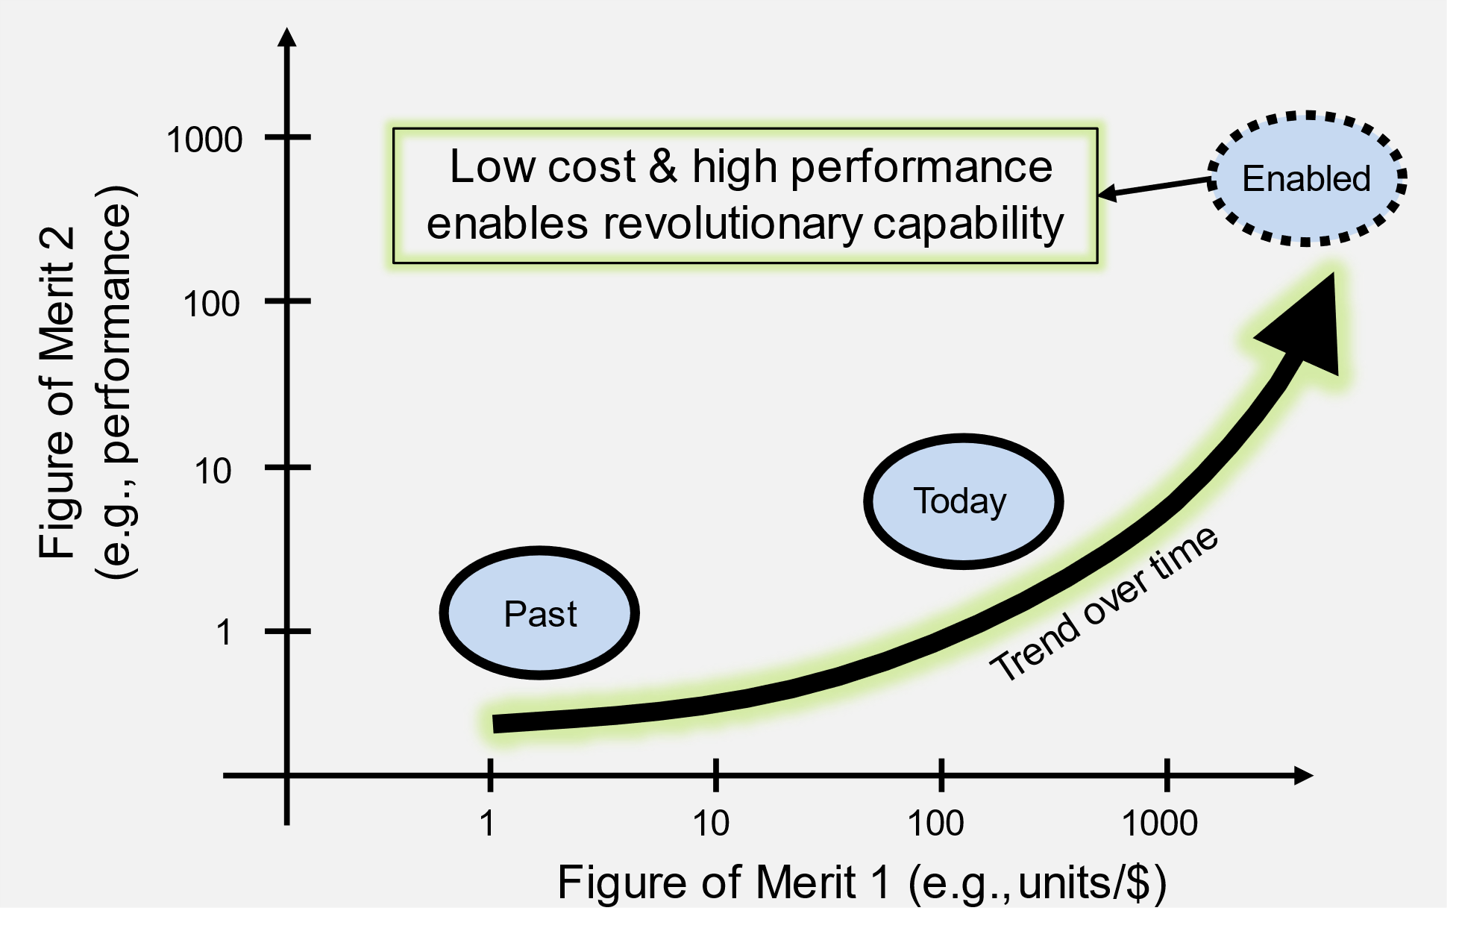
SOLUTION OVERVIEW & DARPA WHITE SPACE CHART
WHAT ARE YOU DOING?
DARPA “WHITE SPACE” CHART
Notional Example (make your own)
Graphic
[Description]
(2-4 sentences)
[Comments: discuss comparison to state of the art]

