Slide 1

PUBLICATION NORMS THROUGH THE TENURE CLOCK
Taylor D. Sparks
materials chemistry | University of Utah
Career year 14, compared against the cohort at career year 6
1,091
6
2008 to 2018
6
people in the cohort
career year both sides are measured
when the cohort started
OpenAlex topics defining the subfield
These numbers describe what a group of people did. They are not a standard, nobody in the cohort agreed to be measured, and no part of this says what any one career should look like.
Generated 2026-08-31 with tenuretrack from OpenAlex data (Priem, Piwowar and Orr, 2022), CC0. | Aggregates only: no cohort member is named anywhere in this deck.

Slide 2
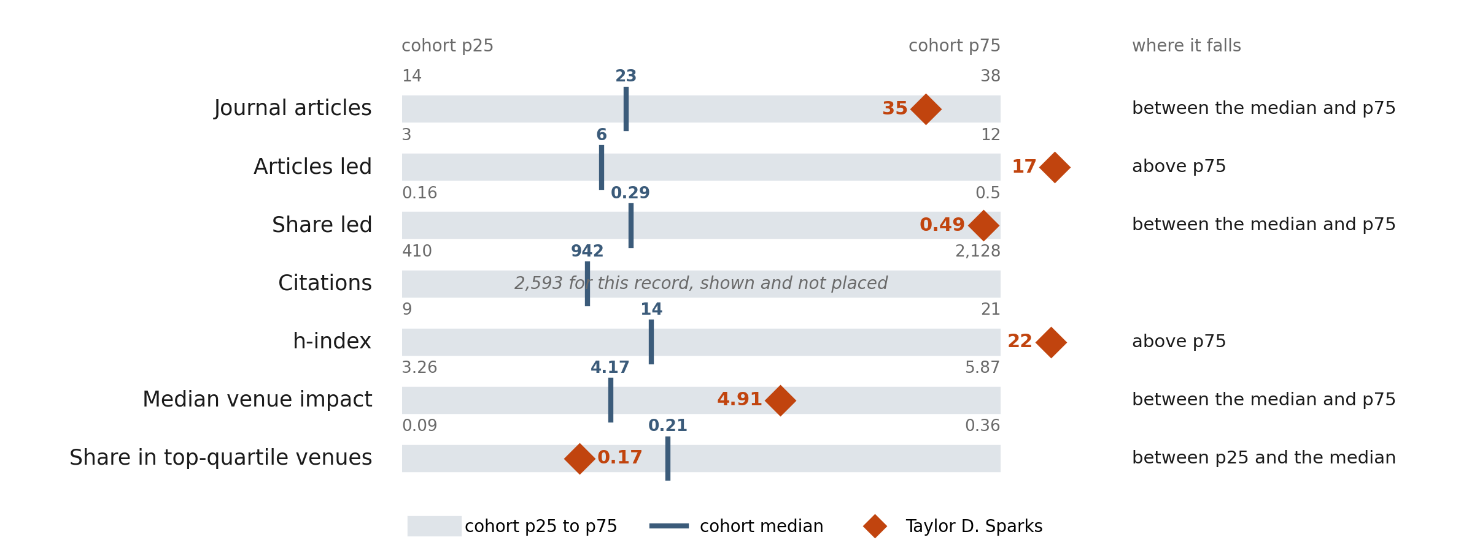
1. AGAINST THE COHORT
Where this record sits at year 6
The shaded band is the middle half of the cohort. Both sides are counted through career year 6.
A value past either end of a band is drawn just outside it rather than to scale. Citations carry a count and no position: the cohort's papers here are eight to eighteen years old and Taylor's are at most 6, so the two counts would measure the calendar.
Taylor D. Sparks | materials chemistry | cohort of 1,091 at career year 6 | aggregates only, and a description rather than a standard
2
Notes:
Subject and cohort are measured at the same career year. A position is a location in a distribution, not a judgement about a career.

Slide 3
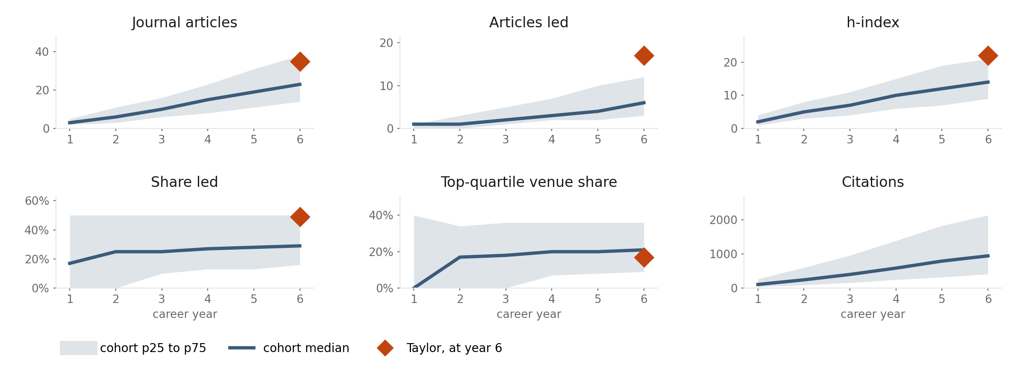
2. ACROSS THE CLOCK
The same cohort, year by year
Each panel counts from the start of the appointment through that career year, so a record earlier on the clock has a year to read against.
Counts are cumulative, so a flat stretch is a year that added little. Citations are counted as they stand today for the papers published by that year, which is why the early years look larger here than they did at the time.
Taylor D. Sparks | materials chemistry | cohort of 1,091 at career year 6 | aggregates only, and a description rather than a standard
3

Slide 4
3. THE COHORT AT YEAR 6
The numbers those bands come from
What 1,091 people had published by the end of career year 6, as quartiles across people.
Measured through year 6 | Lower quarter | Median | Upper quarter
Journal articles | 14 13 to 14 | 23 22 to 25 | 38 36 to 40
Led articles (last or corresponding) | 3 3 to 3 | 6 5 to 6 | 12 11 to 13
Share of articles led | 0.16 0.14 to 0.17 | 0.29 0.27 to 0.31 | 0.50 0.46 to 0.50
Citations to those articles | 410 362 to 448 | 942 853 to 1036 | 2128 1940 to 2394
h-index over those articles | 9 8 to 9 | 14 13 to 15 | 21 20 to 22
Median venue impact | 3.26 3.13 to 3.44 | 4.17 3.97 to 4.33 | 5.87 5.64 to 5.93
Share in top-quartile venues | 0.09 0.08 to 0.11 | 0.21 0.20 to 0.23 | 0.36 0.33 to 0.38
HOW TO READ A ROW
A quarter of the cohort was below the first number.
Half was below the middle one.
A quarter was above the last.
The smaller figures are 95% confidence intervals from a cluster bootstrap that resamples people, not papers, because one person's papers are not independent of each other. A wide interval means the number should be leaned on lightly.
A top-quartile venue is top quartile inside this cohort's own venue list, not against a global journal ranking, because citation rates differ enormously between subfields.
Taylor D. Sparks | materials chemistry | cohort of 1,091 at career year 6 | aggregates only, and a description rather than a standard
4
Notes:
Every figure is a quartile across cohort members. The middle half of the cohort sat between the first and the last column.

Slide 5
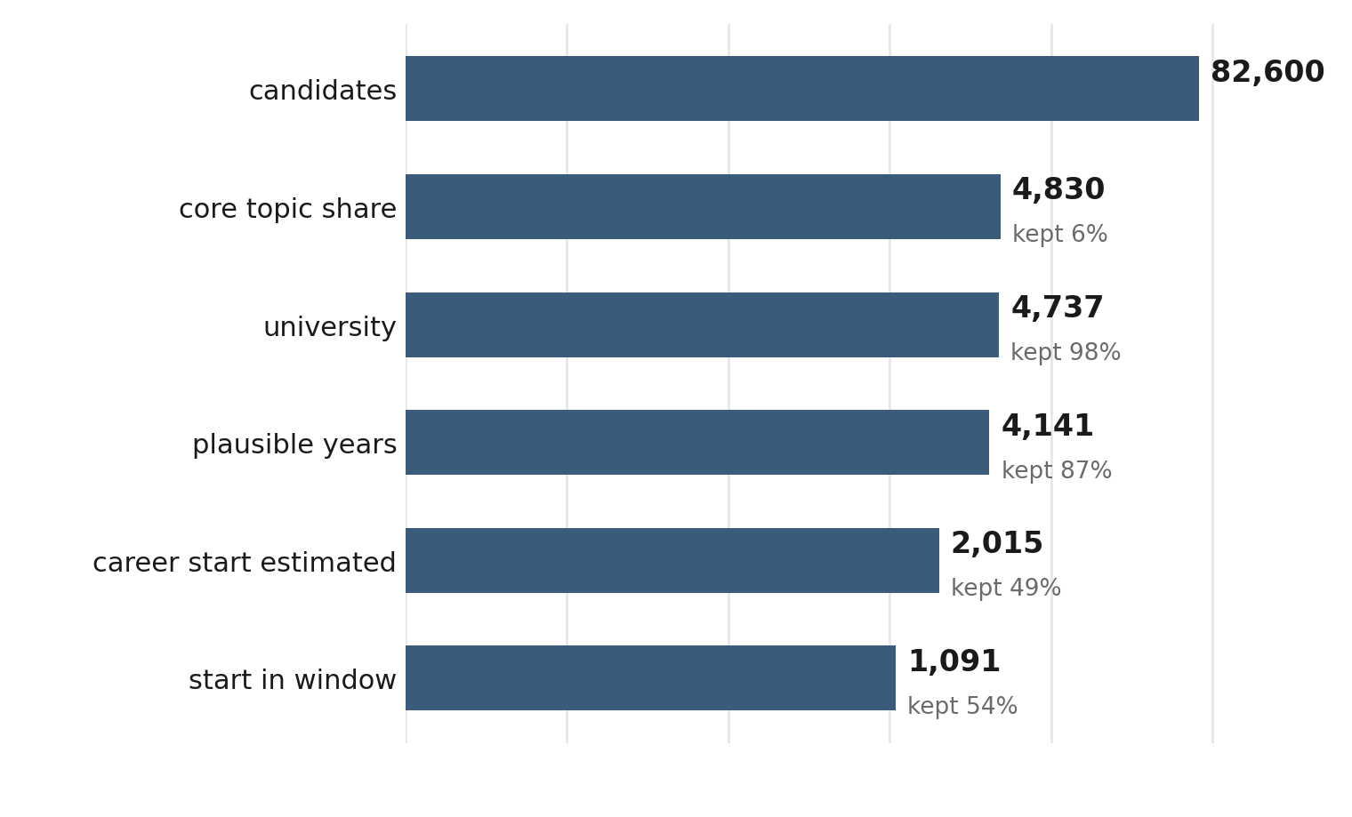
4. HOW IT WAS BUILT
Who ended up in the cohort
The slide to read first when a cohort looks wrong: a step that removes almost everybody, or almost nobody, is the one to question.
THE SUBFIELD, AS DEFINED HERE
Machine Learning in Materials Science
Advanced Thermoelectric Materials and Devices
Topological Materials and Phenomena
Advancements in Battery Materials
Advancements in Solid Oxide Fuel Cells
Bone Tissue Engineering Materials
The cohort is people whose work sits in these topics and whose first independent appointment could be dated confidently from their bylines. It is not everyone in the subfield, and the people it drops are not a random sample of it.
Drawn on a log scale so every step stays visible. The exact rule for each one is in results/funnel.csv and in docs/methods.md.
Taylor D. Sparks | materials chemistry | cohort of 1,091 at career year 6 | aggregates only, and a description rather than a standard
5

Slide 6
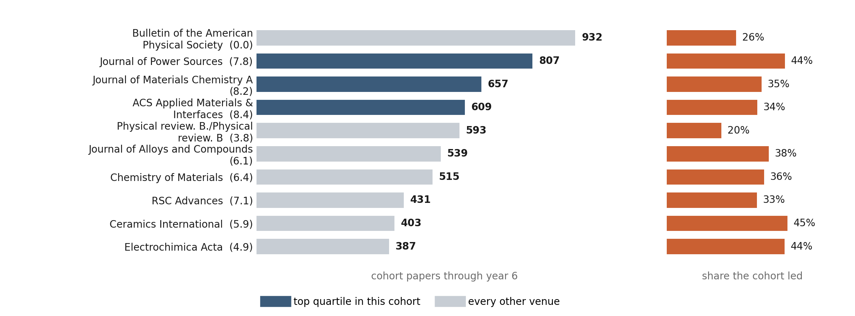
5. THE VENUES
Where this subfield publishes
The journals the cohort used most, so that a top-quartile venue can be checked against titles rather than taken on trust. The right column is how much of that work the cohort led.
The figure in brackets is the journal's 2-year mean citedness, a property of the journal and not of any paper in it. A title near the top of this list with an impact near zero is usually a conference abstract series that OpenAlex types as a journal, counted throughout.
Taylor D. Sparks | materials chemistry | cohort of 1,091 at career year 6 | aggregates only, and a description rather than a standard
6

Slide 7
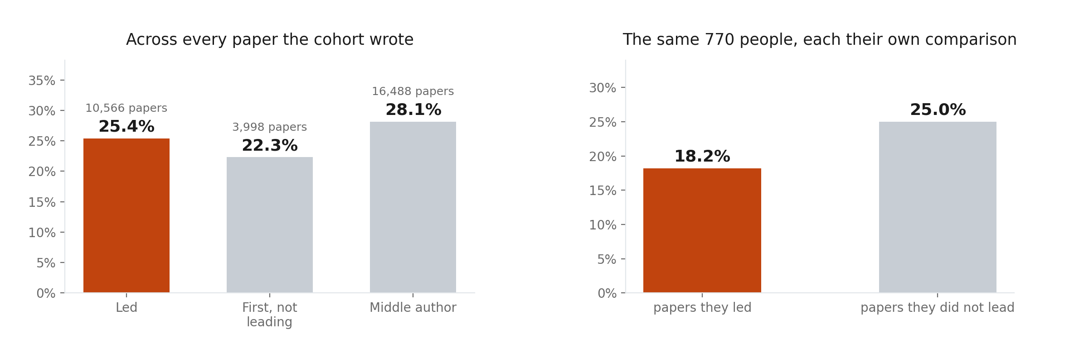
6. THE CHAPERONE EFFECT
Who leads the papers that reach the best venues
Sekara et al. called it the chaperone effect: a route into a selective venue that runs through a senior co-author. Left is dominated by whoever wrote the most papers, and on the right every person is their own control.
Pooled, the cohort's work reached a top-quartile venue 2.8% more often when its members were not leading it (95% confidence interval +0.6% to +5.0%). Where the two readings disagree, that disagreement is the finding.
After Sekara et al., PNAS 2018 (doi 10.1073/pnas.1800471115), which followed authors through time. This is a cross-sectional approximation: the direction of a difference is informative, its size should not be read against their figures.
Taylor D. Sparks | materials chemistry | cohort of 1,091 at career year 6 | aggregates only, and a description rather than a standard
7
Notes:
Led means last author or flagged corresponding. Corresponding flags are missing for many journal-years, so last position carries most of the weight.

Slide 8
LIMITS
What this cannot see
Six things to hold in mind before this deck is used for anything.
A publication record is not a person.
Citations are shown and never placed.
Teaching, mentoring, service, funding, software, datasets and public scholarship do not appear in OpenAlex.
The cohort's papers here are years older, and citations accumulate with time.
Career start is inferred, not looked up.
The missing people are not a random sample.
It comes from publication patterns. Clinical appointments, parental leave and delayed starts are invisible to it.
OpenAlex splits some profiles and merges others, so the cohort tilts toward distinctive names.
Journal impact says nothing about a paper.
This is a description, not an instruction.
Venue quartiles are computed inside this cohort because citation cultures differ between subfields.
A department that reads the median as something everyone must reach has misread it.
The whole method is in docs/methods.md, and every number here is in results/ as CSV. Read the funnel before the quartiles.
Taylor D. Sparks | materials chemistry | cohort of 1,091 at career year 6 | aggregates only, and a description rather than a standard
8

