Slide 1


Application Architecture
Security
Business Components...
Data
Mgmt
Services
Views...
Application Foundation
Base
Toolkit
Shims and
Polyfills
Libraries...
Browser Runtime [HTML, JS, CSS]
O/S and Cordova Bridge

Slide 2
Application Architecture
Security
Business Components...
Data
Mgmt
Services
Views...
Application Foundation
Base
Toolkit
Shims and
Polyfills
Libraries...
Browser Runtime [HTML, JS, CSS]
O/S and Cordova Bridge

Slide 3
Application Architecture
Security
Business Components...
Data
Mgmt
Services
Views...
Application Foundation
Base
Toolkit
Shims and
Polyfills
Libraries...
Browser Runtime [HTML, JS, CSS]
O/S and Cordova Bridge

Slide 4
Application Architecture
Security
Business Components...
Data
Mgmt
Services
Views...
Application Foundation
Base
Toolkit
Shims and
Polyfills
Libraries...
Browser Runtime [HTML, JS, CSS]
O/S and Cordova Bridge

Slide 5
Application Architecture
Security
Business Components...
Data
Mgmt
Services
Views...
Application Foundation
Base
Toolkit
Shims and
Polyfills
Libraries...
Browser Runtime [HTML, JS, CSS]
O/S and Cordova Bridge

Slide 6
Application Foundation
Services / Auth
Cache
Data
Context
Shims and
Polyfills
Libraries...
Application Controller
Logging / Error Handler
Config

Slide 7
Application Architecture
Security
Business Components...
Data
Mgmt
Services
Views...
Application Foundation
Base
Toolkit
Shims and
Polyfills
Libraries...
Browser Runtime [HTML, JS, CSS]
O/S and Cordova Bridge

Slide 8
Application Architecture
Security
Business Components...
Data
Mgmt
Services
Views...
Application Foundation
Base
Toolkit
Shims and
Polyfills
Libraries...
Browser Runtime [HTML, JS, CSS]
O/S and Cordova Bridge

Slide 9
Business Component
Config (opt):
/app/config.json
Constructor Arguments
Subscribed
Topic & Value(s)
Input
Consumes
Template:
./MyMod.html
Processes
app/MyBizComp
Business Component:
Data
Provider
Loads
NLS:
./nls/MyMod*.js
Extends
Published
Topic & Value(s)
app/BizCompBase
./MyMod.css
CSS (opt):
Emits

Slide 10
Application Architecture
Security
Business Components...
Data
Mgmt
Services
Views...
Application Foundation
Base
Toolkit
Shims and
Polyfills
Libraries...
Browser Runtime [HTML, JS, CSS]
O/S and Cordova Bridge

Slide 11
Application Architecture
Security
Business Components...
Data
Mgmt
Services
Views...
Application Foundation
Base
Toolkit
Shims and
Polyfills
Libraries...
Browser Runtime [HTML, JS, CSS]
O/S and Cordova Bridge

Slide 12
Application Architecture
Security
Business Components...
Data
Mgmt
Services
Views...
Application Foundation
Base
Toolkit
Shims and
Polyfills
Libraries...
Browser Runtime [HTML, JS, CSS]
O/S and Cordova Bridge

Slide 13
issw/web/service – Options layering
Final “Options” applied to a service call()
Per call() options passed into request
Service level options defined in config.json
Application options defined in config.json
Precedence
Default options hard coded in module

Slide 14

issw/web/config
<script>
var dojoConfig = {
paths : { "issw" : "/ISSW_Web/issw" },
isswConfig : ["config.json","/remote/config.jsp"]
};
</script>
<script src="/idt190/dojo/dojo.js"></script>;
./config.json
{
“my/settings” : {
“foo” : “bar”
}
}
config.load([
“./config.json”,
“/remote/config.jsp”
]).then(
// continue app loading
);
issw/web/config
1
load()
get()
2
/remote/config.jsp
load() is deprecated in favor of isswConfig
{
“my/settings” : {
“foo” : “baz”
}
}
var cfg = config.get(“my/settings”);
// can now use config members
// cfg.foo == “baz”
doSomething( cfg.foo );
Dynamic response, defined by user, group, or manual setting

Slide 15

issw/web/navigator
issw/mobile/navigator
Config: navigator.json
init( cfg )
{
“Login/Success” : “AccountView”,
“AccountSelected” : {
“module” : “app/accountMgr”,
“function” : “processAccount”
}
}
register( topic, args )
deregister( topic )
“Login/Success”
{id:123, name:”Joe”}
LoginView
topic.publish(“Login/Success”, user);
AccountView
var user = this.getMessage();

Slide 16


Exposes
“Navigable”
Action
Action event matches
Transition Request To View B
Authentication
and Authorization
check
Navigator
Read Metadata for View B
View B
Metadata
View A
Config
Load and Instantiate View B
Loader
View B
Transition to View B with Message
Navigator
Application Controller

Slide 17

AccountList View
AccountList
bijit
AccountDetail View
Remote Server
Publishes
“AccountSelected”
[AcctId payload]
AccountDetail
bijit
Account Details
service
AccountHistory
bijit
Account History
service
Transition to
AccountDetail view
Navigator

Slide 18
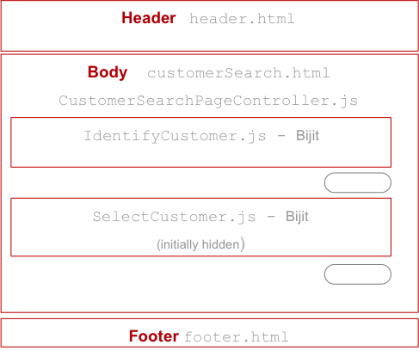

Customer Search Use Case
User: John Smith Help
IBM Service | Products | News | Tools
Customer Search
Client Tax Id
User Access Customer Search
E.g. ./cutomerSearch.html
Browser trigger page request
./customerSearch.html
Web Server delivers content
within StaffApplicationController
Server returns HTML5 page layout
Body customerSearch.html
Page Controller initialize bijits … page is rendered
bijit templates:
IdentifyCustomer.html,
SelectCustomer.html
Account Id
4
Search
Action Bar/ Footer
1
3
JSON / HTTP
HTML / HTTP
Web Server
Application Server
2
Web Resources
Channel Services Gateway
JSON / HTTP
Application Server
Channel Data Services
SOAP / HTTP
App Server / ESB / Main frame
Business Services
MQ

Slide 19
Customer Search Use Case
User: John Smith Help
IBM Service | Products | News | Tools
User Submits Customer Search
E.g. ./cutomerSearch.html
CustomerSearchPageController process search click
- get values from IdentifyCustomer bijit
- IdentifyCustomer bijit validates input and returns filter data
- Page controller passes filter data to SelectCustomer bijit
SelectCustomer bijit invokes search svc
- Passes the filter data received from page controller to search svc
Gateway authenticates the request
- Gateway also adds channel context when sends request to Channel Svc. E.g. channel context: user id, user roles
Channel Svc (IdentifyCustomerService) process the request
customer-svc/searchCustomers
- Check service level entitlement
Business Svc Process the request
- Calls service(s) in fulfilment systems
- May orchestrate a few call to fulfilment systems
Channel Svc applies data entitlements
- Data received from business services may be filtered/masked based on data entitlement
Results are processed by SelectCustomer bijit
- Bijit calls Page controller with received data, where Page controller navigates to next step if only one result row is received
- Bijit renders the list of customers
Customer Search
Client Id
Account Id
123-456
Search Results
Search
1
O | John Smith | 123-456
O | Joane Doe | 234-567
O | Peter Andrews | 345-789
2
7
Select
Ction Footers
HTML / HTTP
JSON / HTTP
Web Server
Application Server
Web Resources
3
Channel Services Gateway
JSON / HTTP
Application Server
4
Channel Data Services
6
SOAP / HTTP
App Server / Main frame
5
Business Services

Slide 20
User: John Smith Help
IBM Service | Products | News | Tools
CustomerSearch
topic
Customer Search
7
Client Tax Id
Account Id
123-456
6
5
CustomerSearchPageController
3
Search
4
Action Bar/ Footer
1
2
HTML / HTTP
Web Server
Web Resources

Slide 21
issw/web/config
./config.json
{
“my/settings” : {
“foo” : “bar”
},
“issw.web.logger” : {
“error” : {
“sendToHost” : true
}
}
}
issw/web/config
config.load([
“./config.json”,
“/remote/config.json”
]).then(
// continue app loading
);
load()
get()
/remote/config.json
{
“my/settings” : {
“foo” : “baz”
}
}
this.config = config.get(“my/settings”);
// can now use config members
// this.config.foo == “baz”
doSomething( this.config.foo );

Slide 22
User: John Smith Help
IBM Service | Products | News | Tools
CustomerSearch
topic
Customer Search
Client Tax Id
Account Id
123-456
1
CustomerSearchPageController
Search
Customer Select
3
O | John Smith | 123-456
O | Joane Doe | 234-567
O | Peter Andrews | 345-789
2
CustomerSelect
topic
5
Select
6
Action Bar/ Footer
4
JSON / HTTP
Application Server
Channel Services Gateway

Slide 23


Unit Test Suite
Application
Unit Test
Bijit
Bijit
Unit Test
Unit Test
Unit Test
Bijit
Bijit
Bijit
Test Spike
Bijit
Bijit
Bijit

Slide 24
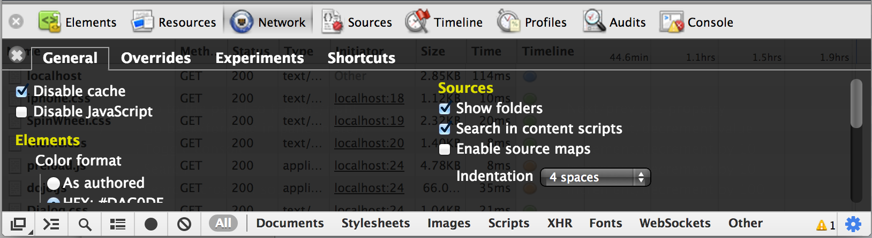

Slide 25
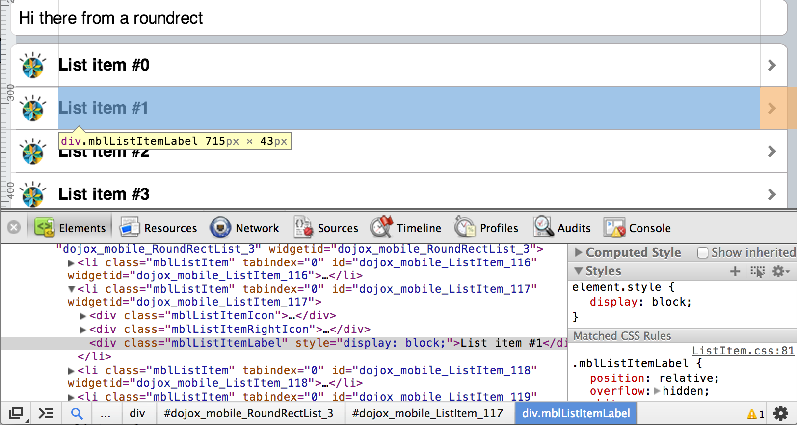
2
1
3

Slide 26
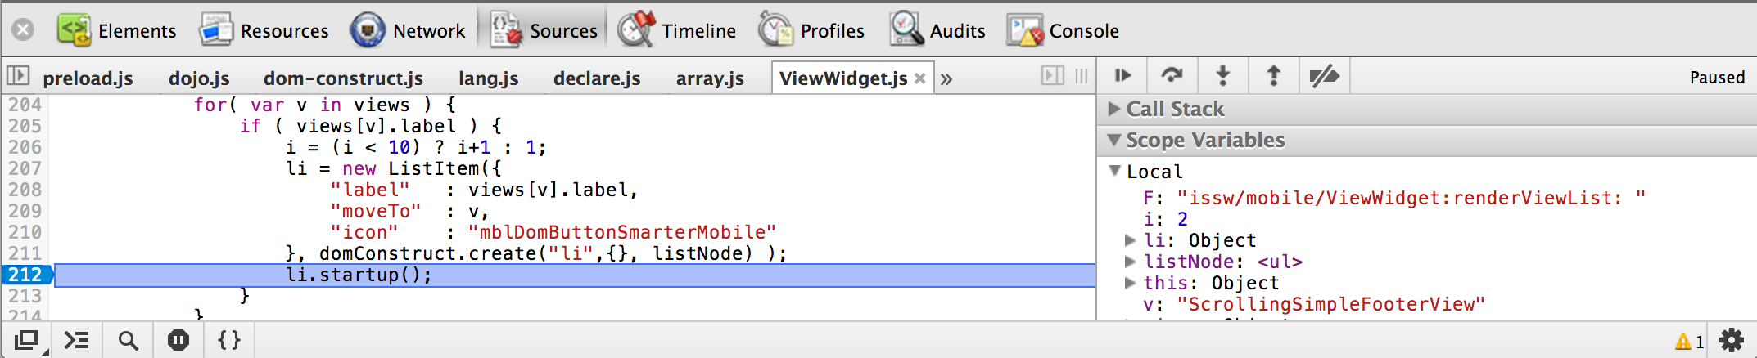
File selector
Current file
Stepper buttons
Break on Error
File selector

Slide 27
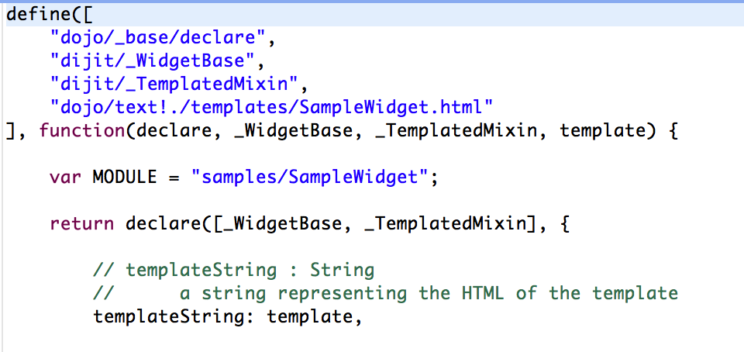
1
2
3
4
1
2
3
4

