Slide 1


Unit Test Suite
Application
Unit Test
BizComp
BizComp
Unit Test
Unit Test
Unit Test
BizComp
BizComp
BizComp
Test Spike
Test
BizComp
BizComp
BizComp

Slide 2
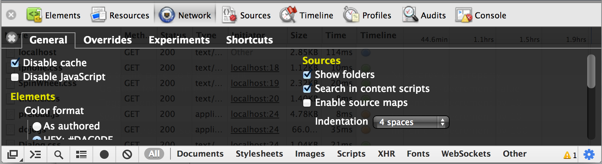

Slide 3
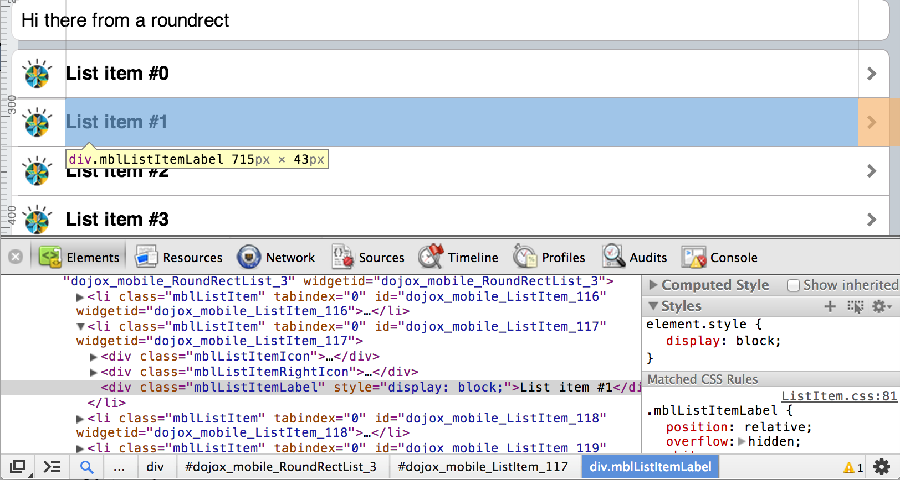
2
1
3

Slide 4
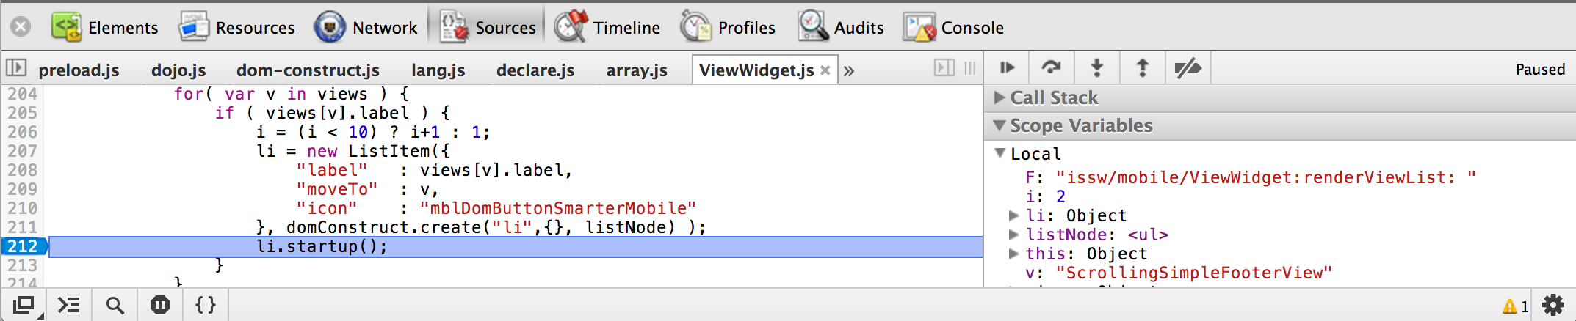
File selector
Current file
Stepper buttons
Break on Error
File selector

Slide 5
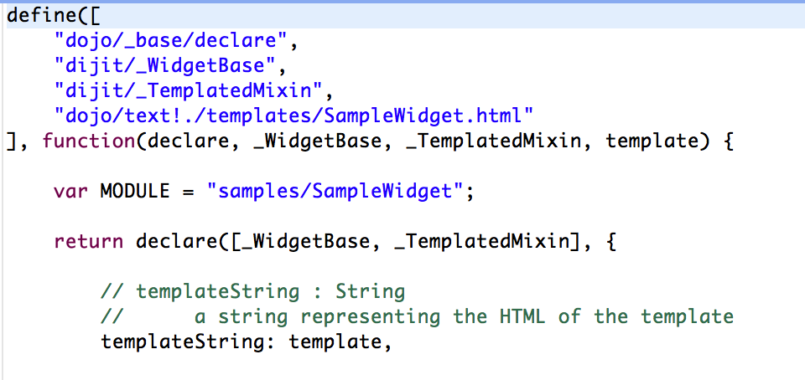
1
2
3
4
1
2
3
4

