Slide 1
Lucene: Search You Can Believe In
Michael C. Neel MVP
michael.neel@gmail.com
http://www.vinull.com

Slide 2
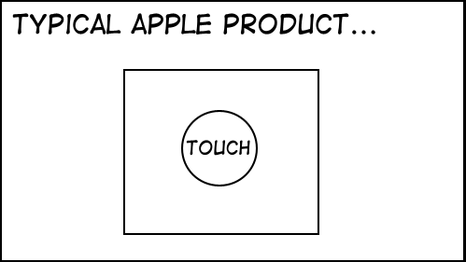

Slide 3
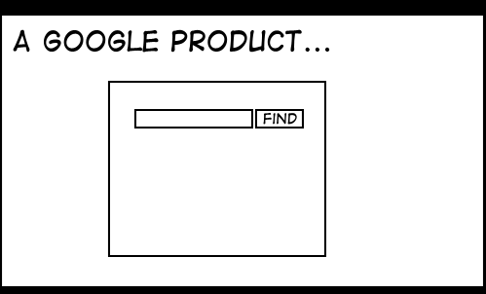

Slide 4
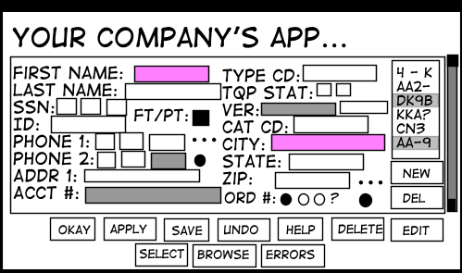
StuffThatHappens.com Eric Burke

Slide 5
Lucene

Slide 6
Where to get it:
http://incubator.apache.org/lucene.net/
http://lucene.apache.org/

