Slide 1
Lucene: Search You Can Believe In
Michael C. Neel MVP
michael.neel@gmail.com
http://www.vinull.com

Slide 2


June 26th – 27th 2009
Knoxville, TN
Regional Speakers / Open Spaces
.NET, Java, Ruby, Erlang, more
Call for speakers – March 31
3 & 6 hour sessions on Friday
1 hour sessions on Saturday
http://CodeStock.org
http://twitter.com/CodeStock

Slide 3
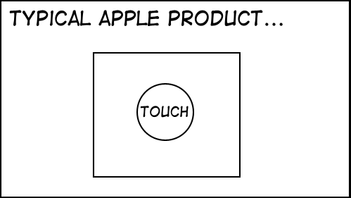

Slide 4
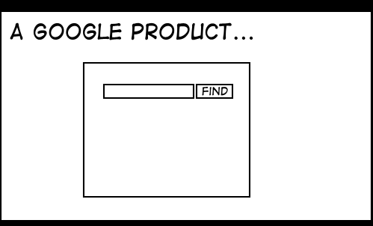

Slide 5
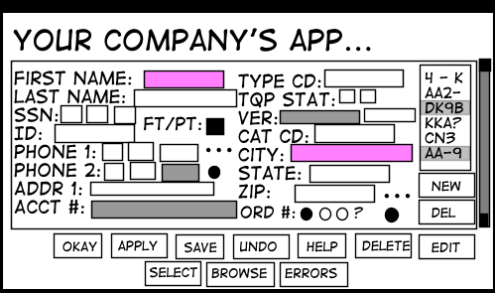
StuffThatHappens.com Eric Burke

Slide 6
Lucene

Slide 7
Where to get it:
http://incubator.apache.org/lucene.net/
http://lucene.apache.org/

