Slide 1
Zen and the
Art of Website
Maintenance
Michael C. Neel
michael.neel@gmail.com
http://www.vinull.com

Slide 2


Zen?

Slide 3
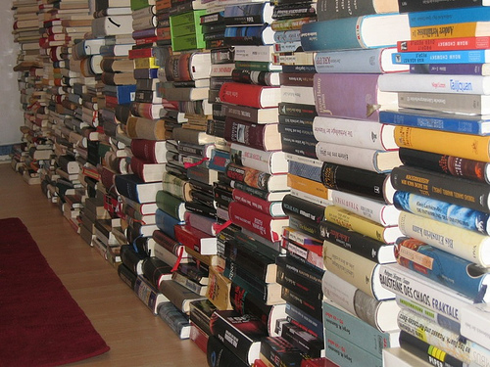
Rules for Zen
Use The Framework

Slide 4

Rules for Zen
Use The Keyboard

Slide 5
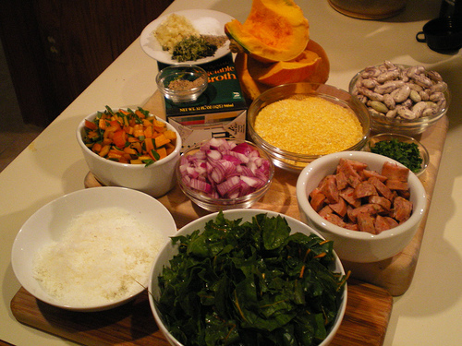
Rules for Zen
Mise en place

Slide 6
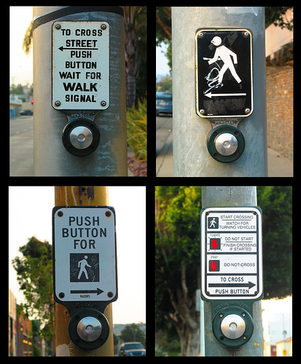
Rules for Zen
Know Thy Language

Slide 7

Rules for Zen
Watch All, Hide None

Slide 8
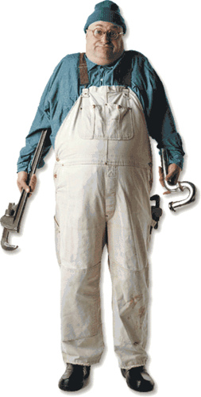
Rules for Zen - Goal
Less time
Plumbing
More time
Building

Slide 9
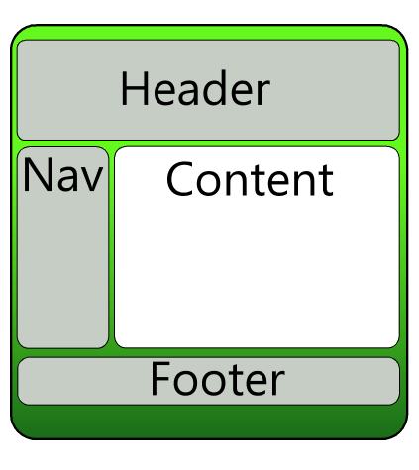
Solid Foundation
Master
Pages

Slide 10
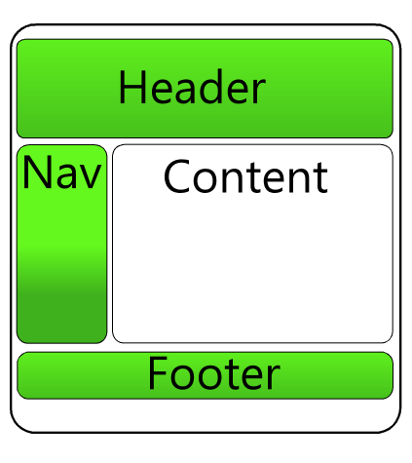
Solid Foundation
User
Controls

Slide 11
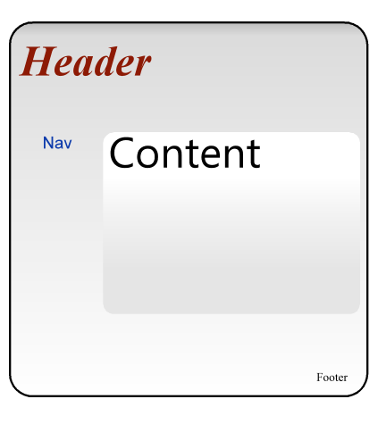
Solid Foundation
Themes

Slide 12
Provider Model
Membership Provider – Account Management
Role Provider – Permissions Management
Site Map Provider – Site Navigation
Session Provider – Session Storage
Profile Provider – User Data
Web Event Provider – Health Monitoring
Web Parts Personalization Provider Advanced User Preferences

Slide 14
Data Layer
Support ObjectDataSource
DataSet Designer / TableAdapters
Extending TableAdapters
Smart Custom Objects

Slide 15
ObjectDataSource
Works with all data-view controls
GridView / DataGrid (ListView) / Repeater
DetailsView / FormView
Supports Multiple Caching Options
Encourages Good Design
Handles Paging (ICollection)
Filtering (DataSet / DataTable)

Slide 16
DataSet Designer
It’s not evil
Rapidly handle the Data Layer CRUD
Immediate Testing
High Visibility
Single Spot for Database Connections

Slide 17
Extending TableAdapters
TableAdapters are partial classes
XML Schema Definition Tool (Xsd.exe)
Expose and share Connection Objects
Direct Access Command Objects
Use without DataTables and DataSets

Slide 18
Example

Slide 19
SOA in 60 Seconds
No Overloading
Custom, Simple Objects
Use a DLL project
Version Deployments
Avoid Session and Profiles
Use IIS / Application authentication with an option for “API Keys”

Slide 20
SOA with ASMX
ASMX Can Support
WSDL / SOAP
JSON and XML
Simple POST
Simple GET (REST)
Dynamic Responses (Yes, this breaks some rules)
All of these at once!

Slide 21
Example

Slide 22
Performance
Measure, don’t guess
Tracing
Profiling
IIS Logs

Slide 23
Monitoring
Email Errors
Global.asax
Monitoring Provider

Slide 24
Example

Slide 25
DYHAQFM?
Michael C. Neel
michael.neel@gmail.com
http://ViNull.Com

