Slide 1

Lucene: Search You Can Believe In
Michael C. Neel MVP

Slide 2




FuncWorks, LLC.
Feel The Func Podcast
FeelTheFunc.com
@ViNull
michael.neel@gmail.com
www.vinull.com

Slide 3






Slide 4
Lucene.Net - Where to get it:
http://incubator.apache.org/lucene.net/
http://lucene.apache.org/
“ Lucene.Net is a source code, class-per-class, API-per-API and algorithmatic port of the Java Lucene search engine to the C# and .NET ”

Slide 5

There are no failing tests or known bugs. Just Bureaucracy.
Işık YİĞİT (DIGY)
Notes:
http://www.flickr.com/photos/macieklew/415909370/

Slide 6



Slide 7

Why Lucene?
Notes:
http://www.flickr.com/photos/oberazzi/318947873/

Slide 8
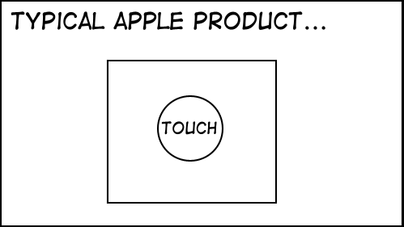

Slide 9
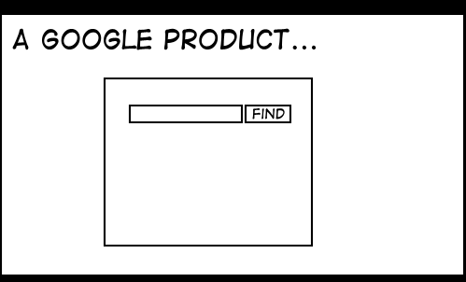

Slide 10
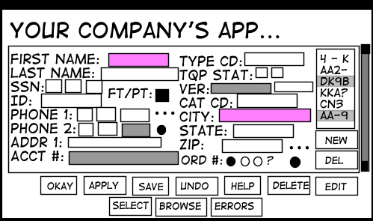
StuffThatHappens.com Eric Burke

Slide 11
Lucene

Slide 12
Lucene Search Examples
Red bike
“Red bike”
Red OR Blue bike (also AND)
(red OR blue) bike
Red -blue bike (also NOT, !)
Red +bike
color: red product: bike

Slide 13
Lucene Advanced Search Examples
Wildcard
Re*
Bl?e
Fuzzy
Red~
Red~0.8
Proximity
“red bike”~10
Range
Pubdate: [20090501 TO 20090531]
Author: {McClure TO Petzold}
Term Weight
Red Bike^4
Red^0.2 Bike
Escaping - \

Slide 14
Lucene Gotchas
Lucene Only Searches TEXT!
Encode dates / numbers in a text format
May 31, 2009 : 20090531
99.95 : 00000099.95
Lucene Index Writing is I/O intensive
Turn off OS level search
Turn off Virus scanners
Lucene is a Search Engine, not a Database!
You can sort with Lucene – but WHY?!?

Slide 15
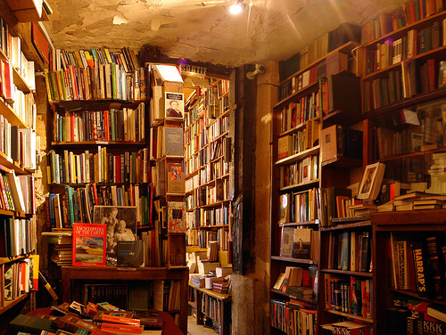
Using Lucene
Notes:
http://www.flickr.com/photos/gadl/110845690/

Slide 16
Lucene Structure
Store
Index
Document
Field
Content
Not a DATABASE!

Slide 17

Field Questions?
To STORE or not to STORE?
To TOKENIZE or not to TOKENIZE?
To INDEX or not to INDEX?

Slide 18
Field Answers*
TOKENIZE, do not STORE content
Do not TOKENIZE, but STORE document keys
Do not INDEX, but STORE short descriptions
Do not TOKENIZE numbers, dates, or other formatted data like phone numbers (normally)
Do not STORE any data that isn’t shown on a search results view
* This slide contains opinions of Michael C. Neel, and does not represent or is endorsed by the Apache Software Foundation, Lucene Project, or the National Football League. Any use of this slide without the NFL’s express, written consent is prohibited.

Slide 19

Legal Documents
Do not need to contain the same Fields (in fact, this is very common and useful)
Cannot be updated – delete and add
Returned from searches
Notes:
http://www.flickr.com/photos/alaskanlibrarian/198050336/

Slide 20
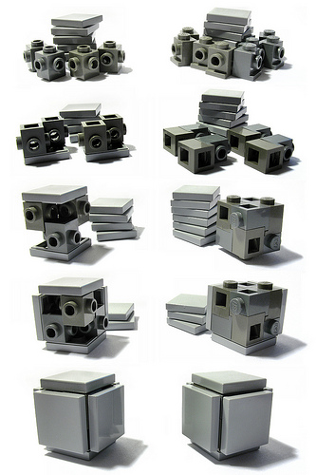
More than one way to Index
IndexWriter
IndexReader
IndexModifer Set Analyzer Use Optimize() Always Close() Reload for Changes
IndexSearcher
Notes:
http://www.flickr.com/photos/donsolo/3706017309/

Slide 21
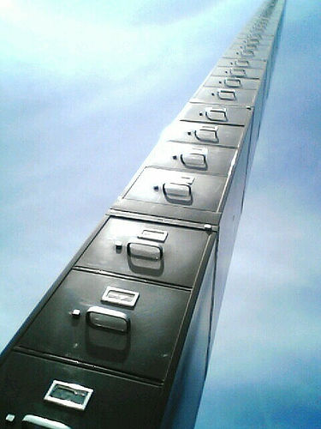
Store it somewhere
FSDirectory
RAMDirectory
Your Own Store
SQL Database
Memcached
Velocity
Notes:
http://www.flickr.com/photos/curiousyellow/11868876/

Slide 22
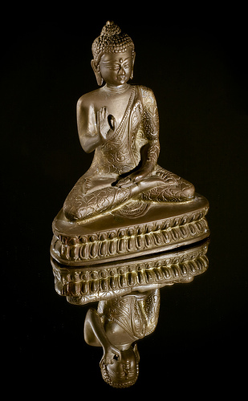
Searching
IndexSearcher
QueryParser
Set Analyzer (same as Index)
Parse / Use Terms
Index.Search()
QueryParser
Sort
Filter
Iteration over Hits
Hits.Doc(i)
Notes:
http://www.flickr.com/photos/nickwheeleroz/2166124358/

Slide 23

Lucene.Net Example
Code and Slides available at:
vinull.com/code
Notes:
http://www.flickr.com/photos/visualarts/2317632657/

