Slide 1

Finding your Customer DNA
Michael C. Neel
ViNull.com
michael.neel@gmail.com

Slide 2
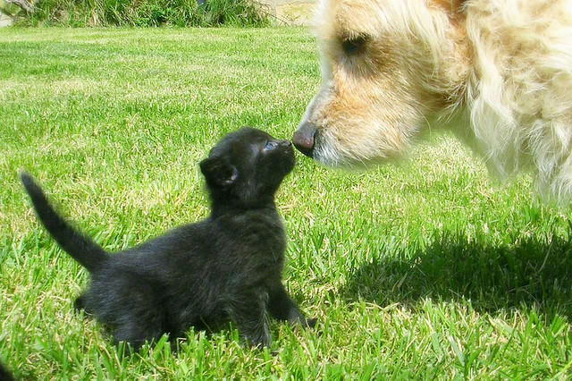
Notes:
http://www.flickr.com/photos/fazen/9079179/

Slide 3


Notes:
http://www.flickr.com/photos/83532250@N06/7650804342/
http://www.flickr.com/photos/inlinguamanchester/5036313154/

Slide 4
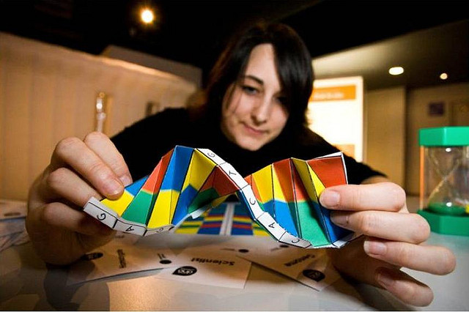
Notes:
http://www.flickr.com/photos/dullhunk/4422952742/

Slide 5
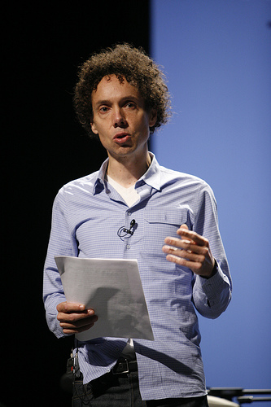
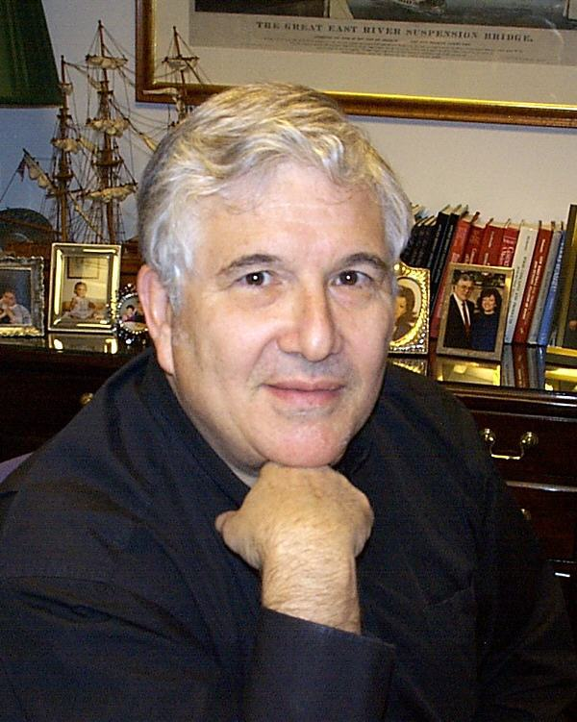

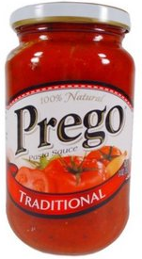
Malcolm Gladwell: TED Talk Choice, happiness and spaghetti sauce
Dr. Howard Moskowitz
Notes:
http://www.flickr.com/photos/poptech2006/2967350188/

Slide 6
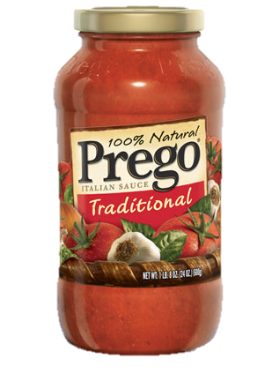
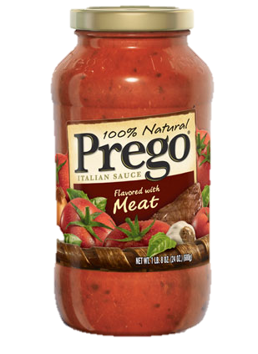
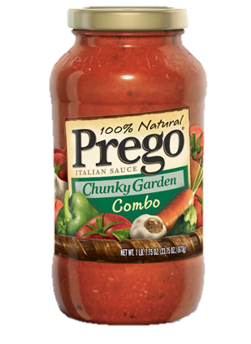
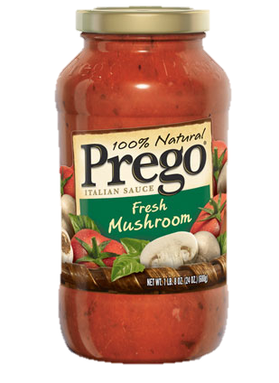
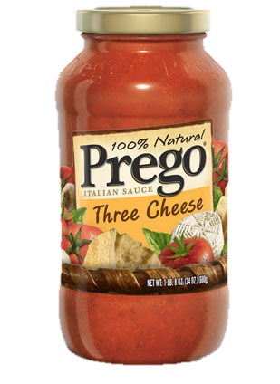

Slide 7
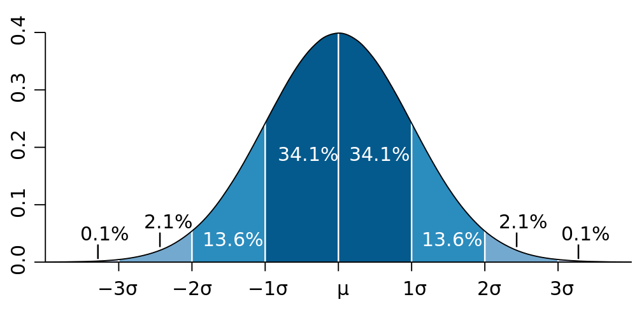

Slide 8

Notes:
http://www.flickr.com/photos/rakka/123380632/

