Slide 1

Dependency Injection:
Way of the Ninja
Michael C. Neel
michael.neel@gmail.com
http://www.vinull.com
http://code.google.com/p/vinull

Slide 2
Dependency Injection (DI) in computer programming refers to the process of supplying an external dependency to a software component. It is a specific form of inversion of control where the concern being inverted is the process of obtaining the needed dependency.
-- http://en.wikipedia.org/wiki/Dependency_injection

Slide 3

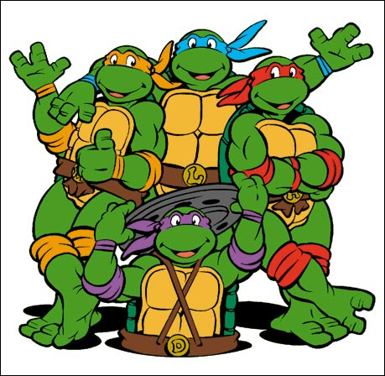
Dependency Injection

Slide 4
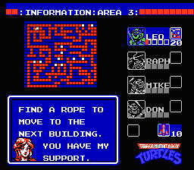
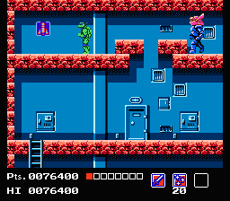
Dependency Injection

Slide 5
Why?

Slide 6

Testability
Notes:
http://flickr.com/photos/cristic/359572656/

Slide 7
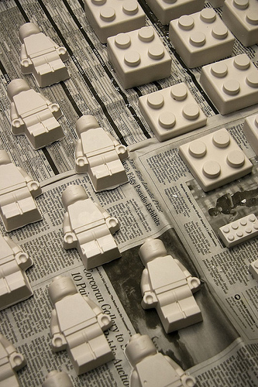
Loose Coupling
Notes:
http://flickr.com/photos/tracyleephoto/2925320390/

Slide 8

Highly Cohesive
Notes:
http://flickr.com/photos/margolove/1810357551/

Slide 9


Code Reuse
Notes:
http://flickr.com/photos/nickwheeleroz/2295584401/
http://flickr.com/photos/spiritual_marketplace/2207966935/

Slide 10
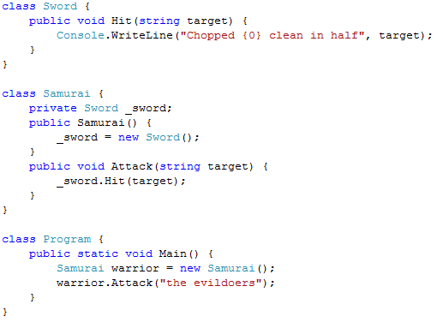

Notes:
http://flickr.com/photos/drurydrama/1942011908/

Slide 11
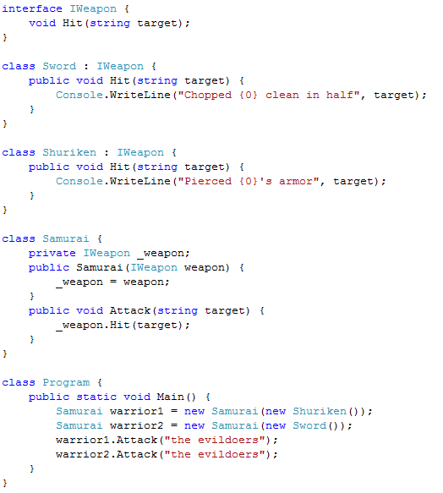
Notes:
http://flickr.com/photos/drurydrama/1942011908/

Slide 12
DYHAQFM?
Photo Credits (flickr usernames): drurydrama, nickwheeleroz, spiritual_marketplace, margolove, tracyleephoto, cristic, and Mirage Studios USA
Michael C. Neel
michael.neel@gmail.com
http://www.vinull.com
http://code.google.com/p/vinull

