Slide 1
Admin Items

Slide 2
jQuery $(Begins)

Slide 3
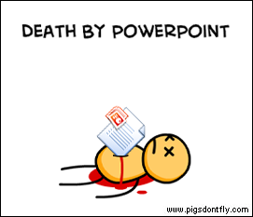
Not the Way to Learn Coding

Slide 4
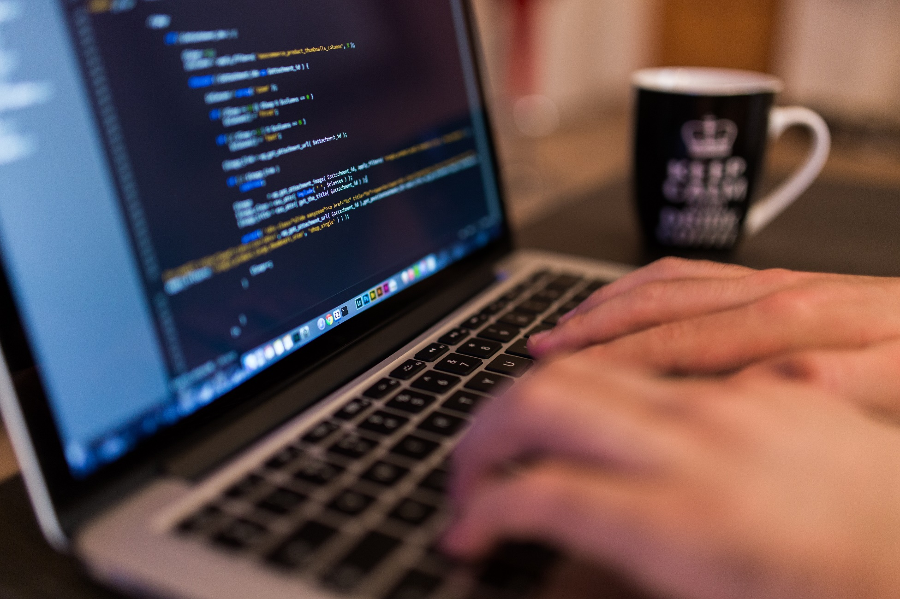
True Way to Learn Coding

Slide 5
A New Era of Class
Be prepared to have classes that are increasingly “just code”
You will appreciate it in the long-run

Slide 6
Today’s Class

Slide 7
Objectives
In today’s class we’ll be covering:
DOM Manipulation using Plain Javascript
DOM Manipulation using jQuery
Responding to click events

Slide 8
DOM Manipulation

Slide 9
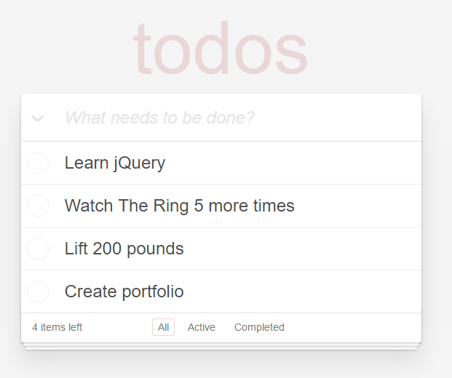
Understanding the “DOM”
Every HTML page begins as static content..
However, with Javascript / jQuery we can “modify the DOM” and change this static content in real-time.
This allows us to build dynamic sites.
Basic Example: http://todomvc.com/examples/jquery/#/all

Slide 10
Demo Time
Instructor: Demo
(1-5.html | 1-DOM_Manipulation)

Slide 11
> YOUR TURN!!
Activity: 2-JSDrinkList | Suggested Time: 15 min
Code Creation: Generating HTML with Javascript
Using the file sent to you as a starting point, add the missing code such that your Javascript generates HTML content that displays all of the drink options.
HINT: You will need a for-loop. Inside your for loop you will need to use each of the following methods: createElement, innerHTML, and appendChild.

Slide 12
Intro to jQuery

Slide 13
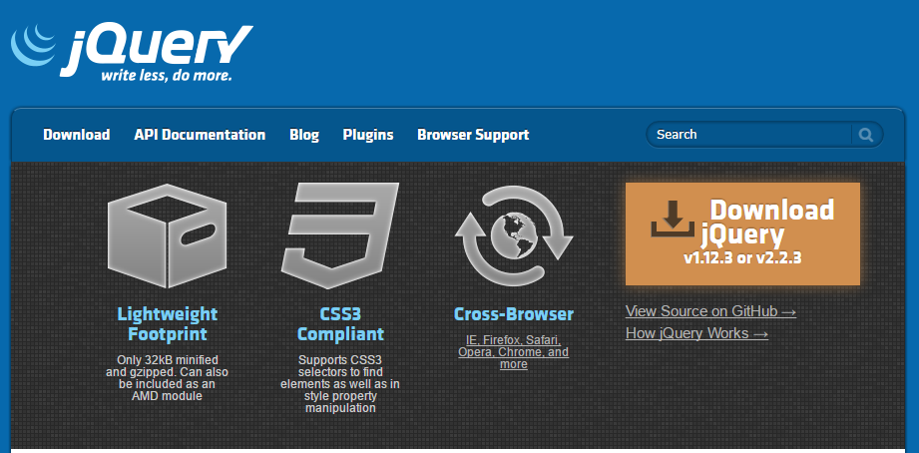
Intro to jQuery
https://jquery.com/
jQuery is a cross-platform Javascript library for easier of client-side HTML scripting.

Slide 14

jQuery Helper Library
jQuery can be useful for tasks like:
Dynamically Inserting, Updating, or Removing HTML
Registering click or other change events
Animating HTML elements
Download data from databases
And much more!

Slide 15


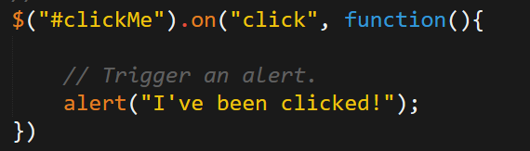
Working with jQuery generally involves…
1. Including a CDN Link to the jQuery script…
2. Utilizing the jQuery specific ($) selector…
3. Then applying jQuery methods on the selected elements.

Slide 16
Demo Time
Instructor: Demo
(1-3.html | 3-jQueryGenerators)

Slide 17
> YOUR TURN!!
Activity: 4-jQueryDrinkList | Suggested Time: 12 min
Code Creation: Generating HTML with jQuery
Re-factor (re-write) your previous drinkList code from earlier, but this time use jQuery to complete all of the same tasks.
Your final code should NOT have any of the following methods: createElement, innerHTML, or appendChild.
HINT: Don’t forget to “incorporate” jQuery before you begin.
BONUS: Instead of using a `for` loop try searching about the use of the jQuery `.each` method.

Slide 18
Demo Time
Instructor: Demo
(OnClick.html | 5-OnClickBasic)

Slide 19
> YOUR TURN!!
Activity: 6-SandwichClick | Suggested Time: 20 min
Code Creation: Click Events with jQuery
Add in the missing code such that clicking any of the sandwiches causes…
An alert message to popup saying something snarky about the sandwich type.
A second alert message that displays to the user the number of that specific sandwich they’ve eaten.
HINT: You will need counter variables.
BONUS: Add an image to the `image-div` on the click event.

Slide 20
jQuery Recap

Slide 21

jQuery – In a Nutshell
Find some HTML.
Attach to an event.
Do something in response.

Slide 22
jQuery – In a Nutshell
We use the jQuery $( ) identifier to capture HTML elements.
$(“.classname”)
$(“elementname”)
$(“#idname”)
$(“etc”)
Then we tie the element to a jQuery method of our choosing to capture events and change that element (or a different element)
.on(“click”)
.ready( )
Finally, we tie the element to a jQuery method of our choosing to capture events and change that element (or a different element)
.append( )
.animate( )
.etc()

Slide 23
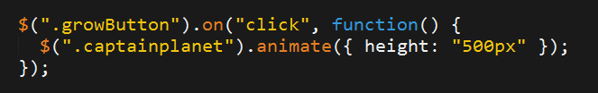
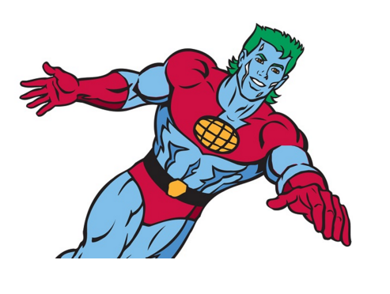
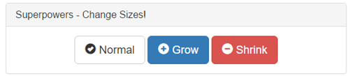
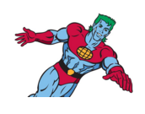
jQuery – Common Example
1. Click the Grow Button
2. Make Captain Planet Grow

Slide 24
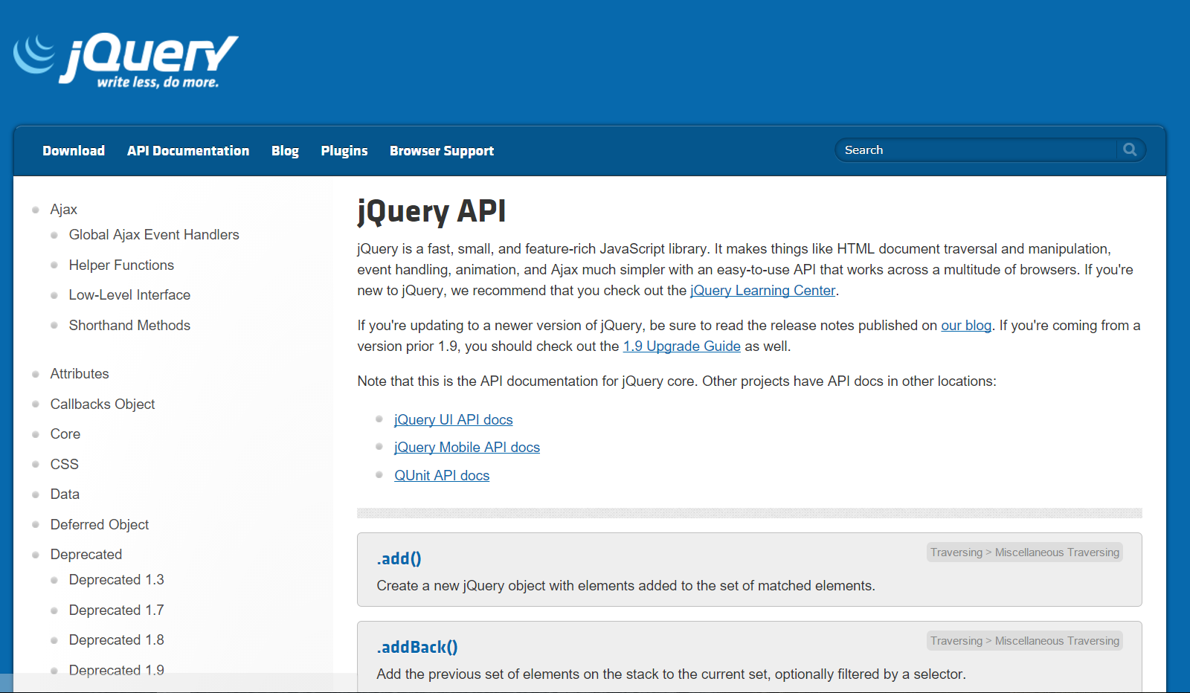
Use Documentation When Needed!

Slide 25
Questions?

