Slide 1


L^{A}T_{E}X: Your friend in typesetting
“Because writing should be more like programming.”
Dr. Mike Liemohn, U of Michigan, sarcastic but correct.
Prof. Dan Welling – UTA Physics
@spacecataz1663
www.twitch.tv/spacecataz1663
blog.uta.edu/wellingdt/

Slide 2
Everything About Today
Today’s Goal: Give you a flavor for what LATEX is and how it works.
Play along at home: Create an Overleaf.com account now and start a new document.
The complete example document & source code: https://www.overleaf.com/read/bjndmxtycrbx
This tutorial, PPTX file, and lots lots more: https://github.com/spacecataz/sciprog_teaching
This is an in-progress repository!

Slide 3
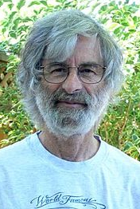
What is L^{A}T_{E}X (LAH-tehk)?
“Lamport Tex”, an extension of the Tex typesetting language.
Created by Leslie Lamport.
A markup language, along the same vein as HTML, XML, etc.
Modern (albeit less used) alternatives include reStructuredText and Markdown (you should know markdown!).
A Human
Koala.

Slide 4
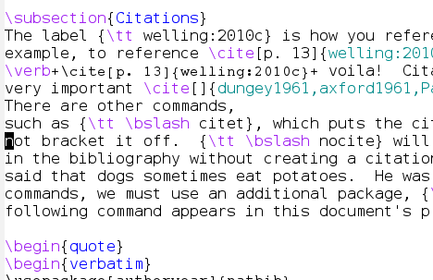
How does it work?
Get a LATEX interpreter
Use package manager (look for texlive packages) or grab click-to-install.
Use preferred editor to create source file containing text & markup.
Emacs, Vi, VSCode, wordpad, whatever.
Dedicated editors available, such as TexShop.
Overleaf.com provides an online, WYSIWYG-style collaborative LATEX. Check it out!

Slide 5
How does it work?
Run the interpreter on your source file.
latex source.tex ~or~ pdflatex source.tex
Dedicated editors may have TeX engine internally; some auto-compile.
Multiple runs over same file often required.
View resulting output and enjoy.
Call to latex results in “dvi” file.
Call to pdflatex results in pdf directly.

Slide 6
Plenty of Good WYSIWYGs
TeXshop: OSX LaTeX IDE editor.
Very popular; can be installed via MacPorts.
TeXStudio: Windows IDE editor.
Visual Studio Code + Latex Workshop + WSL?
Overleaf: Web-based editor.
Collaborative tool. Git and Mendeley integration. growing in popularity.
https://en.wikipedia.org/wiki/Comparison_of_TeX_editors

Slide 7
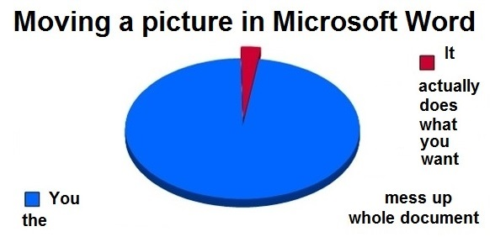
Why would I do this?
Complete control over layout & positioning.
Is the standard for typesetting math symbols.
Python-Matplotlib, MS Word, Google Docs, etc. all use L^{A}T_{E}X math formatting syntax. Try it!
Powerful, automated bibliography construction.
BibTeX is now a standard bib format.
Widely used & accepted.
Scientific manuscripts, theses, etc.

Slide 8
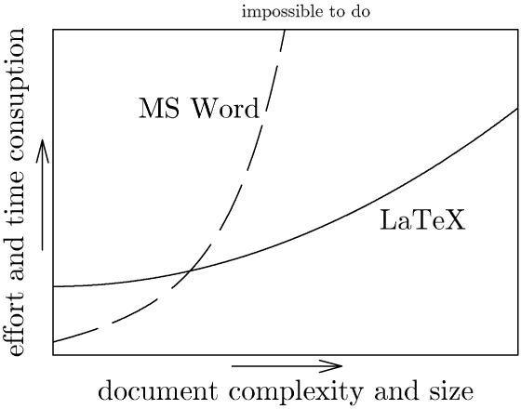
It is often worth the effort.

Slide 9
Why wouldn’t I do this?
Time constraints.
Fast turnaround? No buffer to debug/proof? Use Word.
Team constraints.
Inhomogeneous teams (experience, knowledge, capability, etc.) require the tool with the widest accessibility.
If you’re leading a project, be willing to be flexible!
Tracking changes & organizing feedback a priority
Possible in L^{A}T_{E}X but often cumbersome for teams.
Overleaf.com circumvents many of these issues!

Slide 10
Tips Going Forward
Look for a template!
Most scientific publications supply templates that match their style specifications & save you all the work.
Search the web for templates that you can customize.
Three letters to victory: G.D.S.
Broad L^{A}T_{E}X acceptance means solutions are on the web.
Start building your BibTex library NOW.
Use a tool like Mendeley to automate this task.
It’s more than just papers.
Presentations, posters, and more!
Embrace the command line. It is your destiny.
Integrate with Make, Python, BASH. Automate your workflow.

