Slide 1
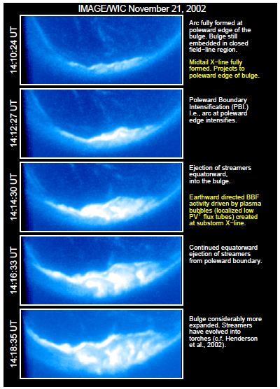
What’s a “substorm”?
Began with observations of fast, nightside-localized aurora.
Named after hypothesis that space weather storm is made of many substorms (nope.jpg).
Results from build up and release of energy in magnetotail.
Many open questions about substorms!
Occur at Mercury, Jupiter, elsewhere.

Slide 2
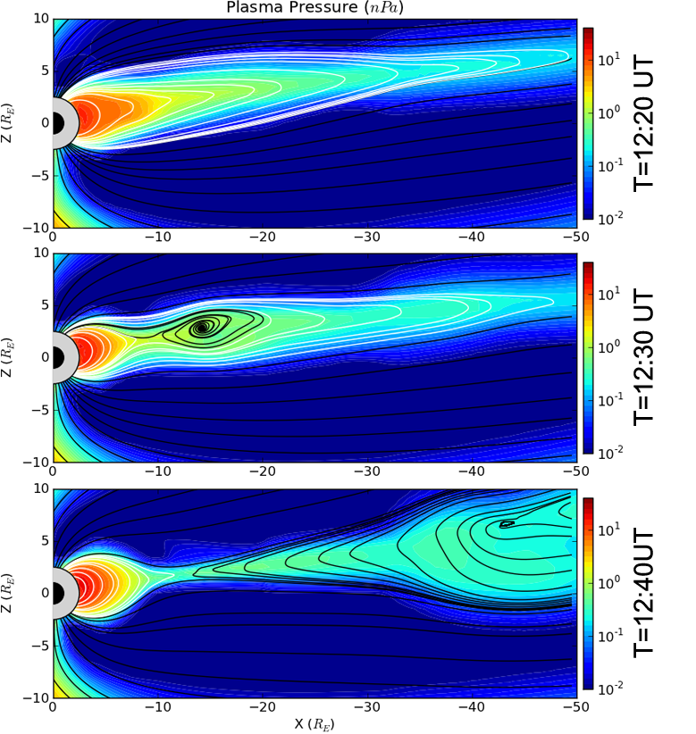

Slide 3
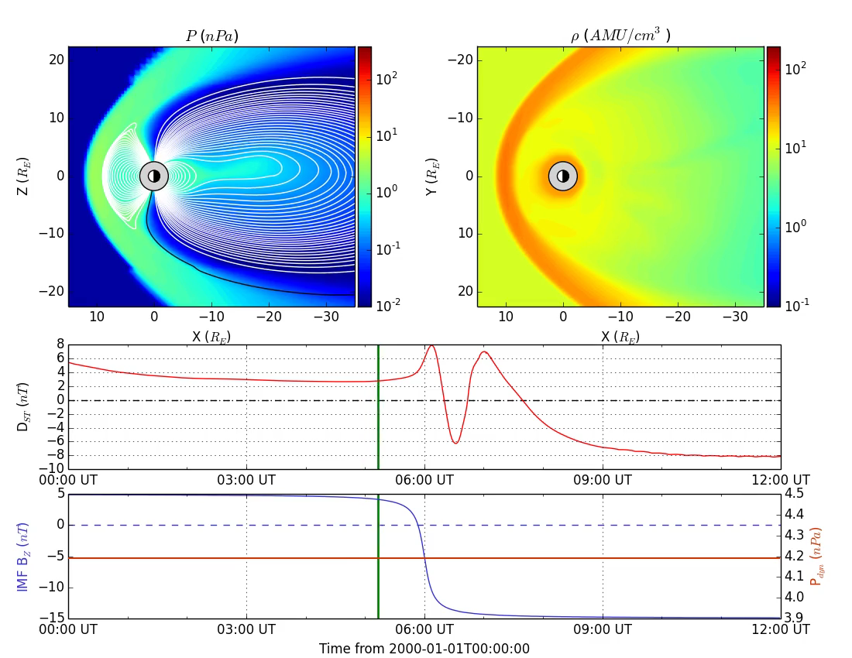

Slide 4
But why?
What precipitates [reconnection/current disruption]?
Or “Why do substorms happen when they do?”
Critical threshold in:
Open magnetic flux? (Unlikely [Boakes et al., 2009])
Kappa parameter? [Buchner and Zelenyi, 1987]
Something else?
For now, we’ll assume a parameter that is proportional to the energy accumulated in the magnetotail lobes.
Notes:
Flux tubes are colour-coded by fluxes from Polar
The MEO orbit is a GPS orbit

Slide 5

A toy model of substorms
Substorm is in generic class of integrate-and-fire models
(like neuron models)
Minimal substorm model [Freeman and Morley, 2004] is solar-wind driven and has only three rules and one free parameter
Notes:
Flux tubes are colour-coded by fluxes from Polar
The MEO orbit is a GPS orbit

Slide 6

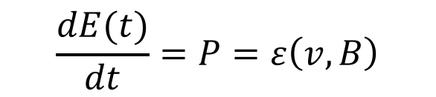

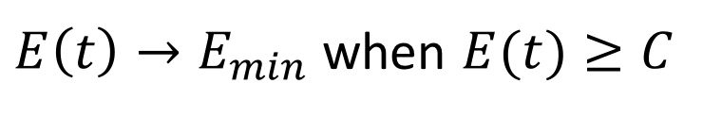
Simple loading-unloading
$$ε≡\frac{vB^{2}}{μ_{0}}{\sin\left(\frac{θ}{2}\right)}^{4}$$
$$θ≡\tan^{−1}\left(\frac{B_{Y}}{B_{Z}}\right)$$
Solar wind power input at magnetopause P accumulates energy in magnetotail E.
Unique minimum energy state for magnetosphere E_{min} exists for given solar wind state P.
Magnetotail can only move to lower energy state E_{min} when energy threshold C is exceeded.
For constant input, substorms occur with constant period of D
Expect D = 2.5-3 hr [Borovsky et al., JGR, 1993; Freeman and Farrugia, JGR, 1995; Huang et al., JGR, 2003]
$$\frac{dE(t)}{dt}=P=ε\left(v,B\right)$$
$$E_{min}=C−DP$$
$E\left(t\right)→E_{min}$ when $E(t)≥C$
Notes:
Flux tubes are colour-coded by fluxes from Polar
The MEO orbit is a GPS orbit

Slide 7
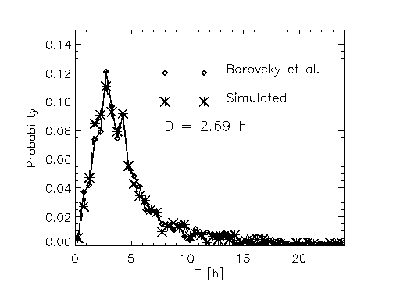
Finding free parameter, D
Compared distribution of inter-substorm intervals from model with those observed by Borovsky et al. 1993.
Energy
Time
Distributions similar at 95% confidence for limited range of D – using both χ² and K-S test.
Range of best-fit D falls in expected range based on observed recurrent substorms
Notes:
Flux tubes are colour-coded by fluxes from Polar
The MEO orbit is a GPS orbit

Slide 8
Our Goal: Create MSM.py
Create a file that outputs the onset time of substorms based on the MSM.
Use solar wind input that we’ve been using so far in class.
Create the time-energy plot displayed on the previous page.
Turn this into a reusable tool that can be called from the command line.

Slide 9
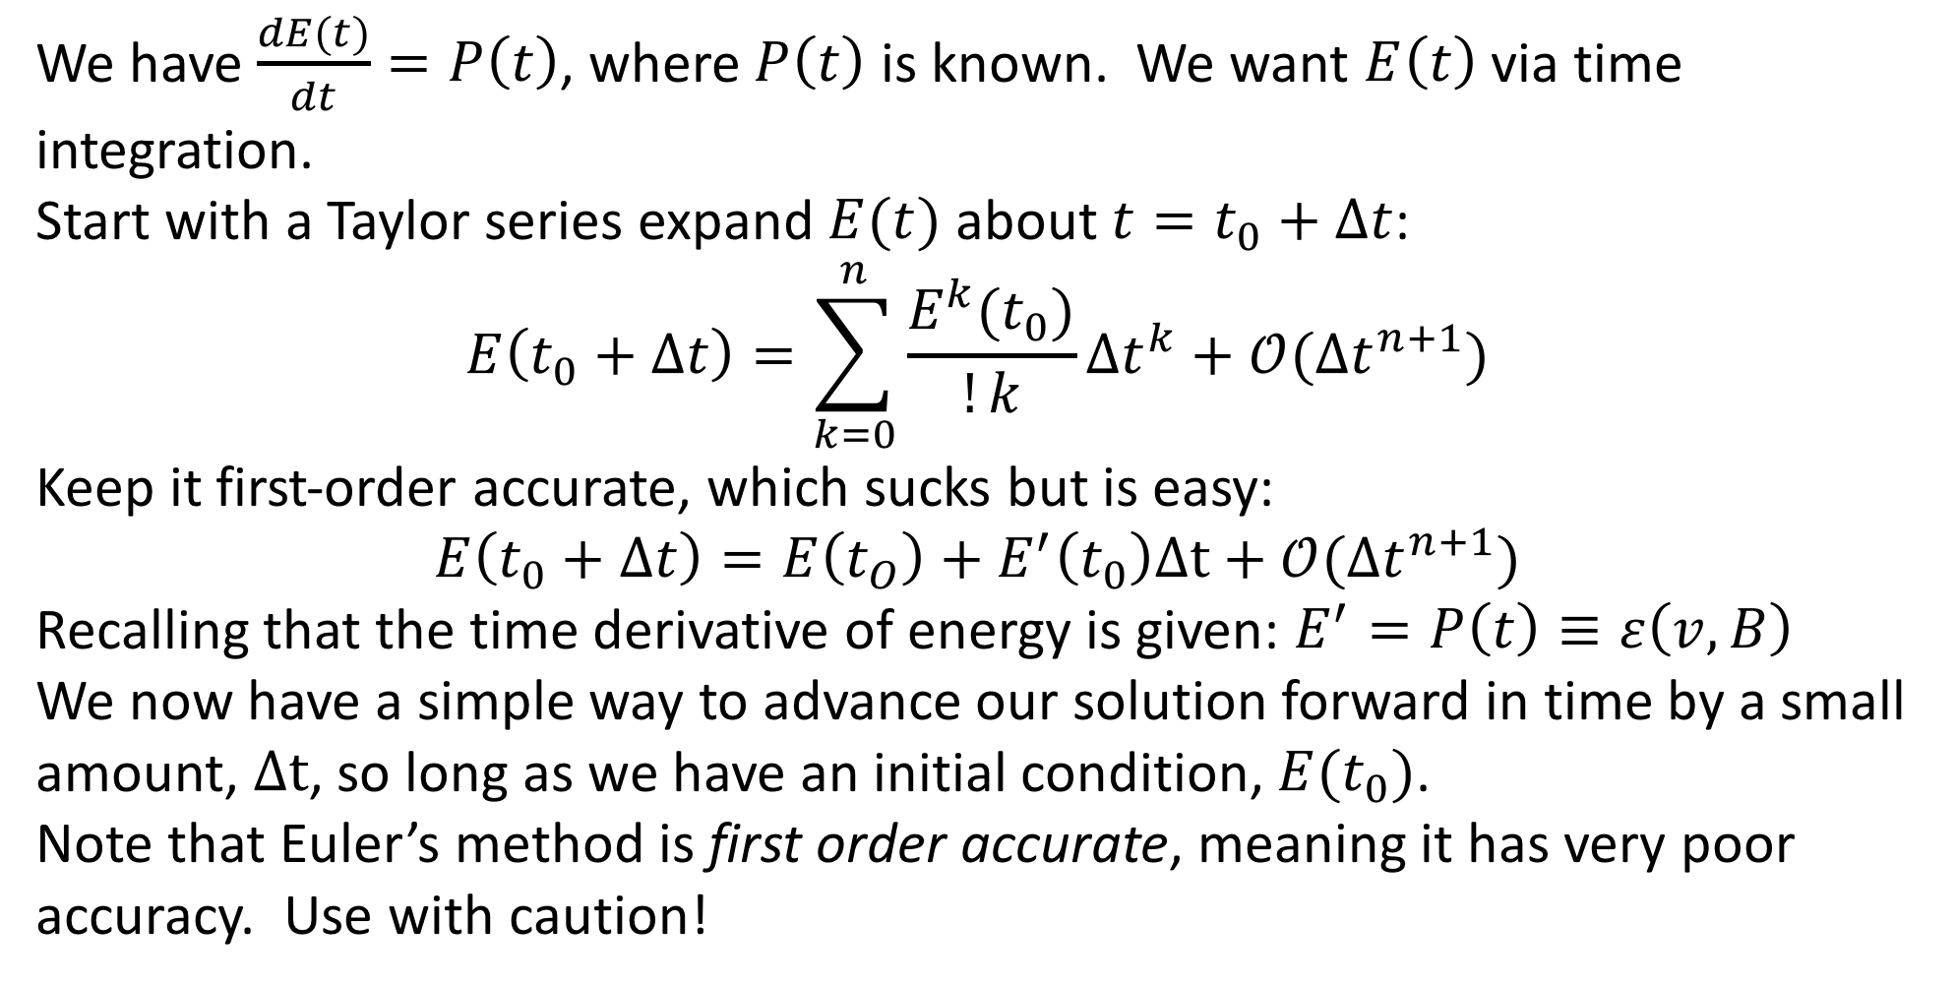
Numerical Integration: Euler’s Method
We have $\frac{dE(t)}{dt}=P\left(t\right)$, where $P\left(t\right)$ is known. We want $E\left(t\right)$ via time integration.
Start with a Taylor series expand $E(t)$ about $t=t_{0}+Δt$:
$$E\left(t_{0}+Δt\right)=\sum_{k=0}^{n}{\frac{E^{k}(t_{0})}{!k}Δt^{k}}+𝒪(Δt^{n+1})$$
Keep it first-order accurate, which sucks but is easy:
$$E\left(t_{0}+Δt\right)=E\left(t_{O}\right)+E^{′}\left(t_{0}\right)Δt+𝒪(Δt^{n+1})$$
Recalling that the time derivative of energy is given: $E^{′}=P\left(t\right)≡ε\left(v,B\right)$
We now have a simple way to advance our solution forward in time by a small amount, $Δt$, so long as we have an initial condition, $E(t_{0})$.
Note that Euler’s method is first order accurate, meaning it has very poor accuracy. Use with caution!

Slide 10
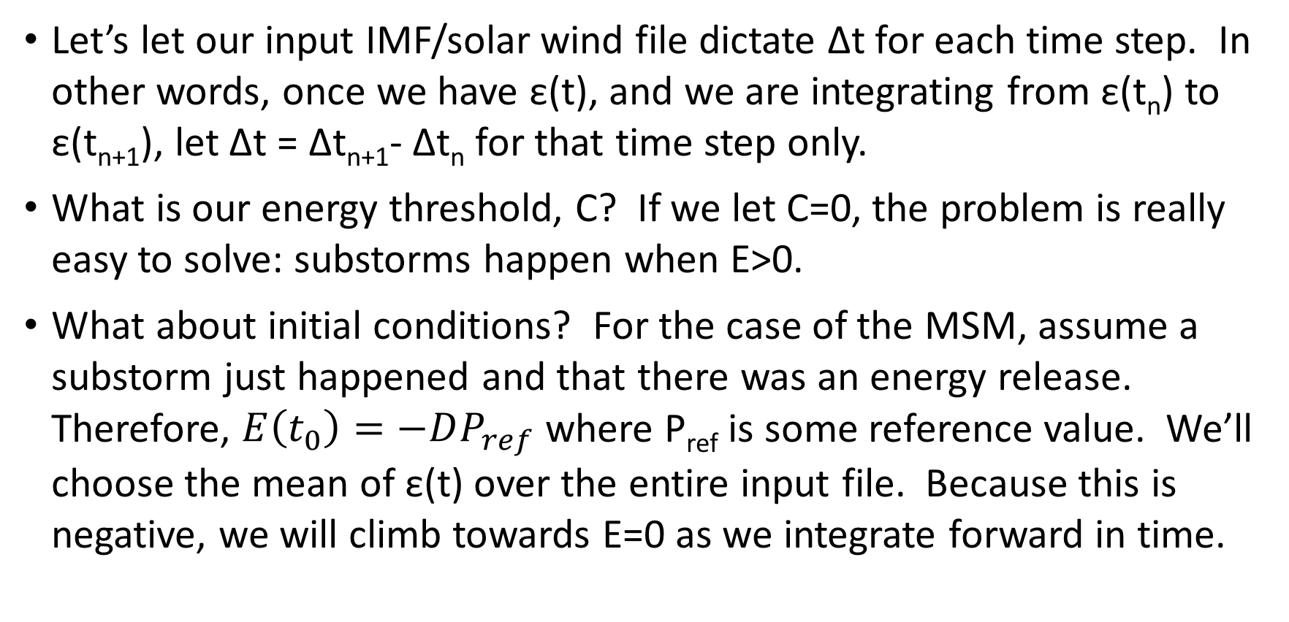
Some Considerations:
Let’s let our input IMF/solar wind file dictate Δt for each time step. In other words, once we have ε(t), and we are integrating from ε(t_{n}) to ε(t_{n+1}), let Δt = Δt_{n+1}- Δt_{n} for that time step only.
What is our energy threshold, C? If we let C=0, the problem is really easy to solve: substorms happen when E>0.
What about initial conditions? For the case of the MSM, assume a substorm just happened and that there was an energy release. Therefore, $E\left(t_{0}\right)=−DP_{ref}$ where P_{ref} is some reference value. We’ll choose the mean of ε(t) over the entire input file. Because this is negative, we will climb towards E=0 as we integrate forward in time.

Slide 11
Program To-Do:
Open IMF/solar wind file using existing ImfData class in clasp605.py
Calculate |V|, |B|, clock angle, and Epsilon.
Set time constant, “D”, to desired value.
Create empty list to hold date, time for each substorm.
Create numpy array to hold E(t). Same number of items as IMF input file.
Integrate: for i=0 through size of E(t) minus 1:
Calculate Δt = imf[‘time’][i+1] – imf[‘time’][i]. Convert to seconds.
Perform Euler step: E[i+1] = E[i] + Δt*ε[i]
Check energy threshold. If E[i+1] > 0: Save epoch via epoch_list.append() and reset energy via E[i+1] = -D*ε[i]
Plot results!

