Slide 1
Programming Project
Passing this class is contingent on completion of “the project” (30% of grade).
Pick a task that incorporates several course aspects. It can be research related. Challenge yourself!
GET APPROVAL FOR YOUR PROJECT.
Code it up. Document your code, add many many comments.
Typeset a document that explains your goals, your approach, and how your code achieves these goals.
Turn it in. Provide all source code via github (including enough data so that I can test it!) and your PDF writeup via Canvas.
DUE DATES ARE IN SYLLABUS! DON’T BE LATE!

Slide 2
Course Aspects Must Be Considered!
Your solution must include 2 or more of the following coding aspects that we cover in class:
File reading & writing
Data visualization
Data processing & analysis
Automation (scripting)
Interacting with the OS
Compilation of complex code

Slide 3
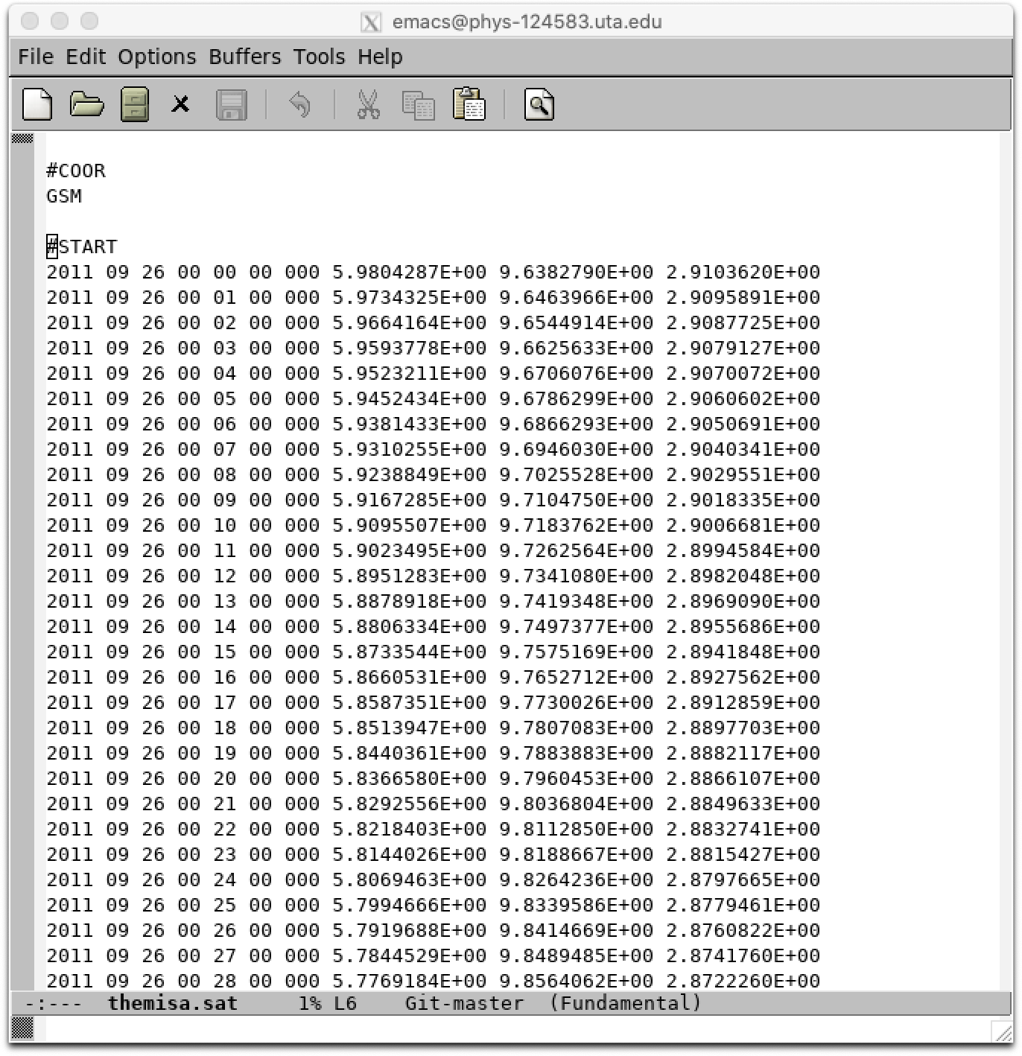
An Example: SWMF Orbit Builder
Problem: creating virtual satellite input files for new SWMF simulations is a lot of work.
Get orbits from the web for each satellite (manually, one for each sat/day, variable names are satellite dependent!).
Convert coordinates to GSM (satellite dependent!).
Write out each to a properly formatted input file.
Each event may cover several days and 10+ spacecraft of interest.

Slide 4
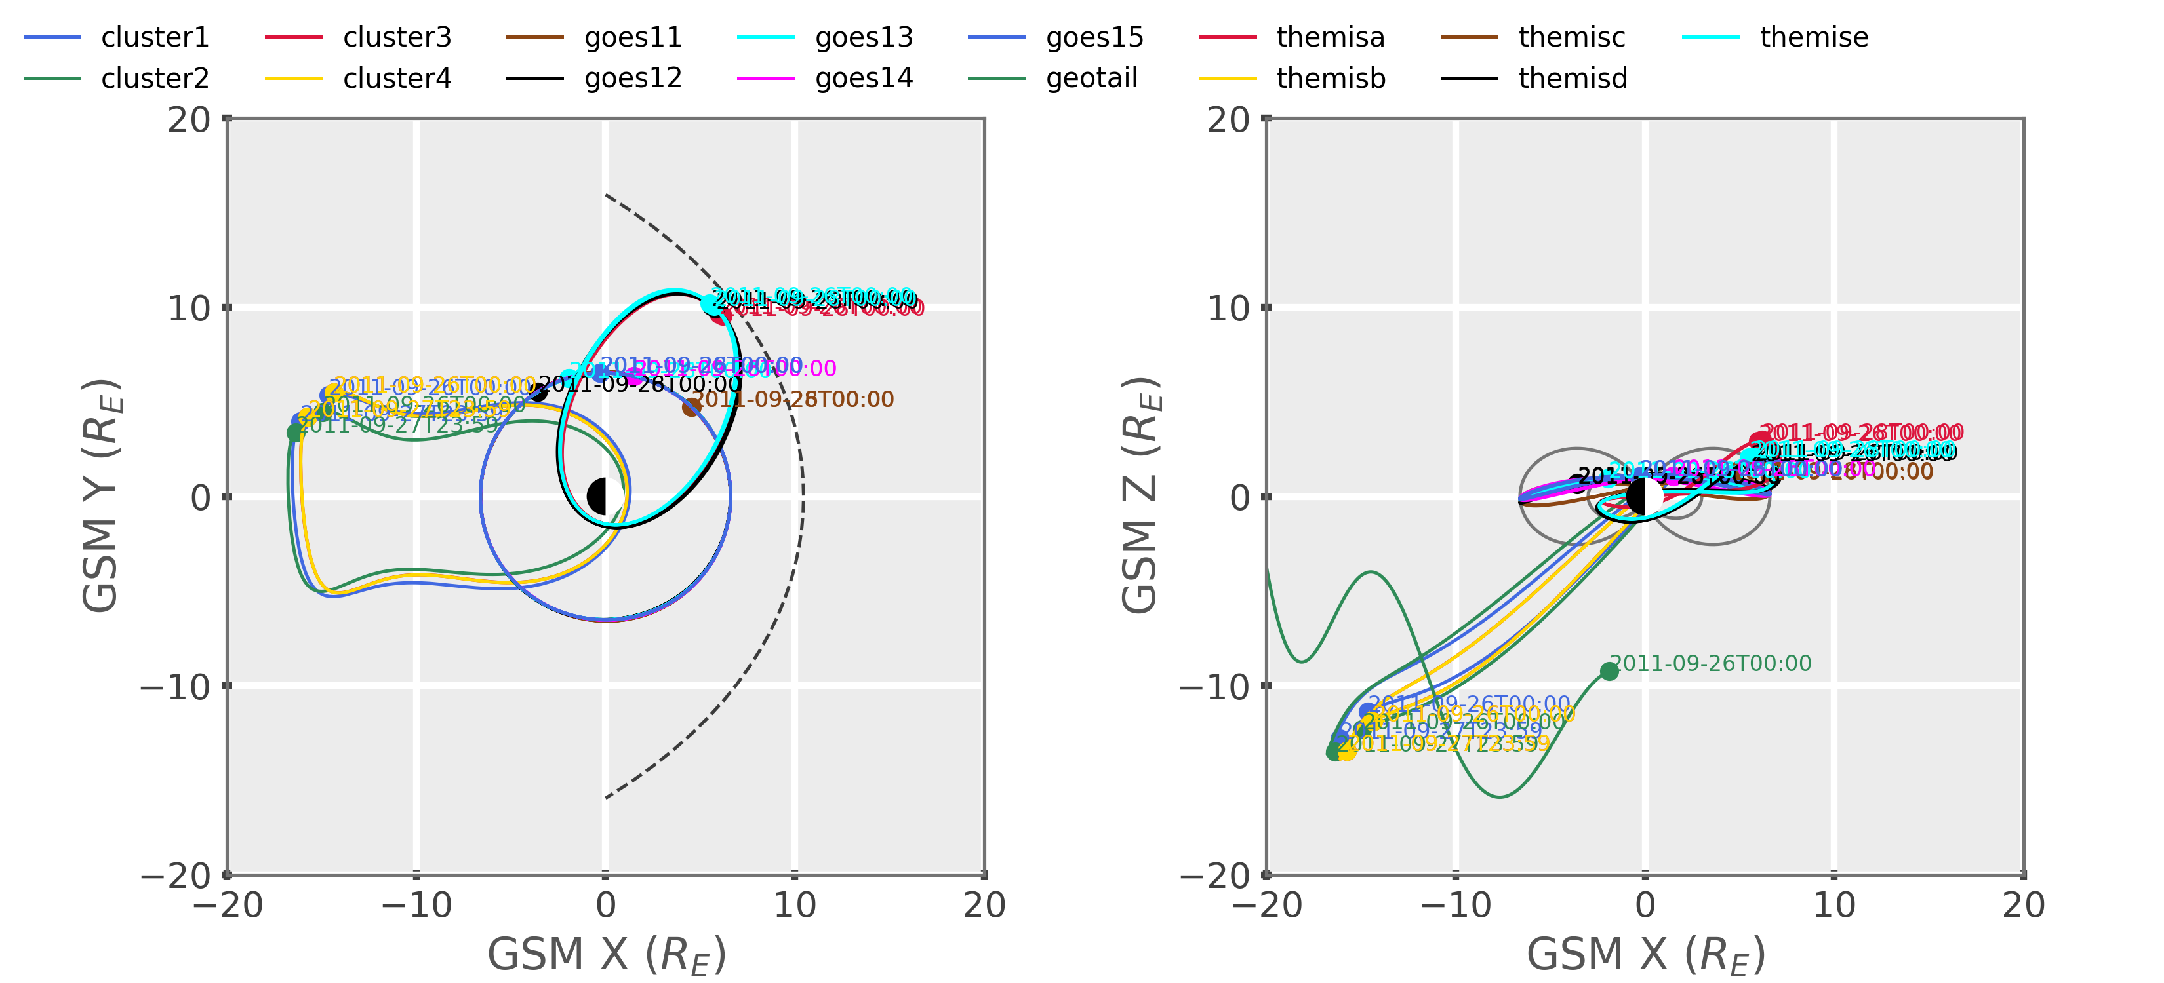
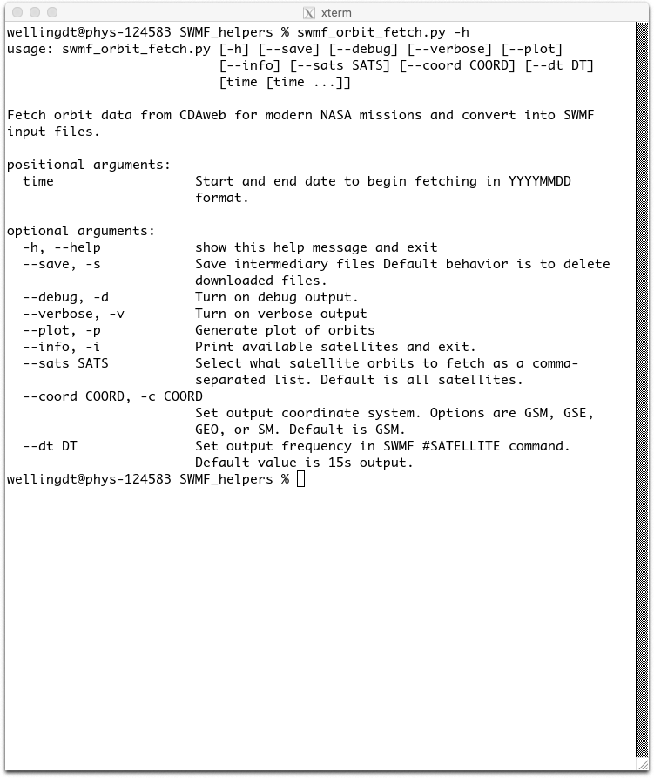
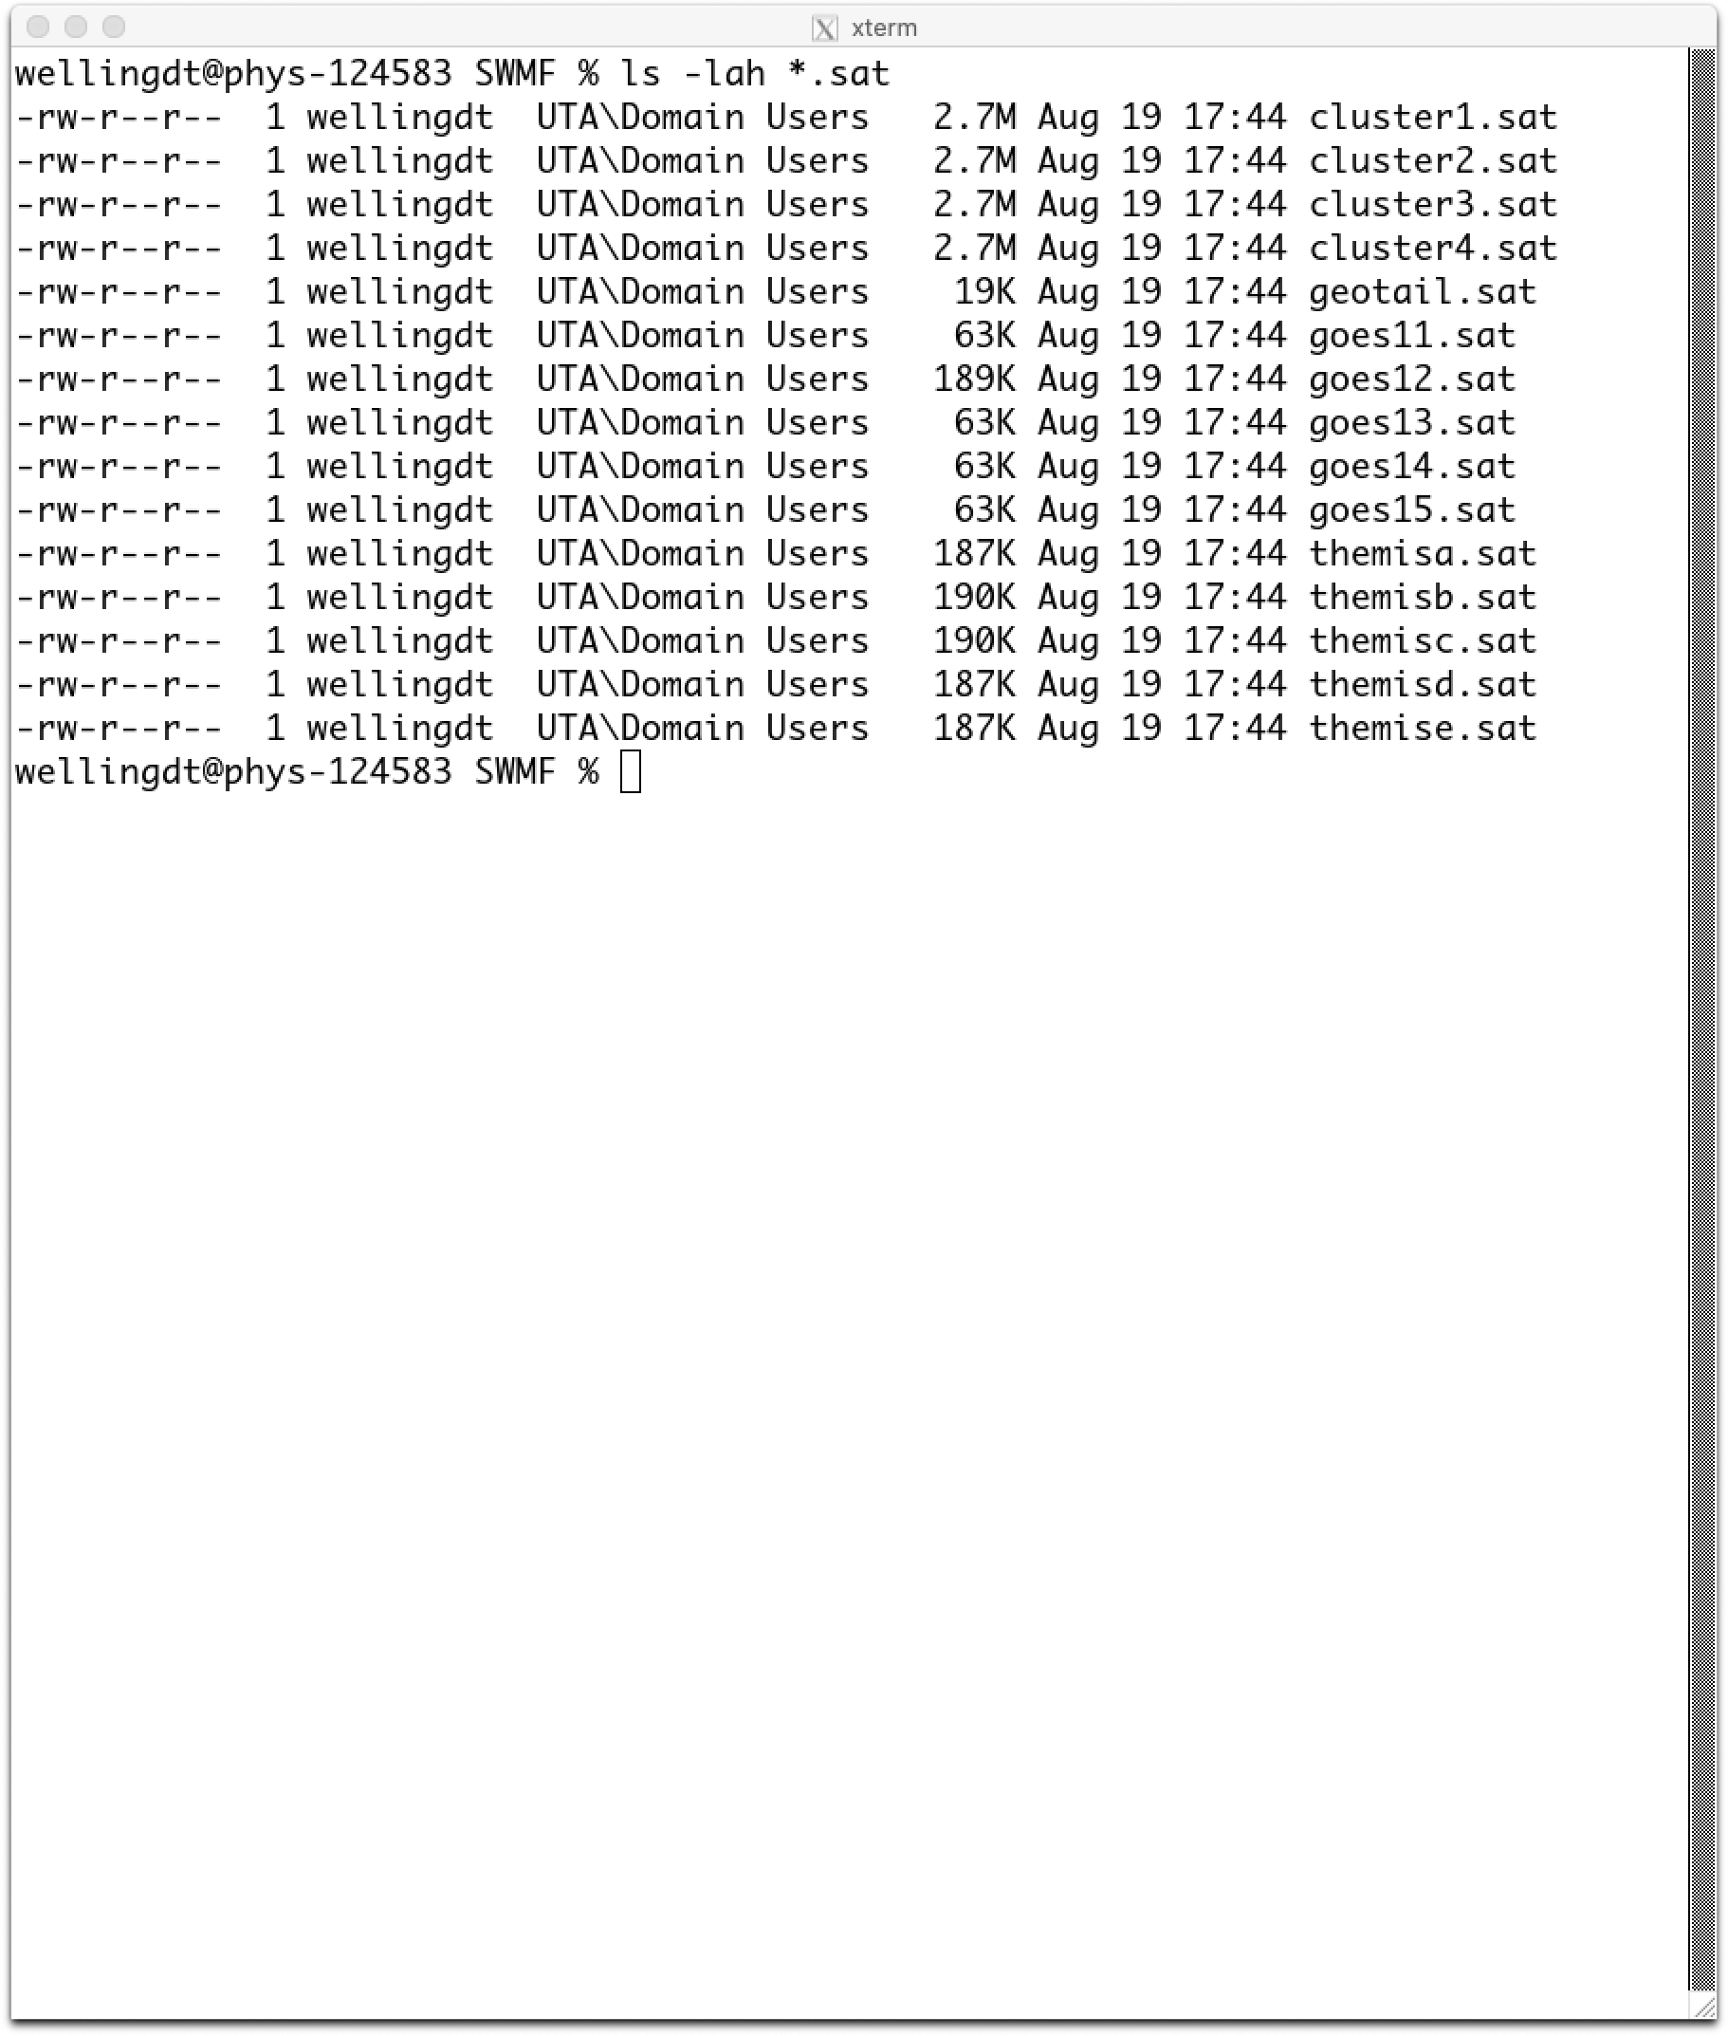
Proposed Solution
Python script takes start/stop date as input from command line.
Python scrapes all necessary data from NASA’s CDAWeb database via HTML requests.
Python reads files, finds correct orbit variables, and converts coordinates to GSM
Script writes data to file, concatenates individual files as necessary.
Creates figure of obtained orbits.

Slide 5
Previous Examples from Students
Work related:
Data analysis for CASSINI LEMMS and MAG instruments
MAVEN instrument data grabber
Fun related:
Kinetic particle drift simulator
Statistical study of NBA player shooting
Animated plots of oscillating systems in Python
Implementing sentiment analysis using Twitter data
The best projects are rewarding to work on. Pick something that either addresses an immediate need or is just fun.
The projects are for YOU.

Slide 6
Getting Approval
Write a 1-paragraph “proposal” about your project.
What is the problem?
How will you overcome it?
What course aspects will you cover?
Email me your proposal.
I’ll provide feedback.
Is it feasible?
Is it appropriate?
Is it too challenging or too easy?

Slide 7
Turning It In
Put everything on GitHub: source code, documentation, LaTeX source, and necessary data.
External dependencies? List them explicitly with instructions on installation. If external libraries are doing >50% of the work, don’t expect a good grade.
I need to be able to run your code without asking you questions. Are your docs good enough?
Upload PDF writeup to Canvas.
LATE SUBMISSIONS ARE NOT ACCEPTED. Start now and don’t doom yourself.

Slide 8
The Write Up
Include all critical pieces:
Description of problem
Coding approach
Examples of use
Analysis of results
Discussion, including shortcomings and potential future work.
Create an actual narrative! Treat this as a draft manuscript. Don’t worry about length, worry about content.

Slide 9
Critical Hints
Start now.
Start now for real.
Planning things out is the key to success. Outline your goal, code approach, and deliverables.
Use the syllabus to see what we’ll learn and when we’ll learn it.
Double dipping* is fine so long as you haven’t done it already.
K.I.S.S.** – great advice, hurts my feelings every time.
*projects that are for research and other classes **keep it simple, stupid

Slide 10
START NOW.

