Slide 1
L^{A}T_{E}X: Your friend in typesetting
“Because writing should be more like programming.”
-Dr. Mike Liemohn, U of Michigan, sarcastically.

Slide 2
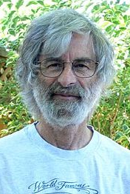
What is L^{A}T_{E}X (LAH-tehk)?
“Lamport Tex”, an extension of the Tex typesetting language.
Created by Leslie Lamport.
A markup language, along the same vein as HTML, XML, etc.
Modern (albeit less used) alternatives include reStructuredText and Markdown (you should know markdown!).
A Human
Koala.

Slide 3
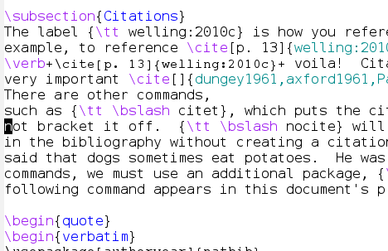
How does it work?
Ensure you have a LATEX interpreter installed.
Use package manager or find click-to-install.
Use preferred editor to create source file containing text & markup.
Emacs, Vi, wordpad, whatever.
Dedicated editors available, such as TexShop.
Overleaf.com provides an online, WYSIWYG-style collaborative LATEX. Check it out!

Slide 4
How does it work?
Run the interpreter on your source file.
$latex source.tex or $pdflatex source.tex
Dedicated editors may have TeX engine internally.
Multiple runs over same file often required.
View resulting output and enjoy.
Call to latex results in “dvi” file.
Call to pdflatex results in pdf directly.

Slide 5
Plenty of Good WYSIWYGs
TeXshop: OSX LaTeX IDE editor.
Very popular; can be installed via MacPorts.
TeXStudio: Windows IDE editor.
Maybe popular? Who knows.
Overleaf: Web-based editor.
Collaborative tool; growing in popularity.
https://en.wikipedia.org/wiki/Comparison_of_TeX_editors

Slide 6

Why would I do this?
Complete control over layout & positioning.
Is the standard for typesetting math symbols.
Python, MS Word, Google Docs, etc. all use L^{A}T_{E}X math formatting.
Powerful, automated bibliography construction.
BibTeX is now a standard bib format.
Widely used & accepted.
Scientific manuscripts, theses, etc.

Slide 7
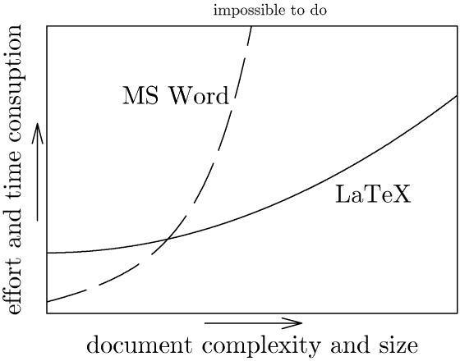
It is often worth the effort.

Slide 8
Why wouldn’t I do this?

Slide 9
Tips Going Forward
Look for a template!
Most scientific publications supply templates that match their style specifications & save you all the work.
Search the web for templates that you can customize.
Three letters to victory: G.D.S.
Broad L^{A}T_{E}X acceptance means solutions are on the web.
Start building your BibTex library NOW.
Use a tool like Mendeley to automate this task.
It’s more than just papers.
Presentations, posters, and more!

