Slide 1
Scripting
…because you have better things to do than the same thing over again.

Slide 2
What is meant by “Scripting”?
Scripting is using any programming language to automate repetitive tasks.
Scripts can be trivial…
One-off codes that do one specific tasks, e.g., make one plot
…or quite sophisticated.
Take arguments from user, navigate file system, fetch from the web, and much more.
Any language is a “scripting” language, but some are better equipped than others.
Popular general choices include shell scripting, Python, Perl, PHP, Javacript, Ruby, etc.

Slide 3
Common Scripting Tasks
Interacting with the operating and file systems
Moving files around, getting system variables, etc.
File globbing
Obtaining lists of files matching certain patterns
Parsing arguments from the command line
Behaving differently based on input commands
Connecting different software pieces together
Piping from one program to another
Text parsing
Pulling apart sentences or complicated strings of characters
Web interfacing
Automated web fetching, form completion, etc.

Slide 4
Essential Examples: BASH
Shell scripting is VERY powerful! Just place commands into a file and call it from the command line.
Try these things:
Globbing lists of files using Linux wild cards.
Piping output from one program into another.
Getting arguments from the caller.
Calling common commands or other programs.
Using grep to find patterns in text.
Using utilities like wget to pull from the web.

Slide 5
Writing Scripts on Linux
#!/bin/bash
for a in ${BASH_ARGV[*]}
do
echo -e "$a"
done
echo -e 'Hello World'
ls *.py | grep sciprog
The “shebang” tells Linux the path of the interpreter required to run the commands in the file. The file suffix doesn’t matter!
ARGV is a special variable in many, many languages that captures arguments.
This script is a BASH script. It contains BASH commands.
Be sure to make your file executable by changing the permissions: chmod +x hello_world.sh

Slide 6
Adding to the System’s $PATH
$PATH is a system variable that tells your shell where to search for a program when it’s called.
Try this: echo $PATH (BASH or Zshell only!)
If your script is in a folder listed in your path, you can call it from anywhere.
Add a folder to $PATH like this: export PATH=$PATH:/folder/to/add
Don’t forget to make your script executable: chmod +x name_of_script.sh

Slide 7
Critical Python Modules
Module | Capabilities
os | Contains tools for interfacing with operating system and file system. Moves and renames files, can test for file existence, and much more
sys | Tools for interfacing with the system; accesses ARGV
re | Regular expression library in Python
glob | Contains glob function for globbing file lists
subprocess | Creates subprocesses to shell, other programs. Extremely powerful and potentially dangerous!
urllib | Powerful library for interfacing to HTTP, FTP, and other web protocol.
All of these are in the standard library- if you have Python, you have these modules.

Slide 8
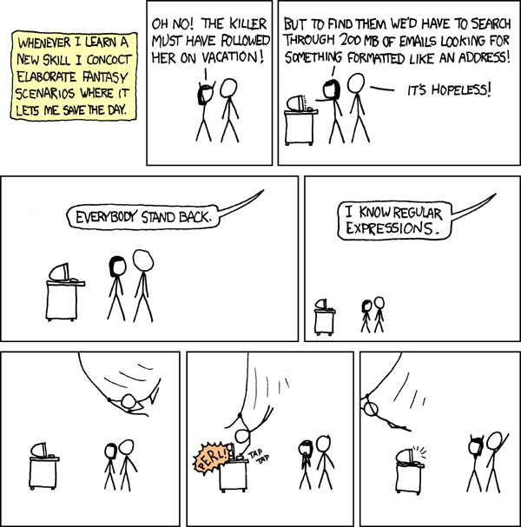
Regular Expressions
Regular expressions are a set of powerful string-parsing tools.
Regex syntax is employed within many different programming languages.
Do a google search for a good tutorial. They take practice but are worth the investment!

