Slide 1
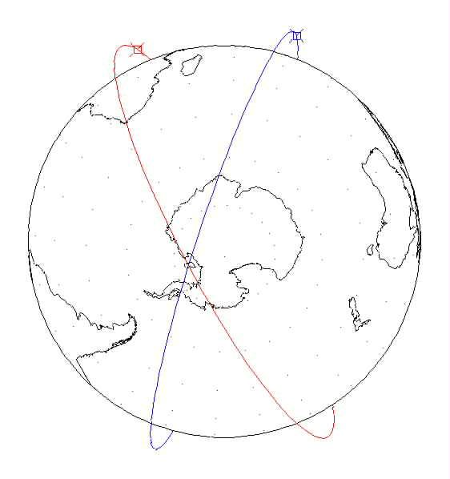
Location of Collision, Alternate View
DMSP R/B
CZ-4 Debris
775 km by 885 km
99.1 deg inclination
700 km by 895 km
98.2 deg inclination
Collision Altitude: 885 km

