Slide 1
BarkCity Week 1
Progress Report
Flatiron School - iOS

Slide 2
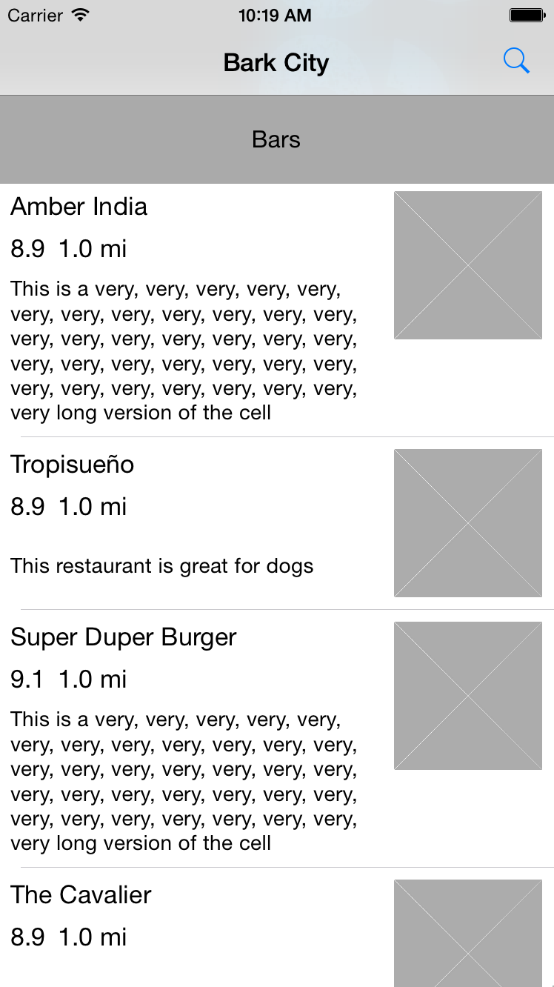
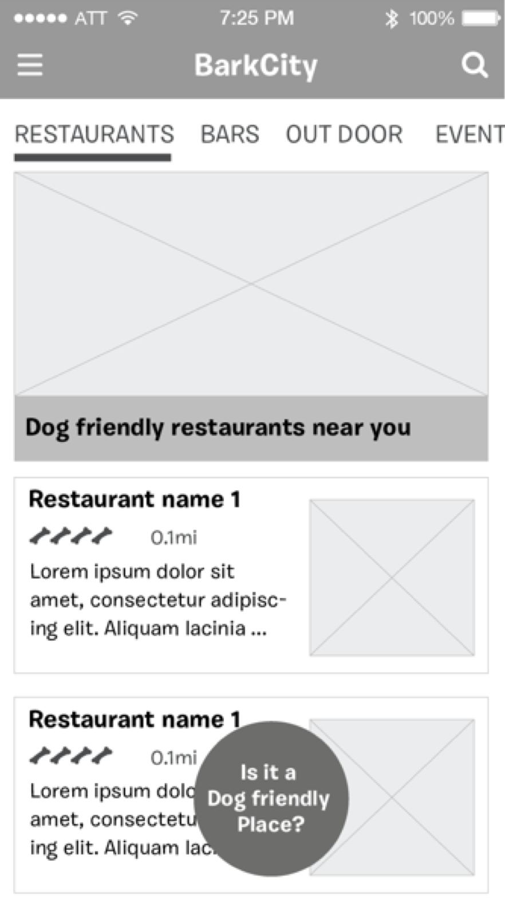
Home View
Questions
“Is it a Dog friendly Place?” button
Image on top
To-Do
Venue category navigation
Notes:
----- Meeting Notes (12/1/14 11:13) -----
Suggestion: Category in the middle
Commitment: Them -> More details by Wednesday / Us -> Version on the right but no bar
See trello

Slide 3
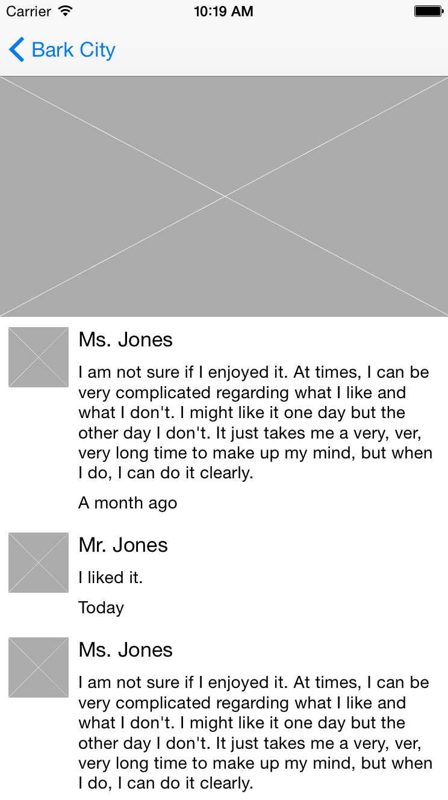
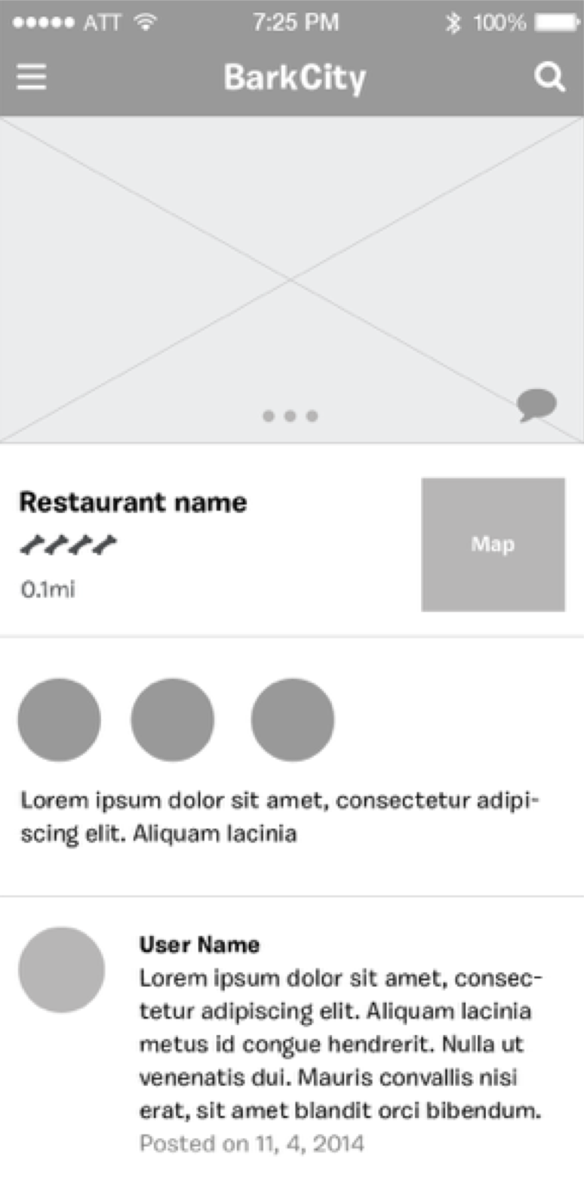
Venue Detail View

Slide 4
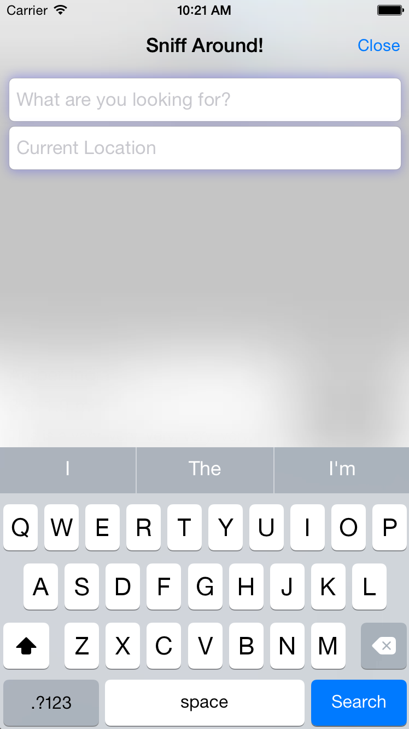
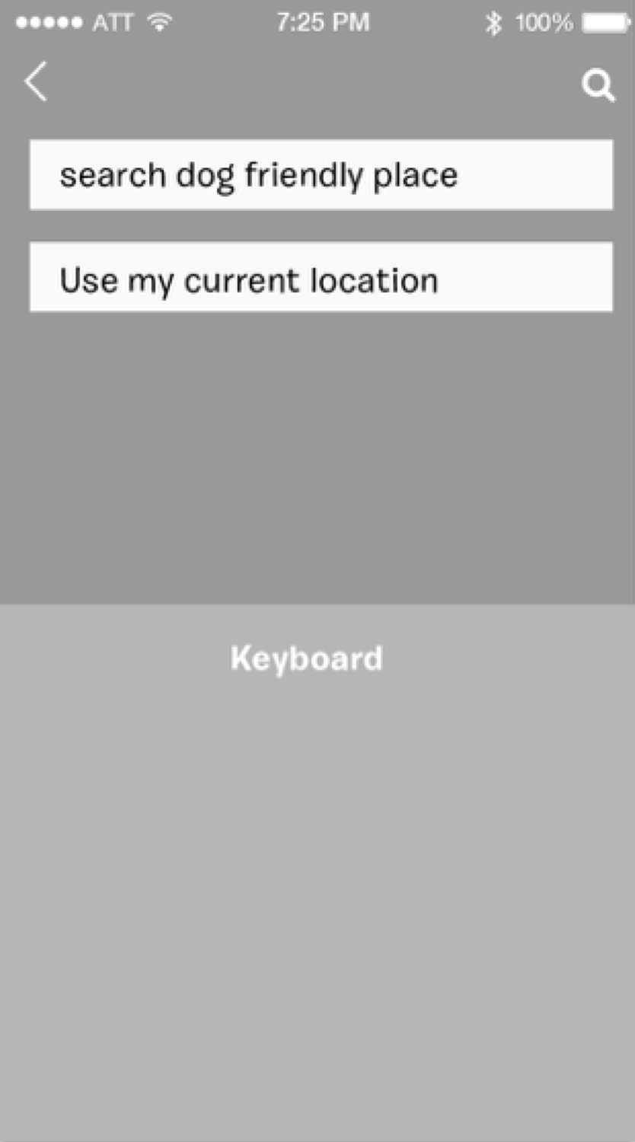
Search View

Slide 5
Questions
Pet vs. Human-oriented reviews
Should the venue description be dog-related or general?
Should we show the venue’s actual rating (from FourSquare) or just its dog-friendliness rating?
Information input
Flow/Wireframes?

Slide 6
Next Week
Robust data fetching from Foursquare API
Implement search + search views

