Slide 1
Inferencing Hidden Information Using
Binary Markov Random Field
Chang Li & Stephen Gould

Slide 2
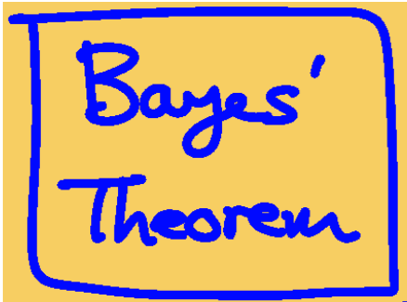
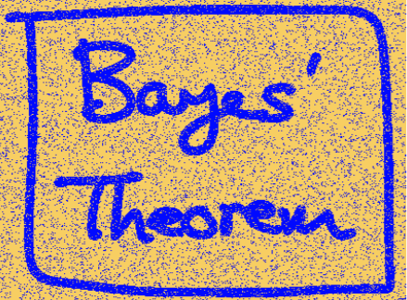
Background: A Simple Example
Adding some noisy by flipping the sign of the pixels with probability 10%.

Slide 3
Challenge: What’s its original color?

Slide 4
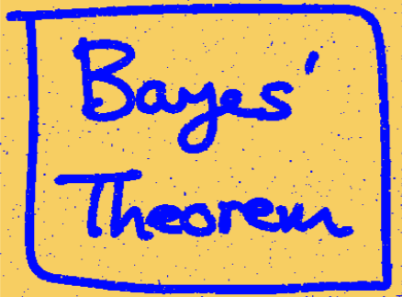
Background: A Simple Example
Denoising Without
Original Image
If one pixel is blue, then its neighbors should also be blue.

Slide 5
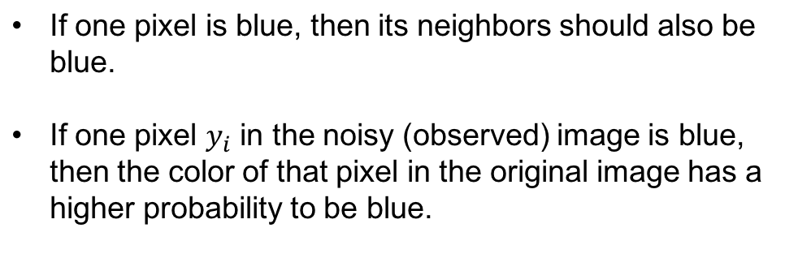
Background: A Simple Example
Denoising Without
Original Image

Slide 6
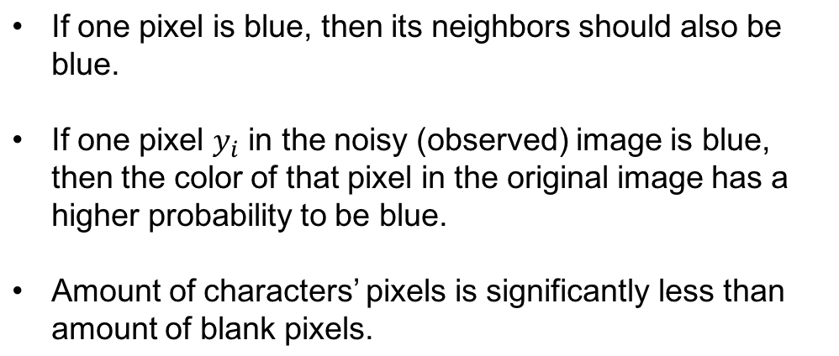
Background: A Simple Example
Denoising Without
Original Image
More ideas?

Slide 7
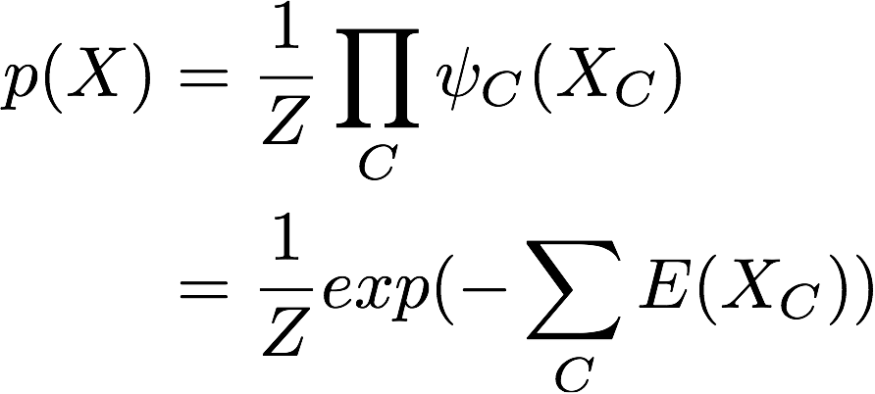
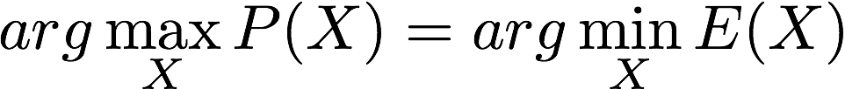
Background: Binary MRF
Potentials & Energy Function
MAP & Energy Minimization
Pattern Recognition and Machine Learning. Bishop.

Slide 8
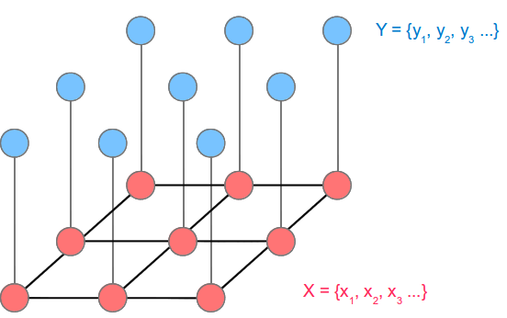
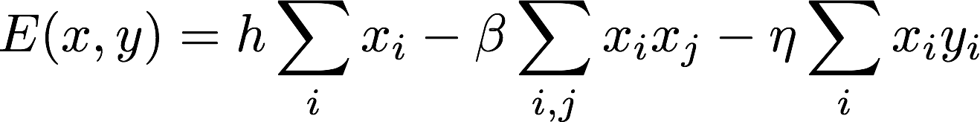
Background: A Simple Example
Same as neighbors
Same as observed
Not too much blue points

Slide 9
Background: A Brief Summary
Energy Function: Defining an arbitrary nonnegative function over a set of variables (encoding prior or expert knowledge).
Inference: Find the assignments minimizing the energy function.
Learning: Optimizing parameters in energy function so that the ground truth assignments’ energy is less than any other assignments’.

Slide 10
Topics
Energy Function: Higher Order Potentials
Inference Method: Graph Cut
Drawback In Previous Research
Our Contribution: Latent Structured SVM Optimization

Slide 11
Energy Function
Unary
Pairwise
Y
Y | 0 | 1
 | 2 | 3
 | 0 | 1
0 | 2 | 3
1 | 4 | 5
X
Gould 2014, PAMI

Slide 12
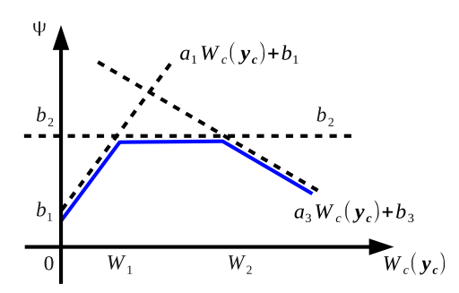


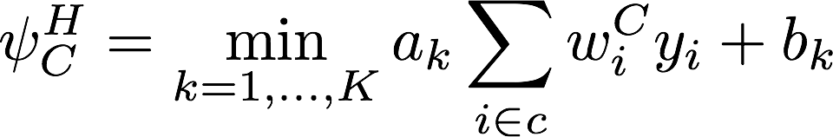
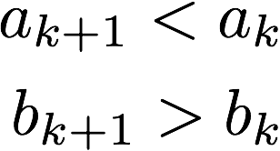
Energy Function: Higher Order Potentials
Weighted Lower Linear Envelope
S.T.

Slide 13
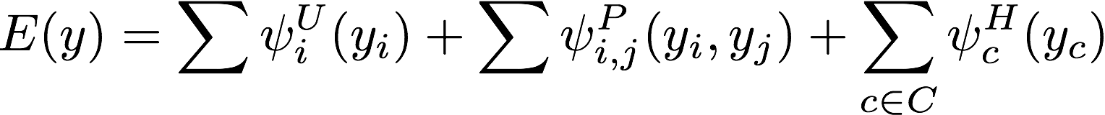
Energy Function

Slide 14
Topics
Energy Function: Higher Order Potentials
Inference Method: Graph Cut
Drawback In Previous Research
Our Contribution: Latent Structured SVM Optimization

Slide 15
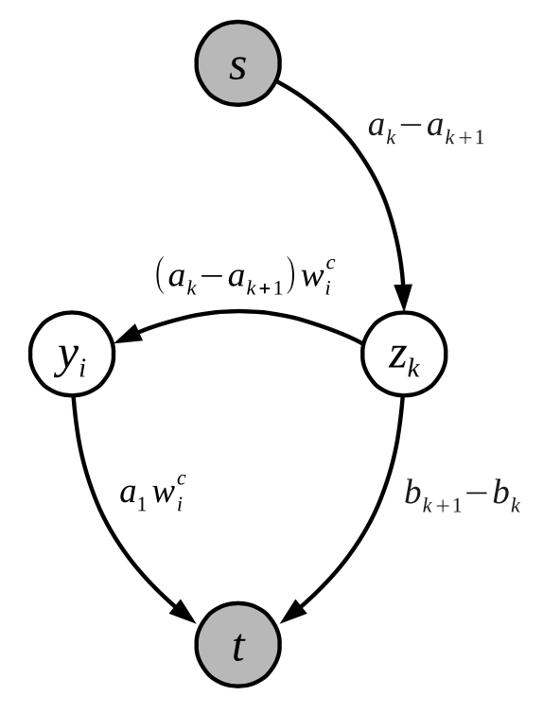
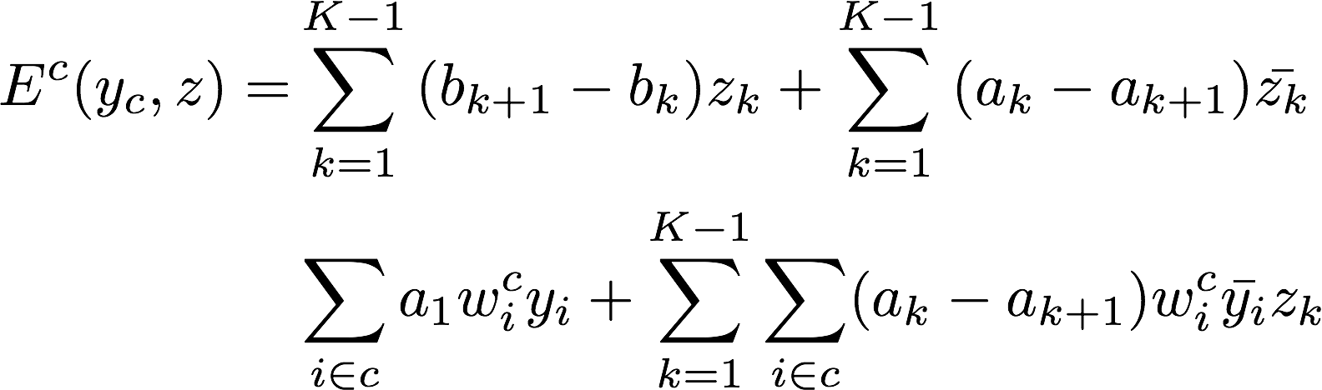
Graph Cut
A cut is a partitioning of nodes into two disjoint sets.
The cost of the cut is the sum of weights of edges.
The minimum cut is the minimum energy assignments.
1
0
Gould 2014, PAMI

Slide 16
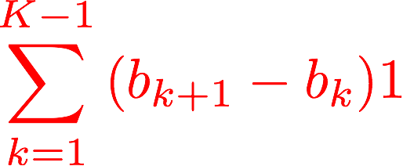

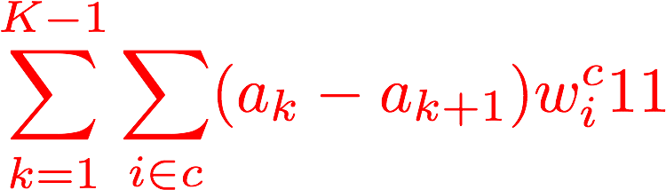
Graph Cut
1
0

Slide 17
Topics
Energy Function: Higher Order Potentials
Inference Method: Graph Cut
Drawback In Previous Research
Our Contribution: Latent Structured SVM Optimization

Slide 18
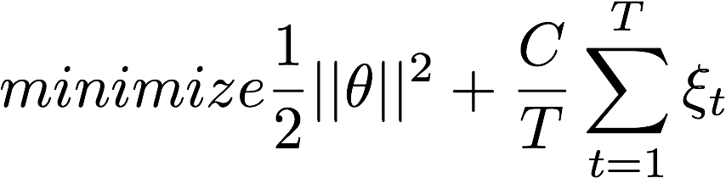
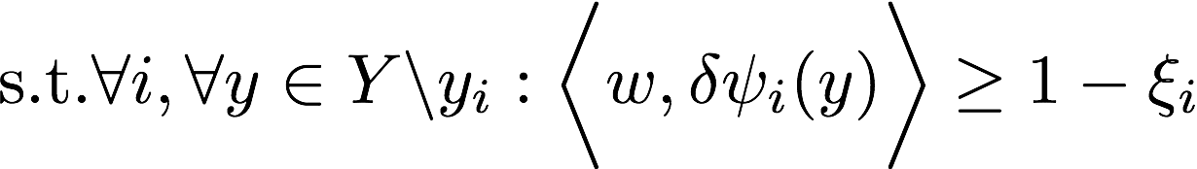
Max-margin Method
To optimize the Energy Function, we use max-margin formulation. This requires us to write the Energy Function into a linear combination of weights and features.
We sample the Lower Linear Envelope at fixed space intervals.
Gould 2014, PAMI

Slide 19
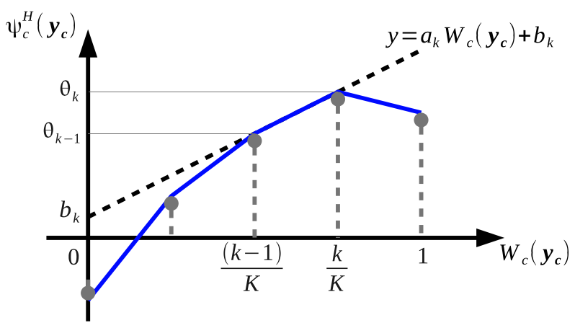

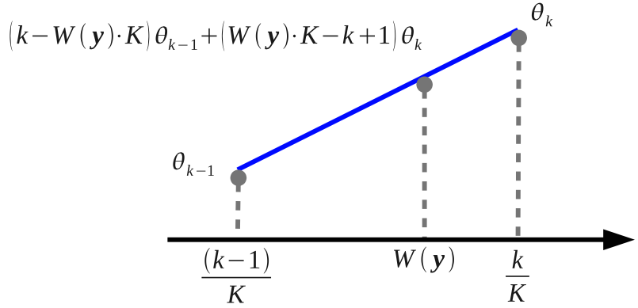
Max-margin Method
Are K+1 sampled values.
The interpolated value is a linear combination of weights and feature vector.

Slide 20
Max-margin Method

Slide 21



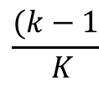
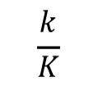


Cons of interpolation
0

Slide 22
Pros & Cons
Therefore, we can globally optimize weights vector using max-margin framework.
The price is that we lose a rich class of representations.

Slide 23
Topics
Energy Function: Higher Order Potentials
Inference Method: Graph Cut
Drawback In Previous Research
Our Contribution: Latent Structured SVM Optimization

Slide 24
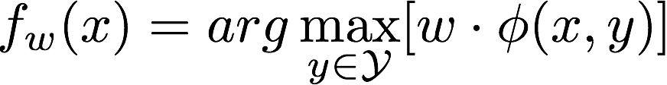
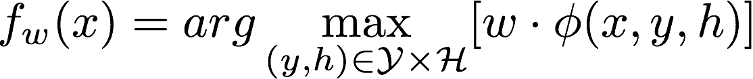
Latent Structured SVM
Structured SVM
Latent Structured SVM
C.N. Yu. 2009, ICML

Slide 25
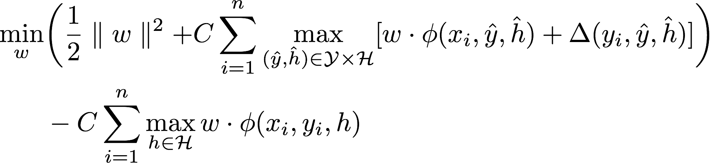

Latent Structured SVM
Optimization Problem
In Our Problem
Auxiliary variables
are hidden variables.

Slide 26
Pros & Cons
We have a much rich class of energy functions.
The price is that we can only learn parameters locally.

Slide 27
That’s All. Thanks!

Slide 28
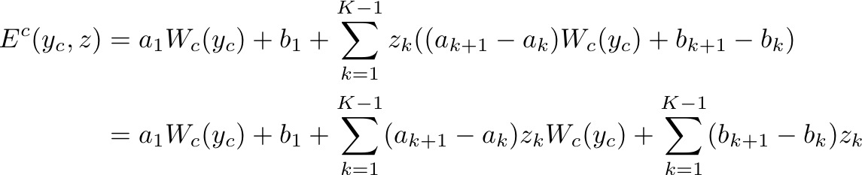
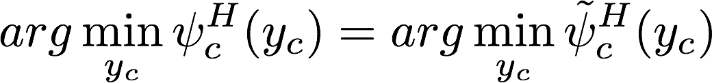
Our Formulation

Slide 29
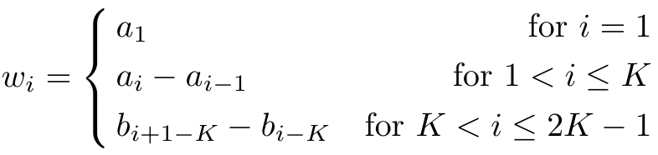
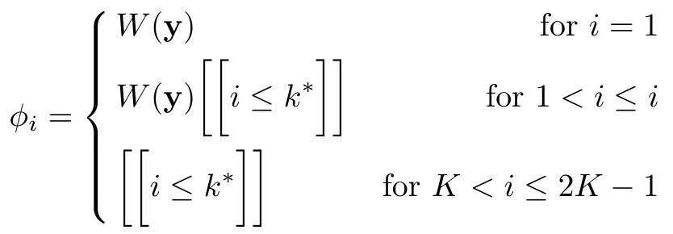

Appendix: Our Formulation

Slide 30
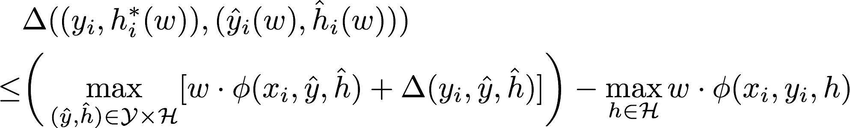
Appendix: Latent Structured SVM
Hinge Loss Style Upper Bound
Optimization Problem

