Slide 1
Business Value of Knowledge Base
Nature of Knowledge Base: Relationships between Enitites
Low business value: Efficiency
High business value: New Product

Slide 2








数量大 速度快 新的关系

Slide 3
Quandl
Large Scale Datafeed
Consumer transactions, cargo movement, employment trends
BV: Unstructured Data -> Structured
AlphaSense
Linguistic Search Engine
Synonyms keyword expansion
Over 10k data sources (financial reports & business terms)
Strong sales team
BV: Efficiency
MEMECT (China)
Financial Knowledge Base
Corp Info
BV: Efficiency

Slide 4
Dataminr
High impact events from twitter etc.
PR; Corp Alerts; Fin Info
230+ Engineers
BV: Info before in news
iSentium
Sentiment Indicator from twitter, stocktwits etc.
Indicator for hedge funds
BV: Large scale sentiment
Kensho
Financial Knowledge Base
PR; Corp Alerts; Fin Info
Acquisited by S&P @ 550M
600 Engineers @ 120K / year
BV: Undiscovered events – asset price relationship

Slide 5
Waterfall Development Cycle:
Clear (Static) Business Requirements
Long delivery term
~70% Effort Spent on Data Infrastructure
Hard to be adapted to new data source (Changed Database in late phrase)
Entity Collection; Entity Annotation
Event Collection; Event Annotation
Annotation Tool (A Web Site)
Web API;
NER, EL
Database Design (Cassandra)
Database Design (Hypetable); OCR Dataset
Improve NER, EL performance
Zoom Website; Re-organizing dataset
Transfer data; Summary; New Annotation website
NER; EL
NER; EL
SUMMARY
Data Collection; Data Cleaning
Data Infrastructure: Database, API

Slide 6
Business Value
Information Complexity

Slide 7
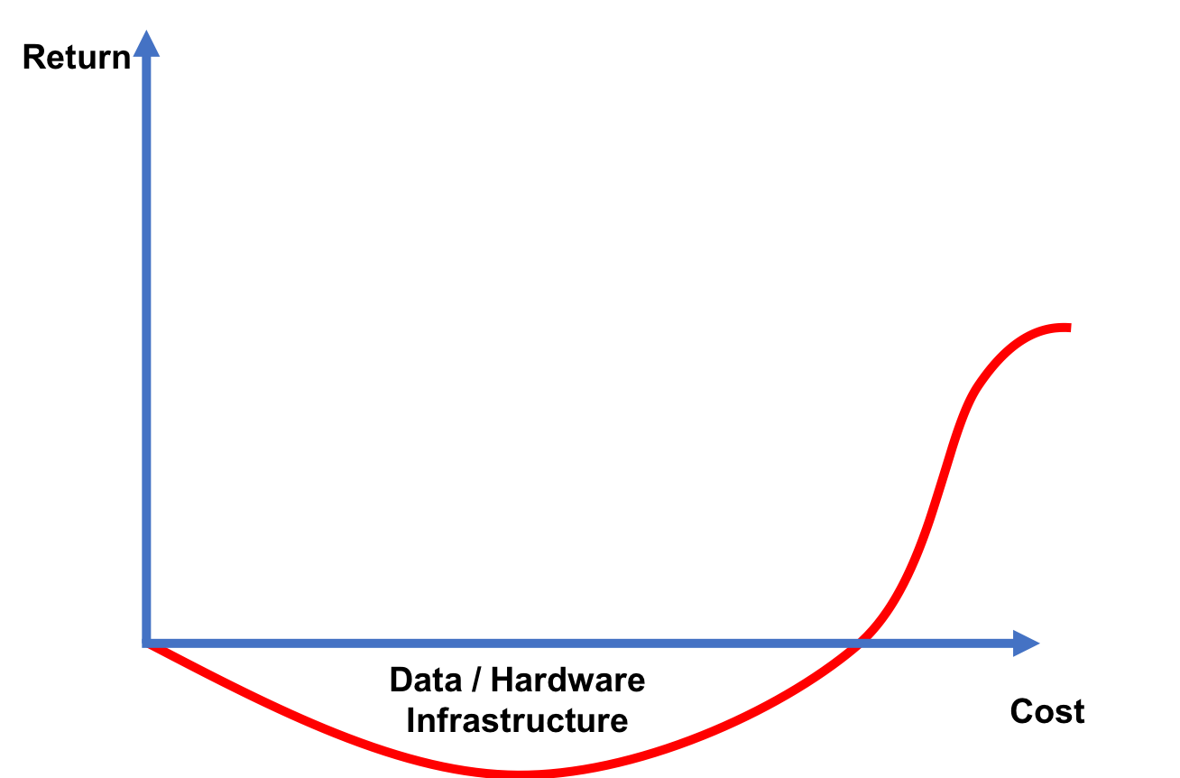
Long product delivery term (2~3 years)
High cost
Massive human resources
$150000 = 1 Big Data Engineer
Annotation
Massive hardware cost
Large selling team
Unclear business model
Customer requirements are illusive yet
Hard to be adaptive to changes
Data Feed API
Expensive selling cost
Low product return

Slide 8
Objectives:
Minimal Data Infrastructure
Training Data (Annotated Data)
Minimal Data Sources (Structured Data Source)
Minimal Software Engineering
Maximal Business Value
Maximal

Slide 9
Return
$150000 = 3 AI Ph.D.
Engineering
Data Infrastructure
Deep Learning Infrastructure
Cost

Slide 10
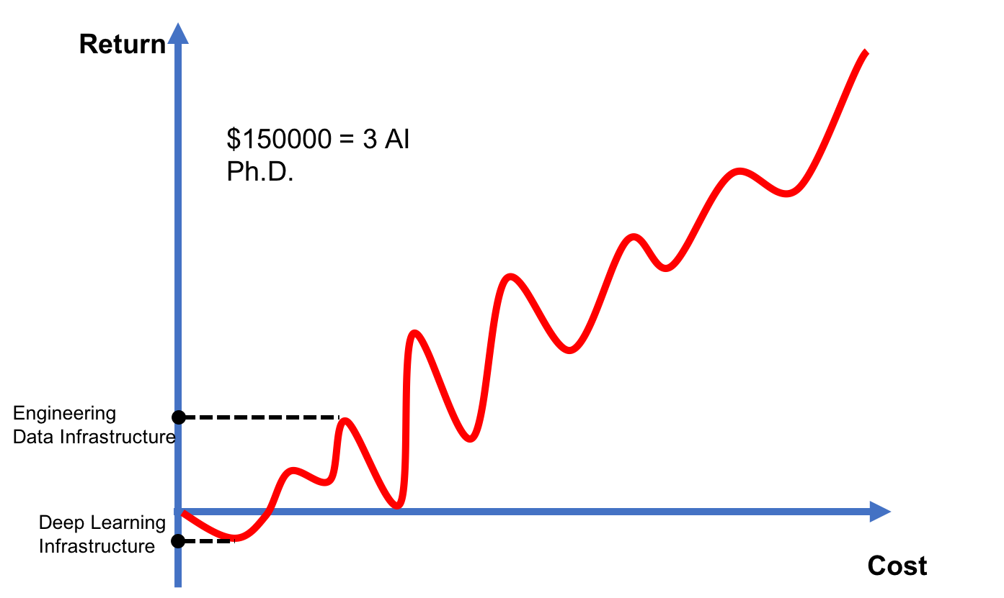
Short product delivery term (4-6 months)
Low cost
$150000 = 3 A.I. Ph.D. Students
Lower hardware cost
Clear business model
Specific custom requirements
Transferable model; Quickly adaptive to requirements changes
Viable A.I. Product
No sales team; Dev on demand
Higher product return

