Slide 1
Optimizing Lower Linear Envelope Using Latent Structural SVM
Chang Li & Stephen Gould

Slide 2
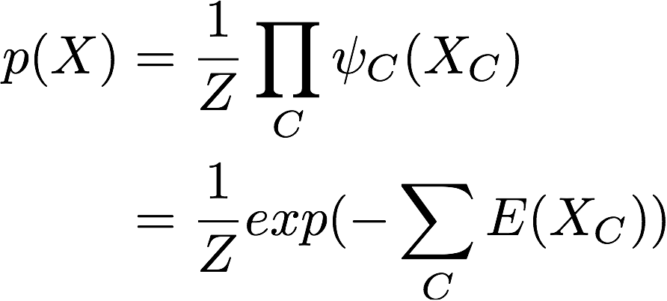
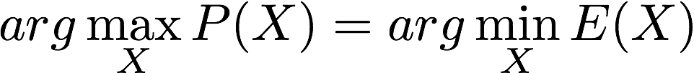
Background: Binary MRF
Potentials & Energy Function
MAP & Energy Minimization
Pattern Recognition and Machine Learning. Bishop.

Slide 3
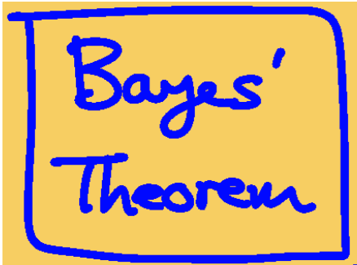
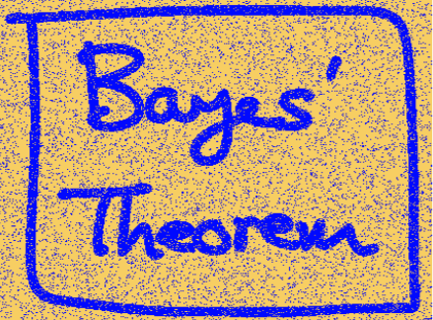
Background: A Simple Example
Adding some noisy by flipping the sign of the pixels with probability 10%.

Slide 4
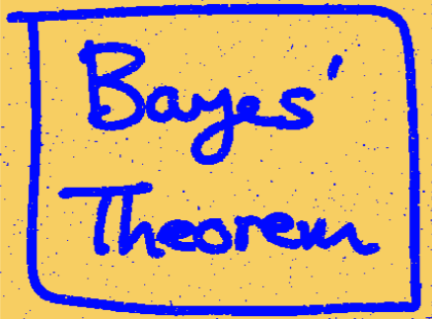
Background: A Simple Example
Denoising Without
Original Image
If one pixel is blue, then its neighbors should also be blue.

Slide 5
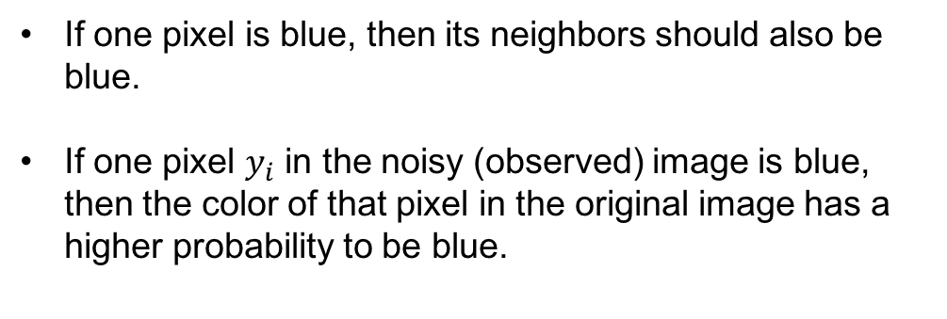
Background: A Simple Example
Denoising Without
Original Image

Slide 6
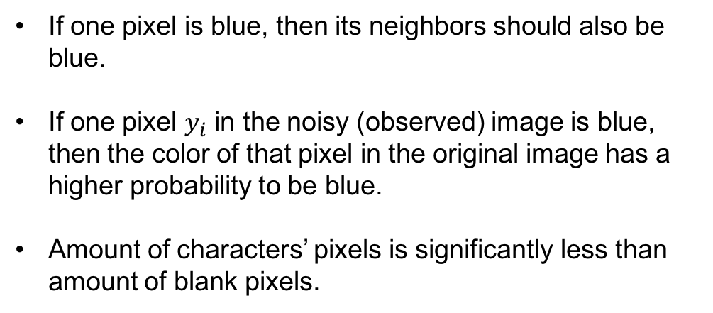
Background: A Simple Example
Denoising Without
Original Image

Slide 7
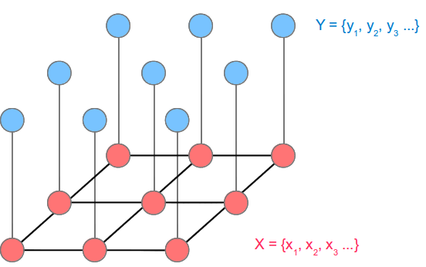
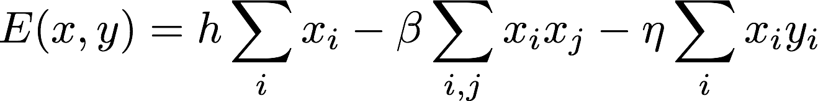
Background: A Simple Example

Slide 8
Background: A Brief Summary
Energy Function: Defining an arbitrary nonnegative function over a set of variables (encoding prior or expert knowledge).
Inference: Find the assignments minimizing the energy function.
Learning: Optimizing parameters in energy function so that the ground truth assignments’ energy is less than any other assignments’.

Slide 9
Topics
Energy Function: Higher Order Potentials
Inference Method: Graph Cut
Drawback In Previous Research
Our Contribution: Latent Structured SVM Optimization

Slide 10
Energy Function
Unary
Pairwise
Y
Y | 0 | 1
 | 2 | 3
 | 0 | 1
0 | 2 | 3
1 | 4 | 5
X
Gould 2014, PAMI

Slide 11
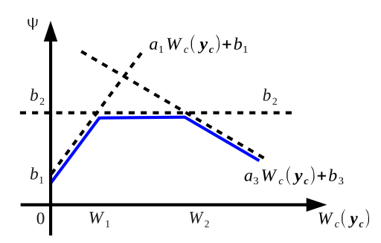
Energy Function: Higher Order Potentials
Weighted Lower Linear Envelope

Slide 12
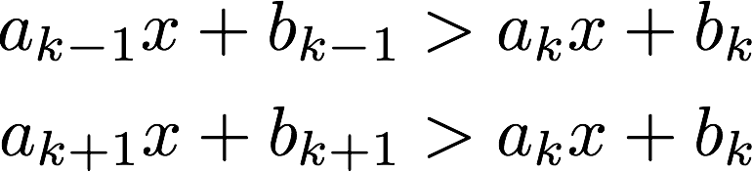
Energy Function: Higher Order Potentials
Weighted Lower Linear Envelope

Slide 13
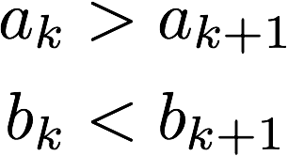
Energy Function: Higher Order Potentials
Weighted Lower Linear Envelope
S.T.

Slide 14
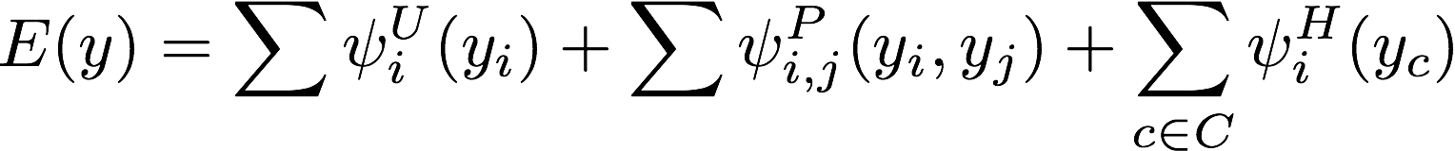
Energy Function

Slide 15
Topics
Energy Function: Higher Order Potentials
Inference Method: Graph Cut
Drawback In Previous Research
Our Contribution: Latent Structured SVM Optimization

Slide 16
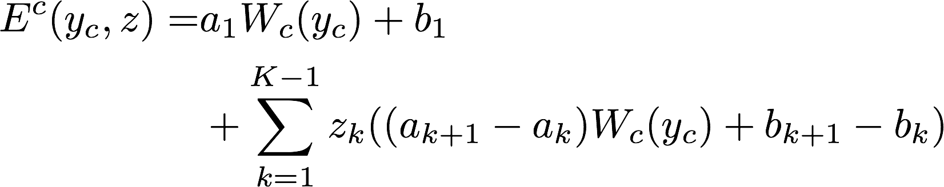
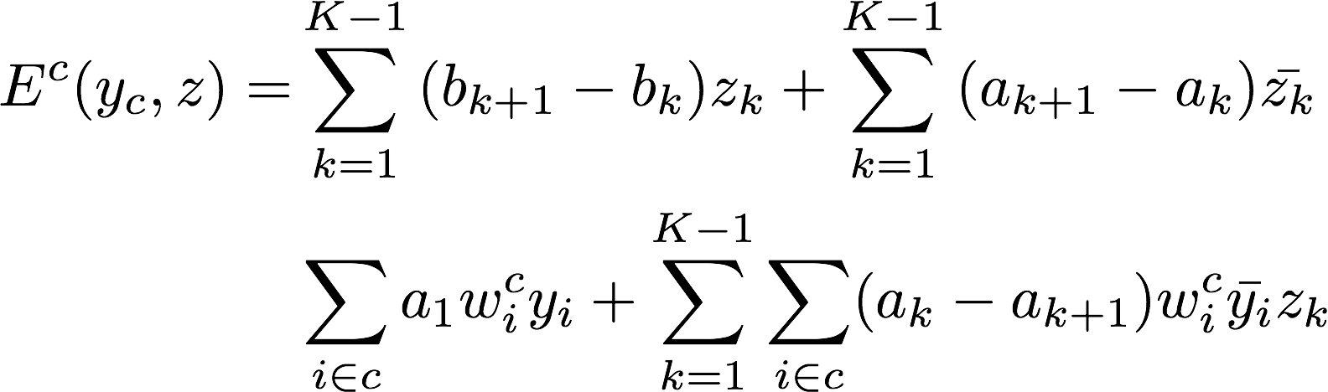
Graph Cut: Pseudo-Boolean function & Posiform
Introducing K-1 binary auxiliary variables into function
Posiform of the function (constants are dropped)
Gould 2014, PAMI

Slide 17
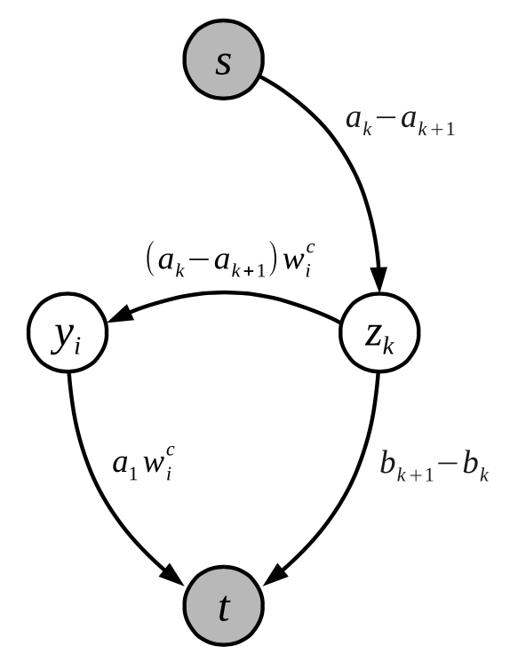
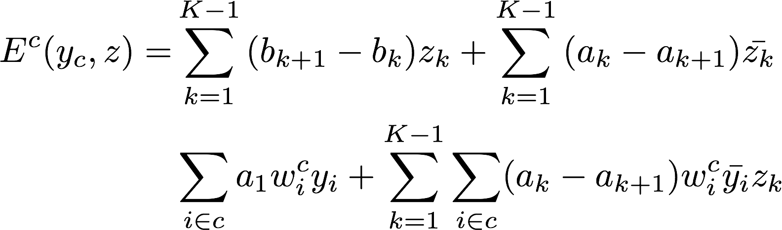
Graph Cut
1
0

Slide 18
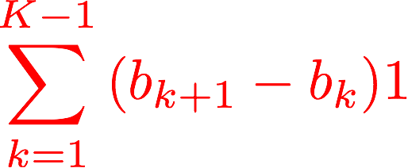

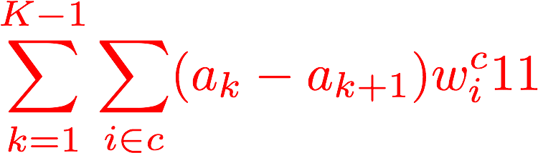
Graph Cut
1
0

Slide 19
Topics
Energy Function: Higher Order Potentials
Inference Method: Graph Cut
Drawback In Previous Research
Our Contribution: Latent Structured SVM Optimization

Slide 20
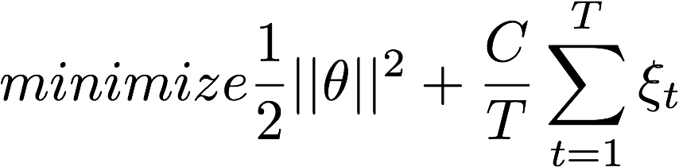
Cons of interpolation
To optimize the Energy Function, we use max-margin formulation. This requires us to write the Energy Function into a linear combination of weights and features.
We sample the Lower Linear Envelope at fixed space intervals.

Slide 21
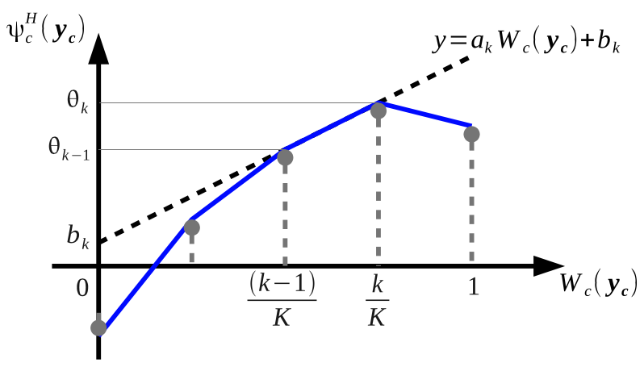

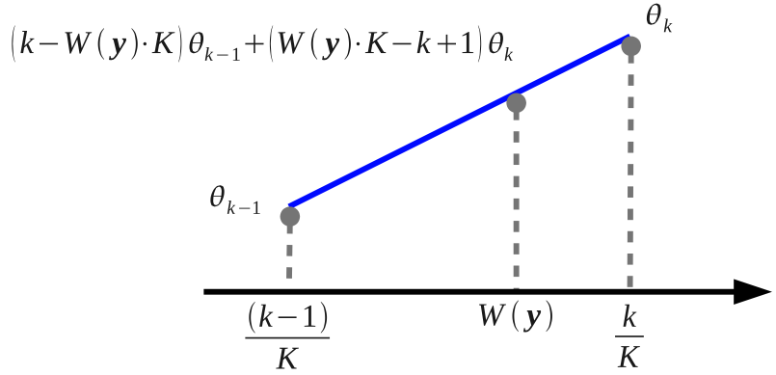
Cons of interpolation
Are K+1 sampled values.
The interpolated value is a linear combination of weights and feature vector.

Slide 22
Therefore, we can globally optimize weights vector using max-margin framework.
The price is that we lose a rich class of representations.

Slide 23
Topics
Energy Function: Higher Order Potentials
Inference Method: Graph Cut
Drawback In Previous Research
Our Contribution: Latent Structured SVM Optimization

Slide 24
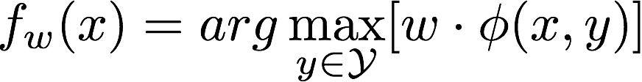
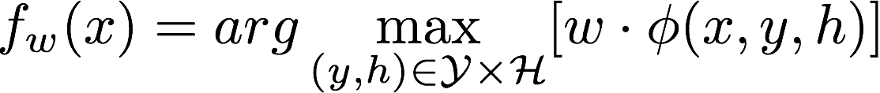
Latent Structured SVM
Structured SVM
Latent Structured SVM

Slide 25
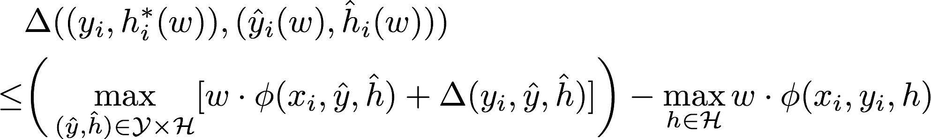
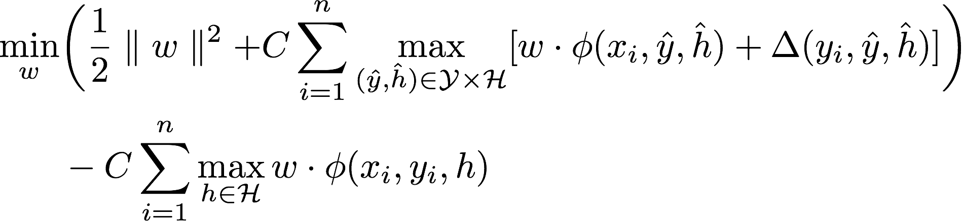
Latent Structured SVM
Hinge Loss Style Upper Bound
Optimization Problem

Slide 26

Latent Structured SVM
Optimization Problem
In Our Problem
Auxiliary variables
are hidden variables.

Slide 27
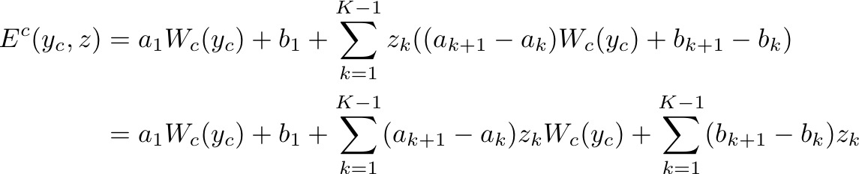
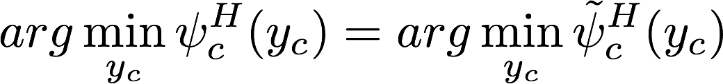
Our Formulation

Slide 28
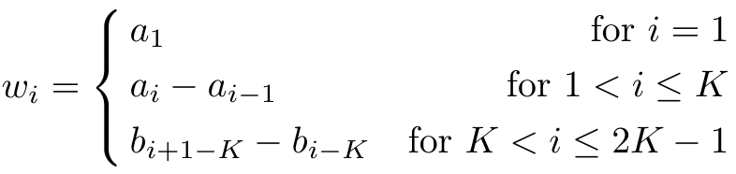
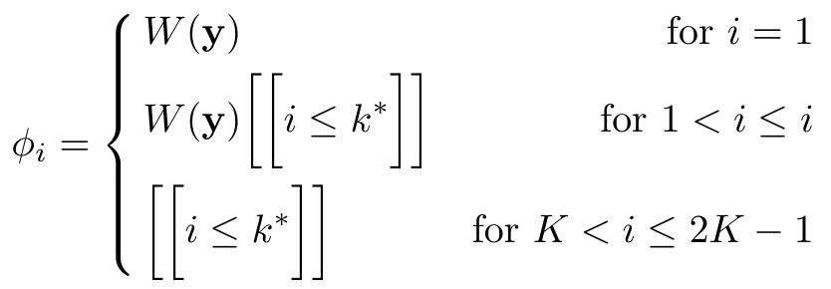

Our Formulation

Slide 29
That’s All. Thanks!

