Slide 1












$$D_{k}$$
$$D_{k+1}$$
$$G_{k}$$
$$G_{k+1}$$
$$E_{k}$$
$$E_{t+1}$$
$$E_{t{\text{+}D}_{k}\text{−}1}$$
$$S_{k}$$
$$S_{t+1}$$
$$S_{t+2}$$
$$S_{t{\text{+}D}_{k}\text{−1}}$$
$$S_{k+\text{1}}$$

Slide 2






$$D_{k^{1}}^{1}$$
$$G_{k^{1}}^{1}$$
$$D_{k^{2}}^{2}$$
$$G_{k^{2}}^{2}$$
$$E_{k^{N}}$$
$$S_{k}$$
$$S_{t+1}$$

Slide 3









$$O_{t}$$
$$O_{t+1}$$
$$β_{t}$$
$$β_{t+1}$$
$$a_{t}$$
$$a_{t+1}$$
$$S_{t}$$
$$S_{t+1}$$
$$S_{t+2}$$

Slide 4











$$G_{t}$$
$$G_{t+1}$$
$$E_{t}$$
$$E_{t+1}$$
$$O_{t}$$
$$O_{t+1}$$
$$S_{t}$$
$$S_{t+1}$$
$$S_{t+2}$$
$$a_{t}$$
$$a_{t+1}$$
$$S_{t}$$
$$S_{t+1}$$
$$S_{t+2}$$

Slide 5
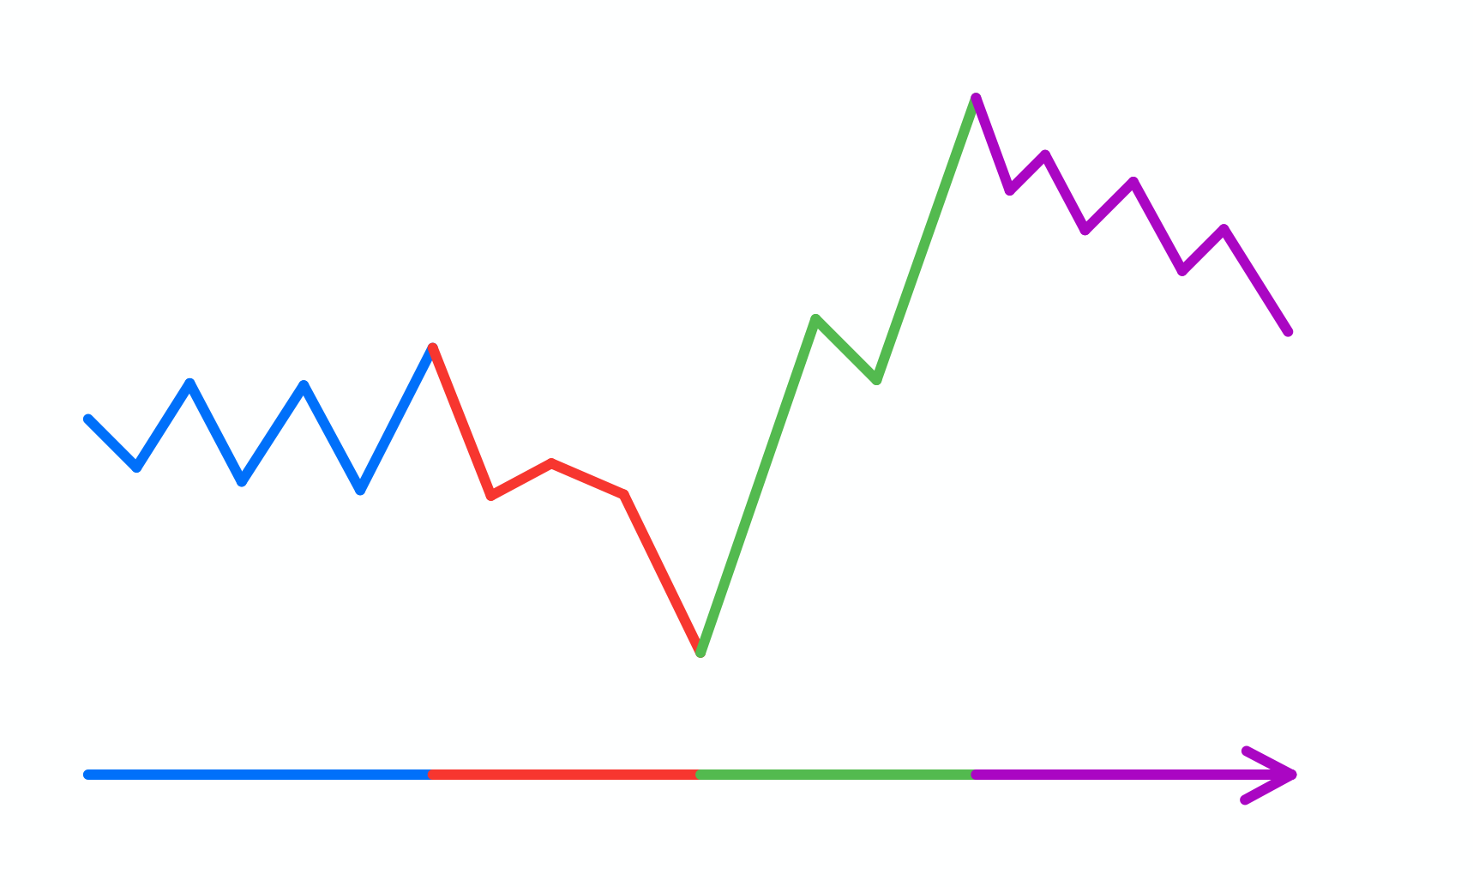
Price
Price
C
D
A
B
C
D
Date
A
B
Time

Slide 6
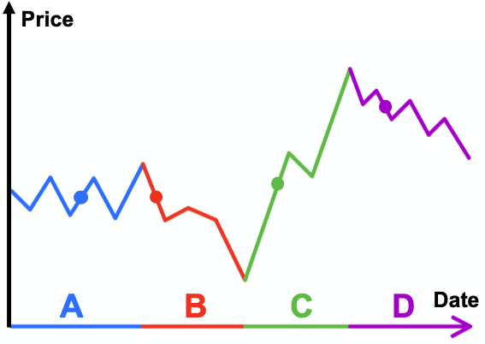
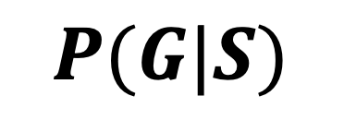

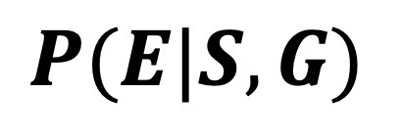
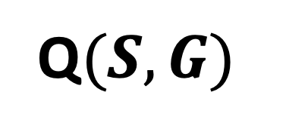

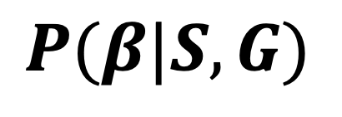





$$G_{N}$$
$$G_{2}$$
Market Environment
$$G_{1}$$
Q$(S,G)$
$$P(β|S,G)$$
$$E$$
$$G$$
$$P(G|S)$$
$$P(E|S,G)$$
Manager LSTM
Manager Level
Strategy LSTM
Strategy Level
$$S$$
$$S$$

Slide 7





































$$O_{t−1}$$
$$O_{t}$$
$$O_{t+1}$$
$$O_{t−1}$$
$$O_{t+1}$$
$$β_{t−1}$$
$$β_{t}$$
$$β_{t+1}$$
$$β_{t−1}$$
$$β_{t}$$
$$β_{t+1}$$
$$a_{t−1}$$
$$a_{t}$$
$$a_{t+1}$$
$$a_{t−1}$$
$$a_{t}$$
$$a_{t+1}$$
$$S_{t−1}$$
$$S_{t}$$
$$S_{t+1}$$
$$S_{t+2}$$
$$S_{t−1}$$
$$S_{t}$$
$$S_{t+1}$$
$$S_{t+2}$$
$$R_{t}$$
$$R_{t+1}$$
$$R_{t+2}$$
$$R_{t}$$
$$R_{t+1}$$
$$R_{t+2}$$
$$G_{t−1}$$
$$G_{t}$$
$$G_{t+1}$$
$$G_{t−1}$$
$$G_{t}$$
$$G_{t+1}$$

Slide 8
















$$O_{t−1}$$
$$O_{t}$$
$$O_{t+1}$$
$$a_{t−1}$$
$$a_{t}$$
$$a_{t+1}$$
$$S_{t−1}$$
$$S_{t}$$
$$S_{t+1}$$
$$S_{t+2}$$
$$R_{t}$$
$$R_{t+1}$$
$$R_{t+2}$$
$$G_{t−1}$$
$$G_{t}$$
$$G_{t+1}$$

Slide 9
















$${\overline{O}}_{t−1}$$
$${\overline{O}}_{t}$$
$${\overline{O}}_{t+1}$$
$$a_{t−1}$$
$$a_{t}$$
$$a_{t+1}$$
$$S_{t−1}$$
$$S_{t}$$
$$S_{t+1}$$
$$S_{t+2}$$
$$R_{t}$$
$$R_{t+1}$$
$$R_{t+2}$$
$$G_{t−1}$$
$$G_{t}$$
$$G_{t+1}$$

Slide 10
































$$O_{t−1}^{1}$$
$$O_{t}^{1}$$
$$O_{t+1}^{1}$$
$$β_{t−1}^{1}$$
$$β_{t}^{1}$$
$$β_{t+1}^{1}$$
$$a_{t−1}$$
$$a_{t}$$
$$a_{t+1}$$
$$S_{t−1}$$
$$S_{t}$$
$$S_{t+1}$$
$$S_{t+2}$$
$$O_{t−1}^{1}$$
$$O_{t}^{1}$$
$$O_{t+1}^{1}$$
$$β_{t−1}^{1}$$
$$β_{t}^{1}$$
$$β_{t+1}^{1}$$
$$β_{t−1}^{2}$$
$$O_{t−1}^{2}$$
$$β_{t}^{2}$$
$$O_{t}^{2}$$
$$β_{t+1}^{2}$$
$$O_{t+1}^{2}$$
$$O_{t−1}^{3}$$
$$O_{t}^{3}$$
$$O_{t+1}^{3}$$
$$S_{t−1}$$
$$S_{t}$$
$$S_{t+1}$$
$$S_{t+2}$$

Slide 11
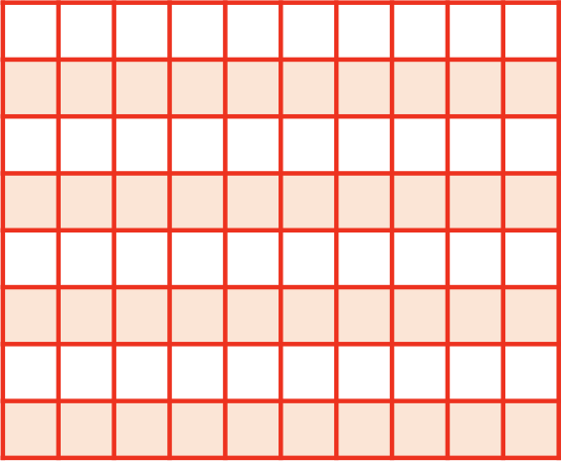
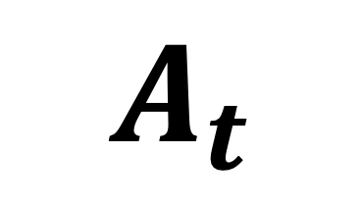
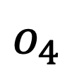
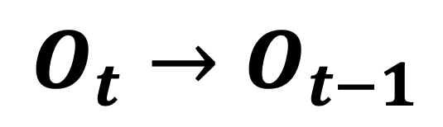


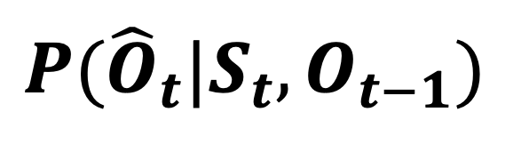
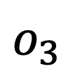
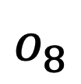

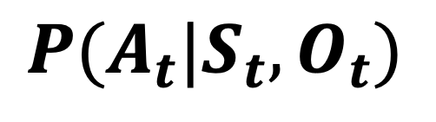
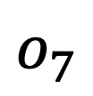
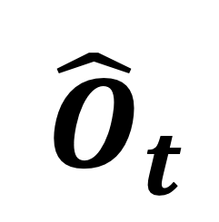
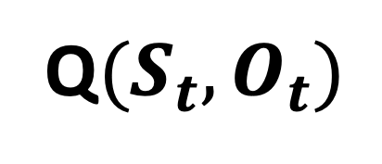
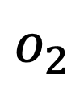


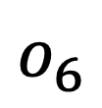

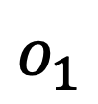
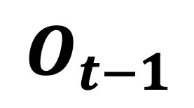


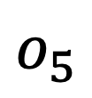

$$O_{8}$$
$$O_{2}$$
$$O_{1}$$
Q$(S_{t},O_{t})$
$$A_{t}$$
$$P({\hat{O}}_{t}|S_{t}, O_{t−1})$$
Multi-head Attn
$$P(A_{t}|S_{t},O_{t})$$
Environment
Multi-head Attn
Value
Key
Query
Value
Query
Skill Policy
Key
Action Policy
$$S_{t}$$
$$Concat[S_{t}, O_{t−1}]$$
$$O_{t−1}$$
$$Concat[S_{t}, O_{t}]$$
$${\hat{O}}_{t}$$
$$O_{t}$$
Skill Context Matrix
$$o_{1}$$
$$o_{2}$$
$$o_{3}$$
$$o_{4}$$
$$W$$
$$o_{5}$$
$${O_{t}→O}_{t−1}$$
$$W$$
$$o_{6}$$
$$o_{7}$$
$$o_{8}$$

Slide 12
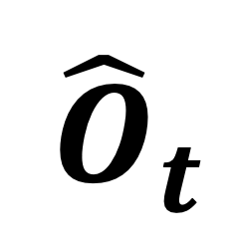


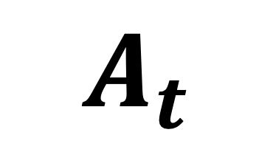
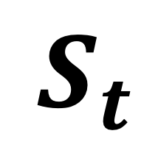
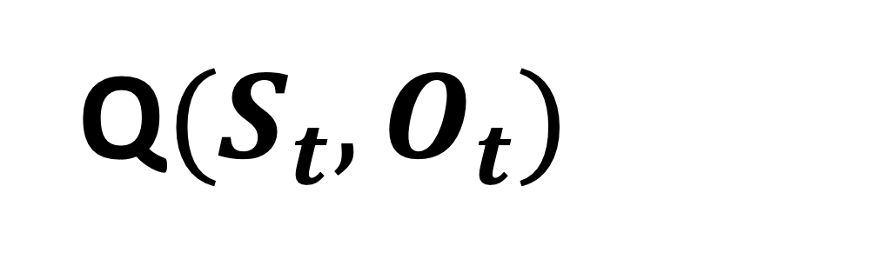




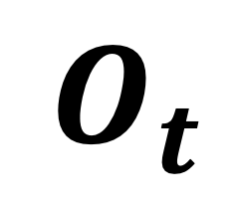


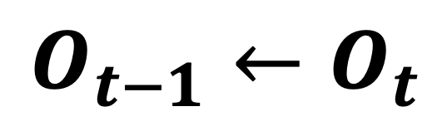

$$P({\hat{O}}_{t}|S_{t}, O_{t−1})$$
Value
M
H
A
Key
Query
Skill Policy
$$W$$
$${\hat{O}}_{t}$$
Skill Context Matrix
$$o_{1}$$
$$o_{2}$$
$$O_{t}$$
$$O_{8}$$
$$o_{3}$$
$$O_{2}$$
$$o_{4}$$
$$W$$
$$O_{1}$$
$$A_{t}$$
$$o_{5}$$
Value
M
H
A
$$P(A_{t}|S_{t},O_{t})$$
$$Concat[S_{t}, O_{t}]$$
$$o_{6}$$
C
Key
$$o_{7}$$
$$o_{8}$$
Query
Action Policy
$$Concat[S_{t}, O_{t−1}]$$
C
$${O_{t−1}←O}_{t}$$
$$Concat[S_{t}, O_{t}]$$
Q$(S_{t},O_{t})$
C
$$R$$
$$S_{t}$$
Environment

Slide 13




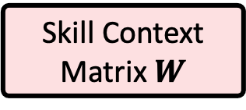

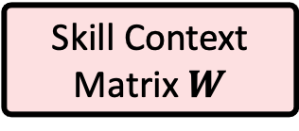

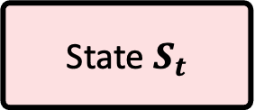


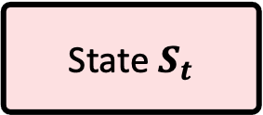



$${\overline{O}}_{t}$$
Option
Policy
Categorical
Distribution
Linear
Add & Norm
Feed Forward
Action
Policy
$$A_{t}$$
Critic
$$Q_{O}$$
Add & Norm
Gaussian
Distribution
Feed Forward
Multi-Head Attention
Feed Forward
$$Query$$
$$Key$$
Feed Forward
$$Concat[S_{t}, {\hat{O}}_{t}]$$
C
$$Concat[S_{t}, {\hat{O}}_{t−1}]$$
$${\hat{O}}_{t}$$
C
Skill Context Matrix $W$
State $S_{t}$
$${\hat{O}}_{t−1}$$
$$W$$
State $S_{t}$
Skill Context Matrix $W$
$${\overline{O}}_{t−1}$$

Slide 14





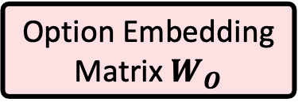



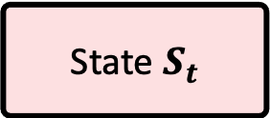

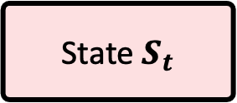


$${\overline{O}}_{t}$$
Option
Policy
Categorical
Distribution
$P({\overline{O}}_{t}|S_{t},{\overline{O}}_{t−1}$)
Linear
Critic
$$Q_{O}[S_{t},{\hat{O}}_{t}]$$
Clustering
Feed Forward
Add & Norm
Feed Forward
$$A_{t}$$
Add & Norm
Action
Policy
${P(A}_{t}|S_{t},{\hat{O}}_{t}$)
Multi-Head Attention
Gaussian
Distribution
Query
Key
Value
Feed Forward
Feed Forward
$$Concat[S_{t}, {\hat{O}}_{t−1}]$$
C
$$Concat[S_{t}, {\hat{O}}_{t}]$$
$${\hat{O}}_{t−1}$$
$$W_{O}$$
C
State $S_{t}$
Option Embedding
Matrix $W_{O}$
$${\hat{O}}_{t}$$
State $S_{t}$
$${\overline{O}}_{t−1}$$

Slide 15
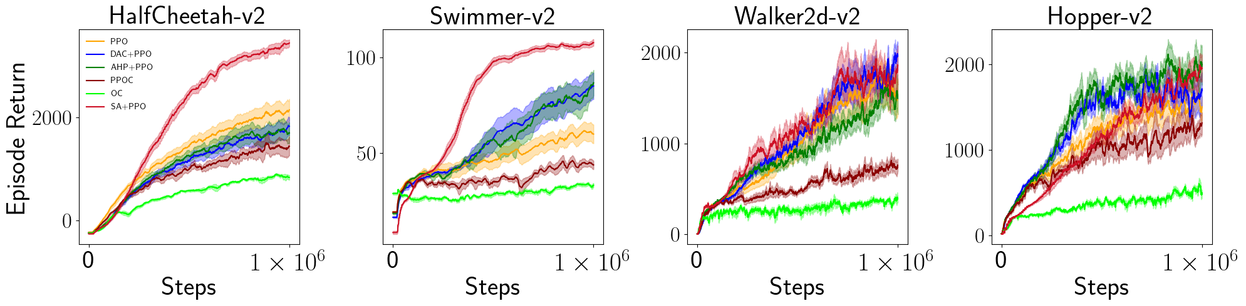
Infinite Horizon Games
Episodic Games

Slide 16
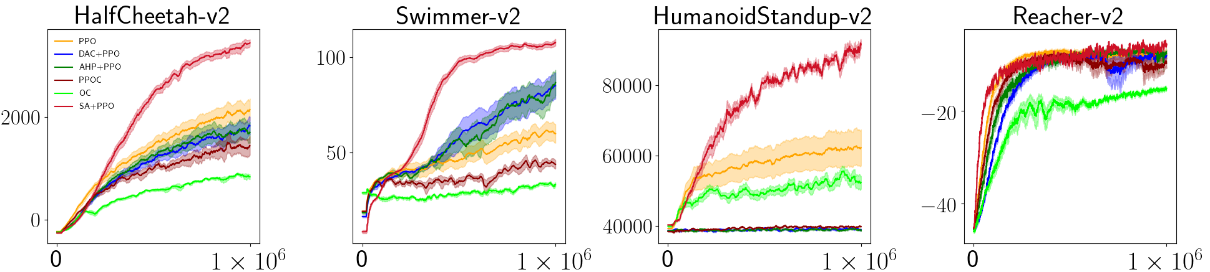
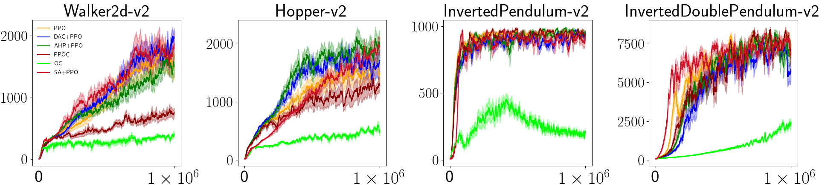

Slide 17
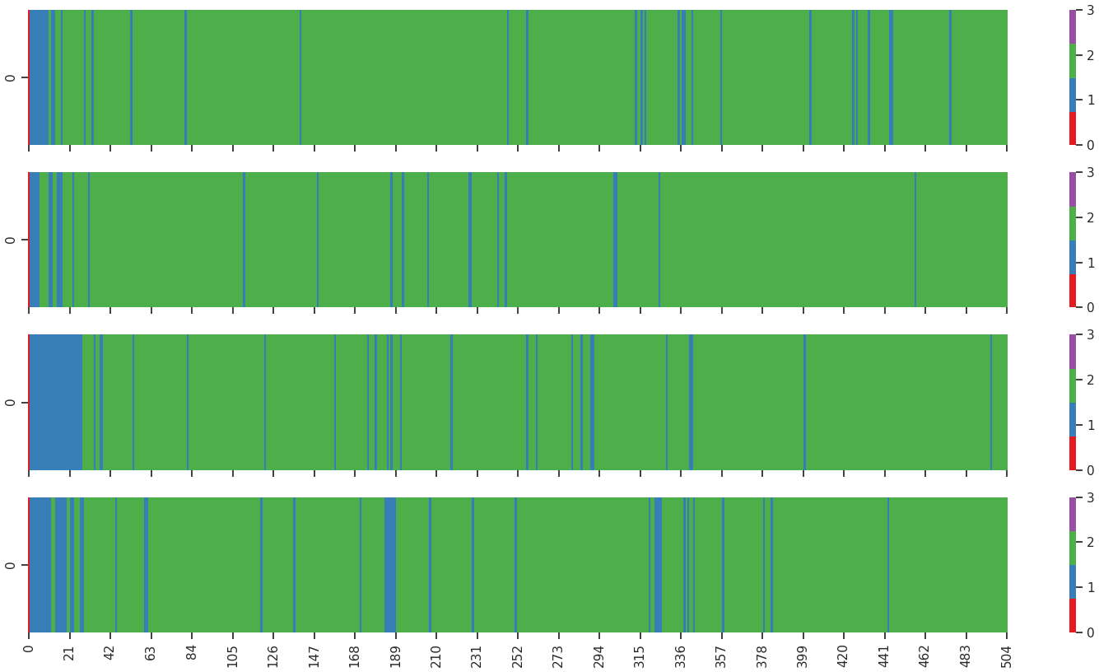
Run 1
Run 2
Run 3
Run 4

Slide 18
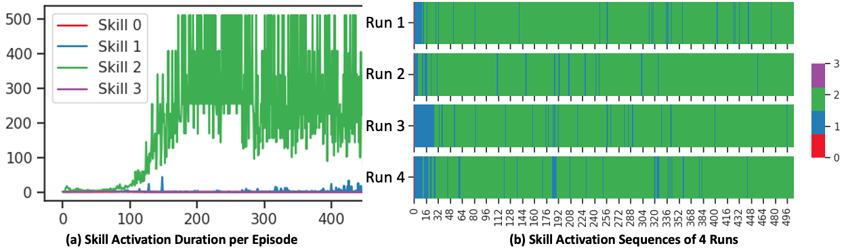
Average Skill Duration in Timesteps
Episodes
Timesteps

