Slide 1
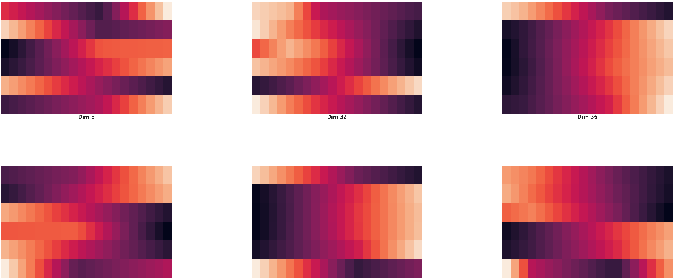
Dim5:
Back Leg Jump
Dim2:
Back Leg Run
Dim36:
Front Leg Run
Dim11:
Back Leg Landing
Dim15:
Front Leg Landing
Dim22:
Balance

Slide 2
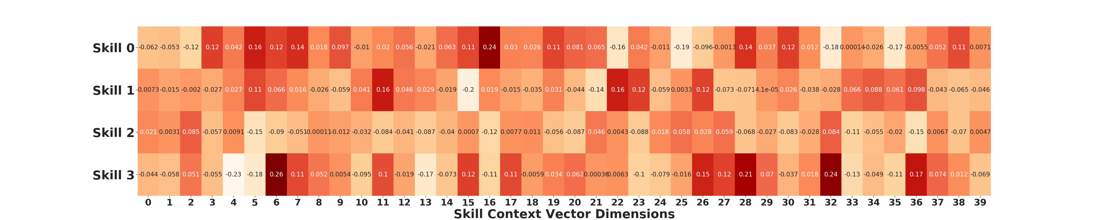
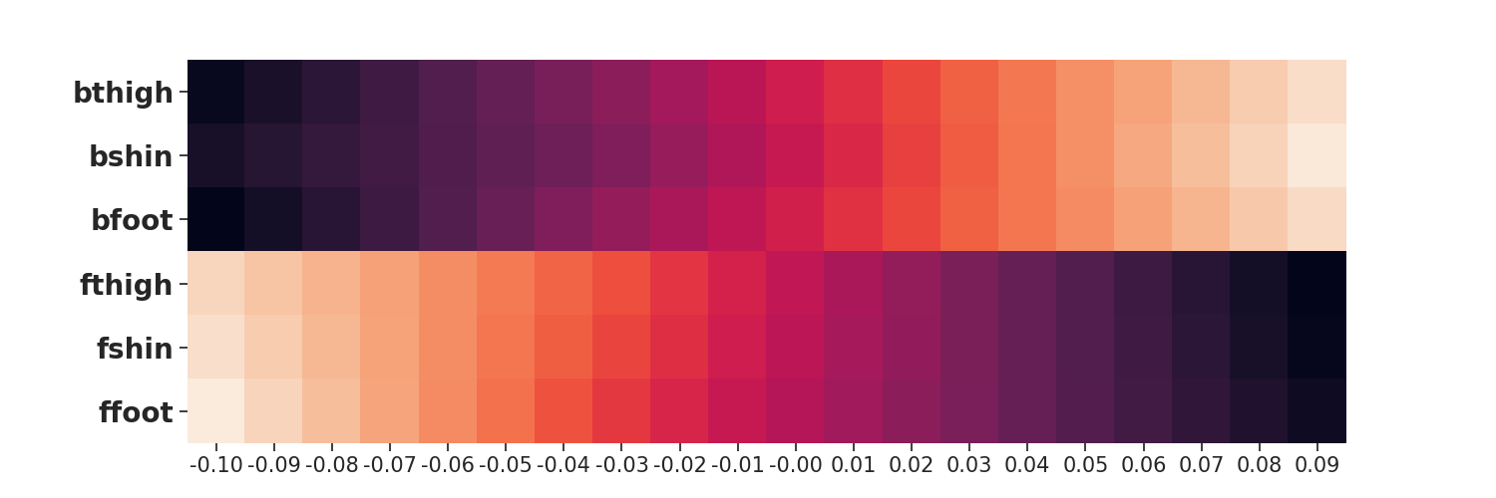
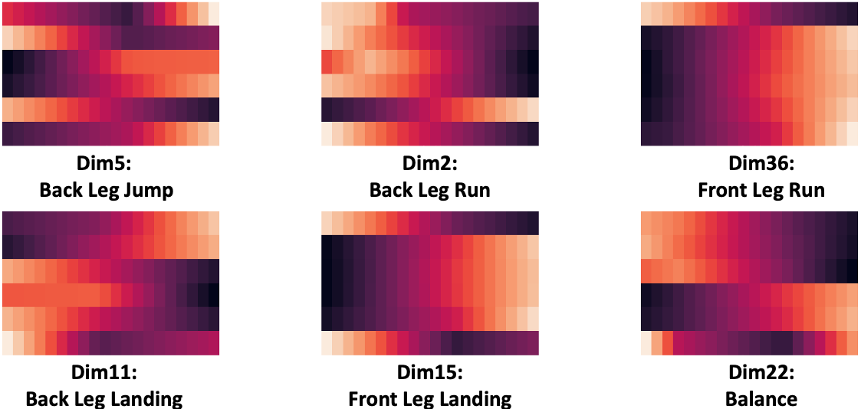
Option 1
Option 2
Option 3
Option 4
(a) Option Embedding Matrix: x-axis is the index of embedding dimensions
(b) 20 Perturbations of Dimension 0
(c) Perturbations of Dim 2, 5, 11, 15, 22, 36

Slide 3
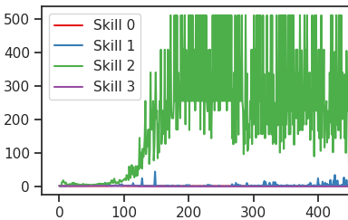
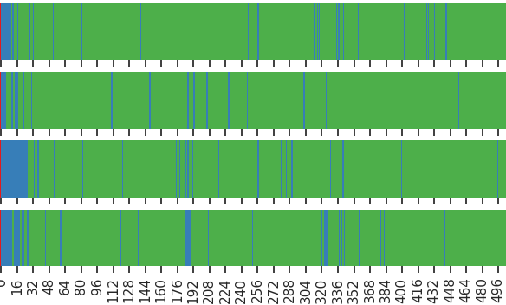
Option 1
Option 2
Option 3
Option 4
(a) Option Execution Duration per Episode
Run 1
Run 2
Run 3
Run 4
(b) Execution duration of all options of 4 Runs

Slide 4

Run 1
Run 2
Average Skill Duration in Timesteps
Run 3
Run 4
Episodes
Timesteps
(a) Skill Activation Duration per Episode
(b) Skill Activation Sequences of 4 Runs

