Slide 1

Interpretability Using Attention
Yaren Zhang

Slide 2
Topics
Encoder-Decoder
Attention
Multi-head Attention
Attention in CNNs

Slide 3
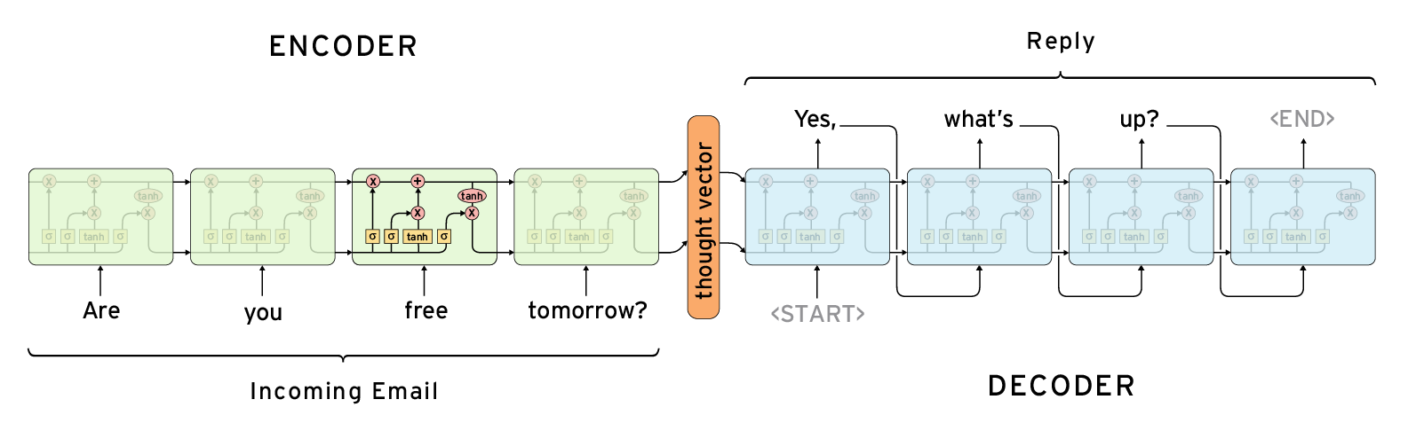
Encoder-Decoder
Problem:
RNNs require fixed dimension of inputs and targets
Solution: Encoder-Decoder (2 RNNs)
Encode the various length of sequence into a single, fixed length vector using encoder
Decoder decodes that vector and generate translation

Slide 4
Topics
Encoder-Decoder
Attention
Multi-head Attention
Attention in CNNs

Slide 5
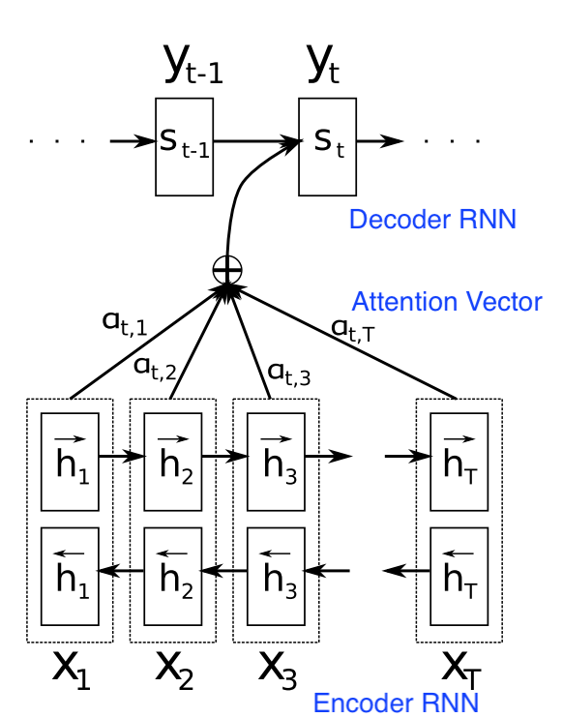
Attention
Problem:
One single fixed-length vector
Performance of a basic encoder–decoder deteriorates rapidly as the length of an input sentence increases
Solution: Attention Weights
Provide a sequence of encoded vectors on which decoder network can do soft-searches

Slide 6
Topics
Encoder-Decoder
Attention
MHA (Multi-head Attention)
Attention in CNNs

Slide 7
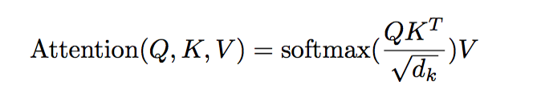
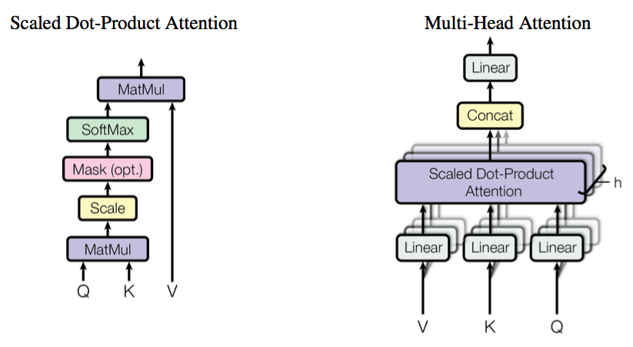
MHA (Multi-head Attention)
An attention function can be described as mapping a query Q and a set of key-value pairs to an output, where the query, keys, values, and output are all vectors
MHA:
linearly project the queries, keys and values h times with different, learned linear projections to dk, dk and dv dimensions, respectively

Slide 8
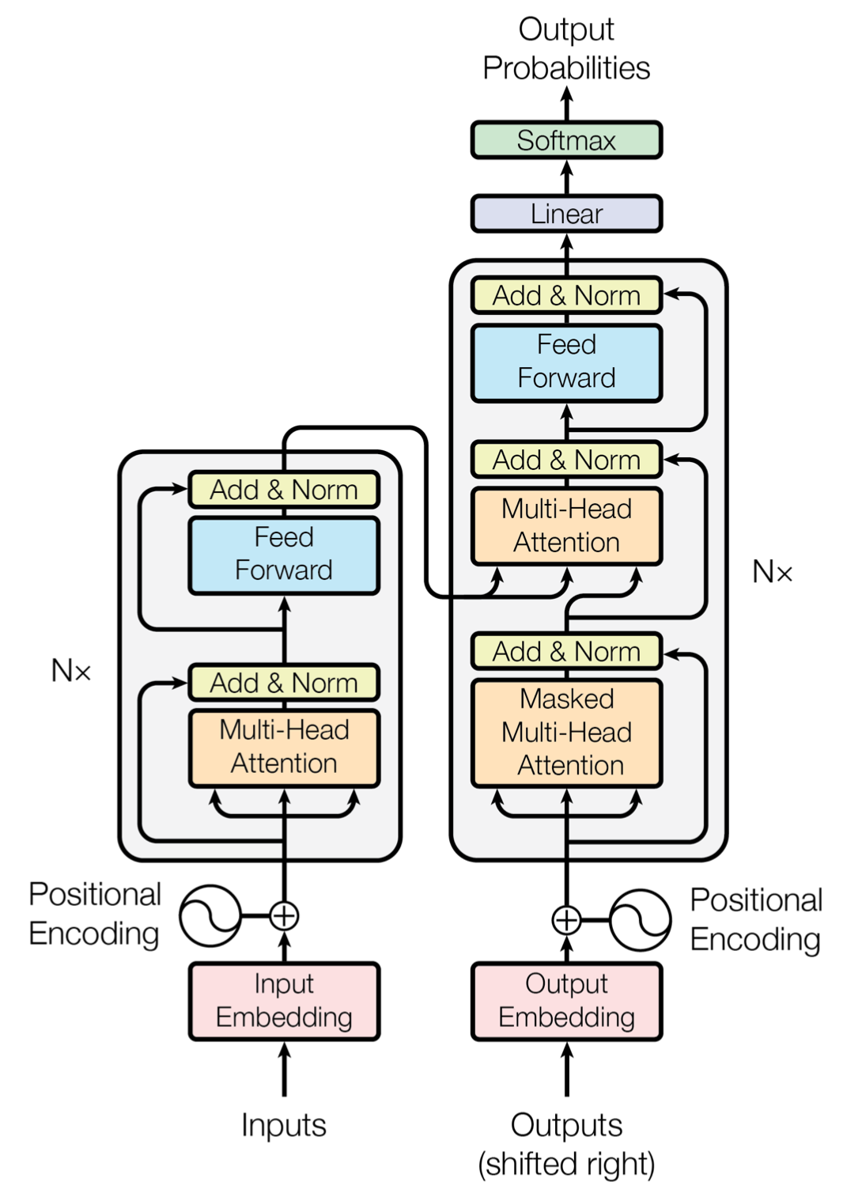
Attention is all you need
Problem:
Recursive structure. Computationally expensive
Solution: Multi-head Feed-forward Net
Allow each head to generate different distributions over encoder output

Slide 9
MHA (Multi-head Attention)
Insight:
There might be some equilibrium between LSTM (gated RNNs) and Attention Mechanism

Slide 10
Topics
Encoder-Decoder
Attention
MHA (Multi-head Attention)
Attention in CNNs

Slide 11
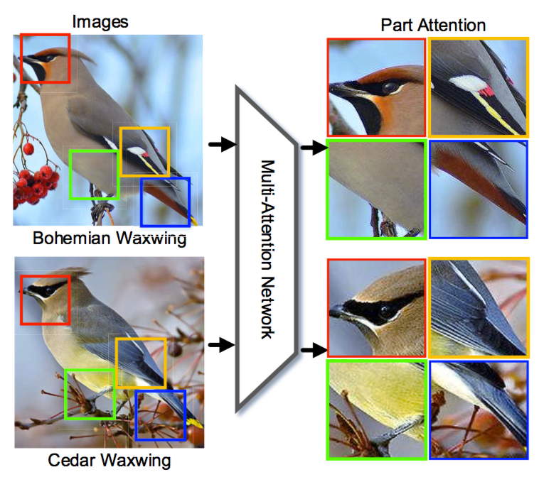
Attention in CNNs
Channel: a certain type of visual pattern
Parts: multiple attention areas with strong discrimination ability in an image

Slide 12
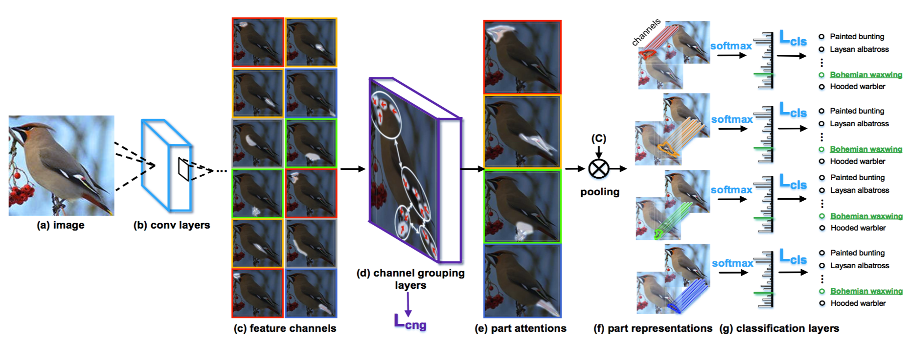
Attention in CNNs
Channel Grouping Layers:
Takes as input feature channels from convolutional layers, and generates multiple parts by clustering, weighting and pooling from spatially-correlated channels
Attention of channels ~= Interpretability

Slide 13
Appendix A
Approximating DNNs using human friendly models
Sampling from DNNs
GAN
Distill

