Slide 1
Part One, Directed PGMs:
Hidden Markov Models (HMMs)
Single Sequence:
Multi-timescale Abstraction
Reinforcement Learning
Part Two, Undirected PGMs:
Markov Random Fields (MRFs)
Multi-Sequences:
Higher-order Dynamics
Supervised Learning

Slide 2
$$O_{t−1}$$
$$O_{t}$$
$$O_{t+1}$$
$$a_{t−1}$$
$$a_{t}$$
$$a_{t+1}$$
$$S_{t−1}$$
$$S_{t}$$
$$S_{t+1}$$
$$S_{t+2}$$
$$R_{t}$$
$$R_{t+1}$$
$$R_{t+2}$$
$$G_{t−1}$$
$$G_{t}$$
$$G_{t+1}$$

Slide 3












$$X$$
$$Y_{t−1}$$
$$Y_{t}$$
$$Y_{t+1}$$
$$Z$$
$$Y$$
$$S_{t−1}$$
$$S_{t}$$
$$S_{t+1}$$
$$C$$
$$A$$
$$B$$

Slide 4
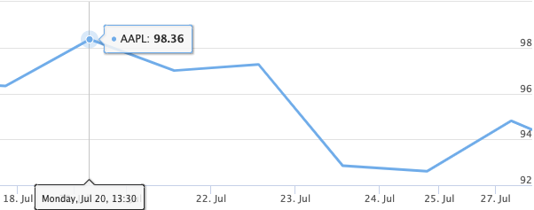
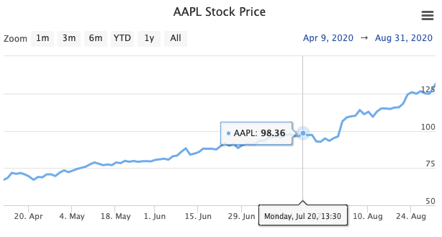


Slide 5
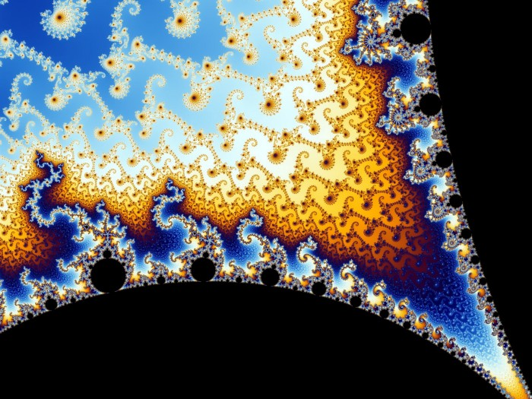

Slide 6
