Slide 1
Editor
Proof-of-concept #2

Slide 2
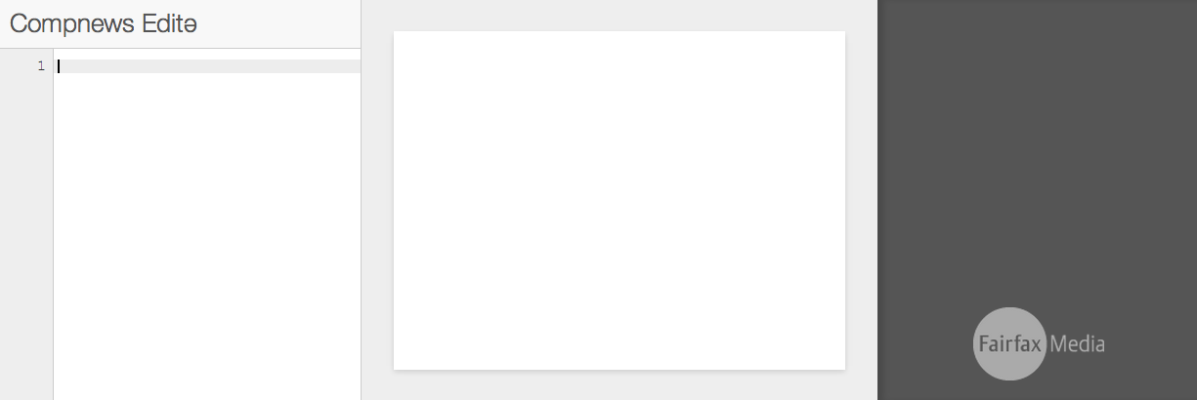
Notes:
Our platform is designed to understand written news, but what if we could integrate more closely with the writing process?
The proof-of-concept editor injects our state-of-the-art Natural Language Processing technology into the writer’s tools. As we type, entities are found in the text and underlined.
We’ve linked the names to Wikipedia pages and their profiles are listed in the entity stack.

Slide 3
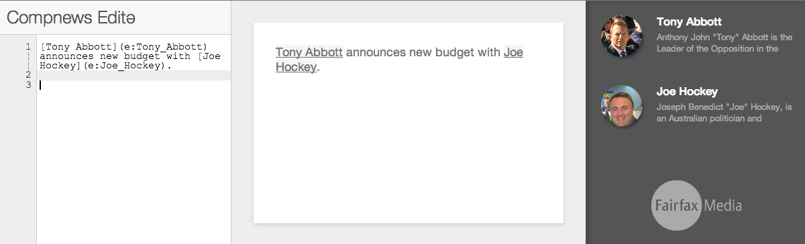

Slide 4
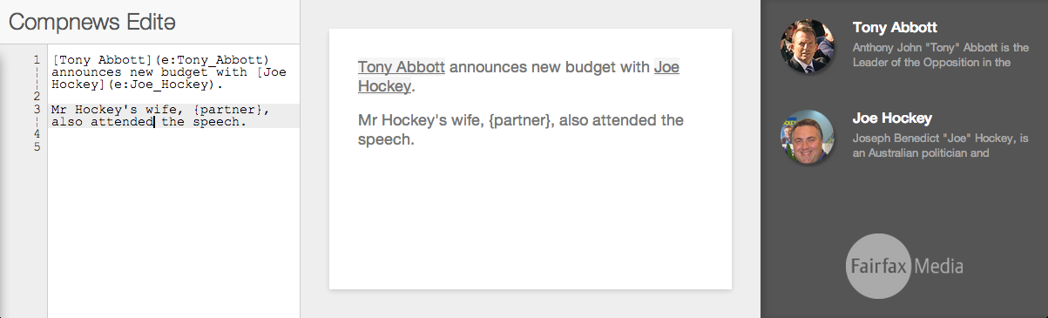
Notes:
Resolving identity is critical here, as this lets us quickly access facts and information about the entity to use in the writing process. Here, we use the “{partner}” macro to autocomplete text with facts from Wikipedia.

Slide 5
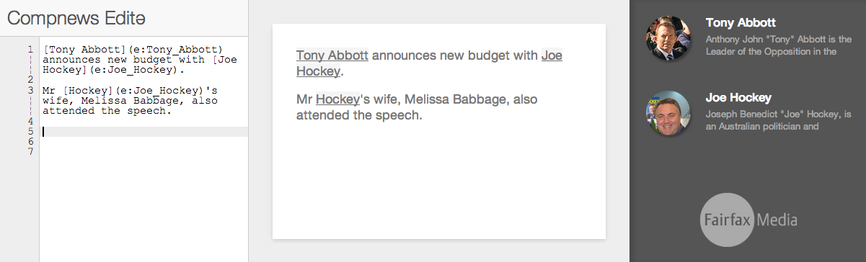
Notes:
Putting humans in the loop this way is really important: we can check and correct system output, but also collect data to feed back into the system to improve it.
The editor is a really powerful way of integrating structured information into the writing process to produce rich, detailed stories.

