Slide 1
Insight
Proof-of-concept #4

Slide 2
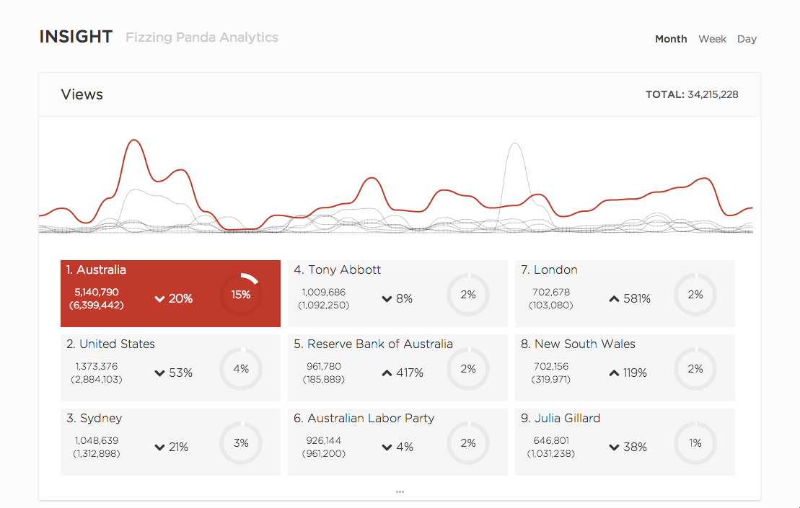
Notes:
Zoom extracts and links entities in two decades of Sydney Morning Herald stories.
We were also interested in turning that focus outward: what Herald stories are people reading, what are people sharing on Twitter?
To explore this, we developed a proof-of-concept tool called “Insight”. This shows page view trends and Twitter sharing over different time grains.
In this month view, Australia is really prominent, as you’d expect.

Slide 3
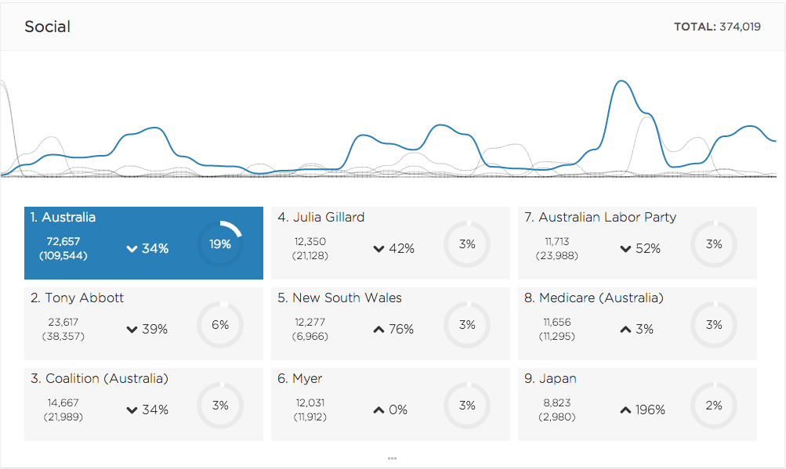
Notes:
This chart shows the volume of Twitter shares of stories mentioning our entities. Again, Australia is popular here.

Slide 4
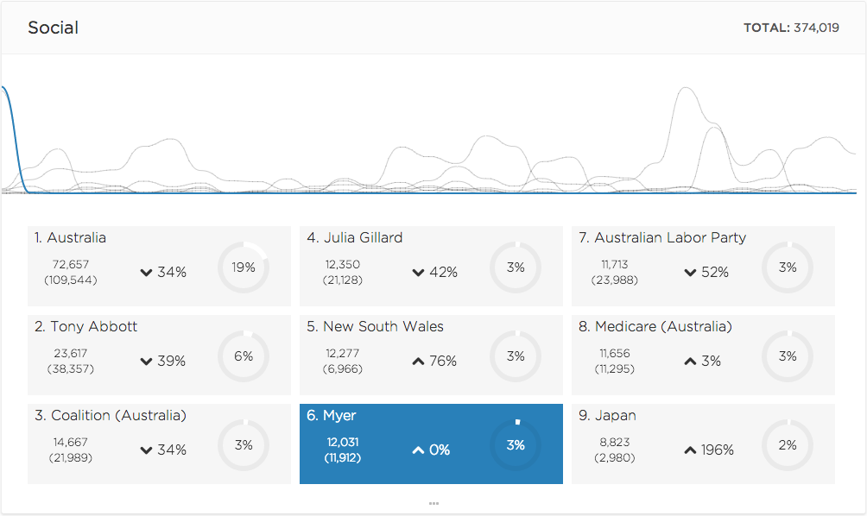
Notes:
But here’s something a bit unexpected.
There’s a huge spike in Twitter sharing at the beginning of May 2013 for stories mentioning the department store, Myer.

Slide 5
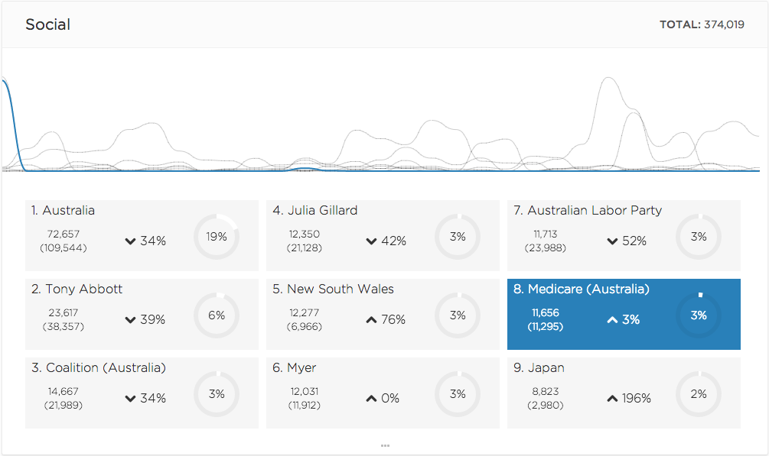
Notes:
We see an almost identical trend for sharing of Medicare articles.
This was driven by the Myer boss, Bernie Brookes’ comments about the National Disability Insurance Scheme.
People disagreed and shared the story, so what insight has uncovered here is a viral event through the people and organisations involved in it.

