Slide 1
Shorty
Proof-of-concept #1

Slide 2
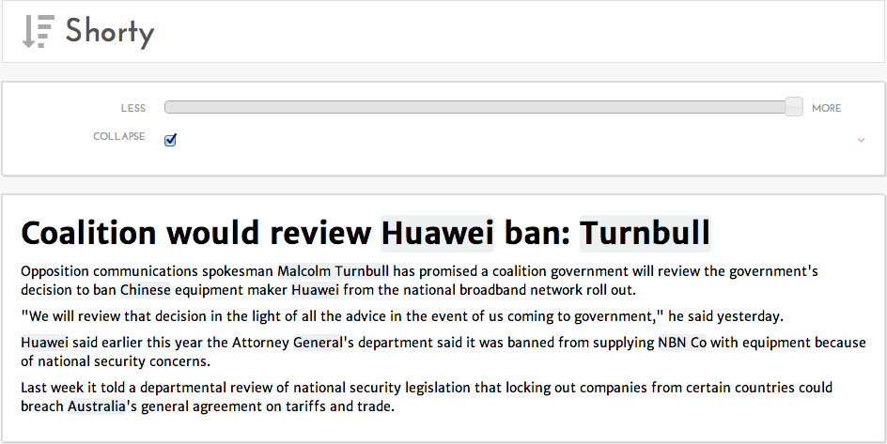
Notes:
“Shorty” uses the Computable News platform to summarise news stories.
Here’s a story from the Sydney Morning Herald. Our system has automatically identified names from the document including “Malcolm Turnbull” and again “Turnbull” in the headline.

Slide 3
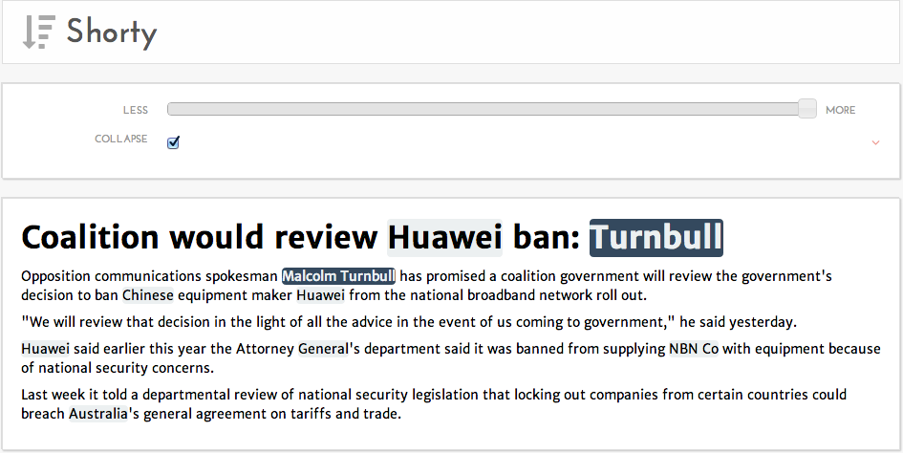

Slide 4
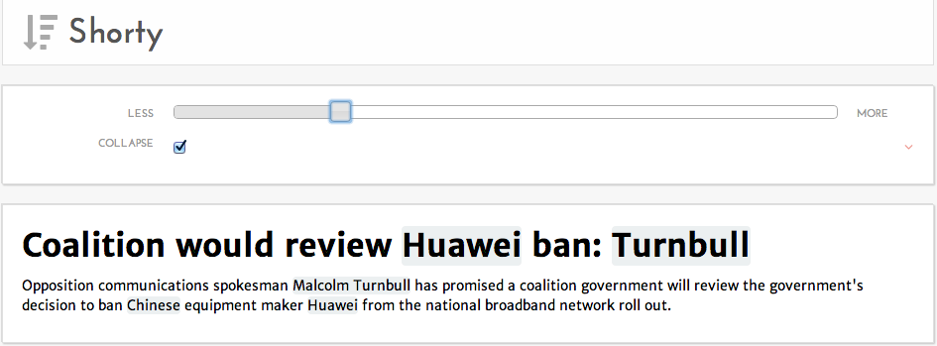
Notes:
This display might be fine on a desktop screen if I have time to read at my leisure. But, move to a mobile device or need to absorb news fast, then I need to be more selective about what I read.
I can move this slider and reduce the number of sentences I need to read.
<scroll slider to reduce sentences>

Slide 5
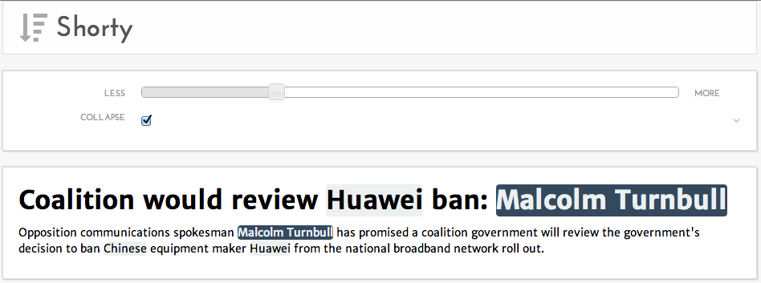
Notes:
Now, we get the details in less reading time. The system also clarifies names where it can, changing “Turnbull” to “Malcolm Turnbull”.

