Slide 1
amp
Proof-of-concept #3

Slide 2
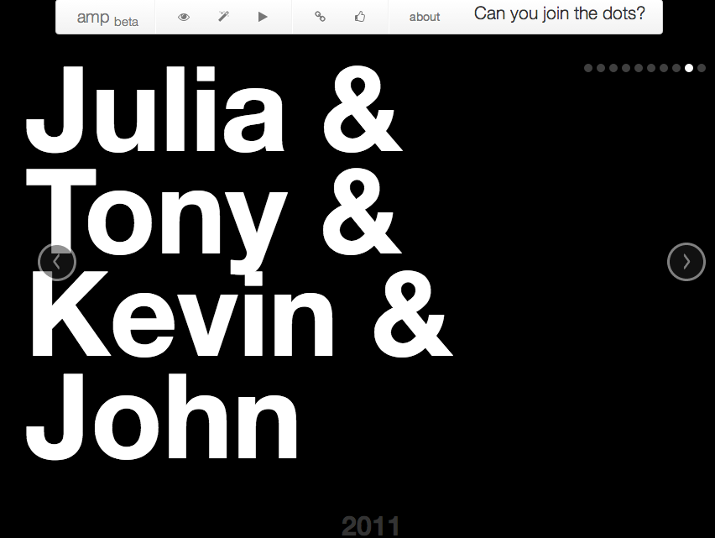
Notes:
Our platform finds and links people mentioned in news stories and identifies relationships between them.
We wanted to think outside the box about what you can do with the platform, and came up with a game that tests your news trivia knowledge.
To play, guess how the four names are connected.

Slide 3
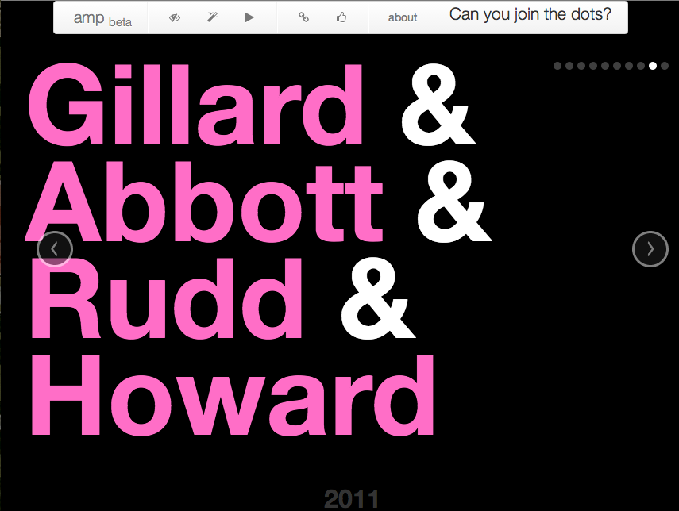
Notes:
If you’re stuck, we can peek at the answers.

Slide 4

Notes:
We get some genuinely interesting insights into how people in the news are connected.
Here’s another political example, this time, New South Wales.

Slide 5

Notes:
We had to look up David Ipp, but he’s a former commissioner for the NSW Independent Commission Against Corruption.
We like to think of amp as an automatically-generated game over two decades of data.

