Slide 1
Real-time Updates
Machine Learning Models
Domain Knowledge
Fraud Detection System
Supervised Detections
Blacklist / Whitelist
Rules / Patterns
Un-supervised Alerts
Knowledge Base
Contracts
User Profile
Device Profile
Transactions
User Info
Device Info

Slide 2
Real-time Updates
Machine Learning Models
Domain Knowledge
Fraud Detection System
Supervised Detections
Blacklist / Whitelist
Rules / Patterns
Un-supervised Alerts
Knowledge Base
User Profile
Device Profile
Transactions
User Info
Device Info

Slide 3
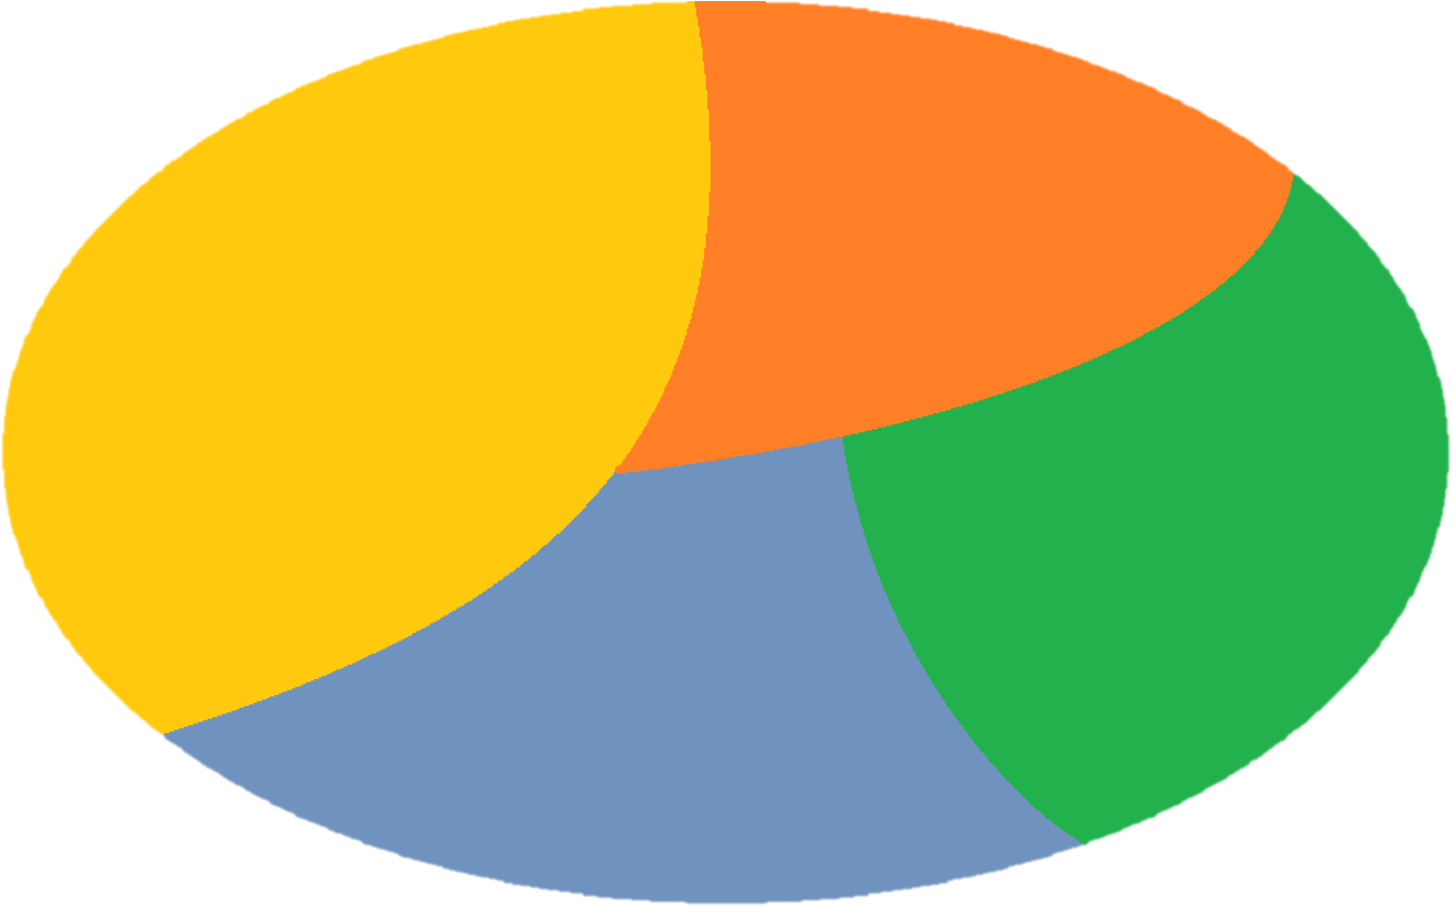
Eftpos Knowledge Base
Industry Statistics
Google
Trends
Amount
Industry
Date / Time
Customer
Mobile
Merchant
Marketing
Info
Location
Discount Info
Census Data
Economic Indicators
Figure 1. Eftpos Knowledge Base (Entities’ Profile Database). Variables in ellipse are those Eftpos already have. Variables outside are accessible external sources from Bureau of Statistics, company’s website etc.

