Slide 1

Breast Cancer Diagnosis Using Machine Learning
CSE 572 – Prof. Yanjie Fu
Aditya Deshpande
Amit Ashok Manjarly
(Checkpoint 1)

Slide 2
01
03
05
Introduction
Exploratory Data Analysis(EDA)
Model 1: Logistic Regression
02
04
06
Dataset Overview
Data Preprocessing
Model 2: k-Nearest Neighbors (KNN)

Slide 3
01. Introduction
OBJECTIVE:
To build and evaluate machine learning models capable of
accurately diagnosing breast cancer tumors as either
malignant or benign based on cellular characteristics.
DATASET:
We will use the Wisconsin Diagnostic Breast Cancer (WDBC) dataset.

Slide 4
APPROACH
Perform Exploratory Data Analysis (EDA) to understand the data.
Preprocess the data to prepare it for modeling.
Train two initial models: Logistic Regression and k-Nearest Neighbors (kNN).
Evaluate and compare their performance.

Slide 5
02. Dataset Overview
Source: University of Wisconsin Hospitals, created by Dr. William H. Wolberg, W. Nick Street, and Olvi L. Mangasarian.
Content: Features are computed from digitized images of a fine needle aspirate (FNA) of a breast mass, describing the characteristics of the cell nuclei.
Instances: 569 total samples.
Class Distribution: 357 Benign (B) and 212 Malignant (M) cases.
Features:
  Each sample has 30 real-valued features.
  These are the mean, standard error, and "worst" value for 10 core measurements (e.g., radius, texture, smoothness).

Slide 6
03. EXPLORATORY DATA ANALYSIS

Slide 7
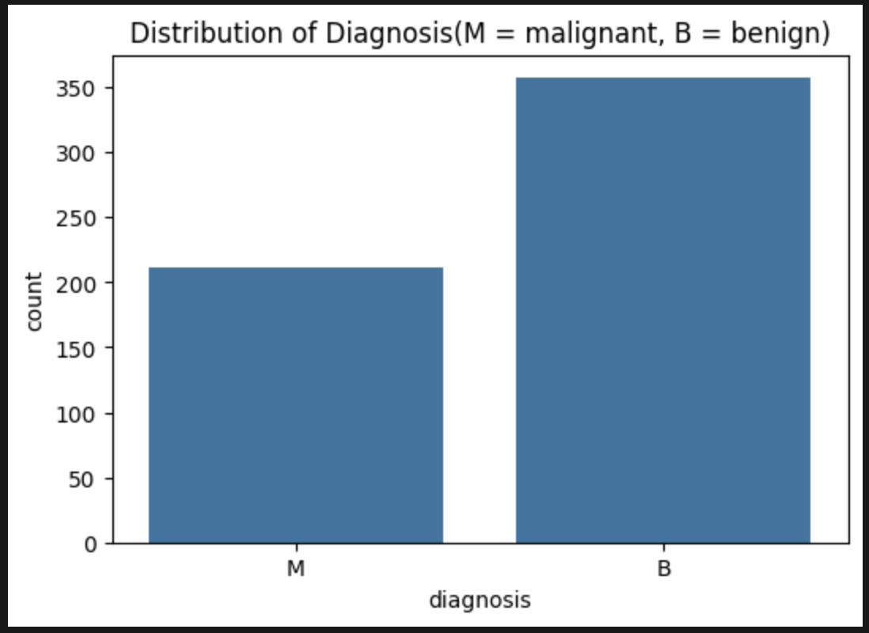
CLASS DISTRIBUTION
How many samples of each diagnosis do we have?
Key Insight: The dataset is somewhat imbalanced, with more benign samples (357) than malignant ones (212). This is important to consider during model evaluation.

Slide 8
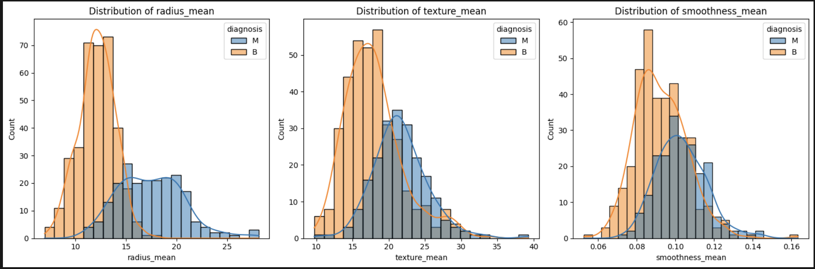
FEATURE DISTRIBUTION
How do key features differ between Malignant and Benign tumors?
Key Insights:
Radius Mean: Malignant tumors (M) generally have a larger mean radius than benign tumors (B).
Texture Mean: There is a significant overlap, but malignant tumors tend to have a wider and slightly higher texture mean.
Smoothness Mean: The distributions overlap considerably, suggesting smoothness alone may not be a strong predictor.

Slide 9
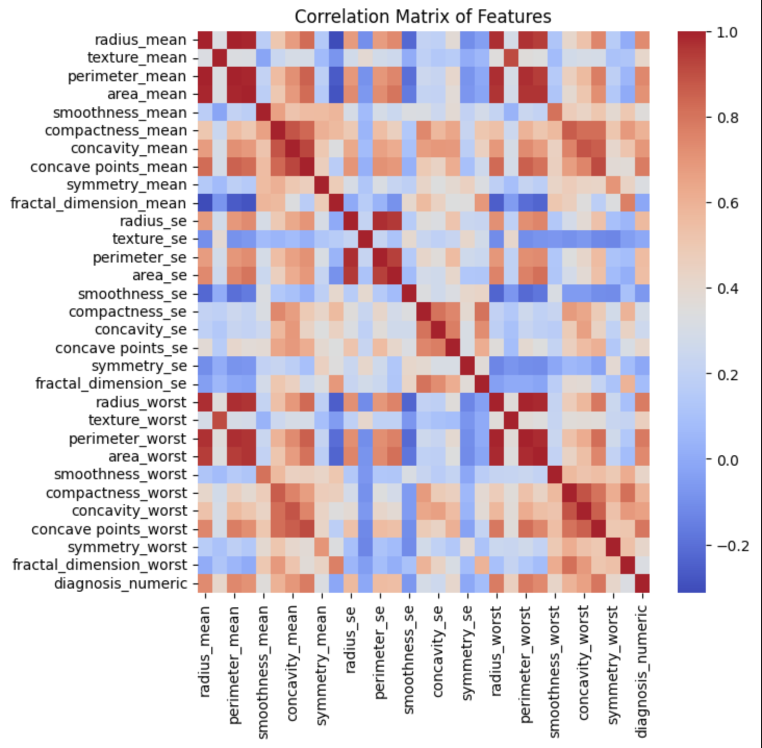
CORRELATION MATRIX
How are the features related to each other?
Key Insights:
Many features are highly correlated (e.g., radius_mean, perimeter_mean, and area_mean), which is expected.
This strong multicollinearity suggests that dimensionality reduction techniques (like PCA) or models robust to it (like tree-based models) could be beneficial later on.

Slide 10
04. Data Preprocessing

Slide 11
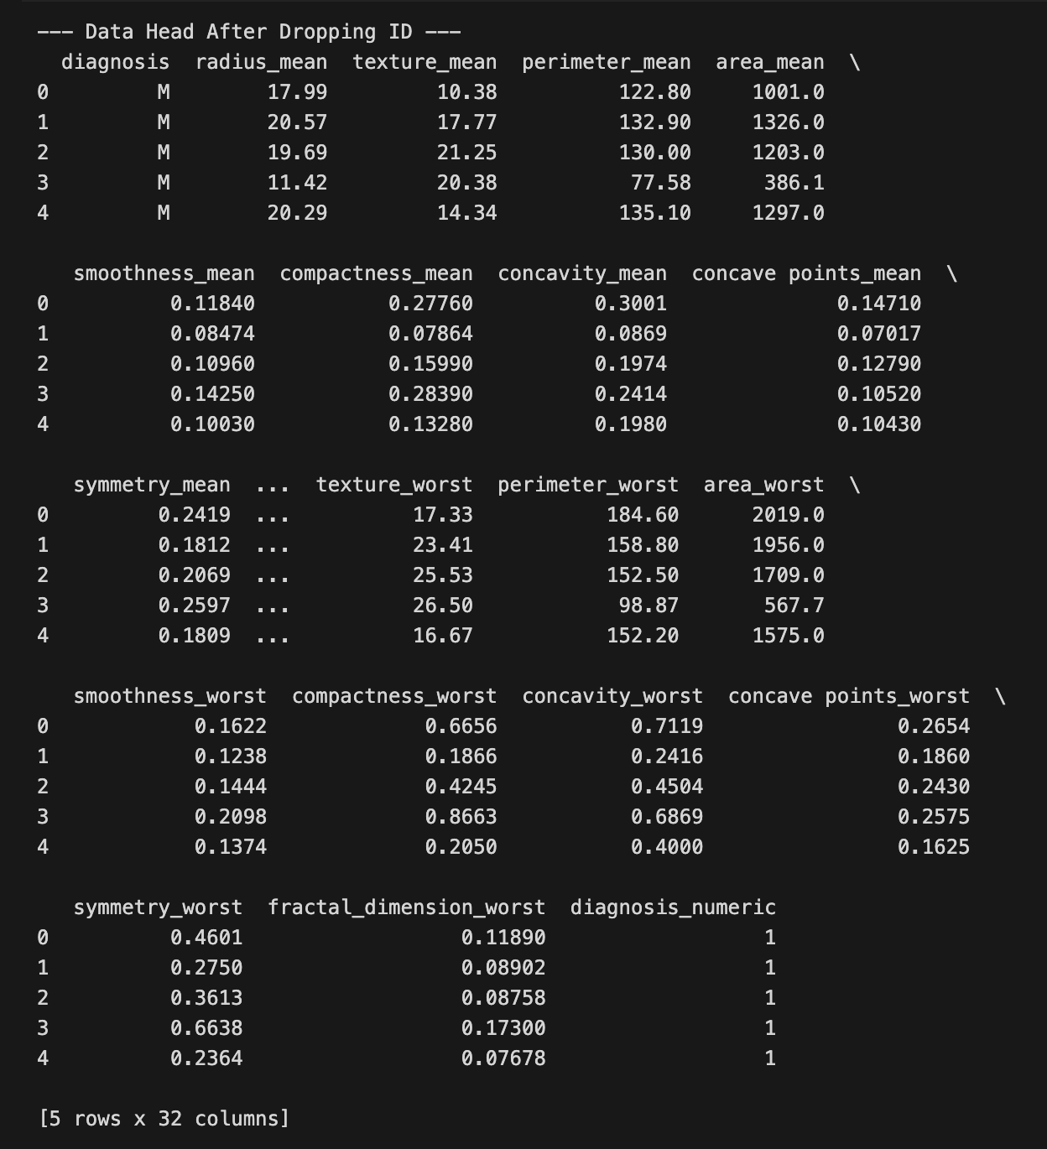
1. Cleaning: Removed the non-predictive id column.

Slide 12
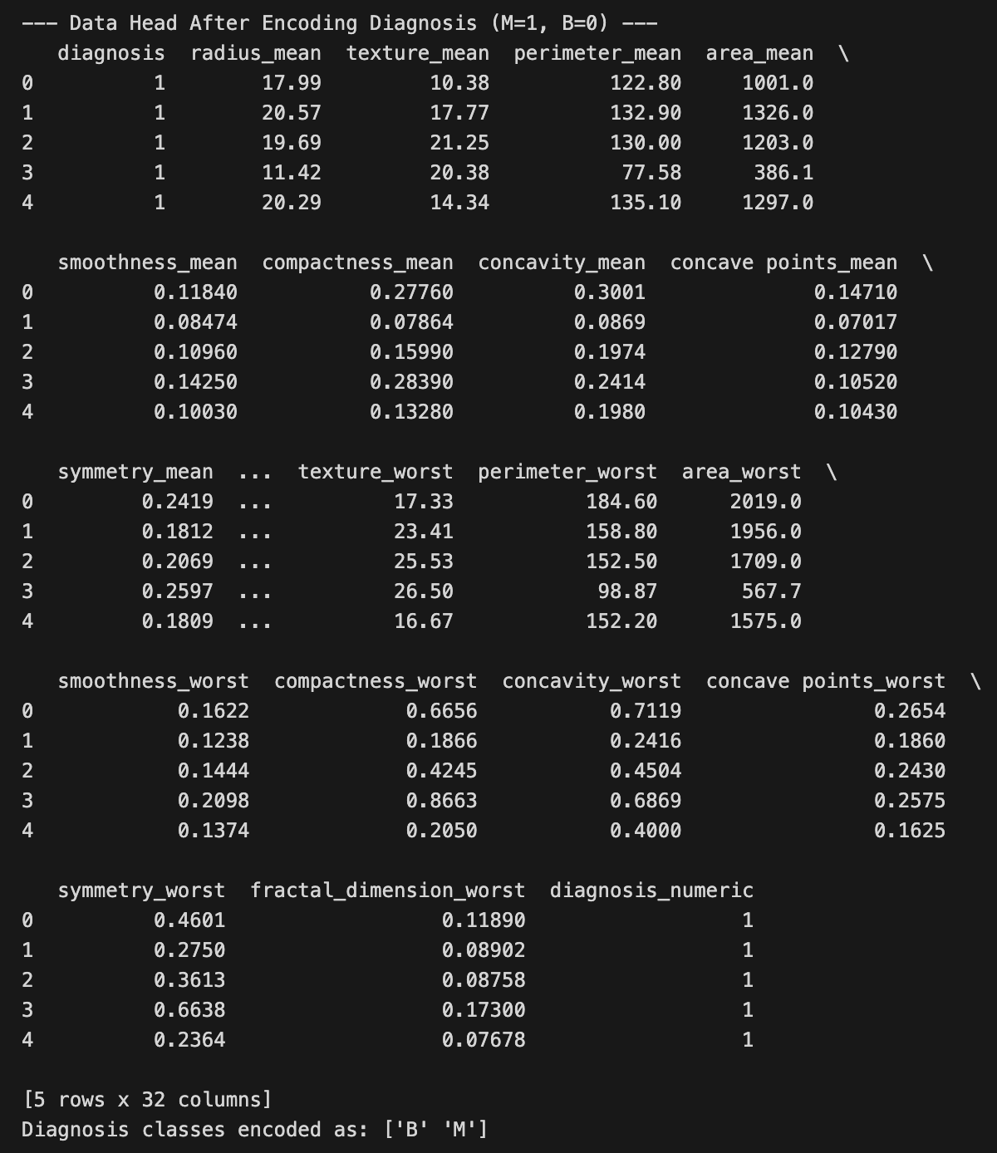
2. Encoding: Converted the categorical diagnosis column ('M'/'B') into numerical values (1/0) using LabelEncoder.

Slide 13
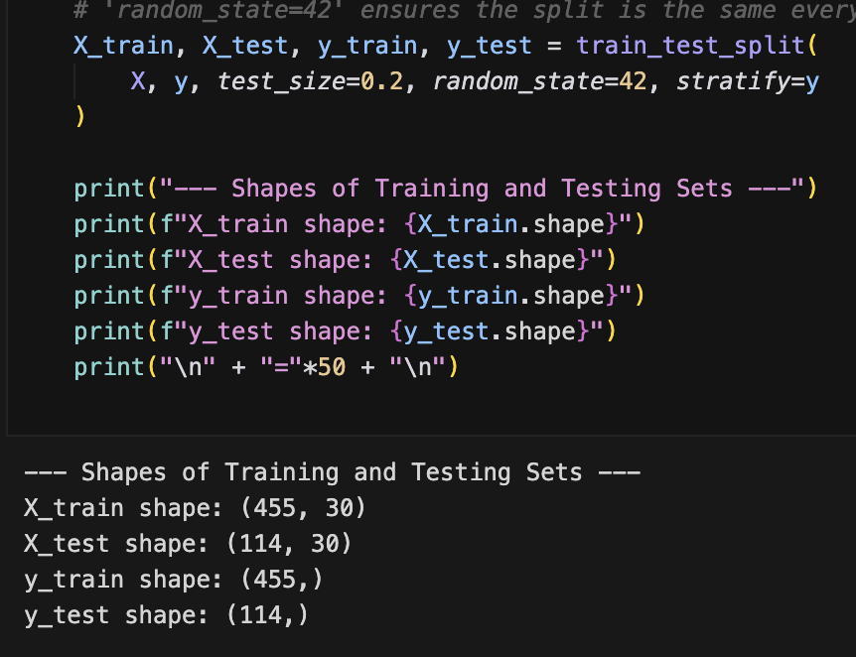
3. Splitting: Divided the data into an 80% training set and a 20% testing set. Stratification was used to maintain the class distribution in both sets.

Slide 14
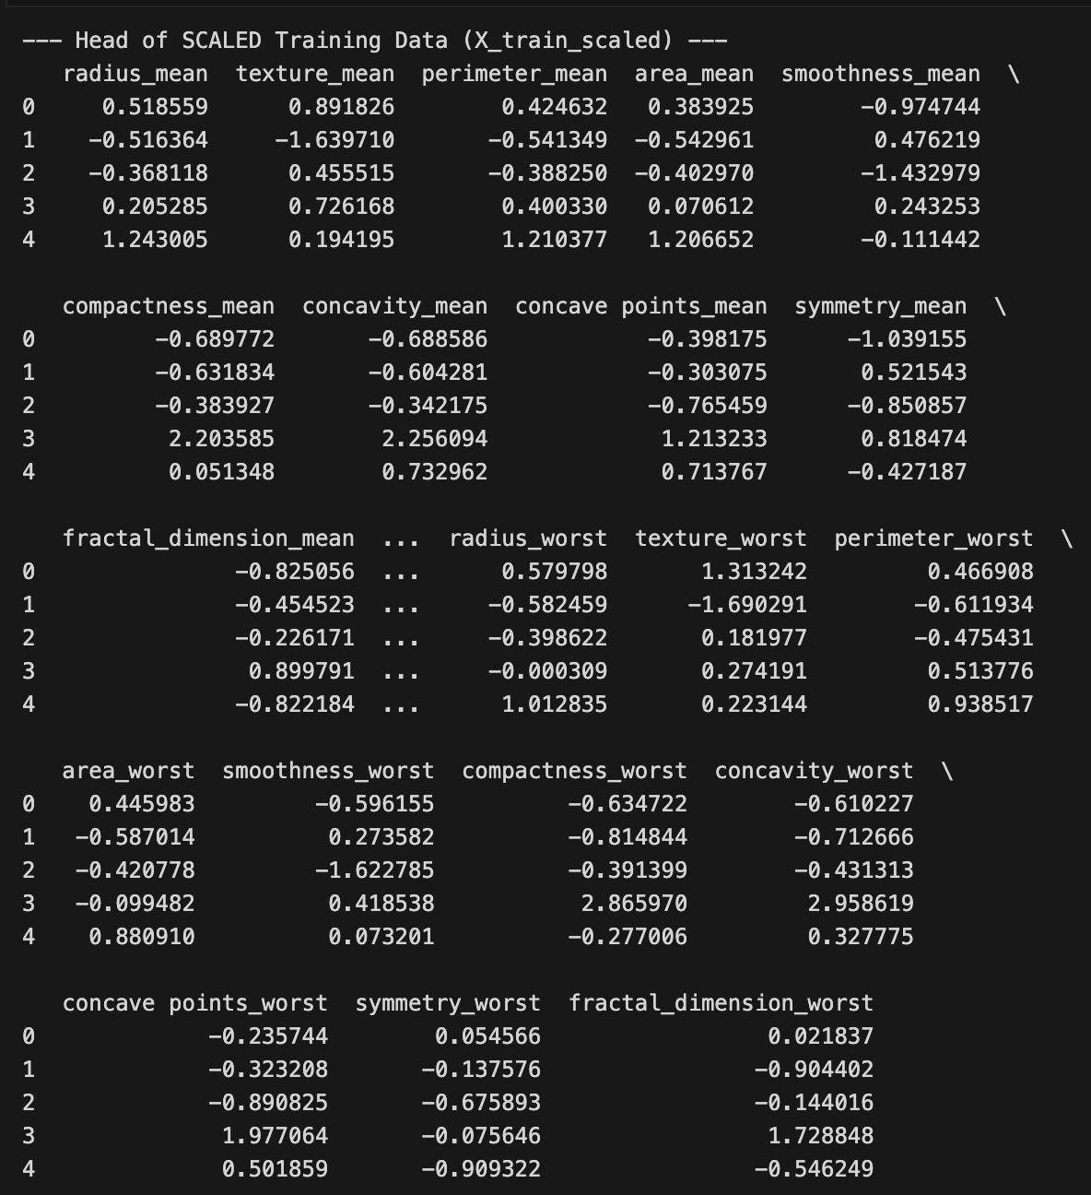
4. Scaling: Standardized all features using StandardScaler. This prevents features with larger scales from dominating the model and is crucial for models like Logistic Regression and kNN.

Slide 15
05. Model 1: Logistic Regression

Slide 16
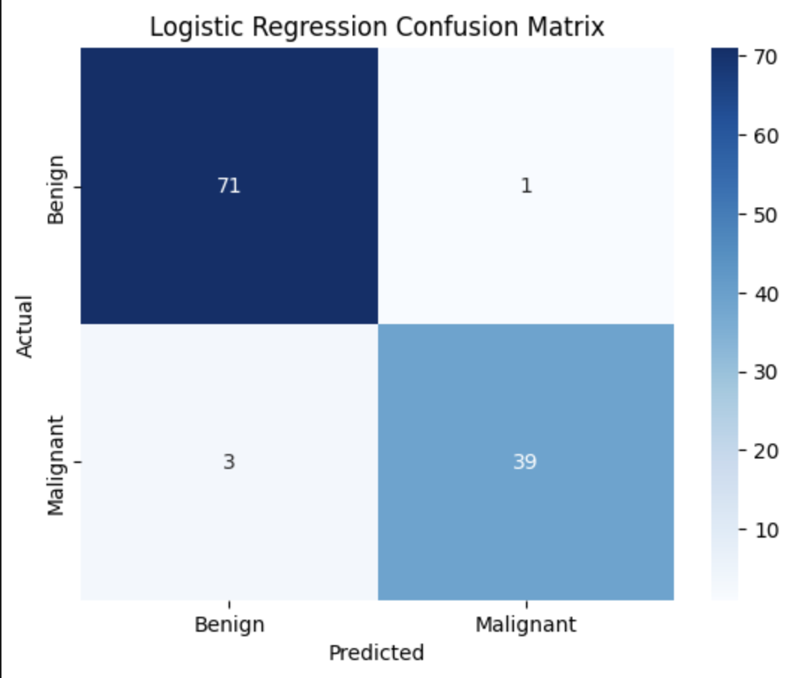
Performance of Logistic Regression
Accuracy: 96.49%
Summary:
  Correctly Predicted:
    Benign: 71
    Malignant: 39
  Incorrectly Predicted:
    Benign as Malignant (False Positive): 1
    Malignant as Benign (False Negative): 3
Conclusion: The model is highly accurate, but it's important to note the 3 cases of malignant tumors that were missed (False Negatives).

Slide 17
06. Model 2: k-Nearest Neighbors (kNN)

Slide 18
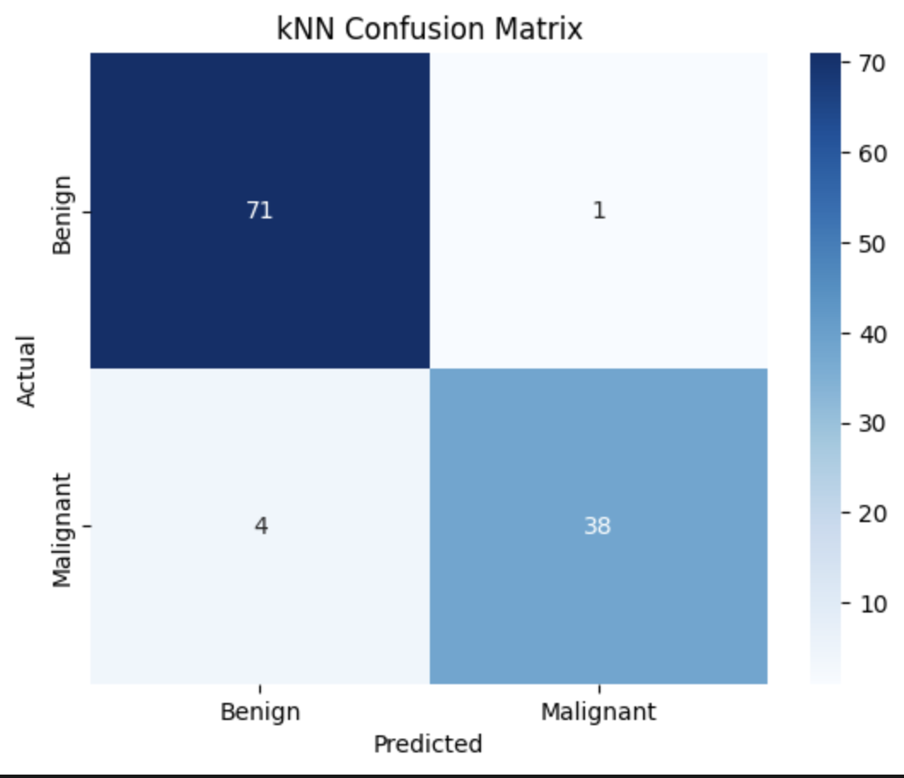
Performance of k-Nearest Neighbors (k=5)
Accuracy: 95.61%
Summary:
  Correctly Predicted:
    Benign: 71
    Malignant: 38
  Incorrectly Predicted:
    Benign as Malignant (False Positive): 1
    Malignant as Benign (False Negative): 4
Conclusion: kNN also performs very well, with a slightly lower accuracy and one more False Negative compared to Logistic Regression.

Slide 19
CONCLUSION

Slide 20
Summary of Findings
Both Logistic Regression and kNN models achieved high accuracy (>95%) in diagnosing breast cancer from the WDBC dataset.
Exploratory analysis showed clear distinctions in features like radius_mean between benign and malignant tumors.
Logistic Regression slightly outperformed kNN, particularly in minimizing dangerous False Negatives.

Slide 21
Future Work / Next Steps:
Experiment with other models (e.g., Support Vector Machines, Random Forest, Gradient Boosting).
Perform hyperparameter tuning to optimize model performance.
Explore feature selection or dimensionality reduction (PCA) to address multicollinearity.

