Slide 1
Basic Concepts in Information Theory
ChengXiang Zhai
Department of Computer Science
University of Illinois, Urbana-Champaign

Slide 2
Background on Information Theory
Developed by Claude Shannon in the 1940s
Maximizing the amount of information that can be transmitted over an imperfect communication channel
Data compression (entropy)
Transmission rate (channel capacity)
Claude E. Shannon: A Mathematical Theory of Communication, Bell System Technical Journal, Vol. 27, pp. 379–423, 623–656, 1948
Notes:
Shannon was interested in the problem of
Shannon wanted to determine theoretical maxima for !)

Slide 3
Basic Concepts in Information Theory
Entropy: Measuring uncertainty of a random variable
Kullback-Leibler divergence: comparing two distributions
Mutual Information: measuring the correlation of two random variables

Slide 4
Entropy: Motivation
Feature selection:
  If we use only a few words to classify docs, what kind of words should we use?
  P(Topic| “computer”=1) vs p(Topic | “the”=1): which is more random?
Text compression:
  Some documents (less random) can be compressed more than others (more random)
  Can we quantify the “compressibility”?
In general, given a random variable X following distribution p(X),
  How do we measure the “randomness” of X?
  How do we design optimal coding for X?

Slide 5
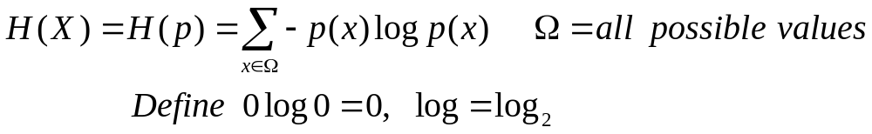
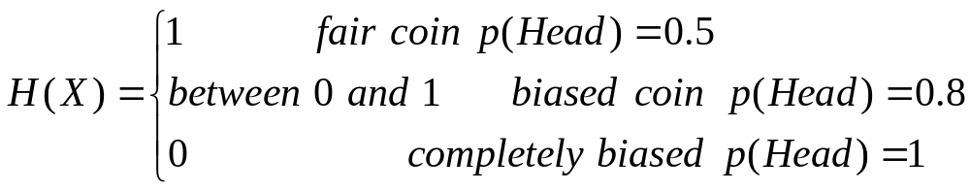
Entropy: Definition
Entropy H(X) measures the uncertainty/randomness of random variable X
Example:
H(X)
P(Head)
1.0

Slide 6
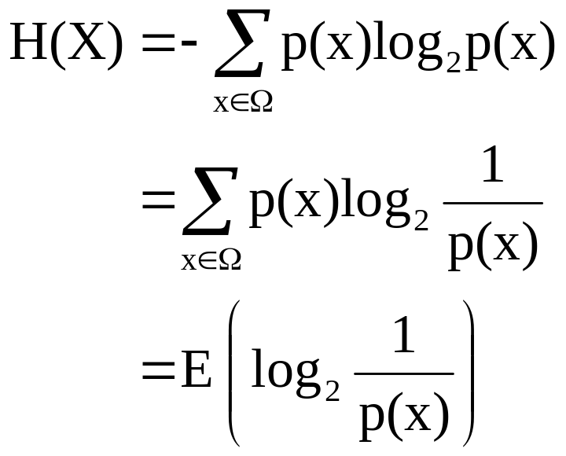
Entropy: Properties
Minimum value of H(X): 0
  What kind of X has the minimum entropy?
Maximum value of H(X): log M, where M is the number of possible values for X
  What kind of X has the maximum entropy?
Related to coding

Slide 7
Interpretations of H(X)
Measures the “amount of information” in X
  Think of each value of X as a “message”
  Think of X as a random experiment (20 questions)
Minimum average number of bits to compress values of X
  The more random X is, the harder to compress
A fair coin has the maximum information, and is hardest to compress
A biased coin has some information, and can be compressed to <1 bit on average
A completely biased coin has no information, and needs only 0 bit

Slide 8
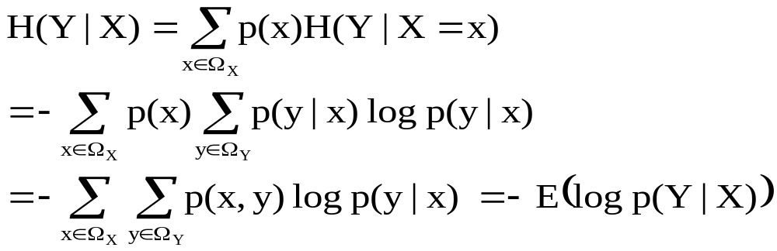
Conditional Entropy
The conditional entropy of a random variable Y given another X, expresses how much extra information one still needs to supply on average to communicate Y given that the other party knows X
H(Topic| “computer”) vs. H(Topic | “the”)?

Slide 9
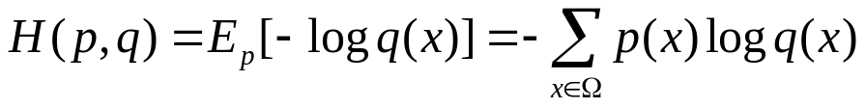
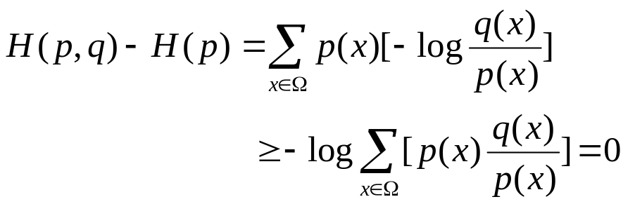
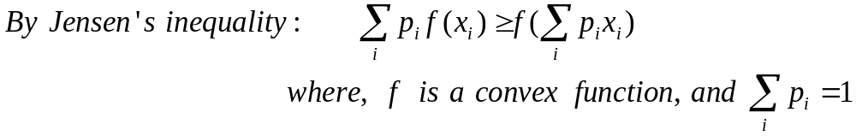
Cross Entropy H(p,q)
What if we encode X with a code optimized for a wrong distribution q?
Expected # of bits=?
Intuitively, H(p,q) ≥ H(p), and mathematically,

Slide 10
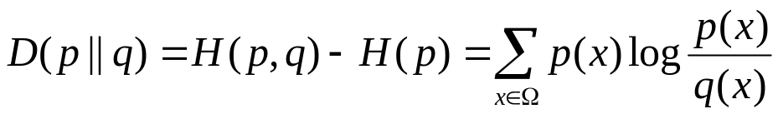
Kullback-Leibler Divergence D(p||q)
What if we encode X with a code optimized for a wrong distribution q?
How many bits would we waste?
Properties:
- D(p||q)≥0
- D(p||q)≠D(q||p)
- D(p||q)=0 iff p=q
Relative entropy
KL-divergence is often used to measure the
distance between two distributions
Interpretation:
Fix p, D(p||q) and H(p,q) vary in the same way
If p is an empirical distribution, minimize D(p||q) or H(p,q) is equivalent to maximizing likelihood

Slide 11
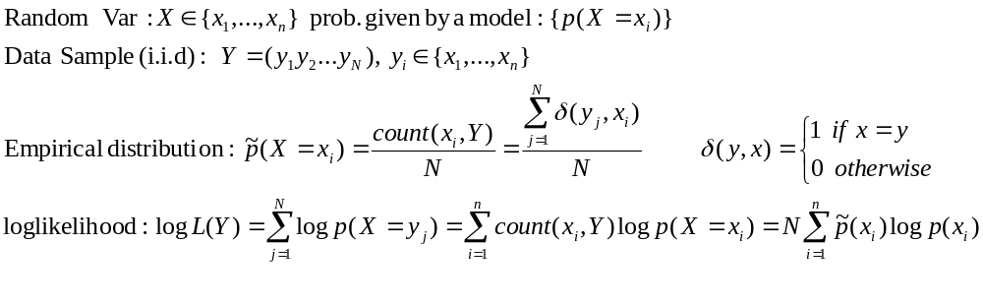

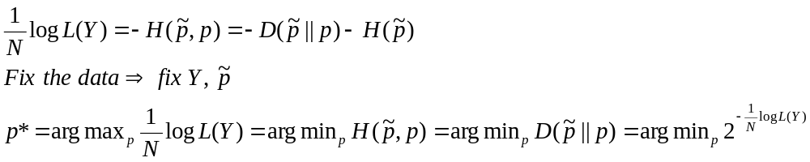
Cross Entropy, KL-Div, and Likelihood
Example: X ∈{“H”,“T”}
Y=(HHTTH)
Equivalent criteria for selecting/evaluating a model Perplexity(p)

Slide 12
Mutual Information I(X;Y)
Comparing two distributions: p(x,y) vs p(x)p(y)
Properties: I(X;Y)≥0; I(X;Y)=I(Y;X); I(X;Y)=0 iff X & Y are independent
Interpretations:
- Measures how much reduction in uncertainty of X given info. about Y
- Measures correlation between X and Y
- Related to the “channel capacity” in information theory
Examples:
I(Topic; “computer”) vs. I(Topic; “the”)?
I(“computer”, “program”) vs I(“computer”, “baseball”)?

Slide 13
What You Should Know
Information theory concepts: entropy, cross entropy, relative entropy, conditional entropy, KL-div., mutual information
  Know their definitions, how to compute them
  Know how to interpret them
  Know their relationships

