Slide 1
Essential Probability & Statistics
(Lecture for CS510 Advanced Information Retrieval )
ChengXiang Zhai
Department of Computer Science
University of Illinois, Urbana-Champaign

Slide 2
Prob/Statistics & Text Management
Probability & statistics provide a principled way to quantify the uncertainties associated with natural language
Allow us to answer questions like:
  Given that we observe “baseball” three times and “game” once in a news article, how likely is it about “sports”? (text categorization, information retrieval)
  Given that a user is interested in sports news, how likely would the user use “baseball” in a query? (information retrieval)

Slide 3
Basic Concepts in Probability
Random experiment: an experiment with uncertain outcome (e.g., tossing a coin, picking a word from text)
Sample space: all possible outcomes, e.g.,
  Tossing 2 fair coins, S ={HH, HT, TH, TT}
Event: E⊆S, E happens iff outcome is in E, e.g.,
  E={HH} (all heads)
  E={HH,TT} (same face)
  Impossible event ({}), certain event (S)
Probability of Event : 1≥P(E) ≥0, s.t.
  P(S)=1 (outcome always in S)
  P(A∪ B)=P(A)+P(B) if (A∩B)=∅ (e.g., A=same face, B=different face)

Slide 4
Basic Concepts of Prob. (cont.)
Conditional Probability :P(B|A)=P(A∩B)/P(A)
  P(A∩B) = P(A)P(B|A) =P(B)P(A|B)
  So, P(A|B)=P(B|A)P(A)/P(B) (Bayes’ Rule)
  For independent events, P(A∩B) = P(A)P(B), so P(A|B)=P(A)
Total probability: If A₁, …, A_{n} form a partition of S, then
  P(B)= P(B∩S)=P(B∩A₁)+…+P(B ∩A_{n}) (why?)
  So, P(A_{i}|B)=P(B|A_{i})P(A_{i})/P(B)
  = P(B|A_{i})P(A_{i})/[P(B|A₁)P(A₁)+…+P(B|A_{n})P(A_{n})]
  This allows us to compute P(A_{i}|B) based on P(B|A_{i})

Slide 5
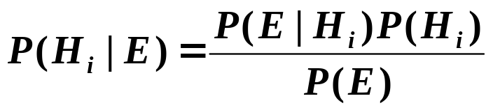
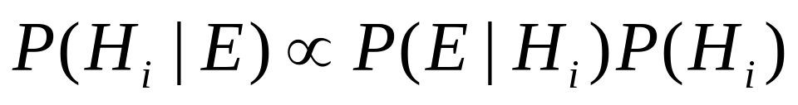
Interpretation of Bayes’ Rule
Hypothesis space: H={H₁ , …, H_{n}} Evidence: E
If we want to pick the most likely hypothesis H*, we can drop P(E)
Posterior probability of H_{i}
Prior probability of H_{i}
Likelihood of data/evidence
if H_{i} is true

Slide 6
Random Variable
X: S → ℜ (“measure” of outcome)
  E.g., number of heads, all same face?, …
Events can be defined according to X
  E(X=a) = {s_{i}|X(s_{i})=a}
  E(X≥a) = {s_{i}|X(s_{i}) ≥ a}
So, probabilities can be defined on X
  P(X=a) = P(E(X=a))
  P(a≥X) = P(E(a≥X))
Discrete vs. continuous random variable (think of “partitioning the sample space”)

Slide 7
An Example: Doc Classification
Sample Space S={x₁,…, x_{n}}
For 3 topics, four words, n=?
Topic the computer game baseball
Conditional Probabilities:
P(E_{sport} | E_{baseball} ), P(E_{baseball}|E_{sport}),
P(E_{sport} | E_{baseball,} _{¬computer} ), ...
X₁: [sport 1 0 1 1]
X₂: [sport 1 1 1 1]
Thinking in terms of random variables
Topic: T ∈{“sport”, “computer”, “other”},
“Baseball”: B ∈{0,1}, …
P(T=“sport”|B=1), P(B=1|T=“sport”), ...
X₃: [computer 1 1 0 0]
X₄: [computer 1 1 1 0]
X₅: [other 0 0 1 1]
… …
Events
E_{sport} ={x_{i} | topic(x_{i} )=“sport”}
E_{baseball} ={x_{i} | baseball(x_{i} )=1}
E_{baseball,¬computer} =
{x_{i} | baseball(x_{i} )=1 & computer(x_{i} )=0}
An inference problem:
Suppose we observe that “baseball” is
mentioned, how likely the topic is about “sport”?
P(T=“sport”|B=1) ∝ P(B=1|T=“sport”)P(T=“sport”)
But, P(B=1|T=“sport”)=?, P(T=“sport” )=?

Slide 8
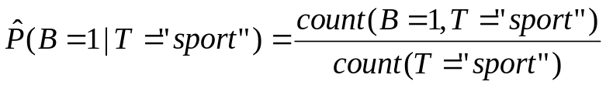
Getting to Statistics ...
P(B=1|T=“sport”)=? (parameter estimation)
  If we see the results of a huge number of random experiments, then
  But, what if we only see a small sample (e.g., 2)? Is this estimate still reliable?
In general, statistics has to do with drawing conclusions on the whole population based on observations of a sample (data)

Slide 9
Parameter Estimation
General setting:
  Given a (hypothesized & probabilistic) model that governs the random experiment
  The model gives a probability of any data p(D|θ) that depends on the parameter θ
  Now, given actual sample data X={x₁,…,x_{n}}, what can we say about the value of θ?
Intuitively, take your best guess of θ -- “best” means “best explaining/fitting the data”
Generally an optimization problem

Slide 10
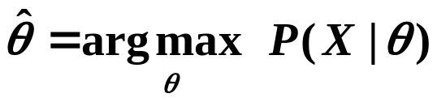
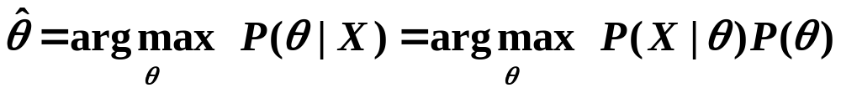
Maximum Likelihood vs. Bayesian
Maximum likelihood estimation
  “Best” means “data likelihood reaches maximum”
  Problem: small sample
Bayesian estimation
  “Best” means being consistent with our “prior” knowledge and explaining data well
  Problem: how to define prior?
Maximum a Posteriori (MAP)
estimate

Slide 11
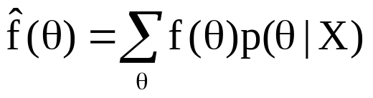
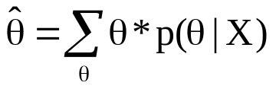
Illustration of Bayesian Estimation
Bayesian inference: f(θ)=?
Posterior:
p(θ|X)∝ p(X|θ)p(θ)
Likelihood:
p(X|θ)
X=(x₁,…,x_{N})
Posterior
Mean
Prior: p(θ)
θ
θ₀: prior mode
θ₁: posterior mode
θ_{ml}: ML estimate

Slide 12
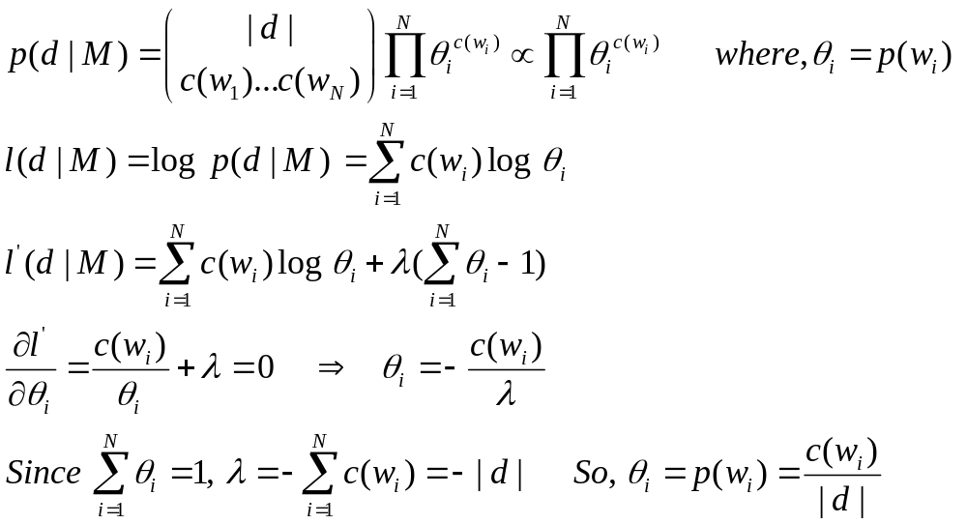
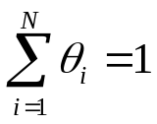
Maximum Likelihood Estimate
Data: a document d with counts c(w₁), …, c(w_{N}), and length |d|
Model: multinomial distribution M with parameters {p(w_{i})}
Likelihood: p(d|M)
Maximum likelihood estimator: M=argmax _{M} p(d|M)
We’ll tune p(w_{i}) to maximize l(d|M)
Use Lagrange multiplier approach
Set partial derivatives to zero
ML estimate

Slide 13
What You Should Know
Probability concepts:
  sample space, event, random variable, conditional prob. multinomial distribution, etc
Bayes formula and its interpretation
Statistics: Know how to compute maximum likelihood estimate

