Slide 1
CS510 Advanced Information Retrieval Topic Overview
ChengXiang Zhai
Department of Computer Science
University of Illinois at Urbana-Champaign

Slide 2

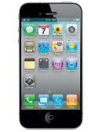








Text data cover all kinds of topics
Topics:
People
Events
Products
Services, …
…
Sources:
Blogs
Microblogs
Forums
Reviews ,…
45M reviews
53M blogs
1307M posts
65M msgs/day
115M users 10M groups
…

Slide 3




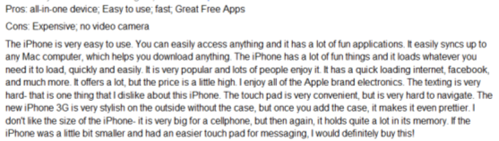

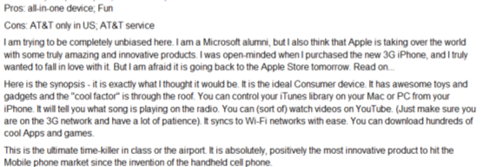
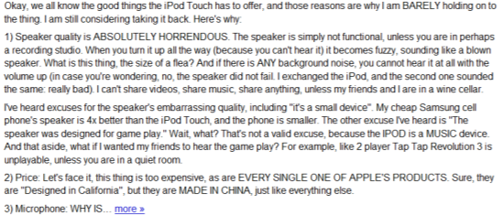
Humans as Subjective & Intelligent “Sensors”
Real World
Sense
Sensor
Report
Data
Weather
Thermometer
3°C , 15°F, …
Locations
Geo Sensor
41°N and 120°W ….
Network Sensor
01000100011100
Networks
Perceive
Express
“Human Sensor”

Slide 4
Unique Value of Text Data
Useful to all big data applications
Especially useful for mining knowledge about people’s behavior, attitude, and opinions
Directly express knowledge about our world: Small text data are also useful!
Data ➔ Information ➔ Knowledge
Text Data

Slide 5
However, NLP is difficult!
“A man saw a boy with a telescope.” (who had the telescope?)
“He has quit smoking” ➔ he smoked before.
How can we leverage imperfect NLP to
build a perfect general application?
Answer: Having humans in the loop!

Slide 6



TextScope to enhance human perception
TextScope
Microscope
Telescope
Intelligent Interactive Retrieval & Text Analysis
for Task Support and Decision Making

Slide 7
Examples of TextScope Applications
Search
Web search, enterprise search, desktop search, PubMed, …
Filtering/Recommender Systems
spam email filter, news/literature/movie recommender
Categorization
news categorization, help desk email routing, sentiment tagging, …
Topic mining
discovery of topical trends in scientific research
discovery of major complaints from customers
business intelligence, bioinformatics, …
Text-based Prediction
prediction of stock prices, voting results, …

Slide 8
Main Techniques for Building a TextScope: Text Retrieval + Text Analysis
Search engines
Clustering
Categorization
Medical/Health
Filtering
Text Retrieval
Text Analysis
Topic mining
Security
Recommender
Sentiment
Education
Business
Summarization
Prediction
… …
… …
Social Media
Big
Text Data
… …
Big Text Data
Small
Relevant Data
Small Relevant Data
Knowledge
Many Applications

Slide 9
This Course: Statistical Language Models
Search engines
Clustering
Categorization
Medical/Health
Filtering
Text Retrieval
Text Analysis
Topic mining
Security
Recommender
Sentiment
Education
Business
Summarization
Prediction
… …
… …
Social Media
Big
Text Data
… …
Big Text Data
Small
Relevant Data
Small Relevant Data
Knowledge
Many Applications

