Slide 1
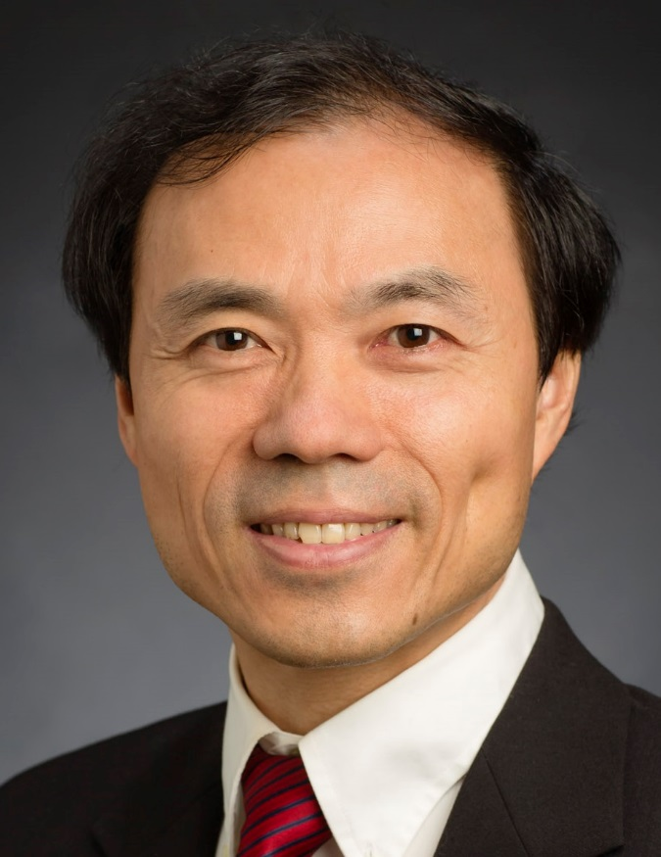
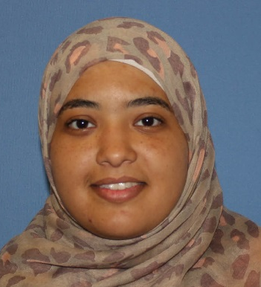
CS510 Advanced Information Retrieval Course Orientation
Instructor
Teaching Assistant
ChengXiang (“Cheng”) Zhai
Assma Boughoula
Department of Computer Science, University of Illinois at Urbana-Champaign

Slide 2
Course Goal
Advanced (graduate-level) introduction to the field of information retrieval (IR), broadly including Text mining
Goal
Provide a systematic introduction to statistical language models and their applications in text retrieval and text analysis
Provide an opportunity for students to explore frontier topics via course projects (customized toward the interests of students)
Give students enough training for doing research in IR or applying advanced IR techniques to applications
Tangible outcome: research paper, open source code, and application system

Slide 3
Prerequisites
Basic concepts in CS410 Text Info Systems
Programming skills: CS225 or equivalent level
A good knowledge of basic probability and statistics
Knowledge of one or more of the following areas is a plus, but not required: Information Retrieval, Machine Learning, Data Mining, Natural Language Processing
Contact the instructor if you aren’t sure

Slide 4
Course Design & Activities
Provide students with theoretical foundation:
Weekly lecture videos + readings (lasting for about 3/4 of the semester)
Regular quizzes (automatically graded) + assignments (peer graded) on Moodle
Late midterm exam (covering questions in quizzes or assignments)
Provide students with experimental skills:
Leaderboard-based competitions
Provide students with an opportunity for open exploration & collaboration
Multi-track course project
Research Track: Discovery of new knowledge ➔ submission/publication
Development Track: Creation of new technology ➔ open source contribution
Application Track: Creation of new application ➔ useful application

Slide 5
Course Activities & Grading
Project
Open
Exploration
&
Collaboration
Open Source
Contributions
End-User
Applications
Publications
30%
Research
Track
Development
Track
Application
Track
10%
Experimental Skills
Leaderboard-based Competitions
25%
15%
Theoretical
Foundation
Quizzes
(Auto-Graded)
20%
Assignments
(Peer-Graded)
Exam
60%
Lecture Videos & Readings

Slide 6
Online Weekly Office Hours
Instructor: ChengXiang (“Cheng”) Zhai
8-9pm Tuesdays & 10am-11am Fridays
TA: Assma Boughoula
12-1pm Mondays & 6-7pm Wednesdays
Occasionally, we may need to change the time of our office hours (new times will be posted on Moodle)
Piazza as a “virtual classroom”
Post your question on Piazza as soon as you have it
Share your expertise by helping answer questions from your peers
Initiate discussions of any technical issues related to the course

Slide 7
Major Topics of Lectures
Background, overview of text retrieval & analysis; relevant math
Overview of statistical language models (LMs)
N-gram LMs
Language Models for Information Retrieval
Mixture LMs (PLSA, LDA)
State-Space LMs (Hidden Markov Models)
Contextualized LMs
Learning to rank
Neural language models (word embedding, deep learning for IR)

Slide 8
Your Work Load Distribution
Jan
Feb
Mar
April
May
First Day of
Instruction
Last Day
of Instruction
Lectures/Readings
Quizzes & Assignments
Exam
Leaderboard Competition
Project
Darker = Heavier work load

Slide 9
Readings: mostly research papers, survey articles, and book chapters, all available online
Text Data Management & Analysis book (covering CS410 materials)
http://www.library.illinois.edu/proxy/go.php?url=http://dl.acm.org/citation.cfm?id=2915031
Synthesis Lectures Digital Library: http://www.morganclaypool.com/
Foundations & Trends in IR: http://www.nowpublishers.com/ir/
Recent papers from SIGIR, CIKM, WWW, WSDM, KDD, ACL, ICML,…

Slide 10
Course Information & Platform
Moodle:
https://learn.illinois.edu/course/view.php?id=58087
Piazza:
https://piazza.com/illinois/spring2021/cs510

