Slide 1
Accelerating Research Discovery: Towards an Intelligent Workbench for Researchers
ChengXiang (“Cheng”) Zhai
Department of Computer Science
Affiliated with Graduate School of Library & Information Science
Department of Statistics
Carl R. Woese Institute for Genomic Biology
University of Illinois at Urbana-Champaign
http://www.cs.uiuc.edu/homes/czhai czhai@illinois.edu
Microsoft Workshop on Big Scholarly Data, July 10, 2015

Slide 2
Motivation
Acceleration of scientific research and discovery ➔ huge societal benefits
Faster discovery of new knowledge
Faster invention of new technology
Less spending on research
Today’s workbench for researchers lacks task support
Question: how can we build a general intelligent researcher’s workbench to improve productivity of every researcher?

Slide 3
Research Workflow
Research
Question
Formulation
Research
Plan
Design
Research
Result
Generation
Research
Result
Dissemination
Collaboration
Literature Search Engines
Literature

Slide 4
An Intelligent Researcher’s Workbench
Research
Question
Formulation
Research
Plan
Design
Research
Result
Generation
Research
Result
Dissemination
Research Task Support
Research
Social
Network
Knowledge Assistant
Literature Access Support
Literature

Slide 5







Time to Integrate Multiple Systems!
Research
Question
Formulation
Research
Plan
Design
Research
Result
Generation
Research
Result
Dissemination
Research Task Support
Research
Social
Network
Knowledge Assistant
Literature Access Support
Literature

Slide 6



Social Scholar “学术圈”
http://soscholar.com/
Developed at Institute of Computing Technology, Chinese Academy of Sciences
Project Leaders
Xueqi Cheng
Jiafeng Guo

Slide 7
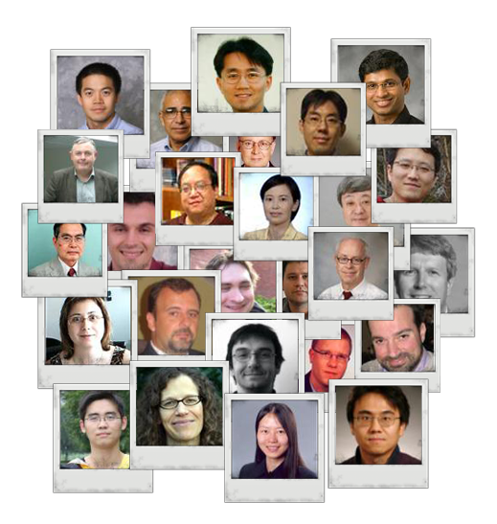
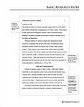
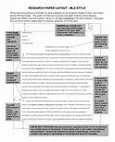
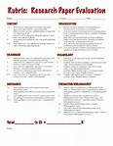
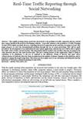
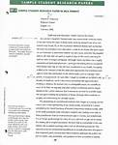
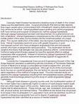
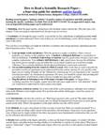
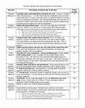
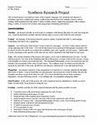

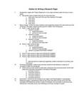
Social Scholar: A Vertical Social Platform
Paper Centric
User Centric
Collaboration, Work Flow

Slide 8
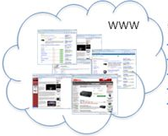
Social Scholar Architecture
Academic Social Platform
search
explore
recommend
analyze
social collaboration
②
Search Engine
③
Recommend Engine
④
Analysis Engine
Data Storage Center
…
…
…
In-Memory MySQL
Database
NoSQL Server
(MongoDB)
MySQL Server
Clusters
Distributed Index
System
Distributed Logging
System (Scribe)
①
Data Process Engine
Data Fetch Pipeline
Data Fusion Pipeline

Slide 9
How to Support Research Tasks?
Research
Question
Formulation
Research
Plan
Design
Research
Result
Generation
Research
Result
Dissemination
Research Task Support
Research
Social
Network
Knowledge Assistant
Literature Access Support
Literature

Slide 10
Potential Research Task Support
Research
Question
Formulation
Research
Plan
Design
Research
Result
Generation
Research
Result
Dissemination
Research Topic Service
Community Service
Paper Writing Assistant
Research Question
Recommender
Discussion Center
Definition Finder
Survey Generator
Collaborator Finder
Novelty Checker
Citation Generator
Community Newsletter
Topic Explorer
Auto Proofreading
Literature Radar
Literature

Slide 11
Research Question Recommender
Function: recommend research questions based on a keyword query
Basic solution:
Mine future work sections of all papers to discover sentences about future work directions
Cluster them to identify major research directions
Recommend large clusters that match a user’s query to the user, or
Recommend major clusters or most recent clusters without requiring any query
Potential extension:
Mine CFPs to discover “hot topics”; then use the hot topics to retrieve specific directions matching the hot topics

Slide 12
Potential Research Task Support
Research
Question
Formulation
Research
Plan
Design
Research
Result
Generation
Research
Result
Dissemination
Research Topic Service
Community Service
Paper Writing Assistant
Research Question
Recommender
Discussion Center
Definition Finder
Survey Generator
Collaborator Finder
Novelty Checker
Citation Generator
Community Newsletter
Topic Explorer
Auto Proofreading
Literature Radar
Literature

Slide 13
Novelty Checker
Function: Check whether an idea is new
Like a search engine, but would need to perform “idea matching”
Basic solution:
Allow a user to provide a detailed description of the idea
Treat the description as a long query and search in papers
Return the best matching paragraphs in a paper
Further extension:
Paraphrasing; favor “impact” sentences

Slide 14
Generating an Impact Summary [Mei & Zhai 08]
Target: extractive summary of the impact of a paper
Abstract:….
Introduction: …..
Content: ……
References: ….
… Ponte and Croft [20] adopt a language modeling approach to information retrieval. …
Citation Context
… probabilistic models, as well as to the use of other recent models [19, 21], the statistical properties …
Author picked sentences: good for summary, but don’t reflect the impact
Reader composed sentences: good signal of impact, but too noisy to be used as summary
Solution: Citation context → infer impact;
Original content → summary
Extraction of variable-length citation context [Sondhi & Zhai 14]

Slide 15
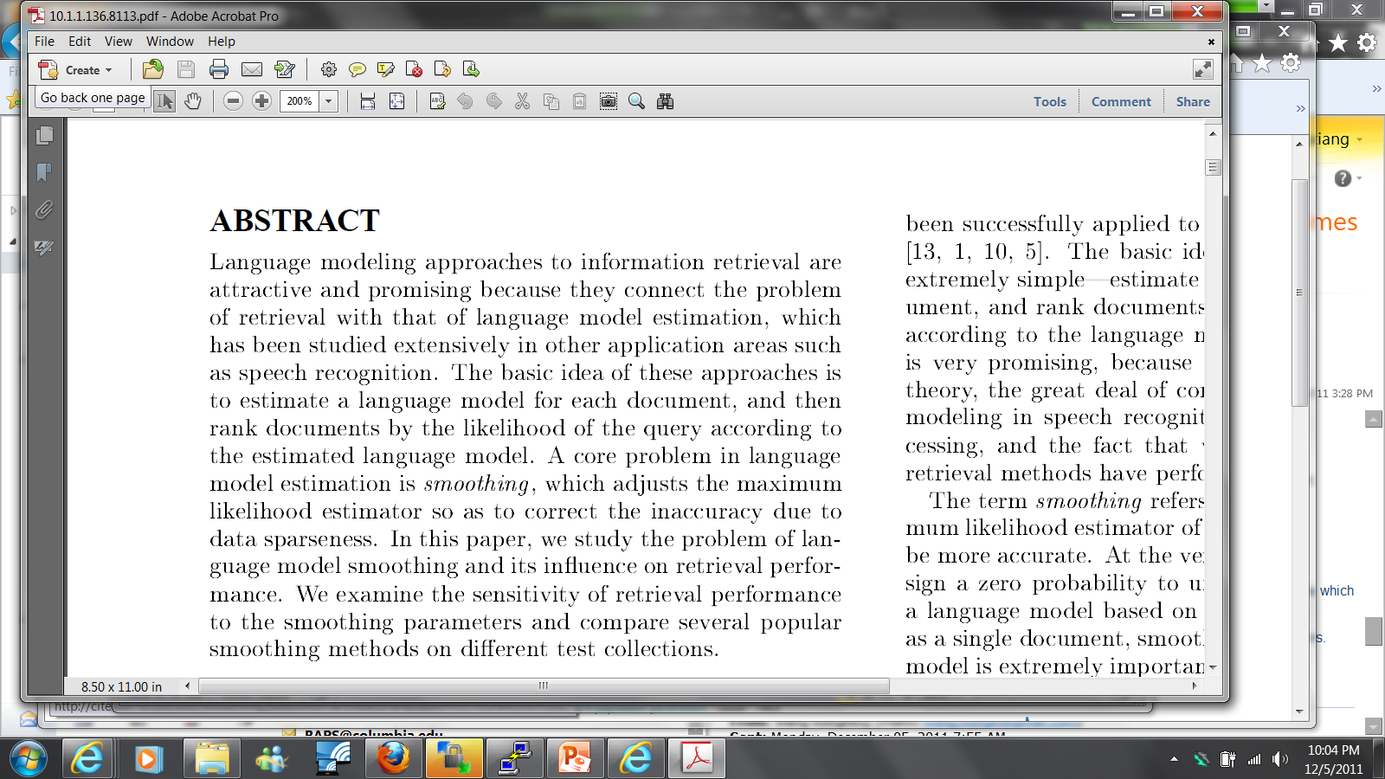
Original Abstract of “A Study of Smoothing Methods for Language Models Applied to Ad Hoc Information Retrieval”

Slide 16
Impact Summary of “A Study of Smoothing Methods for Language Models Applied to Ad Hoc Information Retrieval”
1. Figure 5: Interpolation versus backoff for Jelinek-Mercer (top), Dirichlet smoothing (middle), and absolute discounting (bottom).
2. Second, one can de-couple the two different roles of smoothing by adopting a two stage smoothing strategy in which Dirichlet smoothing is first applied to implement the estimation role and Jelinek-Mercer smoothing is then applied to implement the role of query modeling
3. We find that the backoff performance is more sensitive to the smoothing parameter than that of interpolation, especially in Jelinek-Mercer and Dirichlet prior.
Specific to smoothing LM in IR;
especially for the concrete smoothing techniques (Dirichlet and JM)

Slide 17
Potential Research Task Support
Research
Question
Formulation
Research
Plan
Design
Research
Result
Generation
Research
Result
Dissemination
Research Topic Service
Community Service
Paper Writing Assistant
Research Question
Recommender
Discussion Center
Definition Finder
Survey Generator
Collaborator Finder
Novelty Checker
Citation Generator
Community Newsletter
Topic Explorer
Auto Proofreading
Literature Radar
Literature

Slide 18
Topic Explorer
Function: Support flexible navigation in the research topic space
Basic solution: Construct a multi-resolution topic map; seamless integration of search & browsing
Search log-based map
Document-based map
Ontology-based map
Flexible switching between different maps
Further extension:
Entity-Relation graph browsing

Slide 19
Information Seeking as Sightseeing
Know the address of an attraction site?
Yes: take a taxi and go directly to the site
No: walk around or take a taxi to a nearby place then walk around
Know what exactly you want to find?
Yes: use the right keywords as a query and find the information directly
No: browse the information space or start with a rough query and then browse
When query fails, browsing comes to rescue…

Slide 20

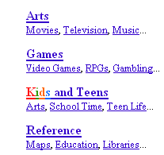
Current Support for Browsing is Limited
Hyperlinks
Only page-to-page
Mostly manually constructed
Browsing step is very small
Web directories
Manually constructed
Fixed categories
Only support vertical navigation
Beyond hyperlinks?
ODP
Beyond fixed categories?
How to promote browsing as a “first-class citizen”?

Slide 21
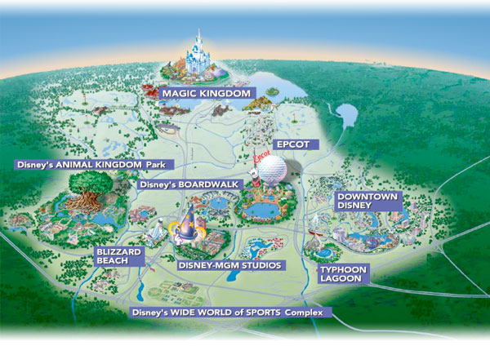
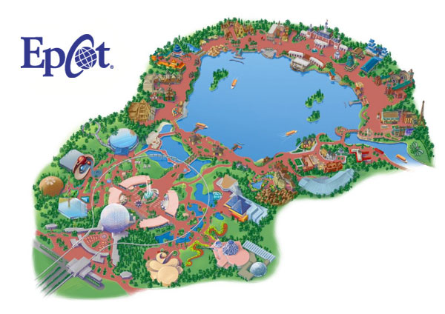
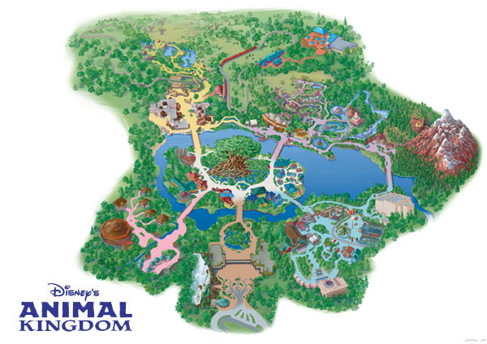
Sightseeing Analogy Continues…
Horizontal
navigation
Region
Zoom in
Zoom out

Slide 22
Topic Map for Touring Information Space
Topic regions
Multiple resolutions
Zoom in
0.03
0.05
0.03
0.02
0.01
Zoom out
Horizontal navigation

Slide 23

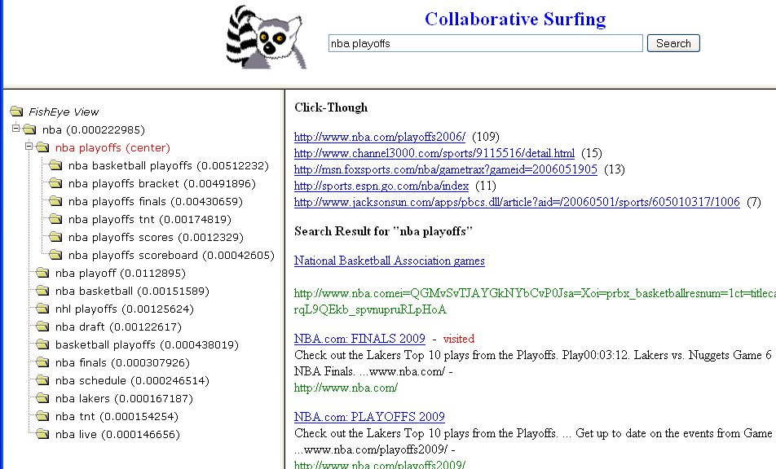
Collaborative Surfing [Wang et al. 08] http://ucair.cs.uiuc.edu/cgi-nin/xwang20/kwmap3/framesetkw.cgi
New queries become new footprints
Navigation trace enriches map structures
Clickthroughs become new footprints
Browse logs offer more opportunities
to understand user interests and intents

Slide 24
Constructing Topic Evolution Map with Probabilistic Citation Analysis [Wang et al. 13]
Given research articles and citations in a research community
Identify major research topics (themes) and their spans
Construct a topic evolution map
For each topic, identify milestone papers

Slide 25
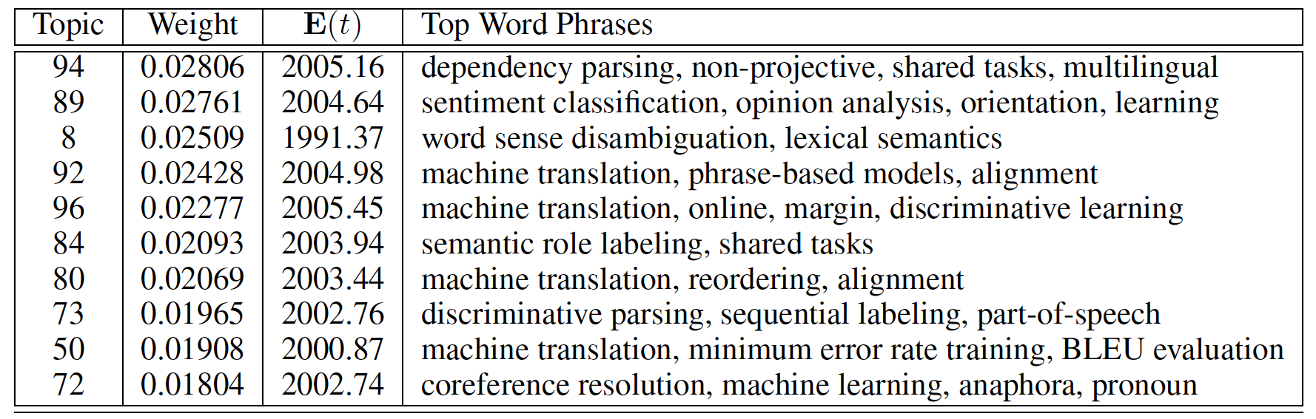
Sample Results: Major Topics in NLP Community
ACL Anthology Network (AAN)
Papers from NLP major conferences from 1965 - 2011
18,041 papers
82,944 citations

Slide 26
NLP-Community Topic Evolution
Topic Evolution: (green: newer, red: older)
96: phrase-based SMT (2000)
20: Early SMT(1994)
Branching
50: min-error-rate approaches (2000)
8: Word sense disambiguation (1991)
29: decoding, alignment, reordering (1998)
18: Prepositional phrase attachment (1994)
89: Sentiment-Analysis (2004)
Fading-out
13: tree-adjoining grammer (1992)
34: Statistical parsing (1998)
73: Discriminative-learning parsing (2002)
6: Interactive machine translation (1989)
95: Dependency parsing (2005)
3: Unification-based grammer (1988)
72: Coreference resolution (2002)
25: Spelling correction (1997)
Shifting
10: Discourse centering method (1991)

Slide 27
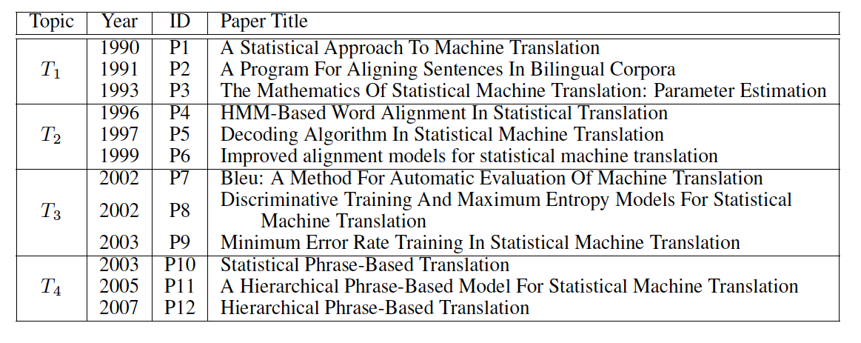
Detailed View of Topic “Statistical Machine Translation”

Slide 28
Potential Research Task Support
Research
Question
Formulation
Research
Plan
Design
Research
Result
Generation
Research
Result
Dissemination
Research Topic Service
Community Service
Paper Writing Assistant
Research Question
Recommender
Discussion Center
Definition Finder
Survey Generator
Collaborator Finder
Novelty Checker
Citation Generator
Community Newsletter
Topic Explorer
Auto Proofreading
Literature Radar
Literature

Slide 29
Discussion Center
Function: Support research discussion with a Research Forum or Community Question Answering platform
Basic solution:
Community QA organized by a topic map or papers
Push questions to the most relevant experts (authors)
Research forums organized by topics
Further extension:
Automatic question answering
One forum per paper/Collaborative paper annotation

Slide 30
Potential Research Task Support
Research
Question
Formulation
Research
Plan
Design
Research
Result
Generation
Research
Result
Dissemination
Research Topic Service
Community Service
Paper Writing Assistant
Research Question
Recommender
Discussion Center
Definition Finder
Survey Generator
Collaborator Finder
Novelty Checker
Citation Generator
Community Newsletter
Topic Explorer
Auto Proofreading
Literature Radar
Literature

Slide 31
Collaborator Finder
Function: Support searching for an expert on a topic
Basic solution
Information Extraction + Query creation
Queries can contain both structured and non-structured data.
Build a profile for each individual person and support expert finding
Further extension:
Automatic team formation: take BAA/RFP as input, suggest people to form a team

Slide 32
Potential Research Task Support
Research
Question
Formulation
Research
Plan
Design
Research
Result
Generation
Research
Result
Dissemination
Research Topic Service
Community Service
Paper Writing Assistant
Research Question
Recommender
Discussion Center
Definition Finder
Survey Generator
Collaborator Finder
Novelty Checker
Citation Generator
Community Newsletter
Topic Explorer
Auto Proofreading
Literature Radar
Literature

Slide 33
Community Newsletter
Function: Automatically generate a newsletter for any research community, possibly personalized
Basic solution:
Report new papers, upcoming conferences, emerging topics
Report other news (e.g., new grants)
Further extension:
Personalization; relevance feedback

Slide 34
Potential Research Task Support
Research
Question
Formulation
Research
Plan
Design
Research
Result
Generation
Research
Result
Dissemination
Research Topic Service
Community Service
Paper Writing Assistant
Research Question
Recommender
Discussion Center
Definition Finder
Survey Generator
Collaborator Finder
Novelty Checker
Citation Generator
Community Newsletter
Topic Explorer
Auto Proofreading
Literature Radar
Literature

Slide 35
Definition Finder
Function: Enable a researcher to search for the definition of any concept
Basic solution:
Extract definition sentences from research papers
Build a search engine for searching definitions
Further extension:
Summarization of definitions

Slide 36
Potential Research Task Support
Research
Question
Formulation
Research
Plan
Design
Research
Result
Generation
Research
Result
Dissemination
Research Topic Service
Community Service
Paper Writing Assistant
Research Question
Recommender
Discussion Center
Definition Finder
Survey Generator
Collaborator Finder
Novelty Checker
Citation Generator
Community Newsletter
Topic Explorer
Auto Proofreading
Literature Radar
Literature

Slide 37
Survey Generator
Function
Given a topic map, automatically generate a survey on the topic
Basic solution: Define the survey generation task as
find all the relevant papers
Cluster them
Create a hypertext document with links to specific papers.
Extensions:
Learn to automatically “write” an introduction by learning from many introduction text data.
Automatically extract the findings

Slide 38
Potential Research Task Support
Research
Question
Formulation
Research
Plan
Design
Research
Result
Generation
Research
Result
Dissemination
Research Topic Service
Community Service
Paper Writing Assistant
Research Question
Recommender
Discussion Center
Definition Finder
Survey Generator
Collaborator Finder
Novelty Checker
Citation Generator
Community Newsletter
Topic Explorer
Auto Proofreading
Literature Radar
Literature

Slide 39
Citation Generator
Function: While a researcher is editing a paper, the system automatically suggests the papers to be cited and where to cite them
Basic solution:
Use the current paragraph that a user is writing as a query, and search for relevant references
Automatically or semi-automatically add references
Extensions:
Learn how to generate sentences describing a cited work based on what other papers have said about the work

Slide 40
Potential Research Task Support
Research
Question
Formulation
Research
Plan
Design
Research
Result
Generation
Research
Result
Dissemination
Research Topic Service
Community Service
Paper Writing Assistant
Research Question
Recommender
Discussion Center
Definition Finder
Survey Generator
Collaborator Finder
Novelty Checker
Citation Generator
Community Newsletter
Topic Explorer
Auto Proofreading
Literature Radar
Literature

Slide 41
Auto Proofreading
Function: automatically do grammar checking and improve rhetorical structures etc.
Basic solution:
Use existing techniques for spelling and grammar correction.
Extensions:
Learn how to polish the English usage of a paper by using many high-quality full-text articles as training data

Slide 42
Potential Research Task Support
Research
Question
Formulation
Research
Plan
Design
Research
Result
Generation
Research
Result
Dissemination
Research Topic Service
Community Service
Paper Writing Assistant
Research Question
Recommender
Discussion Center
Definition Finder
Survey Generator
Collaborator Finder
Novelty Checker
Citation Generator
Community Newsletter
Topic Explorer
Auto Proofreading
Literature Radar
Literature

Slide 43
Literature Radar
Function: Monitor and track the literature for potentially interesting new research results
Basic solution:
Literature recommendation
Personal library
Learn a researcher’s interest over time
Further extensions:
Inference of relevance; explanation of recommendation

Slide 44
Summary
Intelligent Research Workbench for Every Researcher ➔ Accelerate Research Discovery
Support the entire workflow of research
Multiple interactive task assistants
Unified portal to all resources
Personalization
Scholar social network (collaborative research)
Optimize the combined intelligence of humans and machines
Let the machine do only what it’s good at
Minimize human’s overall effort, but have human to help the machine if needed
Action item: Let’s work together!
Integration of multiple systems and parties (federation?)
From Search to Access to Task Support: Learning engine

Slide 45
Thank You!
Looking forward to opportunities for collaboration!
Questions/Comments?

Slide 46
References
Qiaozhu Mei, ChengXiang Zhai. Generating Impact-Based Summaries for Scientific Literature , Proceedings of the 46th Annual Meeting of the Association for Computational Linguistics: Human Language Technologies ( ACL-08:HLT), pages 816-824.
Parikshit Sondhi, ChengXiang Zhai: A Constrained Hidden Markov Model Approach for Non-Explicit Citation Context Extraction. SDM 2014: 361-369
Xuanhui Wang, ChengXiang Zhai, Mining term association patterns from search logs for effective query reformulation, Proceedings of the 17th ACM International Conference on Information and Knowledge Management ( CIKM'08), pages 479-488.
Xiaolong Wang, ChengXiang Zhai, Dan Roth, Understanding Evolution of Research Themes: A Probabilistic Generative Model for Citations, Proceedings of the 20th ACM SIGKDD International Conference on Knowledge Discovery and Data Mining (KDD'13), pp. 1115-1123, 2013.

