Slide 1
ITAI 2373 · FINAL PROJECT
NewsBot Intelligence System 2.0
A transparent NLP research platform built as an extension of the completed NewsBot midterm.
Independently completed by Jason Trimble
Notes:
Introduce the project as a transparent independent extension of the completed midterm.

Slide 2
The research problem
Historical coverage is expensive to triage manually
Automation can speed first-pass research
Confidence must never be mistaken for truth
NEWSBOT 2.0 · ITAI 2373
2
Notes:
Frame NewsBot as a research and triage assistant, not a fact-checker.

Slide 3
Midterm → final evolution
Preserved: deterministic data, preprocessing, TF-IDF, VADER, NER, visuals
Added: topics, graph, summaries, retrieval, multilingual demos, conversation
Refactored into tested reusable modules
NEWSBOT 2.0 · ITAI 2373
3
Notes:
Stress that the final evolves the midterm instead of replacing it.

Slide 4
System architecture
Validated local corpus and separate authored demonstrations
Specialized NLP modules feed one integrated system
Notebooks, metrics, figures, API, and UI share the same modules
NEWSBOT 2.0 · ITAI 2373
4
Notes:
Trace the flow from source records to integrated analysis and evidence artifacts.

Slide 5
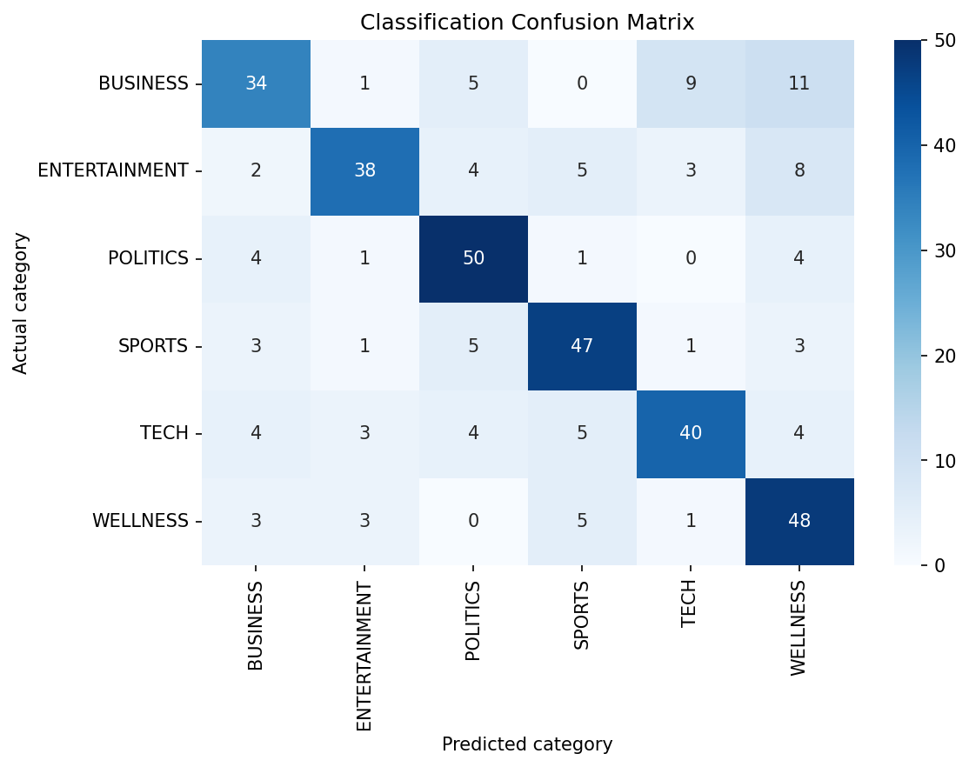
Dataset and responsible scope
1,800 balanced historical HuffPost records
Six coverage categories; headline/description records, not full articles
Spanish/French examples are separate paired demonstrations
NEWSBOT 2.0 · ITAI 2373
5
Notes:
Explain why claims remain local and historical.

Slide 6
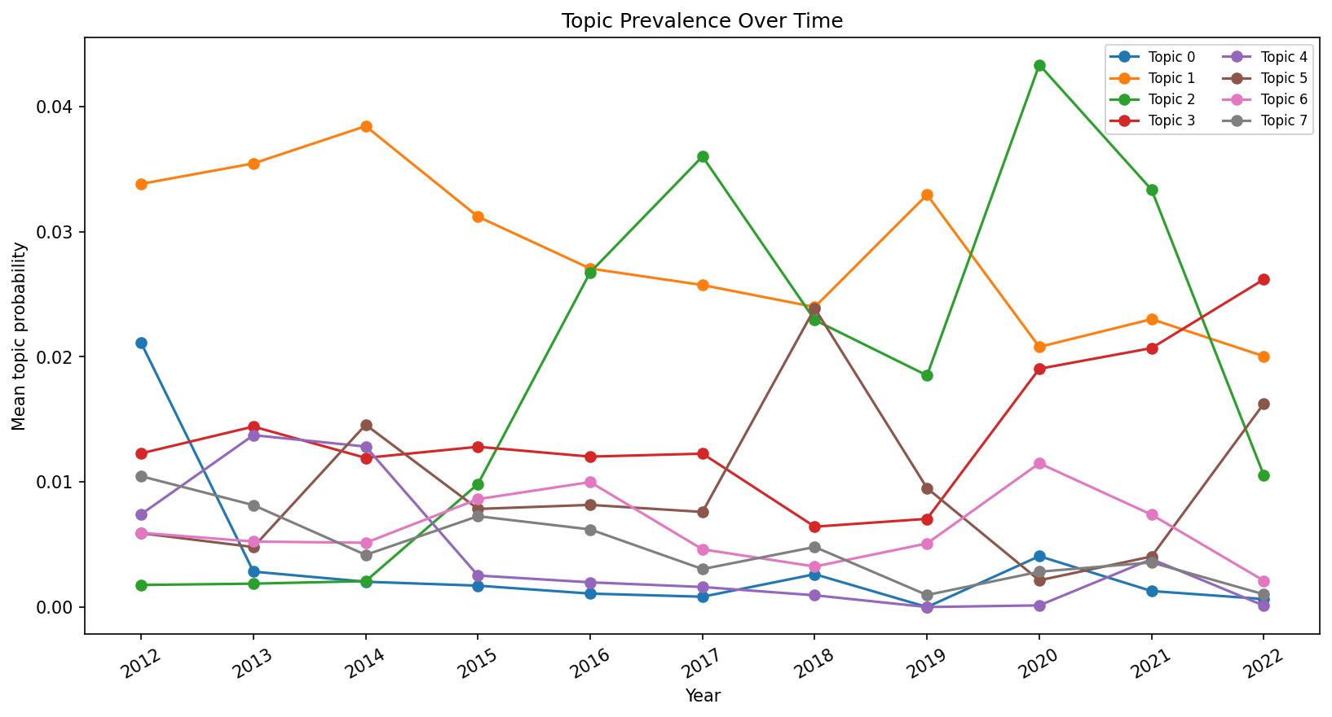
Advanced classification
Selected baseline: Multinomial Naive Bayes (midterm baseline)
Held-out accuracy: 0.714
Macro F1: 0.712; calibration is reported
NEWSBOT 2.0 · ITAI 2373
6
Notes:
Explain selection by macro F1 and the value of probability-aware outputs.

Slide 7
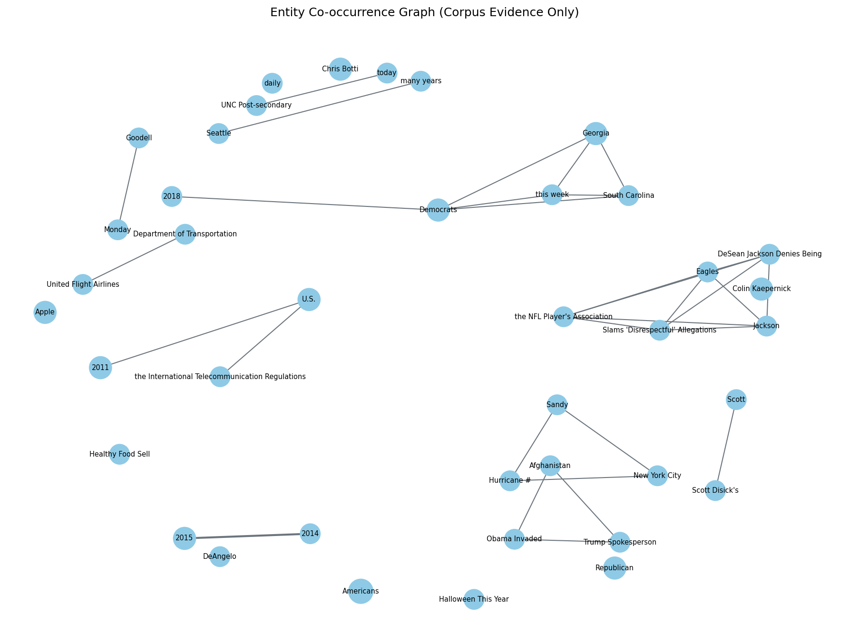
Topic discovery and evolution
LDA and NMF trained with fixed seed
NMF selected for lexical distinctiveness
Annual trends are historical local-corpus descriptions
NEWSBOT 2.0 · ITAI 2373
7
Notes:
Call the coherence score a lexical-overlap proxy, not a human topic-quality verdict.

Slide 8
Sentiment and entity graph
VADER sentiment trends and anomaly signals
spaCy entities plus transparent co-occurrence/dependency heuristics
Graph links never prove a real-world relationship
NEWSBOT 2.0 · ITAI 2373
8
Notes:
Use the graph as a starting point for reading, not a relationship claim.

Slide 9
Language understanding
Lazy DistilBART integration with CUDA detection
Reliable extractive fallback in default CPU-safe run
Summary quality records compression, readability, retention, and ROUGE-L
NEWSBOT 2.0 · ITAI 2373
9
Notes:
Show active backend rather than hiding a fallback.

Slide 10
Semantic retrieval and enhancement
Category-based Precision@1: 67%
Hit@5: 100% across 6 authored queries
Related local coverage is not factual agreement
NEWSBOT 2.0 · ITAI 2373
10
Notes:
Emphasize small authored evaluation and topical—not factual—relevance.

Slide 11
Multilingual demonstration
Language detection, translation provenance, and cross-language matching
6 paired examples; detection accuracy 100%
Descriptive framing signal, not cultural understanding
NEWSBOT 2.0 · ITAI 2373
11
Notes:
Show a Spanish/French example and explain the intentionally limited scope.

Slide 12
Conversational interface
Supervised intent model plus transparent high-precision rules
Filters: category, sentiment, entity, timeframe, comparison
9 authored cases; intent/slot accuracy 100%/100%
NEWSBOT 2.0 · ITAI 2373
12
Notes:
Demonstrate a query and follow-up using historical data.

Slide 13
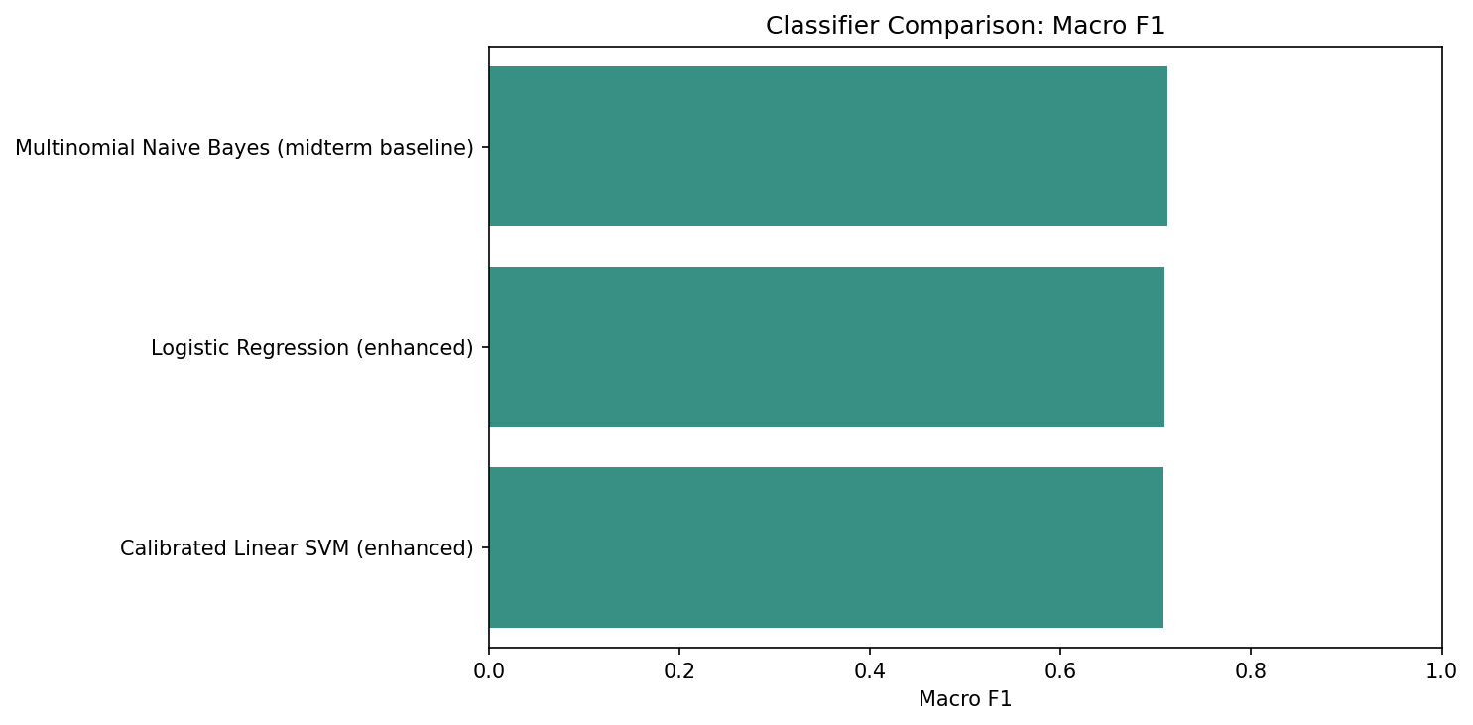
Integrated live demo
Analyze a newly written article
Show a corpus query and follow-up
Open visual evidence and name limitations
NEWSBOT 2.0 · ITAI 2373
13
Notes:
Keep the demo short. Cite the runtime backend and warnings if an optional model is unavailable.

Slide 14
Evaluation and reproducibility
Tests, executed notebooks, stored metrics, figures, tables, and GraphML
Every percentage has a stated evaluation-set size
Run the same scripts to regenerate the evidence
NEWSBOT 2.0 · ITAI 2373
14
Notes:
Point to exact commands in the README and technical documentation.

Slide 15
Business value and ROI assumptions
Faster first-pass routing and historical research
Value = time saved × loaded cost − operating cost
No audited savings claim; human review stays required
NEWSBOT 2.0 · ITAI 2373
15
Notes:
Use the example formula as an assumption, never as claimed customer ROI.

Slide 16
Limitations and ethics
Historical/source bias and English-dominant corpus
Sentiment/NER/topic/translation errors are expected
Confidence ≠ truth; similarity ≠ fact-checking; privacy needs governance
NEWSBOT 2.0 · ITAI 2373
16
Notes:
This slide establishes credibility. State the limits plainly.

Slide 17
Contribution and future work
Jason Trimble: architecture, modules, tests, evidence, and delivery
Independently completed capstone
Future work: human evaluation, broader multilingual data, monitored deployment
NEWSBOT 2.0 · ITAI 2373
17
Notes:
Summarize the individual contribution and future directions.

Slide 18
Questions and discussion
How can the evaluation set become more representative?
Which limitations matter most for a newsroom use case?
What would a responsible production deployment require?
NEWSBOT 2.0 · ITAI 2373
18
Notes:
Invite questions about reproducibility, model selection, safeguards, and next steps.

