Slide 1
Introduction To C Programming
Lesson 09
Programming Style

Slide 2
The purpose of programming style
A program can use the right syntax, have no bugs, and run efficiently, but be poorly written
Make the code easy to read and understand
  Well written programs are easier to understand and modify
Be consistent - use the same style throughout
  E.g., stick with one curly brace style

Slide 3
What is good programming style?
Code should be:
  Clear and simple
  Straightforward logic
  Conventional language use
  Meaningful variable, function, and constant names
  Neat formatting
  Helpful comments

Slide 4
Attributes of bad programming style
Clever tricks
  Clever code is often hard to understand code
  E.g.,
    Using #define to make C look like another language
    Complex expressions (unwrap them)
Unusual constructions or use of the language
  Test: An experienced programmer has to go to a reference book to understand code
    for (i=0; i < COUNT; i++)
      int j = 0; /* is j initialized once or for every loop? */

Slide 5
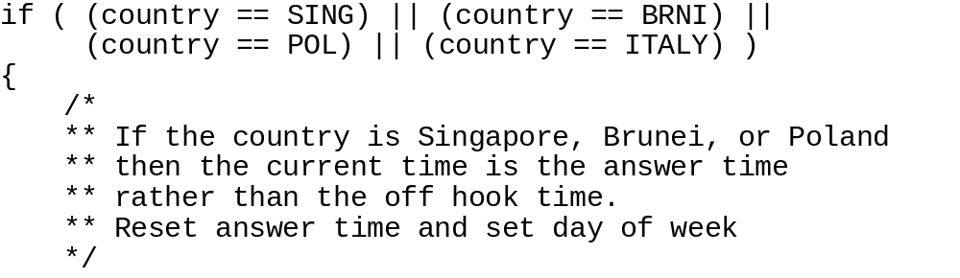
Comments
What relationship links Singapore, Brunei, Poland, and Italy?
Why isn't Italy mentioned in the comment?

Slide 6
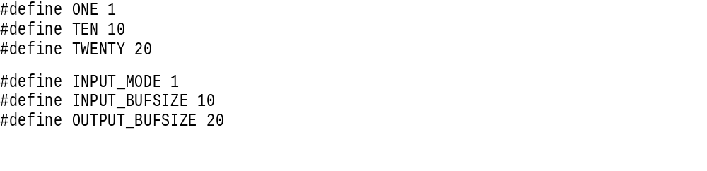
Names
What are potential problems with top 3 #defines?
Why are the next 3 better?

Slide 7
Names
Variable Names
  Use descriptive names for globals, short names for locals
  /* Current length of input queue */
  int nPending = 0;
  /* Which is better? */
  for (theElementIndex = 0; theElementIndex < numberOfElems;
  theElementIndex++)
  /* or */
  for (i = 0; i < nElemens; i++)
  elem[i] = i;

Slide 8
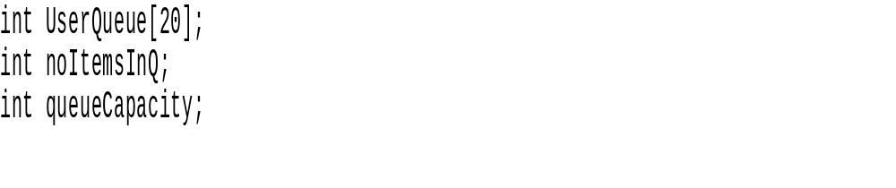
Names - Be Consistent
The word queue appears as Queue, Q, and queue
  A reader wonders - do these all belong together?

Slide 9
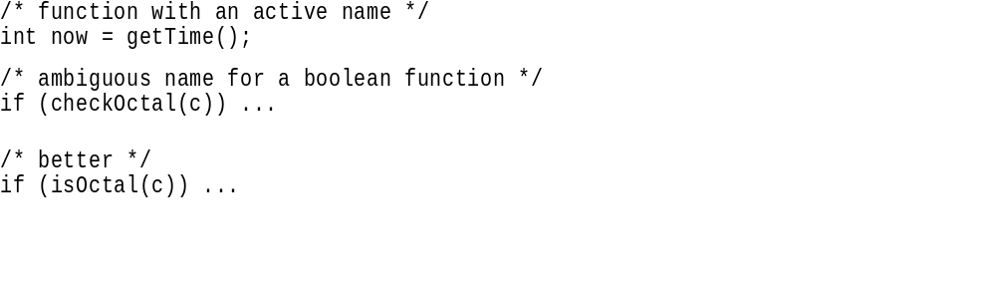
Use active names for functions
Function names should be based on active verbs perhaps followed by nouns
Functions that return a boolean value should be named so that the return value is unambiguous

Slide 10
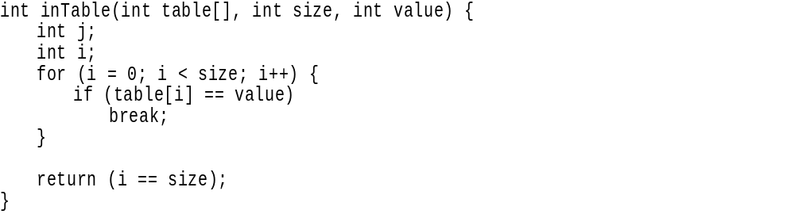
Use accurate names
Using the name it appears that inTable() returns true if the value is in the table
In practice it does the opposite
  This name is sure to confuse

Slide 11
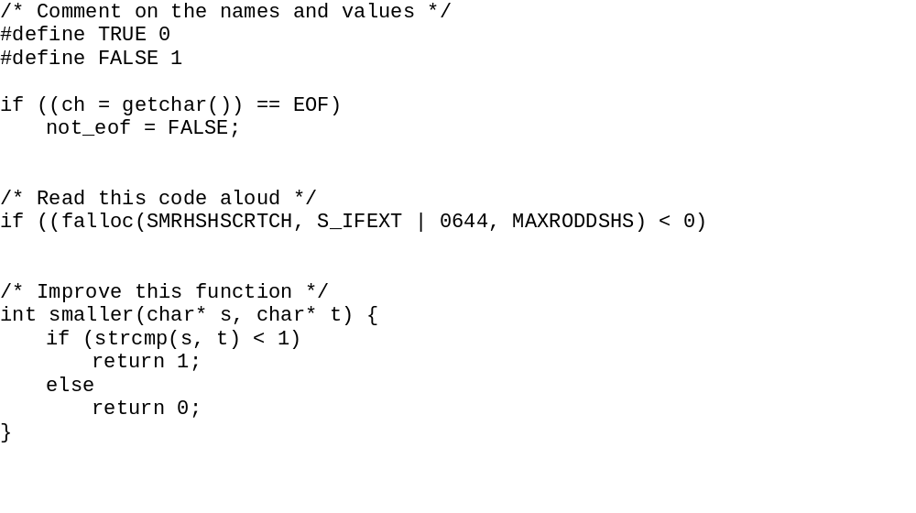
Bad Examples

Slide 12
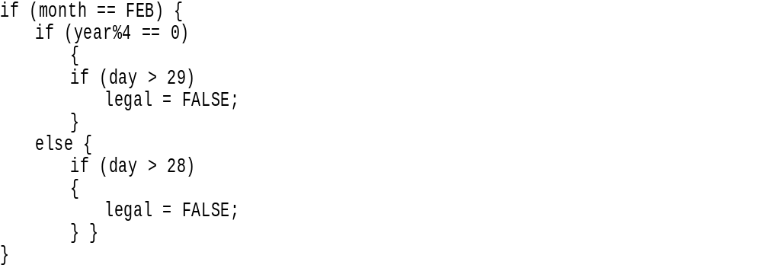
Consistency
Use consistent indentation and brace style
  If you work on a program that is not your own - preserve the style found there

Slide 13
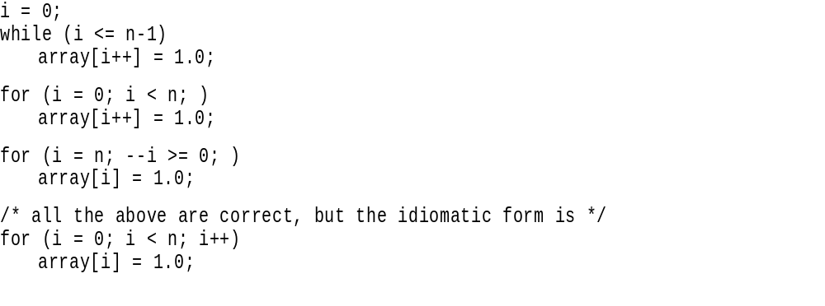
Idioms
Programming languages have conventional ways to write common code
  i, j, k for array counters
  p, q for short term pointer names
  c, ch for short term char names

Slide 14
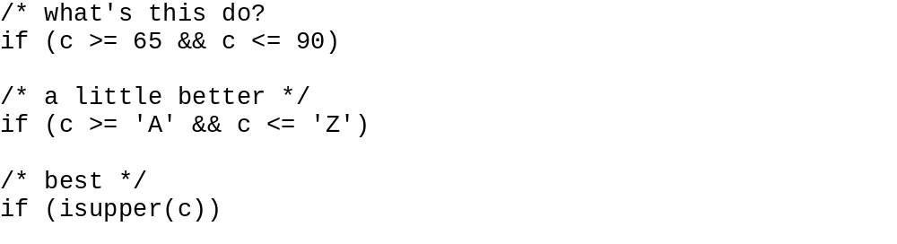
Magic numbers
Give names to magic numbers
Define numbers as constants, not macros
Use the language to calculate the size of an object (I.e., sizeof())
Use character constants, not integers

Slide 15
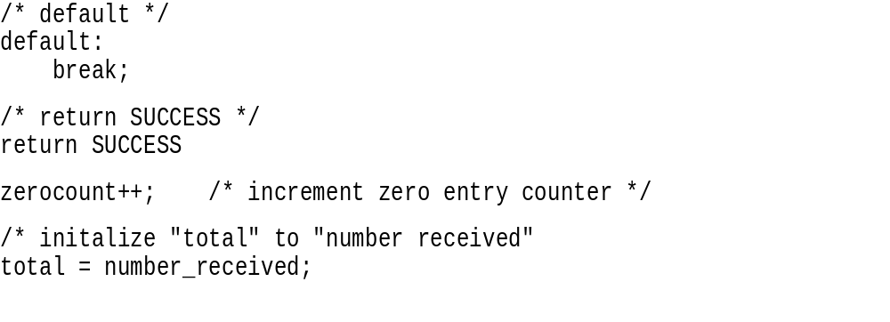
Don't belabor the obvious
Comment functions and global data
  Make comments concise
  Beware standard function comment header

Slide 16
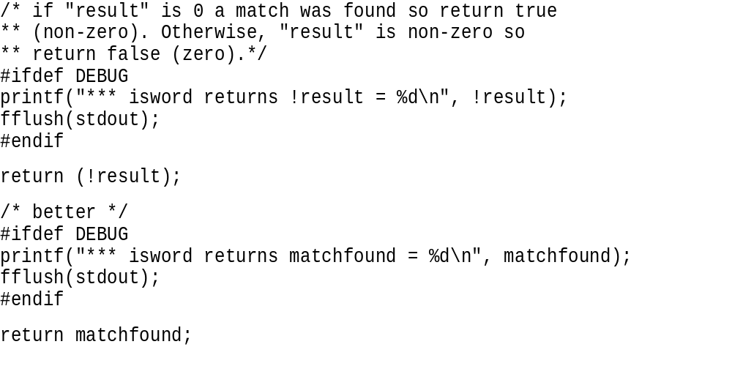
Comments
Don't comment bad code - rewrite it.

Slide 17
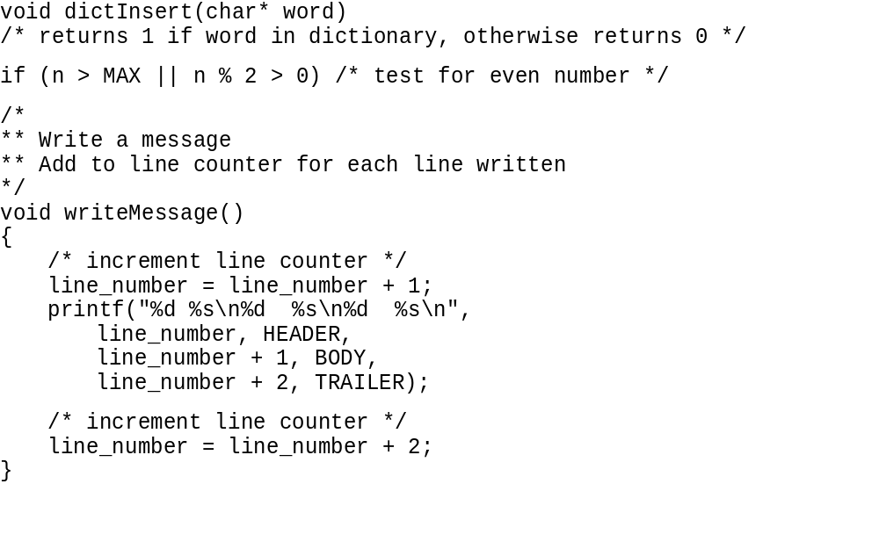
Comment on these comments

Slide 18
Programming Style References
Writing Solid Code, Steve McGuire, MS Press
The Practice of Programming, Brian Kernighan, Rob Pike, Addison Wesley
Code Complete, Steve McConnell, MS Press

