Slide 1
Week 3: File I/O
We’ve been looking at I/O of characters, strings and numbers
So far, everything has been to the screen and from the keyboard
Now we’ll look at creating, reading and writing files.
Since files provide permanent storage of data (usually on hard disk), file I/O is usually more prominent in programs than other I/O

Slide 2
Files
At the most basic level, “files” are simply series of 0’s and 1’s stored in some machine dependent manner on some device
Usually, we think of “files” as being a collection of text and data that is stored on a hard disk
By interpreting the collection of 0’s and 1’s in the file, we can change the file into something readable by us (text) or the machine (data)

Slide 3

C’s view of files
C sees a file as a sequence of bytes (8 bits)
The file ends at an end of file (EOF) marker
C assumes no structure or data type for the file
As far as C is concerned, a file is simply a string of bytes. How you change, manipulate or mangle that string of bytes is up to you.

Slide 4
File I/O
In order to manipulate a file, we need to communicate with it
When we communicate with a file, we say we “open” the file
We then “read” and “write” to and from the file
When we’re done, we “close” the file, meaning it’s no longer communicating with our program

Slide 5
Streams
When a file is “opened”, a stream is associated with it
A stream allows access to files and provides communication between the program and the file
Three streams are opened whenever a program runs: stdin, stdout and stderr.
  These streams are associated with files “attached” usually to the keyboard and screen

Slide 6
Streams
Terminal
stdout
stderr
Program
file stream
File
stdin
keyboard

Slide 7
File communication
When communicating with a file, C needs to know such things as
  which file its communicating with
  file attributes (e.g. read-only)
  current location in the file
This data is stored in the FILE pointer

Slide 8
Standard I/O
int main(int argc, char *argv[]) {
int ch;
FILE *fp;
. . . . . . . . . . . .
if (( fp = fopen(argv[1], “r” )) = = NULL ) {
printf(“Can’t open %s\n”, argv[1]);
exit();
}
while ((ch = fgetc(fp)) != EOF) {
fputc(ch,stdout);
}
fclose(fp);
}

Slide 9
The FILE pointer
When files are opened, the function call returns a pointer to a FILE structure
We’ll look at structures later...for now just think of FILE as a new data type
  declare it the same way as a pointer to an int or other data type
The FILE structure provides all the data necessary for the program to communicate with the file
main(){
FILE *fp = NULL;
int j,k;
.....

Slide 10
File manipulation functions
The FILE pointer is used by a variety of standard C library functions to manipulate data in C
C provides functions for opening and closing files, reading and writing data, moving to and determining a location in a file and more
We’ll now look at some of the standard C library functions for file manipulation

Slide 11
Opening a file: fopen <stdio.h>
The first thing we probably want to do with our new FILE pointer is actually associate it with a real file
#include <stdio.h>
FILE *fopen(const char *filename,
const char *mode)
  “filename” is the name of the file. This is what it is called on disk (directory path).

Slide 12
Opening a file: fopen_s <stdio.h>
The first thing we probably want to do with our new FILE pointer is actually associate it with a real file
#include <stdio.h>
int fopen_s(FILE **pfile,
const char *filename,
const char *mode)
  “filename” is the name of the file. This is what
  it is called on disk (directory path).
  fopen_s returns non-zero error code on failure

Slide 13
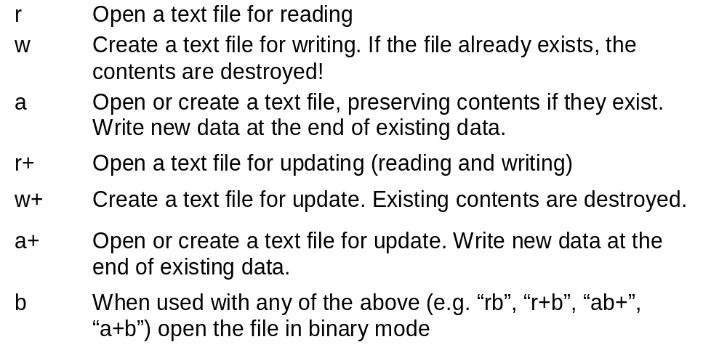
Open file mode
The “mode” string describes how we want to manipulate the file

Slide 14
Opening a file: example
#include <stdio.h>
#include <stdlib.h>
main(){
FILE *fp_read = NULL;
FILE *fp_write = NULL;
if ( (fp_read = fopen(“infile.txt”, “r”)) == NULL) {
printf(“Can’t find input file!...Exiting.\n”);
exit(-1);
}
if ( (fp_write = fopen(“outfile.txt”, “w”)) == NULL) {
printf(“Can’t open output file!...Exiting.\n”);
exit(-1);
}
.....

Slide 15
Opening a file: example
#include <stdio.h>
#include <stdlib.h>
main(){
FILE *fp_read = NULL;
FILE *fp_write = NULL;
if ( fopen_s(&fp_read,“infile.txt”, “r”)) {
printf(“Can’t find input file!...Exiting.\n”);
exit(-1);
}
if ( fopen_s(&fp_write,“outfile.txt”, “w”)) {
printf(“Can’t open output file!...Exiting.\n”);
exit(-1);
}
.....

Slide 16
Closing a file: fclose <stdio.h>
When we’re done with a file, it needs to be closed
  Prevents further reading or writing to the file
  Tells the system to clean up the streams
int fclose(FILE *stream)
  “stream” is a file previously opened with the fopen command
  returns 0 on success, otherwise EOF

Slide 17
Opening and closing a file: example:
#include <stdio.h>
#include <stdlib.h>
main ( ) {
FILE *fp = NULL;
if( (fp = fopen(“myfile.txt”, “r”)) == NULL){
printf(“Error opening file!\n”);
exit(-1);
}
.....
fclose(fp);
}

Slide 18
Sequential files
Since C imposes no overall structure on a file, sequential files are common
In a sequential file, we read and write data depending on our own format.
We don’t assume all lines in the file are the same length or contain the same data
Simply read and write assuming a series of bytes that we know the meaning of ahead of time

Slide 19
Reading and writing sequential files
C library provides routines for manipulating sequential files
Two main routines, fprintf and fscanf, are analagous to printf and scanf
  Writes to or reads from a stream attached to a file, but could also write to terminal or read from keyboard
  Takes the FILE * as an additional argument

Slide 20
Writing sequential files: fprintf <stdio.h>
int fprintf(FILE *fp, const char *format, ...)
  like printf, but writes to the file
  takes FILE * as an additional argument
  writes items just like printf
  returns the number of characters written to the stream, or a negative value if the write failed

Slide 21
Writing a sequential file: example:
Input:
John Smith 28
Henry James 69
Beth Johans 22
A A 0
#include <stdio.h>
#include <stdlib.h>
main(){
char lname[80], fname[80];
int age = 1;
FILE *fp = NULL;
if( (fp = fopen(“myfile.txt”, “w”)) = = NULL){
printf(“Error opening file!\n”);
exit(-1);
}
scanf(“%s%s%d”, fname, lname, &age);
while( age > 0 ){
fprintf(fp, “%s %s %d\n”, lname, fname, age);
scanf(“%s%s%d”, fname, lname, &age);
}
fclose(fp);
return 0;
}
Output file:
Smith John 28
James Henry 69
Johans Beth 22

Slide 22
Reading sequential data: fscanf, feof <stdio.h>
int fscanf(FILE *, const char *, ...)
  like scanf, but reads from a file
  takes a FILE * as an additional argument
  returns the number of items assigned, or EOF if couldn’t read from FILE
int feof (FILE *)
  returns non-zero if the stream is set to EOF
int ferror (FILE *)
  returns a nonzero value if a read or write error has occurred on stream fp

Slide 23
Reading sequential data: example:
#include <stdio.h>
#include <stdlib.h>
main(){
char lname[80], fname[80];
int age;
FILE *fp = NULL;
if( (fp = fopen(“myfile.txt”, “r”)) == NULL){
printf(“Error opening file!\n”);
exit(-1);
}
fscanf(fp, “%s%s%d”, lname, fname, &age);
while( !feof(fp) ) {
printf(“%s %s is %d.\n”,
fname, lname, age);
fscanf(fp, “%s%s%d”,
lname, fname, &age);
}
fclose(fp);
return 0;
}
Input file:
Smith John 28
James Henry 69
Johans Beth 22
Output:
John Smith is 28.
Henry James is 69.
Beth Johans is 22.

Slide 24
Writing sequential files: fputc, fputs <stdio.h>
int fputc(int c, FILE *fp)
  like “putchar”, but writes the character to the file that has been opened with fopen
  returns character written or EOF on error
int fputs(const char *s, FILE *fp)
  like “puts”, but writes the string to the file that has been opened with fopen
  Does NOT append a null character or newline when it prints
  returns EOF on error

Slide 25
Reading sequential files: fgetc, fgets
int fgetc(FILE *fp)
  like “getchar”, but reads the character from the file that has been opened with fopen
  returns the character read or EOF on error
char *fgets(const char *s, int n, FILE *fp)
  like “gets”, but reads the string from the file
  reads up to newline or an EOF or until n - 1 characters are read
  Appends a newline character followed by null character
  returns s, or NULL on EOF or error

Slide 26
Reading/Writing sequential data: Example
int main( int argc, char *argv[ ]) {
char inarray[80];
int linecount = 1;
FILE *fp;
if ( argc < 2 ) {
printf( “Usage: programname filename\n”);
exit( 1 );
}
else if ((fp = fopen(argv[1], “r”)) == NULL){
printf(“Unable to open file %s.\n”, argv[1]);
exit( 1 );
}
while( fgets( inarray, 80, fp ) != NULL ) {
//while( fgets( inarray, 80, fp ) ) {
printf(“%d\t”, linecount++ );
fputs( inarray, stdout ); //puts(inarray);
}
fclose(fp);
return 0;
}

Slide 27
Summary
Files provide permanent storage
  A FILE * is used to associate a stream with a file and allow the program to read and write
  fopen and fclose are used to associate and disassociate the stream with the file
  fscanf, fprintf, fputc, fputs, fgetc, fgets, and feof read and write to files in a manner analogous to scanf , printf, putc, puts, getc, gets.
Next:
  Now let’s look at binary files

Slide 28
Binary Files
A collection of data stored in the internal format of the computer
No conversion takes place when data is written to a binary file
Much faster and more flexible file handling than text files
Usually takes less space than text files
File transportability across different hardware platforms is reduced

Slide 29
Writing to binary files: fwrite <stdio.h>
size_t fwrite(const void *ptr, size_t n, size_t ndata, FILE *fp)
  writes data from the memory location pointed to by ptr to the FILE referenced by fp
  writes ndata data elements
  takes each of the ndata elements to be n bytes in size
  overall, writes n*ndata bytes from ptr to fp
  returns number of elements written

Slide 30
Writing to binary files: Example:
/* Creates a binary file containing 10 integers values */
…………….
FILE *fp;
int score[10] = {22,45,34,12,98,56,23,44,9,11};
fp = fopen(“nums.bin”, “wb”);
fwrite ( score, sizeof(int), 10, fp);
fclose(fp);

Slide 31
Writing to binary files: Example:
/* Creates a binary file containing the integers 1-100 */ …………….
FILE *fp;
int i;
fp = fopen(“nums.bin”, “wb”);
……………..
for ( i = 1; i <= 100; i++ )
fwrite ( &i, sizeof(int), 1, fp);
fclose(fp);

Slide 32
Reading binary files: fread <stdio.h>
size_t fread(void *ptr, size_t n,
size_t ndata, FILE *fp)
  reads data into the memory location pointed to by ptr from the FILE referenced by fp
  reads ndata data elements
  takes each of the ndata elements to be n bytes in size
  overall, reads n*ndata bytes from fp to ptr
  returns number of elements read

Slide 33
Reading binary files: Example:
// Reads a file of integers, three integers at a time
FILE *fp;
int i, itemsRead, int intArray[3];
fp = fopen(“int_file.dat”, “rb”);
……………..
while ( ( itemsRead = fread ( intArray, sizeof(int),
3, fp ) ) != 0 ) ) {
/* process array */
for ( i = 0; i < itemsRead ; i++ )
……………………….
}

Slide 34
Random access files
“Random access” means being able to read or write a specific number of bytes from anywhere in the file
It assumes I know where the data I want is located in the file
need different functions for random access
ftell and fseek

Slide 35
Moving in random access files: fseek <stdio.h>
int fseek(FILE *fp, long int offset, int whence)
  sets the file position indicator to a position determined by offset and whence
  “offset” is the number of bytes to move the file position indicator
  “whence” indicates the reference point from which to move the file position indicator
    SEEK_CUR = relative to current location
    SEEK_SET = move relative to file beginning
    SEEK_END = move relative to file end
  returns non-zero on error

Slide 36
Moving in random access files: ftell <stdio.h>
long int ftell(FILE *fp)
  returns the current value of the file position indicator
  this is the number of bytes from the beginning of the file

Slide 37
Moving in random access files:
Example:
Function that returns the length of a file and keeps the current position in the file.
long fileLength(File *fp) {
long oldposition = ftell(fp);
long length;
fseek( fp, 0, SEEK_END);
length = ftell(fp);
fseek( fp, oldposition, SEEK_SET);
return ( length );
}

Slide 38
Summary
A binary file is a collection of data stored in the internal format of the computer
fread and fwrite are used to read and write to binary files
Random access files allow data to be stored at arbitrary points in a file
fseek and ftell are used to move to a given position in a binary file

