Slide 1
Predicting a Successful Crowdfunding Campaign
Outline
Problem Statement
Data Acquisition
Workflow
Data Exploration
Feature Engineering
Feature Reduction
Modeling
Evaluation
Conclusions
Next Steps
Stacey S. Camp
February 7,2018

Slide 2



















Problem Statement
Can machine learning techniques predict crowdfunding success using historical data?
Who: Crowdfunding platforms, organizations and individuals
What: Long term success of a crowdfunding platform or individual success of a project
Where: Cross-industry application
When: Before launching a project or continuous
Why: Competitive market for crowdfunding requests

Slide 3



GlobalGiving
Reduce Work Hours for Ecuador’s Street Children
Background on GlobalGiving
API
Data Available
Requests Library
Output and storage
 | title | activities | longTermImpact | summary | need
0 | Poor women micro-enterprise development-Indonesia | 150 families will be trained in basic business... | 150 poor families will take the first step out... | Helping 150 poor Indonesian women in 14 villag... | 35 million people in Indonesia live below the ...
1 | Digital Divide Data (DDD) | Self-sustainability is fundamental to DDD’s mi... | The outcomes of this project include employeei... | DigitalDivideData is an IT socially conscious ... | As the world’s economy becomes increasingly in...
2 | Bridging the digital divide with computers | The goal of the project is to supply at least ... | We have sent our first 94 PCs and 6 printers i... | Reusing low-end computers from the developed w... | Currently U.S. businesses pay for the disposal...

Slide 4
Modeling Workflow
Data Preparation
Data Exploration
Iterative process
Data preparation
Data exploration
Feature engineering
Modeling
Evaluation
Evaluation
Feature Engineering
Modeling

Slide 5
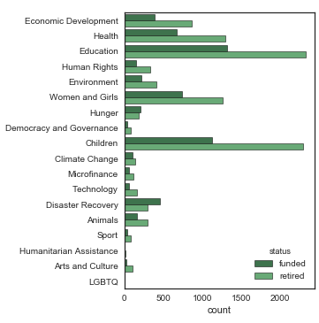
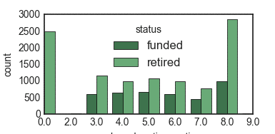
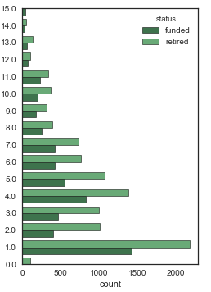
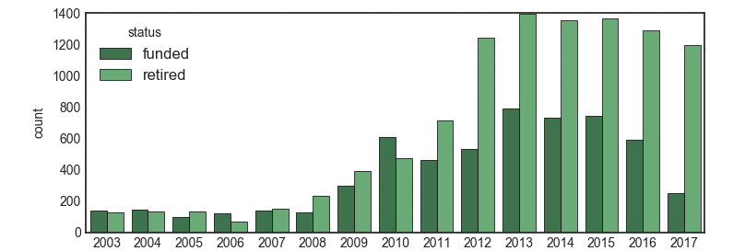
Data Exploration -Categorical
Theme
Number of Donation Options
Examples of categorical data
Count plots
Chi-Square test
Number of Images
Year

Slide 6
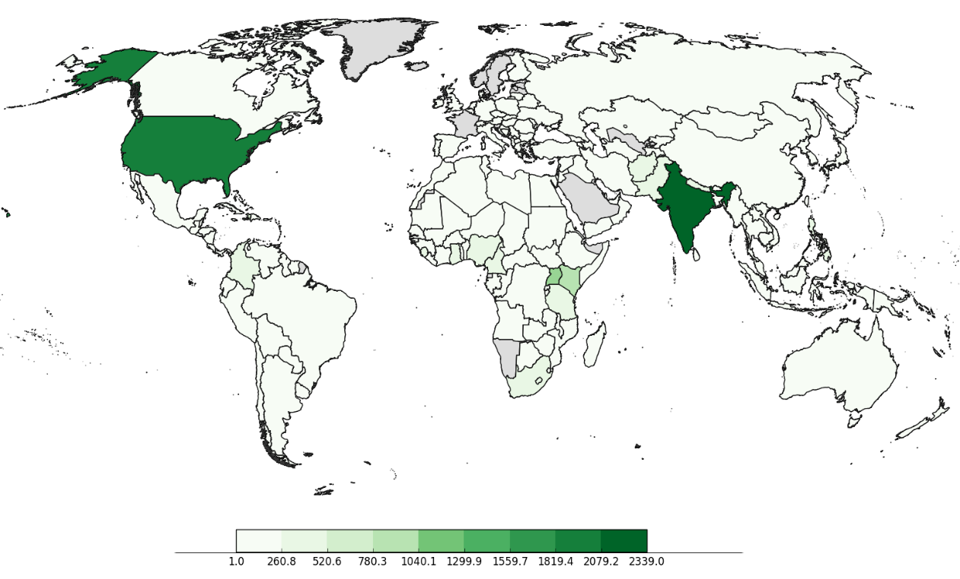
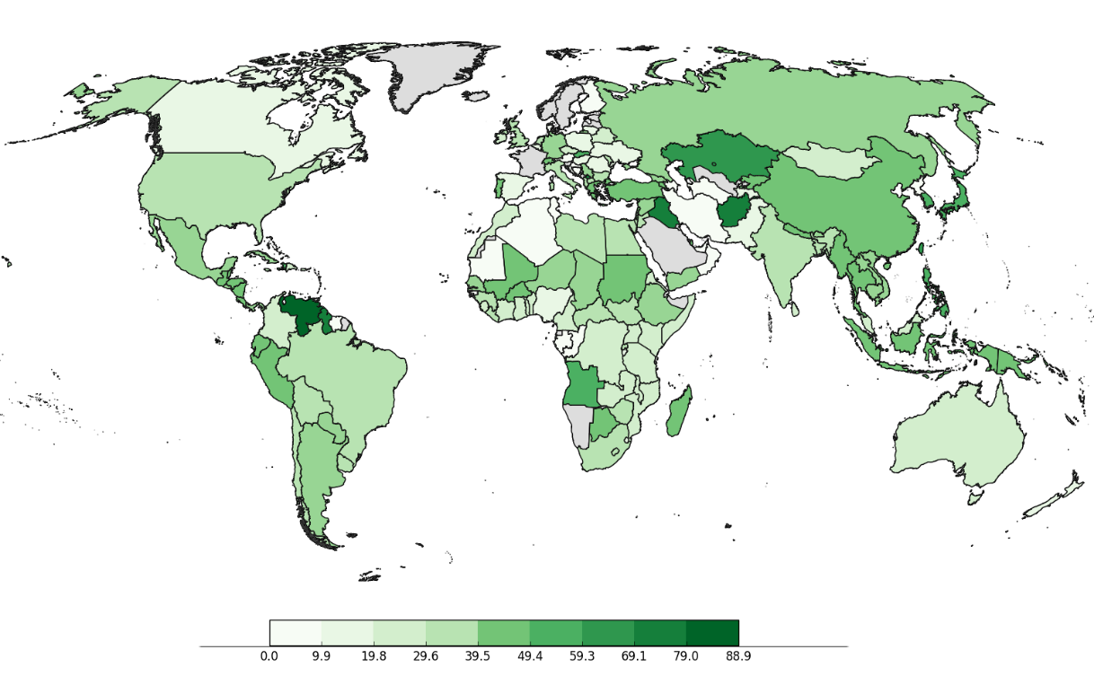
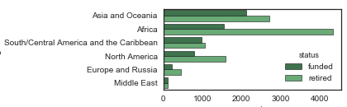
Spatial Patterns
a.
Total Projects by Country
Percent Funded by Country
Regional patterns in funding
b.
c.

Slide 7
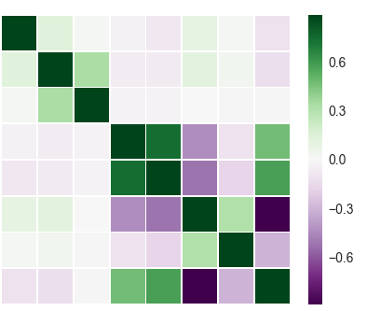
Data Exploration -Continuous
Heat Map from
Correlation Matrix
Goal
Max Donation
Min Donation
Active Projects
Total Projects
Examples of continuous data
Correlations
Heat map
T-tests
# Don. Options
# Images
Min / Max
Goal
 | min_ | min_donation_amount
status
funded | count | 5763
 | mean | 26.515877
 | std | 258.091472
 | min | -1
 | 25% | -1
 | 50% | 10
 | 75% | 20
 | max | 15000
retired | count | 10267
 | mean | 79.191974
 | std | 1233.872554
 | min | -1
 | 25% | 10
 | 50% | 10
 | 75% | 20
 | max | 75000
Min / Max
Min Donation
# Images
Max Donation
Active Projects
Total Projects
# Don. Options
Descriptive Statistics
Grouped by Status

Slide 8
Feature Engineering
Categorical | Continuous | Text
Dummy features | Calculated Features | Tf-idf | Custom
Data Normalized and Reduced with PCA |  | Latent Semantic Analysis
Combined Datasets
Raw
Continuous
Categorical
Text
Feature Reduction
Final Feature Sets
Derived
Reduced
Feature
Sets

Slide 9
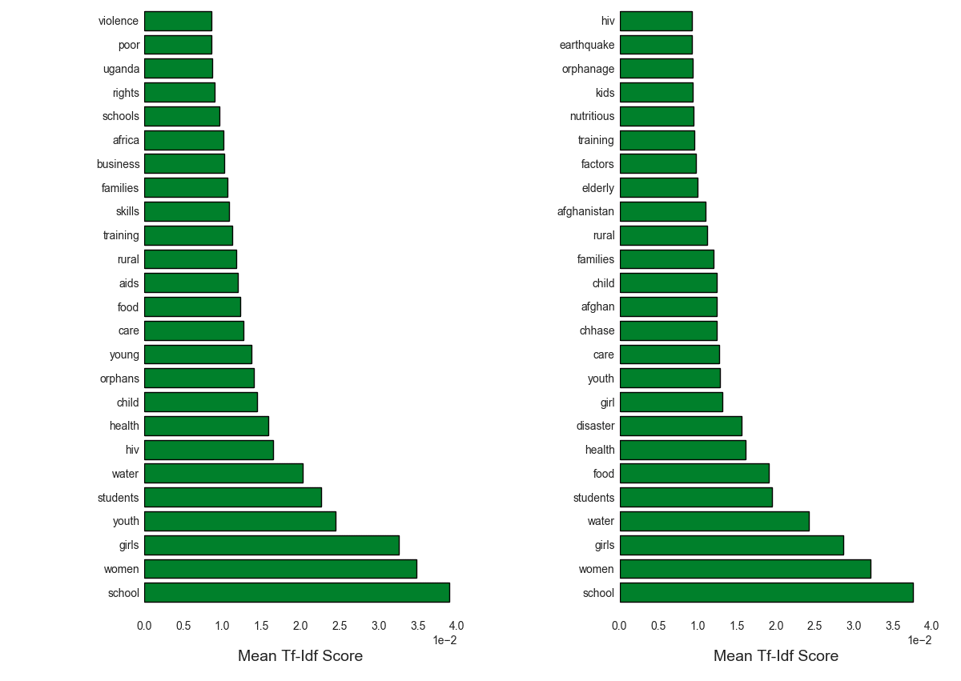
Natural Language Processing
Retired
Funded
spaCy
Tf-idf
Custom Features

Slide 10
Modeling
Model | Training Set Accuracy | Test Set Accuracy
Random Forest | 0.98 | 0.71
Logistic Regression | 0.74 | 0.73
Bernoulli Naïve Bayes | 0.67 | 0.66
Gradient Boost (Logistic Regression) | 0.98 | 0.76
Train/Test groups
Model Output
Notes:
I tried 4 different models to see which one performed best
The results output here are the best obtained

Slide 11
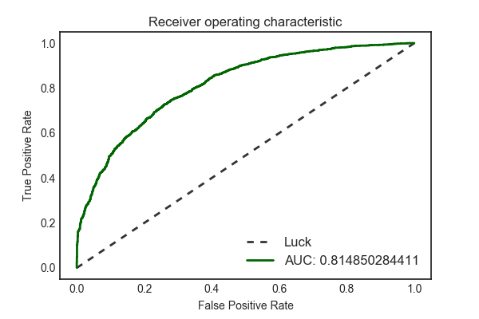
Evaluating Output
Evaluating model using ROC
Conclusions
Next Steps

