Slide 1
Predicting Vaccine Sentiment on Twitter
Stacey Camp
10/24/2017

Slide 2
Data Source
Tweet Content
Label
The Effect of Aluminum in Vaccines on Humans https://t.co/iVcL37ened via @YouTube
World Renowned Genetics Doctor Sees Relationship Between Fetal Cells Used in Vaccines and Increasing Autism Rates https://t.co/is4BS7kic4
Vaccines are covertly injecting everyone with disease-causing viruses, warns scientist author of “Plague” – https://t.co/SgGEGhdKpC
This is a must watch video if u want to question the safety of #vaccines, dont believe everything u r told https://t.co/2izVOKEg4Q
Vaccines dont cause autism. There is no link.
Vaccines covertly injecting everyone with disease-causing viruses https://t.co/HDB02VraRn Vaccines dont save lives healthy immunity does!
VACCINES ARE SAFE THIS IS NOT A JOKE https://t.co/qVgMI1FJf3
Vaccines are the SUPERSTARS of medicine!? Amazing scientific superstars!! Its time we started celebrating them in… https://t.co/lqGg1dMSDi
Vaccines save lives and money. Primary prevention is the best. https://t.co/bnxm3QaJx4
The jury is not still out on vaccines, you frickin idiots! @ValentineShow @JohnnyBPhilV @997wtn @Stval3 @jimmystone1996 @soupsONcampbell
1
1
1
1
0
1
0
0
0
0

Slide 3
Feature Engineering
#pediatrician #rotarian #globalhealth #vaccineswork #endpolio, Coordinator @IPAWORLDorg , president @Asiapacific_Ped ex#CSOs rep on @gavi board, #childsurvival
pediatrician, rotarian, globalhealth, vaccineswork, endpolio, coordinator, ipaworldorg, president, asiapacificped, excsos, rep, on, gavi, board, childsurvival]
pediatrician | people | maga | philanthropic | science | globalhealth | whine
1 | 0 | 0 | 0 | 0 | 1 | 0
0 | 1 | 0 | 0 | 0 | 0 | 1

Slide 4
Feature Selection
health = 1
(1,1)
Target = 1
(1,1) | truth, world, news, life, people, maga, god, music, right, advocate, make, good, constitution, family, artist, mom, follow, natural, freedom, lover, mother
(0,1) | science, care, services, community, public, account, views, disease, development, updates, writer, nurse, scientist, retweets, mum, diseases, policy, across, ill, office

Slide 5
Model Selection
Model | Feature Set | Accuracy | Average Accuracy in Cross-Validation
Naïve Bayes - Bernoulli | Original | 86% | 64%
 | JSS Derived | 78% | 75%
Logistic Regression | Original | 97% | 65%
 | JSS Derived | 87% | 75%
Random Forest | Original | 62% | 68-72%
 | JSS Derived | 70% | 68-73%

Slide 6
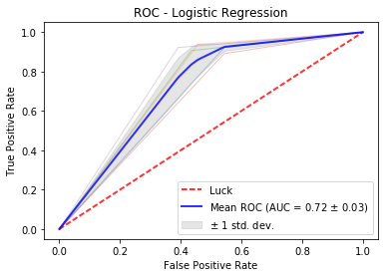
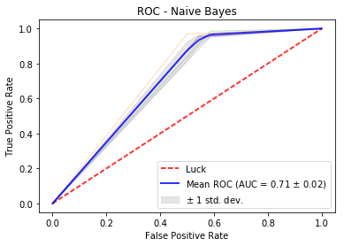
ROC Analysis

Slide 7
Model Limitations:
Class Imbalance
Accuracy
Next Steps:
1. More Data
2. Combining features
3. Different Test Dataset

