Slide 1
COMP 311: Software Testing and Quality Assurance GitHub + CircleCI Presentation for Test tools assignment by Che Shing Winson Li Yik Hong To
Ho Ting Edmund Tsoi

Slide 2
What is GitHub + CircleCI?
GitHub:
A platform for version control, code hosting, and collaboration.
Key features: repository hosting, branching, pull requests, issue tracking.
CircleCI:
A CI/CD tool that automates testing, builds, and deployment for GitHub-hosted projects.
Configured using .circleci/config.yml to define jobs, workflows, and steps.
Purpose:
Streamline CI/CD pipelines by automatically testing and integrating changes in GitHub-hosted projects.
Who uses it:
Developers, testers, DevOps engineers.

Slide 3
How to Acquire GitHub + CircleCI
GitHub URL: http://github.com/
CircleCI URL: https://circleci.com/
License:
GitHub: Free for public repos; paid plans for private repos.
CircleCI: Free for open-source projects; paid plans for private use.
Requirements:
Git installed locally, GitHub account, CircleCI account, and integration enabled.

Slide 4
How GitHub + CircleCI work
GitHub:
Repository hosting, branching, pull requests.
Collaboration with issues and discussions.
CircleCI:
Automates testing and deployment.
Configured using .circleci/config.yml.
Supports multiple languages and environments.
Strengths
Free for open-source, robust community support.
Weaknesses
Paid tiers for private repositories, limited parallel builds on free plans.

Slide 5
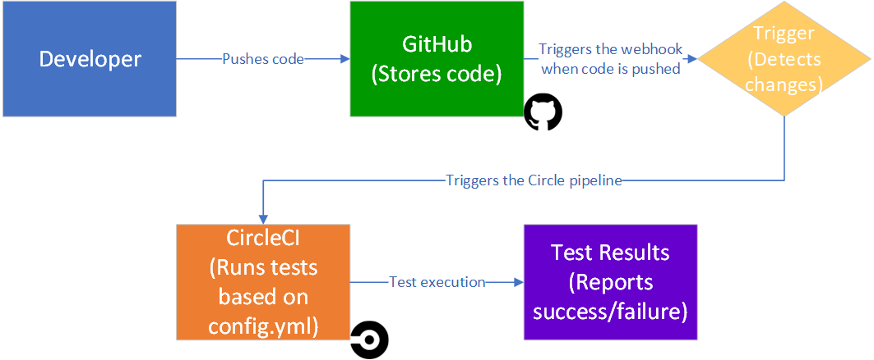
Integration and Workflow

Slide 6
Installation and overview of use (1)
GitHub:
Create a GitHub repository for the project.
CircleCI:
Sign up at CircleCI.
Enable repository integration in CircleCI. Enter the project details and then set up a pipeline to choose your GitHub repository.
Create a .circleci/config.yml file in the repository for configuration. This file will contain all the configuration for running tests and deployments.

Slide 7
Installation and overview of use (2)
Configure CircleCI for the Project:
Specify where the test files are located.
Ensure that the necessary dependencies (e.g., pytest) are installed via the config file.
Push the configuration file to the GitHub repository so that CircleCI can automatically run it on each commit.
Deploy and Run Tests:
Push your code to GitHub: This will trigger CircleCI to automatically detect changes and run the test jobs.
Monitor the test results on CircleCI’s dashboard, where you can view build statuses, logs, and generated reports.

Slide 8
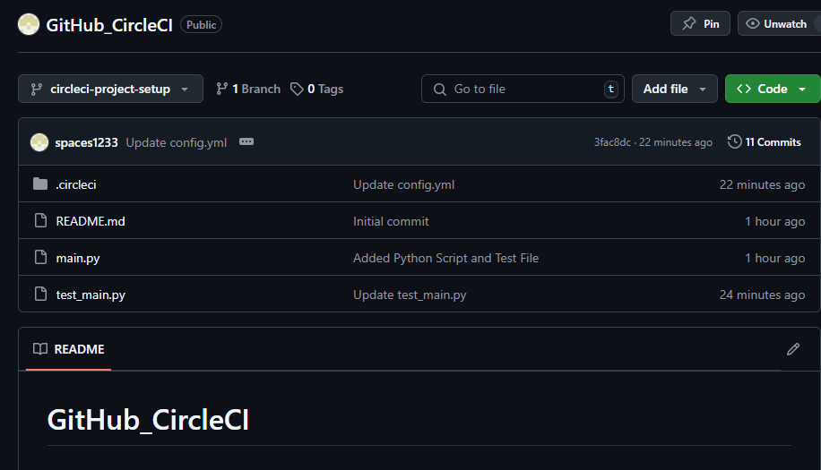
Demonstration – GitHub Setup

Slide 9
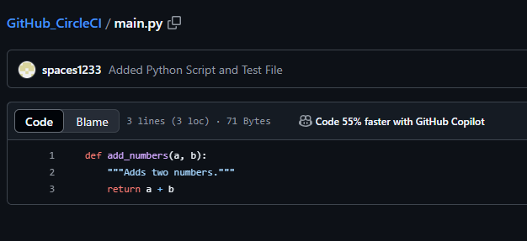
Demonstration – Python Script

Slide 10
Demonstration – Test File
test_main.py:
import pytest
from main import add_numbers
def test_add_numbers():
assert add_numbers(2, 3) == 5 # Pass: 2 + 3 = 5
assert add_numbers(-1, 1) == 1 # Fail: Result will be 0, but we expect 1
def test_add_large_numbers():
assert add_numbers(10**6, 2 * 10**6) == 2000000 # Fail: 10^6 + 2 * 10^6 = 3000000
assert add_numbers(10**6, 10**6) == 1500000 # Fail: 10^6 + 10^6 = 2000000
def test_add_floating_point_numbers():
assert add_numbers(2.5, 3.5) == 6.0 # Pass: 2.5 + 3.5 = 6.0
assert add_numbers(1.5, 2.5) == 4.0 # Pass: 1.5 + 2.5 = 4.0

Slide 11
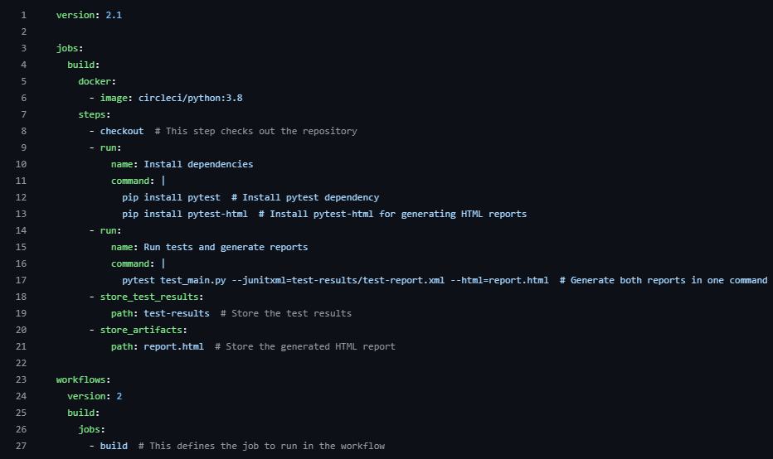
Demonstration – Config.yml

Slide 12
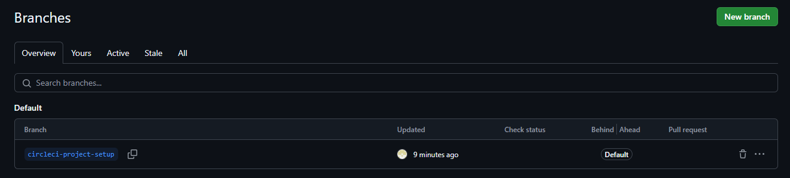
Demonstration – GitHub Branch
In CircleCI, the trigger source is set to "circleci-project-setup". Therefore, we renamed the branch from "main" to "circleci-project-setup".

Slide 13
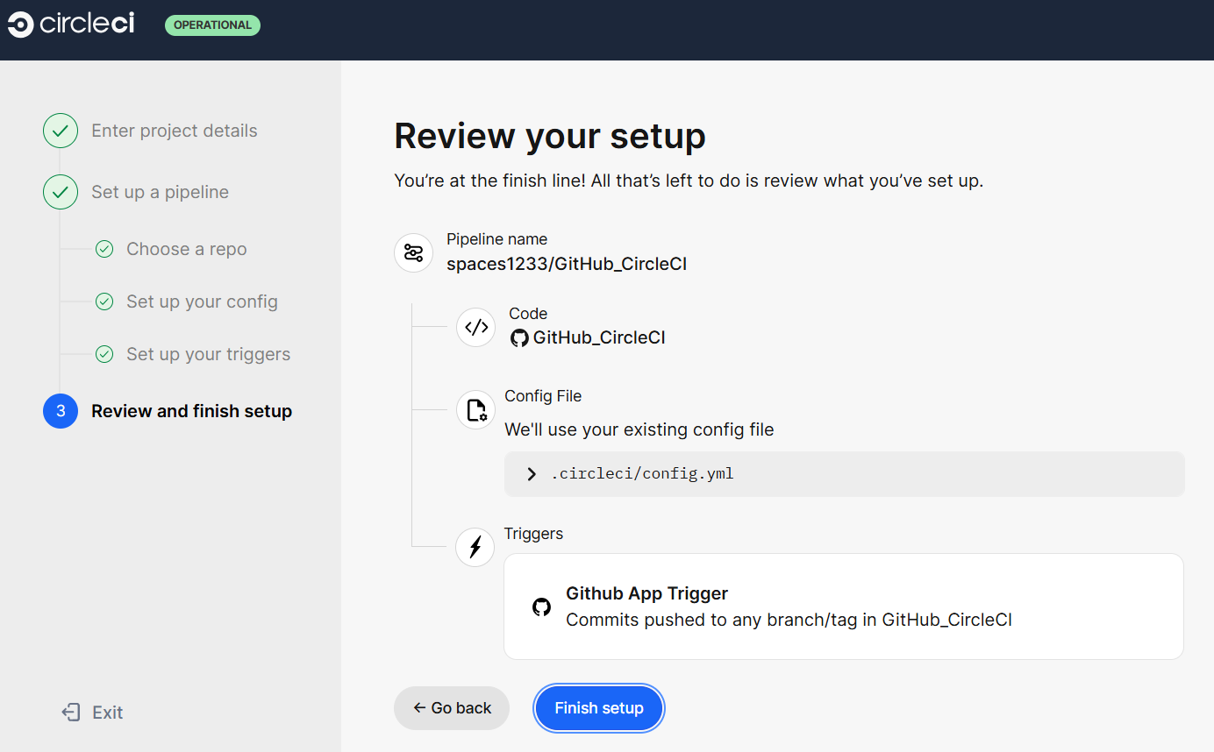
Demonstration – Project Setup

Slide 14
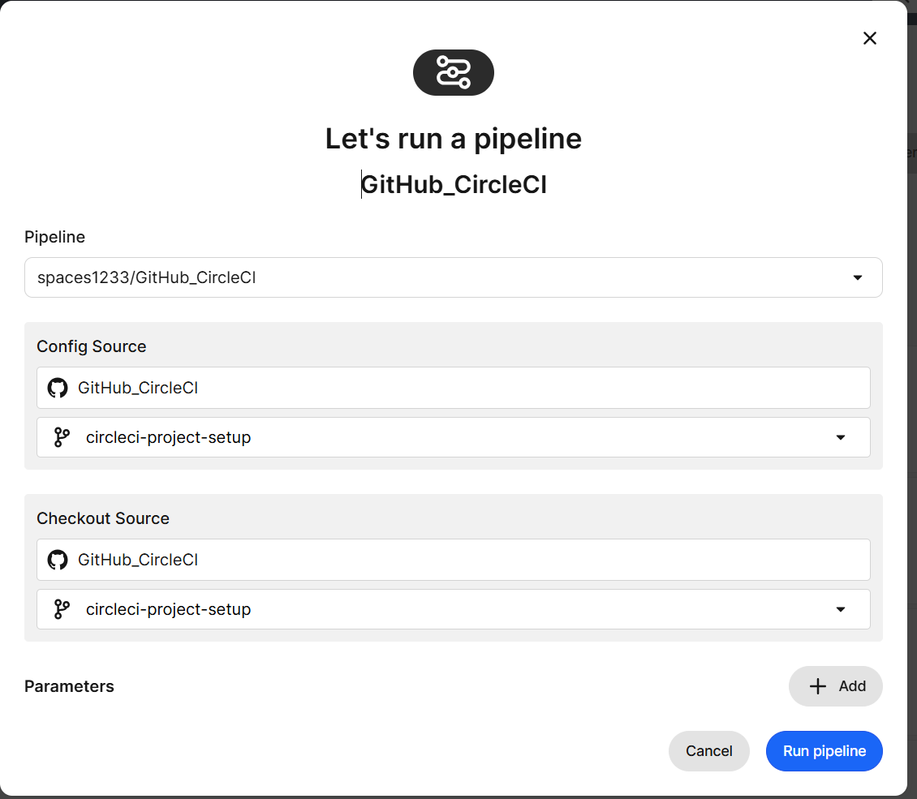
Demonstration – Pipeline Setup

Slide 15
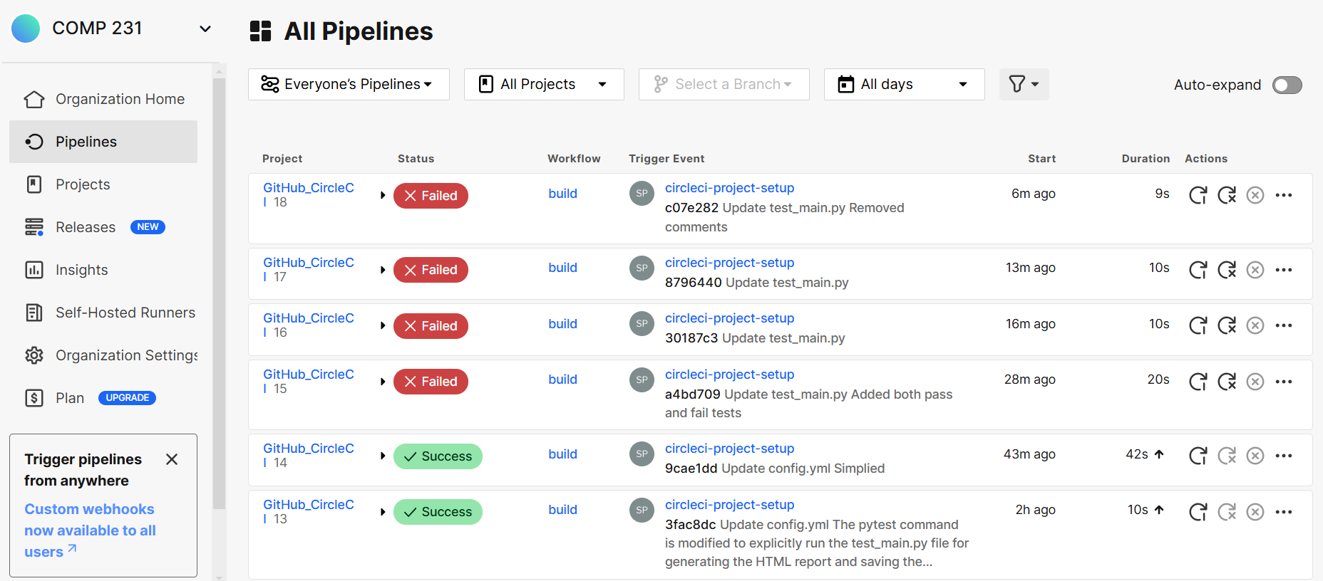
Demonstration – Pipeline Page

Slide 16
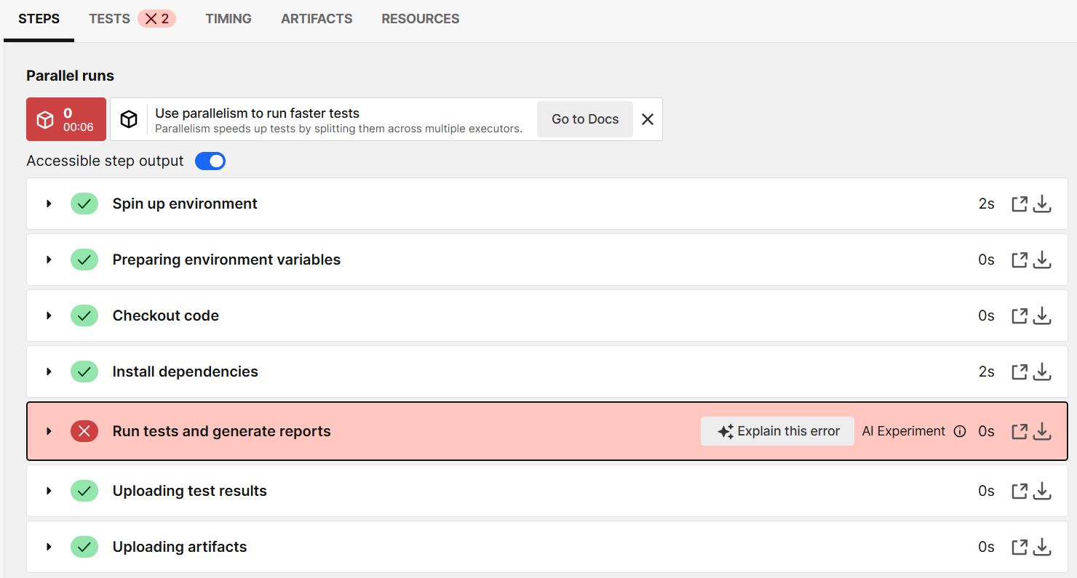
Demonstration – Build Page

Slide 17
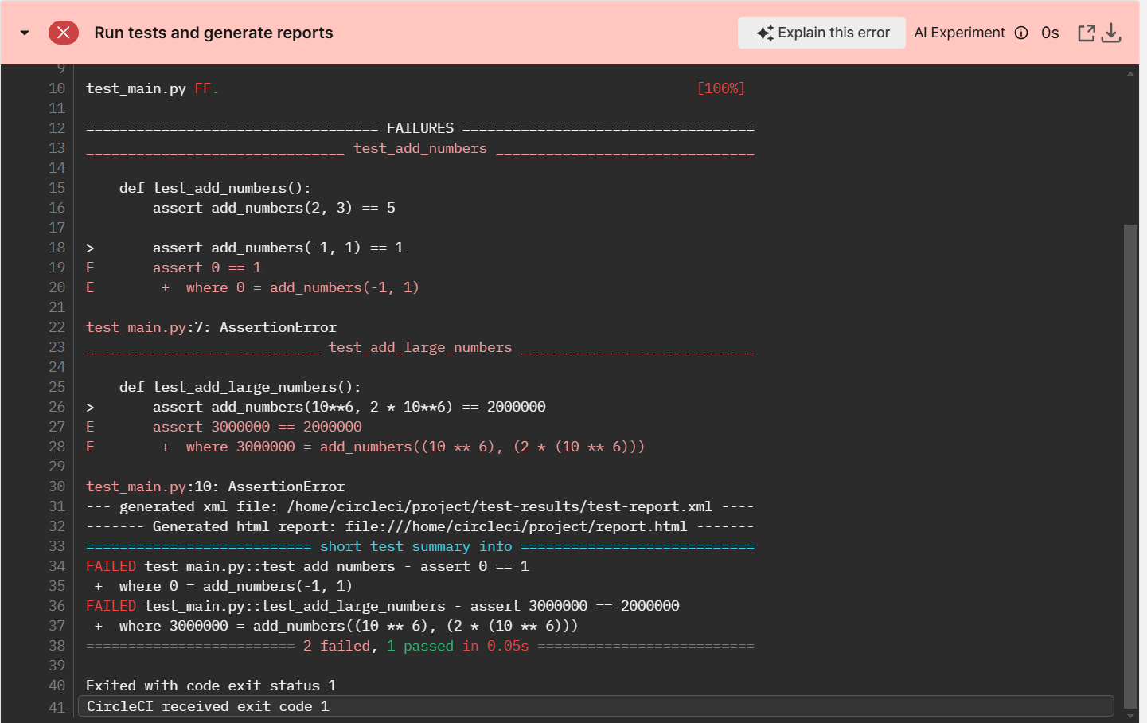
Demonstration – Error Message

Slide 18
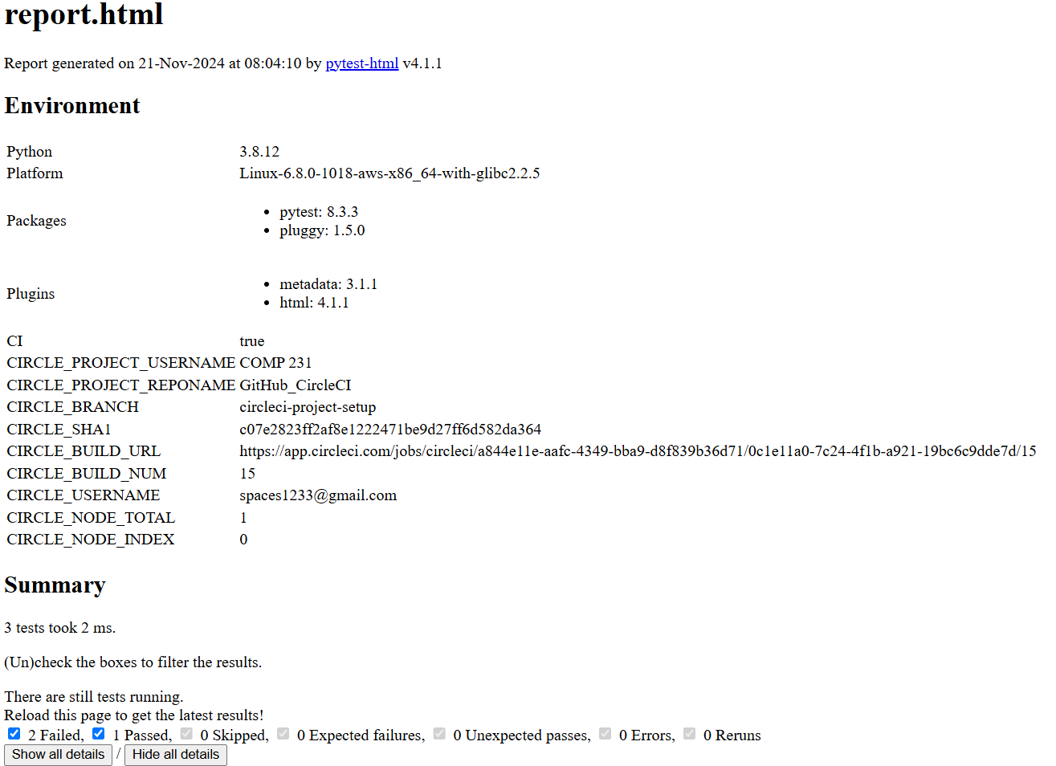
Demonstration – report.html (1)

Slide 19
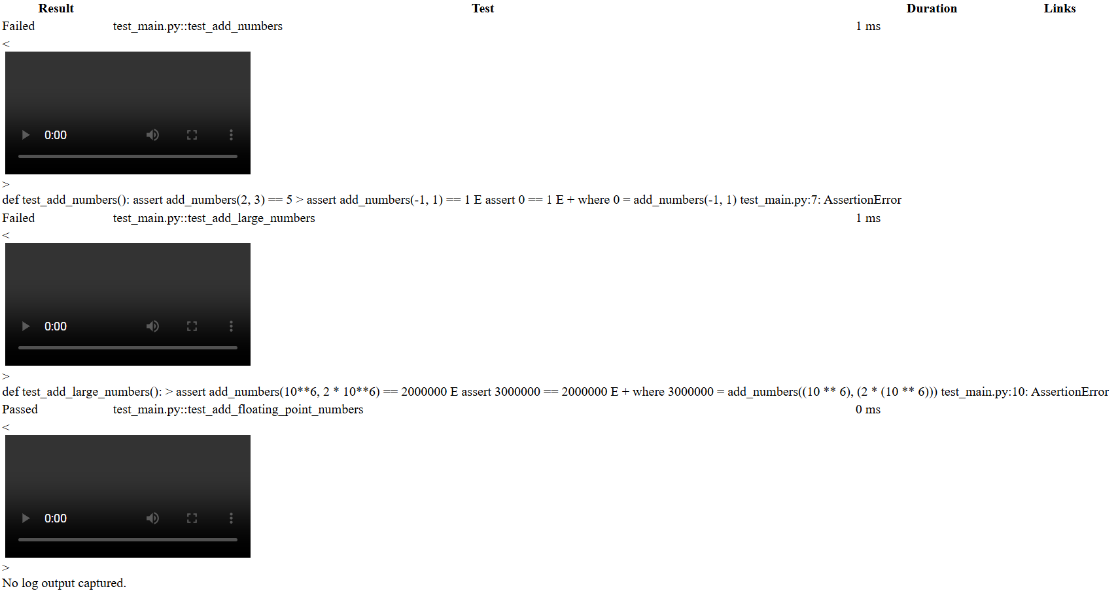
Demonstration – report.html (2)

Slide 20
Live Demo – Test File Change
Our GitHub repository: https://github.com/spaces1233/GitHub_CircleCI
Our CircleCI organization home page: https://app.circleci.com/organization/circleci/MnA9UhYF8jBfCEzuD5D9KW
Our original test file has 1 test pass (both assertions pass) and 2 tests fail (one or two fail).
Then we will change the test file to make all 3 tests pass and see the result at CircleCI.

Slide 21
Real-World Examples
Open-Source Projects
Node.js libraries and Python packages use CircleCI for automated testing and compatibility checks.
Web Applications
CI pipelines streamline testing and deployment for SaaS platforms and e-commerce sites (e.g., AWS, Heroku).
Game Development
Unity projects rely on CircleCI for testing and ensuring cross-platform builds.
Mobile Apps
CircleCI supports Android/iOS app testing, integration, and beta deployment via Firebase or TestFlight.

Slide 22
Advanced Features
Parallel Builds
Speeds up testing by running multiple jobs (e.g., "Unit Tests," "Integration Tests") simultaneously. Example: Faster CI pipelines for large projects.
Workflows
Manages multi-job pipelines with dependencies. Example: "Run Tests" → "Build App" → "Deploy to Staging."
Deployment
Supports platforms like AWS, Heroku, or Docker Hub. Example: Automate deployment to staging and production environments.
Custom Scripts
Allows advanced workflows tailored to project needs. Example: Run pre-deployment scripts or custom environment setup.

Slide 23
Comparison with Similar Tools
GitLab CI/CD:
Built-in CI/CD for GitLab projects.
Advantages: Seamless integration, free tiers for private and public repos.
Limitations: Requires GitLab platform.
Jenkins:
Self-hosted CI/CD tool with extensive customization.
Advantages: Highly flexible, supports complex workflows.
Limitations: Steep learning curve, requires server maintenance.
Why GitHub + CircleCI?
Integration: Optimized for GitHub repositories with effortless setup.
Simplicity: No server hosting needed; beginner-friendly .circleci/config.yml.
Accessibility: Free for open-source projects; supports multiple languages.

Slide 24

Q&A Thanks for listening

