Slide 1
Country Categorization
Notes:
Hello, this project is about country categorization.

Slide 2
Description
HELP International is an international NGO that is dedicated to fighting poverty and providing amenities and relief for people of backward countries.
To use the money strategically and effectively, the countries need to be categorized into groups so that the NGO could identify the countries that are in the direst need of aid.
This project aims at categorizing the countries according to some socio-economic and health factors and thus suggesting the countries that the NGO should focus on the most.
Notes:
First, let me introduce the background.
HELP International is an international NGO that is dedicated to fighting poverty and providing amenities and relief for people of backward countries.
To use the money strategically and effectively, the countries need to be categorized into groups so that the NGO could identify the countries that are in the direst need of aid.
This project aims at categorizing the countries according to some socio-economic and health factors and thus suggesting the countries that the NGO should focus on the most.

Slide 3
Description
Unsupervised learning problem, specifically clustering problem
The dataset is from Kaggle:
https://www.kaggle.com/datasets/rohan0301/unsupervised-learning-on-country-data.
The GitHub website of the project:
https://github.com/spaceship-glitch/countries.
Notes:
This is an unsupervised learning problem. Specifically, this is a clustering problem. The dataset is downloaded from Kaggle. You can find the project on this GitHub link.

Slide 4
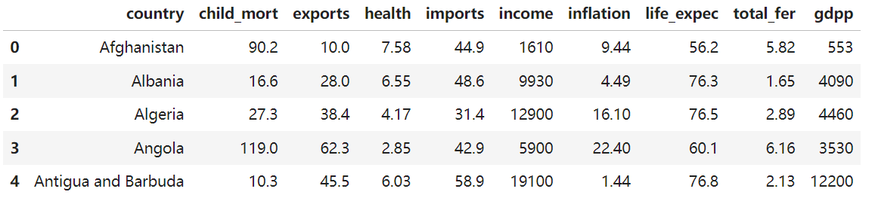
EDA
167 rows, 10 columns
Notes:
First, I performed exploratory data analysis. The dataset contains 167 rows or 167 countries, and 10 columns.

Slide 5
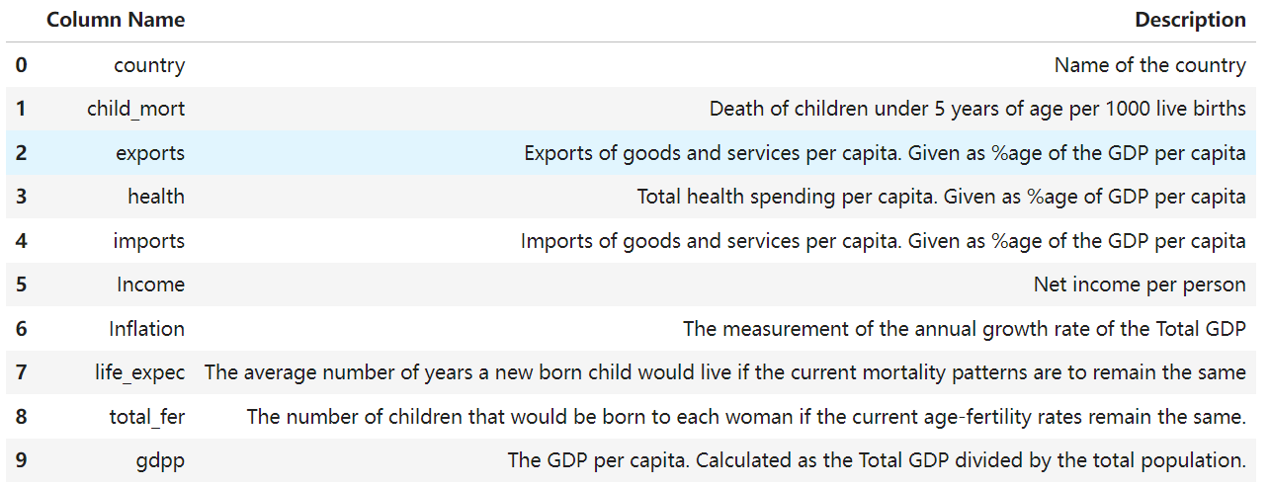
EDA
Notes:
This table explains the meaning of each column. The columns include country name, child mortality, exports, health spending, imports, net income, inflation rate, life expectation, total fertility rate and GDP per capita. At the first glance, I think a country that is in need of aid would have a high child mortality and inflation rate, and a low health spending value, net income and GDP per capita.

Slide 6
EDA
No invalid values
No duplicated rows
No outliers
Notes:
The dataset is already clean. There are no invalid values, no duplicated rows, no outliers.

Slide 7
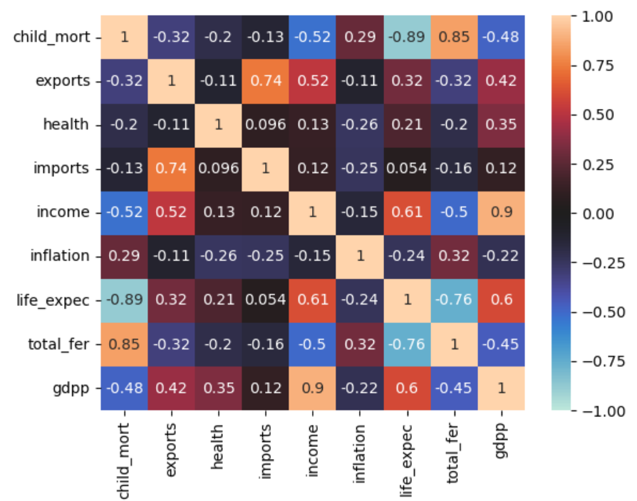
EDA
Correlated columns:
Child mortality, life expectation and total fertility rate
Net income and GDP per capita
Correlation coefficient threshold: 0.75
Notes:
This heatmap shows the correlation coefficients of each pair of columns. It turns out that child mortality, life expectation and total fertility rate are correlated with one another, and net income and GDP per capita are correlated. I dropped life expectation, total fertility rate and GDP per capita. So there are 6 columns used in the following analysis steps.

Slide 8
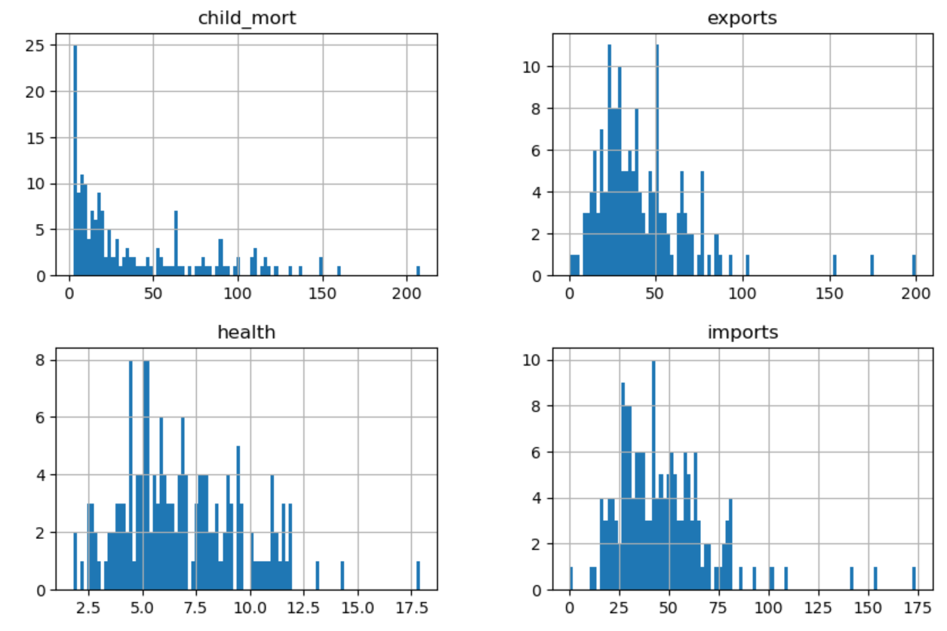
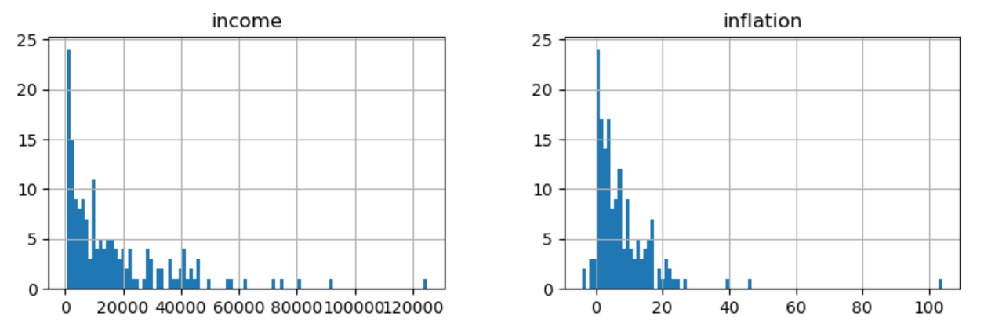
EDA
Standardization, then offsetting to obtain non-negative values within the roughly same range
Notes:
These histograms show that the ranges of the values in different columns are quite different. So I standardize the values such that they roughly fall in the same range. Because I want to use Non-negative Matrix Factorization later, I offset the values to make them non-negative.

Slide 9
Analysis and Results
K-means clustering
Hierarchical clustering
Notes:
Then, I used two clustering methods, K-means clustering and Hierarchical clustering, to analyze the problem.

Slide 10
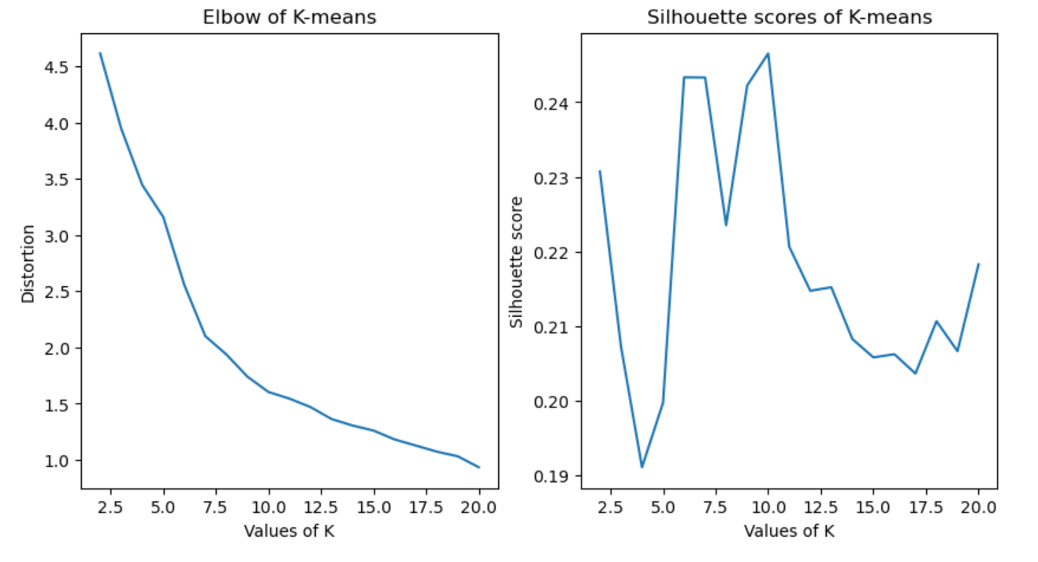
K-means Clustering with no dimension reduction
Best K = 10
Notes:
First, I tried K-means clustering with no dimension reduction. I used the elbow method and the silhouette score to choose the best number of clusters, K. According to the elbow method, the best K should be 7 or 10. And as to the silhouette score, the best K should be 10. Taking both metrics into consideration, I chose the best K to be 10.

Slide 11
K-means Clustering with no dimension reduction
Group1: Algeria, Argentina, Armenia, Azerbaijan, Bangladesh, Bolivia, China, Colombia, Dominican Republic, Ecuador, Egypt, Eritrea, Guatemala, India, Indonesia, Iran, Iraq, Kazakhstan, Kenya, Madagascar, Myanmar, Nepal, Pakistan, Peru, Philippines, Russia, South Africa, Sri Lanka, Sudan, Tajikistan, Tanzania, Timor-Leste, Turkey, Uzbekistan, Venezuela, Yemen
Group2: Luxembourg, Malta, Singapore
Group3: Australia, Austria, Bahamas, Bosnia and Herzegovina, Brazil, Canada, Chile, Costa Rica, Croatia, Denmark, Finland, France, Germany, Greece, Iceland, Israel, Italy, Japan, New Zealand, Norway, Portugal, Serbia, Spain, Sweden, Switzerland, United Kingdom, United States, Uruguay
Group4: Belgium, Czech Republic, Estonia, Hungary, Ireland, Lithuania, Malaysia, Maldives, Netherlands, Panama, Seychelles, Slovak Republic, Slovenia, Vietnam
Group5: Bahrain, Brunei, Kuwait, Libya, Oman, Qatar, Saudi Arabia, United Arab Emirates
Notes:
Here shows the clustering result. I noticed two groups with very small number of elements. One is Group 2 which consists of Luxembourg, Malta and Singapore. The other one is Group 6 which contains Nigeria only. I think the small element number in a group indicates that the group might represent extreme conditions. And that is probably what we want.

Slide 12
K-means Clustering with no dimension reduction
Group6: Nigeria
Group7: Afghanistan, Benin, Burkina Faso, Burundi, Cameroon, Central African Republic, Chad, Comoros, Cote dIvoire, Gambia, Guinea-Bissau, Haiti, Malawi, Mali, Mozambique, Niger, Rwanda, Senegal, Sierra Leone, Togo, Uganda
Group8: Albania, Antigua and Barbuda, Barbados, Belarus, Belize, Bhutan, Botswana, Bulgaria, Cambodia, Cape Verde, Cyprus, El Salvador, Fiji, Georgia, Grenada, Guyana, Jamaica, Jordan, Kyrgyz Republic, Latvia, Lebanon, Macedonia, FYR, Mauritius, Montenegro, Morocco, Namibia, Paraguay, Poland, Romania, Samoa, Solomon Islands, South Korea, St. Vincent and the Grenadines, Suriname, Thailand, Tonga, Tunisia, Ukraine, Vanuatu
Group9: Kiribati, Lesotho, Liberia, Micronesia, Fed. Sts., Moldova
Group10: Angola, Congo, Dem. Rep., Congo, Rep., Equatorial Guinea, Gabon, Ghana, Guinea, Lao, Mauritania, Mongolia, Turkmenistan, Zambia

Slide 13
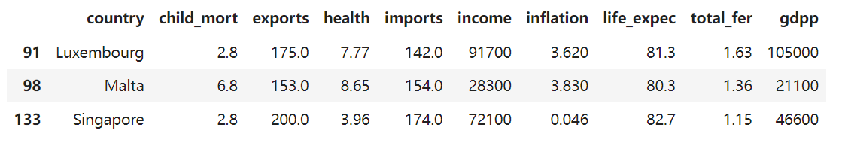
K-means Clustering with no dimension reduction
Nigeria is in a bad condition, while Luxembourg, Malta and Singapore are in a good condition.
Notes:
Here are the detailed data of the two groups. Nigeria shows a very high child mortality and inflation rate, and a low health spending value. It is obvious that Nigeria is in a bad condition. On the contrary, the three countries in the other group are in a good condition.

Slide 14
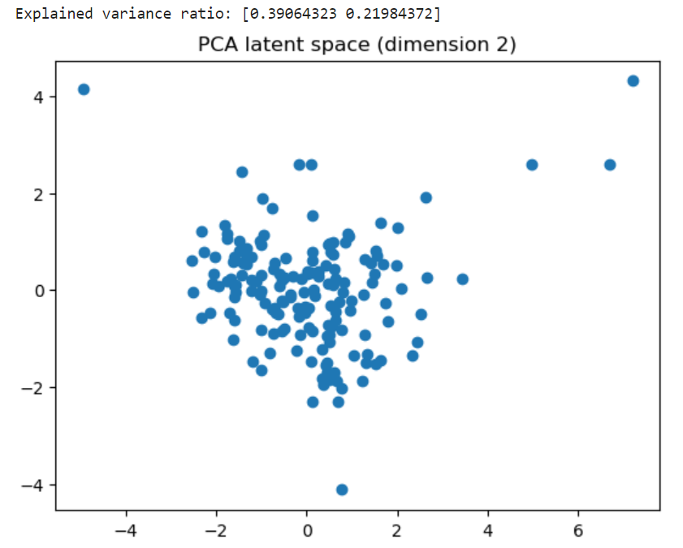
K-means Clustering with dimension reduction by PCA
Dimension 4 (result not shown here)
Dimension 2:
Groups with small numbers of countries still show up:
The single-element group consisting of Nigeria only
The three-element group consisting of Luxembourg, Malta and Singapore
Notes:
Next, I performed dimension reduction using PCA before K-means clustering. The results are similar. This figure shows the PCA latent space of dimension 2. We can see that some points deviate from others. And the two groups mentioned earlier still show up in the results.

Slide 15
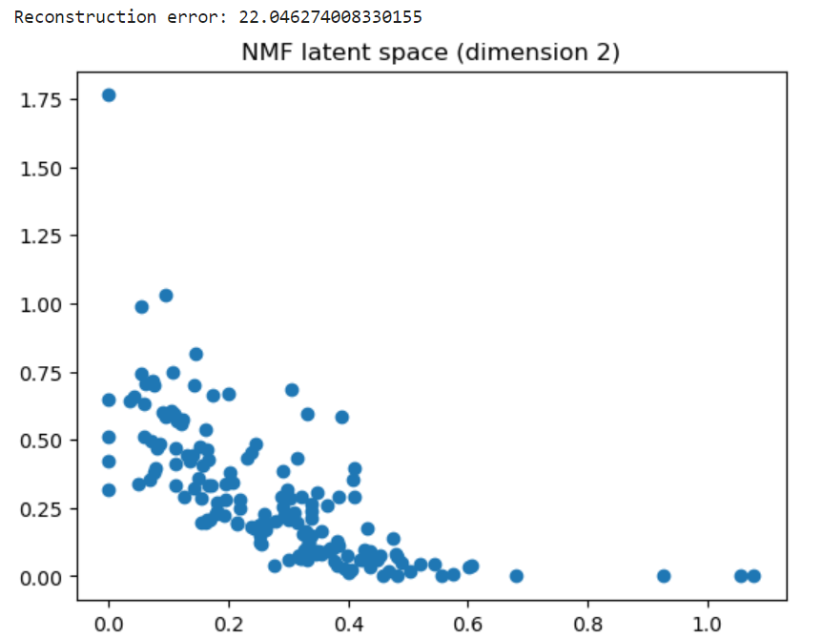
K-means Clustering with dimension reduction by NMF
M ≈ WH, rows of W can be considered as latent feature vectors
Dimension 4 (result not shown here)
Dimension 2:
Groups with small numbers of countries still show up:
The single-element group consisting of Nigeria only
The three-element group consisting of Luxembourg, Malta and Singapore
Notes:
I also tried dimension reduction by NMF. After the data matrix is factorized into the product of W and H, the rows of W could be considered as latent feature vectors. So NMF can also be used for dimension reduction. The 2-dimensional latent space obtained by NMF is quite different from that obtained by PCA. However, The single-element group consisting of Nigeria and the three-element group consisting of Luxembourg, Malta and Singapore still show up in the results.

Slide 16
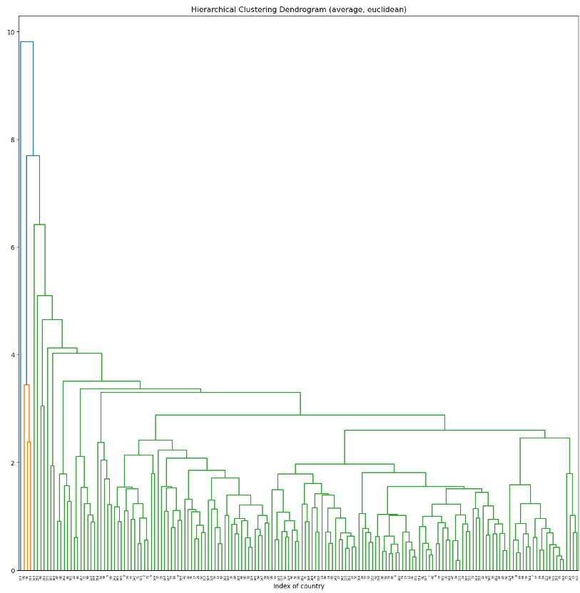
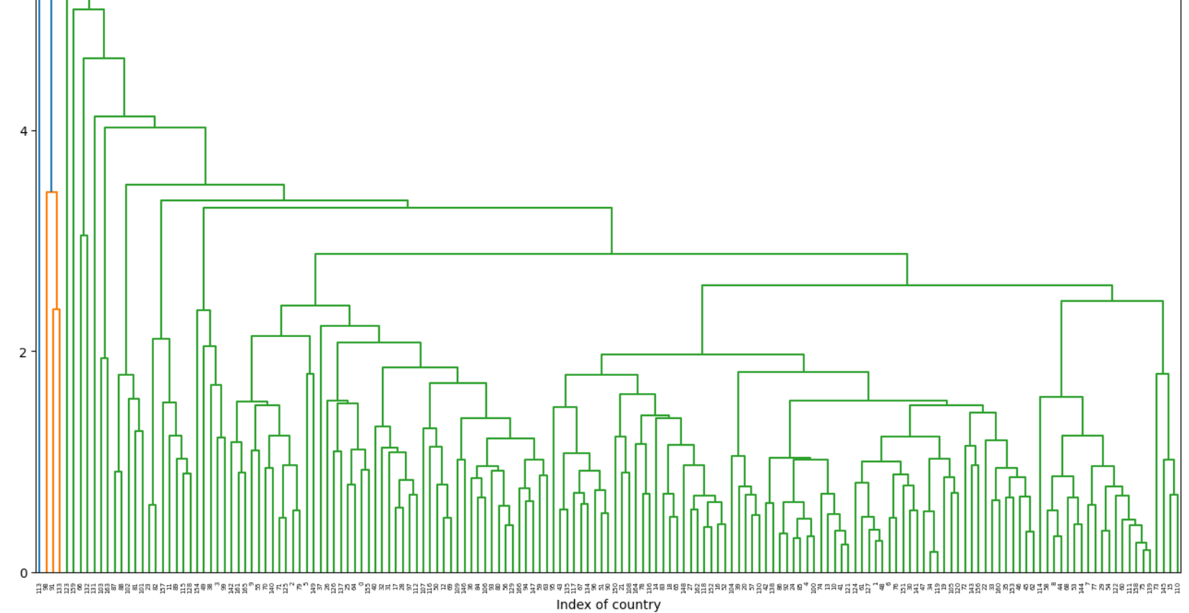
Hierarchical Clustering with no dimension reduction
More than half of combinations of linkage methods and distance metrics show similar results
Notes:
Then I tried Hierarchical clustering with no dimension reduction. I tried different combinations of linkage methods and distance metrics. More than half of the combinations give the similar results. This figure shows the result with average linkage and Euclidean distance.

Slide 17
Hierarchical Clustering with no dimension reduction
Group1: Nigeria
Group2: Luxembourg, Malta, Singapore
Group3: All the other countries
Notes:
The countries are categorized into three groups. One consists of Nigeria. One consists of Luxembourg, Malta and Singapore. And all the other countries form the last group. The two groups with small element numbers are pretty consistent with the result of K-means clustering.

Slide 18
Hierarchical Clustering with dimension reduction by PCA
Similar result
Notes:
Finally, I tried dimension reduction by PCA before hierarchical clustering. The result is similar.

Slide 19
Conclusion and Discussion
After correlated columns dropped, the dimension of feature space is 6 which is small enough, so dimension reduction by PCA or NMF do not improve the results significantly
Dimension reduction by PCA or NMF is helpful for visualization
As to which countries are in the direst need of aid, both K-means clustering and hierarchical clustering give similar results
Nigeria is in the direst need of aid
Notes:
The last part is conclusion and discussion. Dimension reduction by PCA or NMF do not improve result. I think the reason is that the dimension of feature space is 6 which is already small enough. Although dimension reduction do not improve result, it is helpful for visualization. We can clearly see that some points deviate from others in the figures of 2-dimensional latent spaces. Both K-means clustering and hierarchical clustering give similar results that Nigeria is in the direst need of aid.

